Slide 1

Wissenschaftliche Kommunikations-Infrastruktur
Workshop
CIDOC CRM SIG Meeting
Germanisches Nationalmuseum, Nürnberg
May 19, 2015
Mark Fichtner
Germanisches Nationalmuseum Nürnberg

Slide 2
WissKI = Wissenschaftliche KommunikationsInfrastruktur
Funding by DFG (LIS) 2009 – 2011 (extended until 2012)
Second funding by DFG (LIS) 2014-2015
Projectpartners
  Friedrich-Alexander-Universität Erlangen-Nürnberg (FAU), Lehrstuhl für Informatik 8: Künstliche Intelligenz (Prof. Dr. Günther Görz)
  Germanisches Nationalmuseum (GNM) Nürnberg, Referat für Museums- und Kulturinformatik (Dr. Siegfried Krause)
  Zoologisches Forschungsmuseum Alexander Koenig (ZFMK) Bonn, Biodiversitätsinformatik (Dr. Karl-Heinz Lampe †, Dr. Peter Grobe)

Slide 3
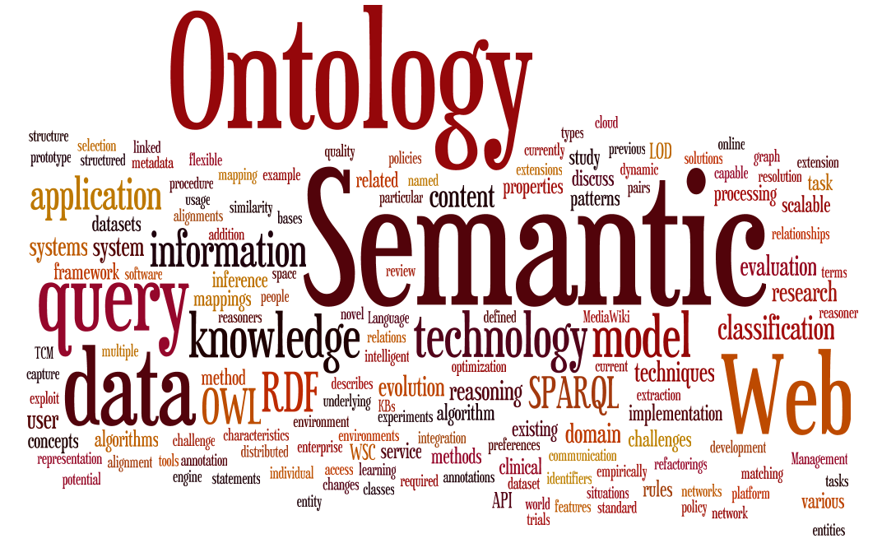

http://tw.rpi.edu/weblog/wp-content/uploads/2010/11/ISWCTagCloudNew.png

Slide 4
WissKI is …
a virtual research environment for scientific research data
based on idea of the Wiki
accessible online via web browser from everywhere
Open Source and free for download
  http://wiss-ki.eu http://www.facebook.com/wisskiproject

Slide 5
Characteristics of the systems
Compatible to ISO 21127 (CIDOC CRM)
Modular, easy adjustable and customizable
A lot of interfaces
Support for usage of authority files like Getty TGN and PND
Ideal system für Linked Open Data

Slide 6






Semantic Data Modelling
Albrecht Dürer
Self-portrait
Nürnberg

Slide 7
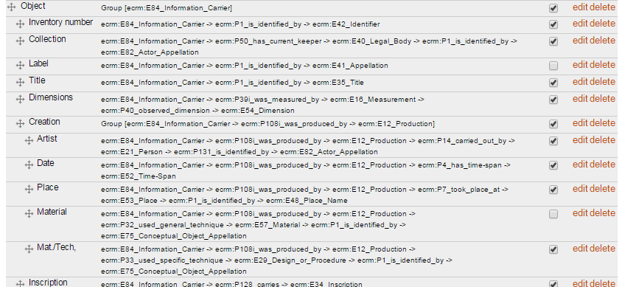
Semantic Pathbuilder

Slide 8
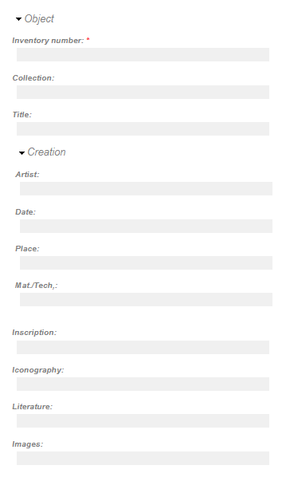
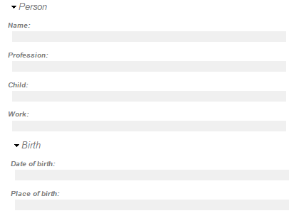
Semantic Data Modelling
Albrecht Dürer
Albrecht Dürer
Nürnberg
Nürnberg

Slide 9
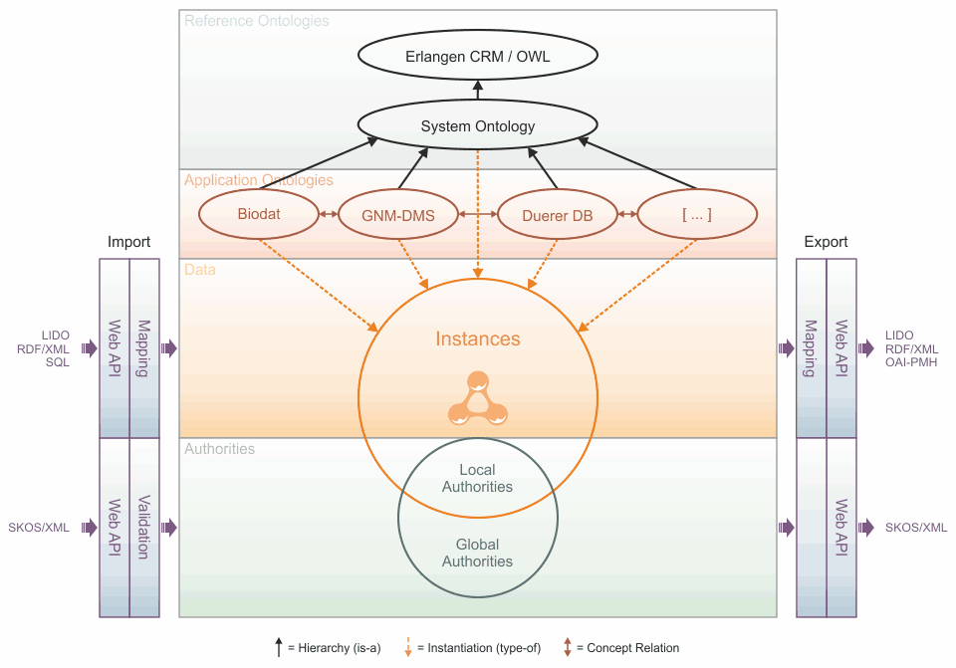
System- and Datamodel

Slide 10
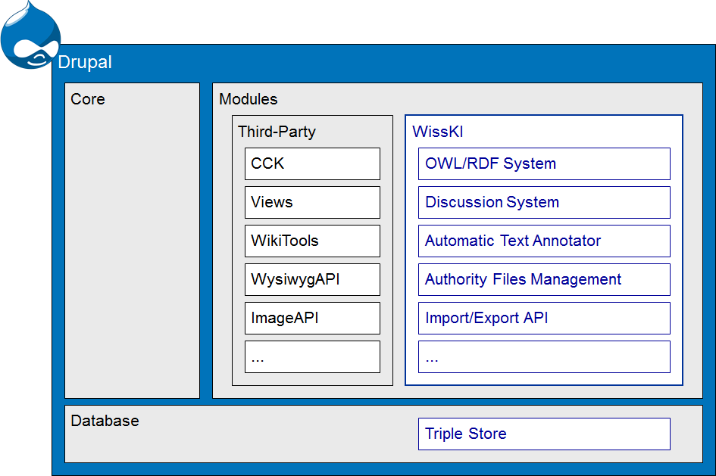
WissKI is…
a module set for the CMS Drupal
storing its data in a triple store
using all features that drupal provides e.g. user management, web pages, forums, wysiwyg editors, …

Slide 11
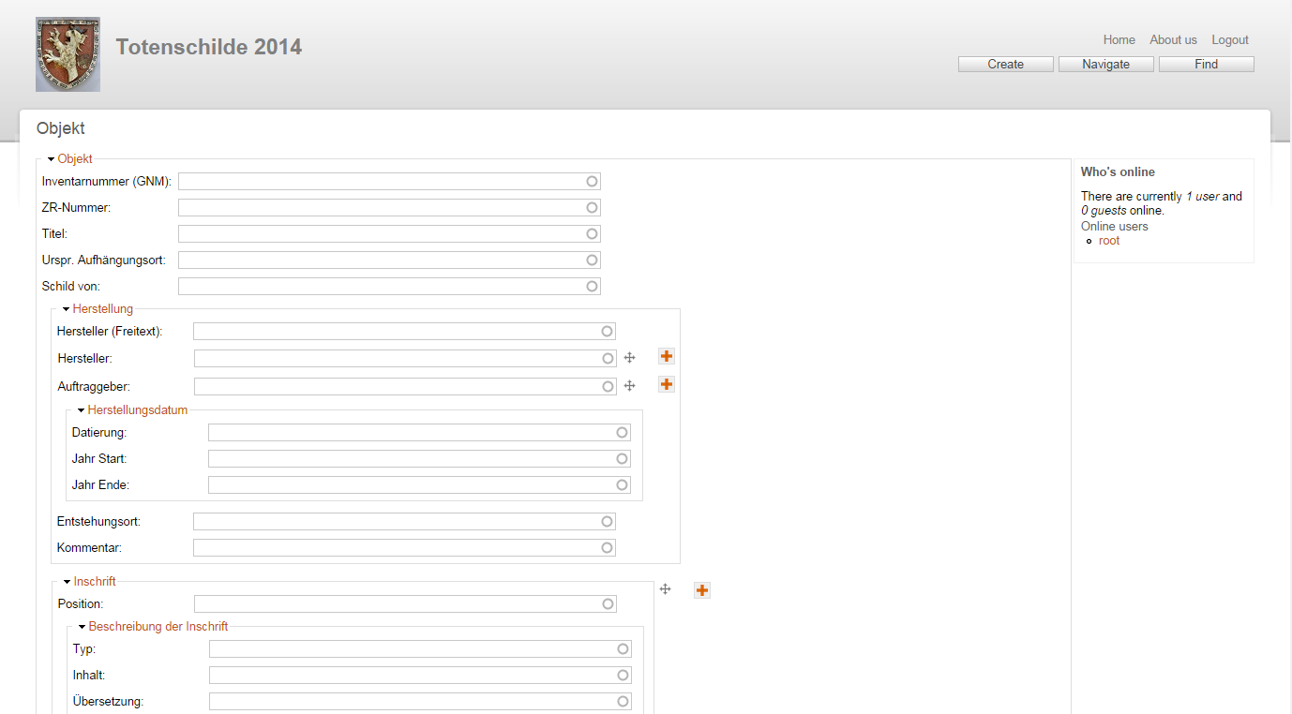
Form based data acquisition

Slide 12
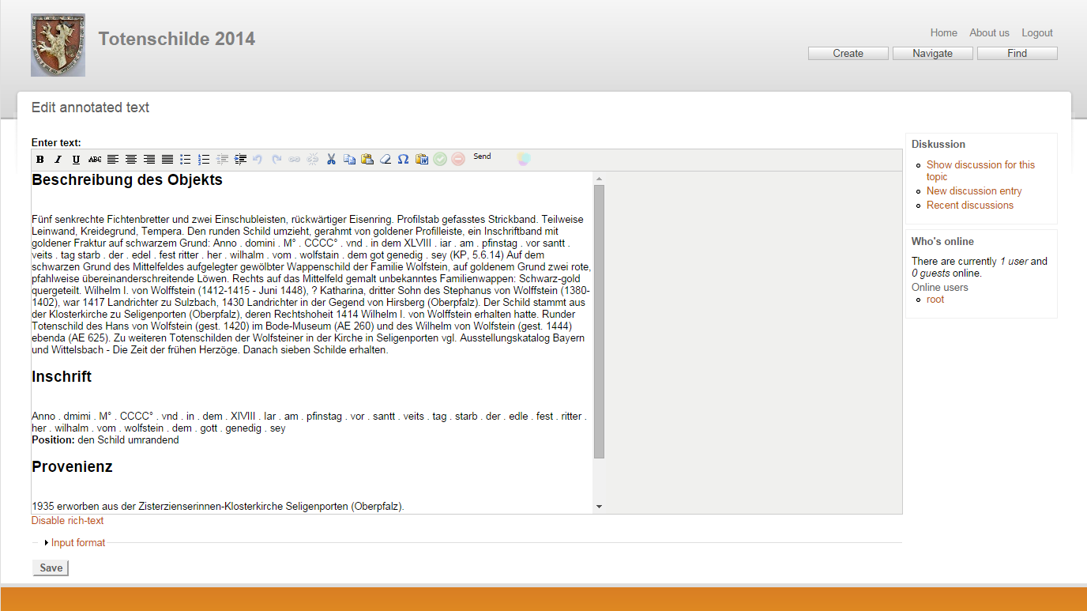
Text based data acquisition

Slide 13
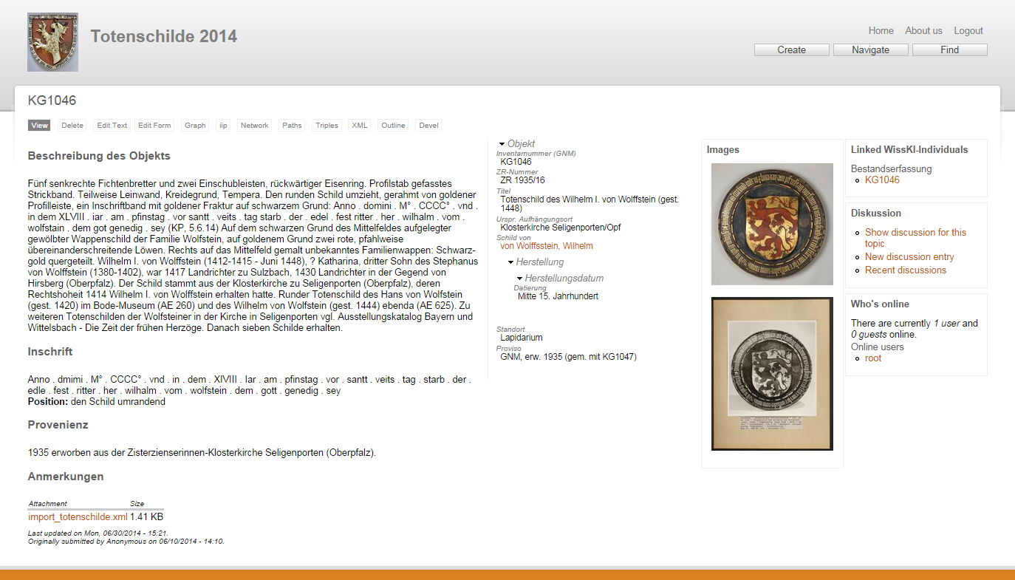
Data presentation

Slide 14
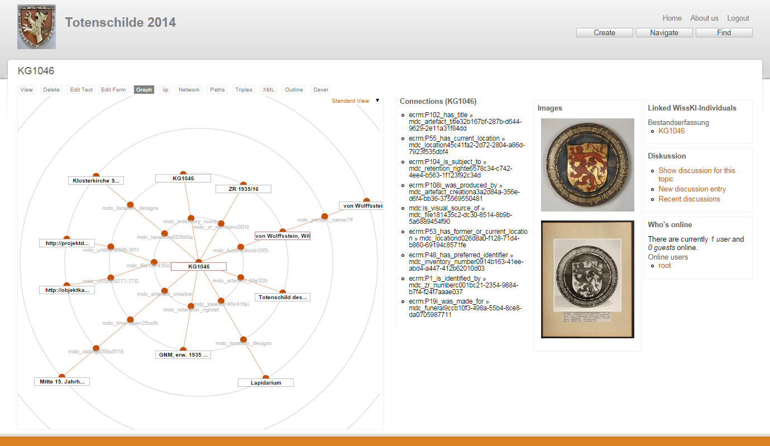
OWL/XML in the triplestore

Slide 15
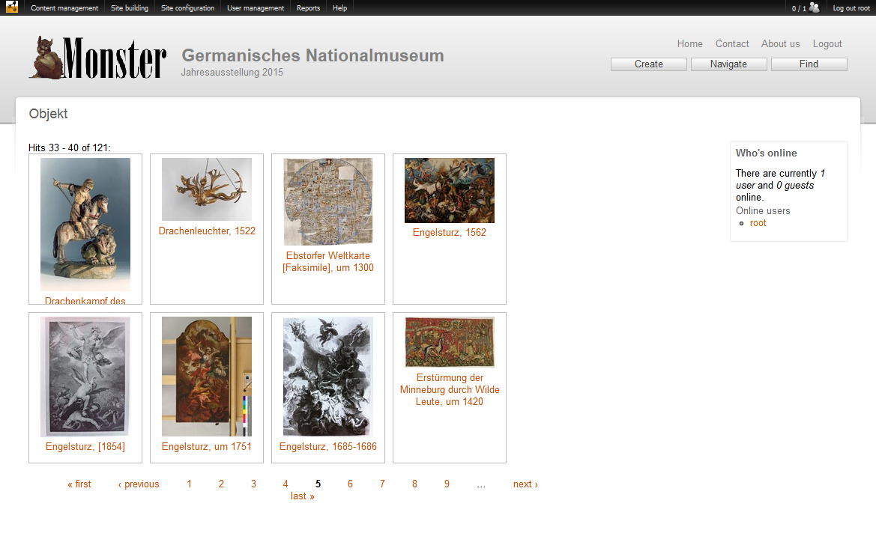
Navigation

Slide 16
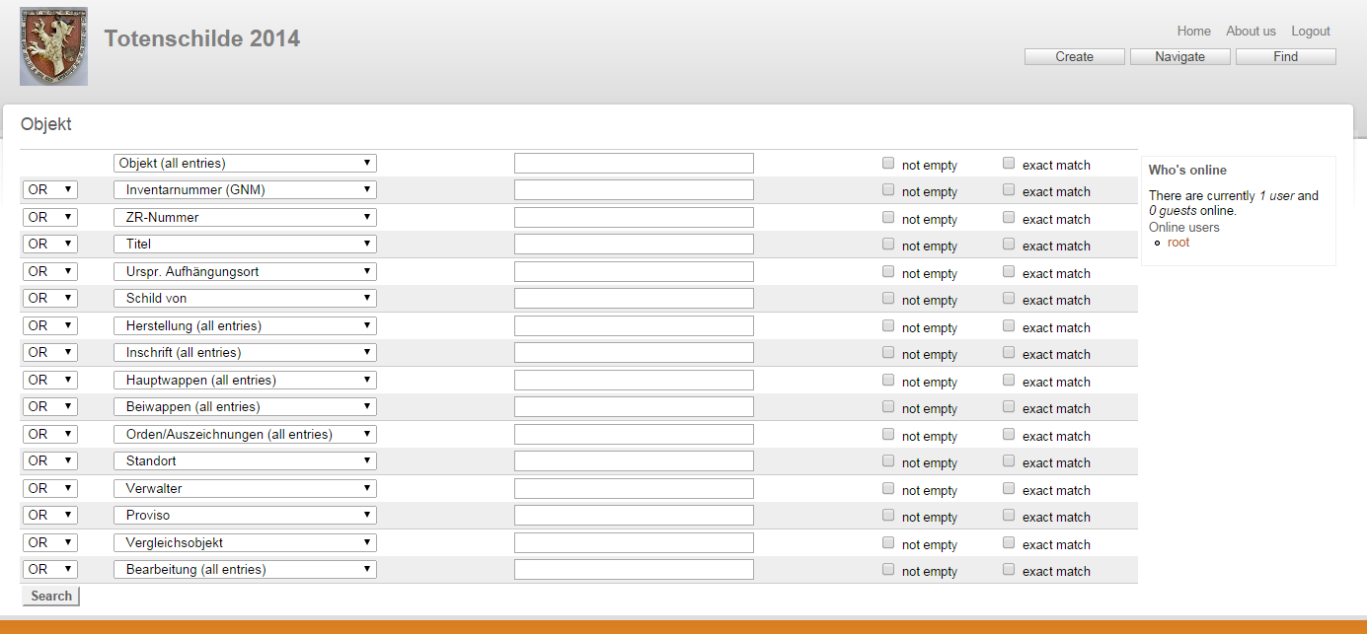
Full-text search and detailed search

Slide 17
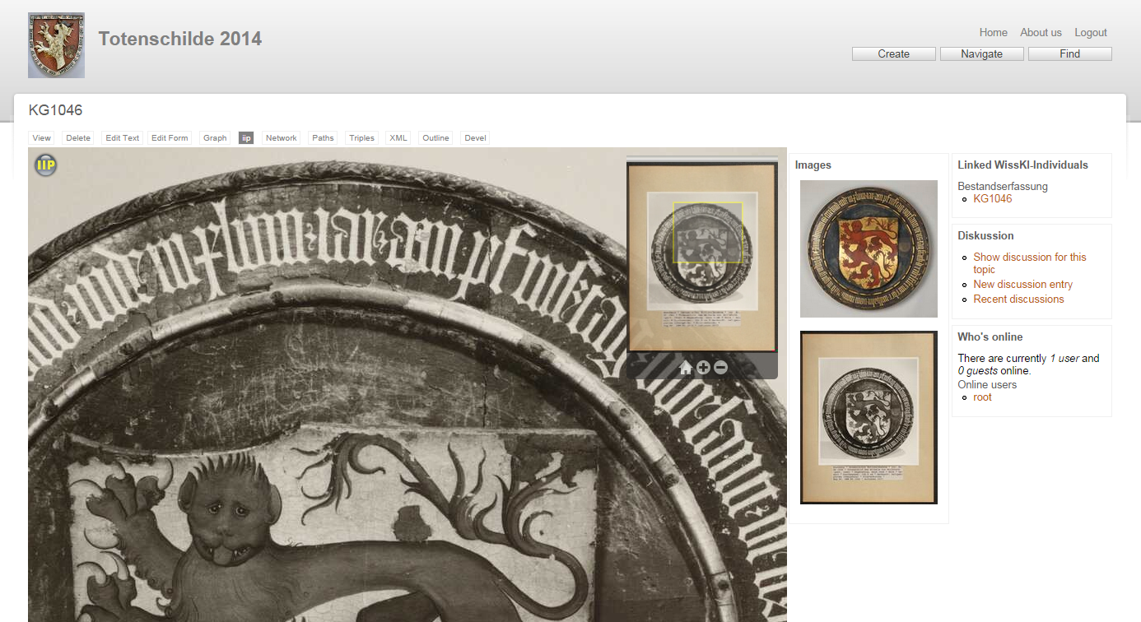
Zoom

Slide 18
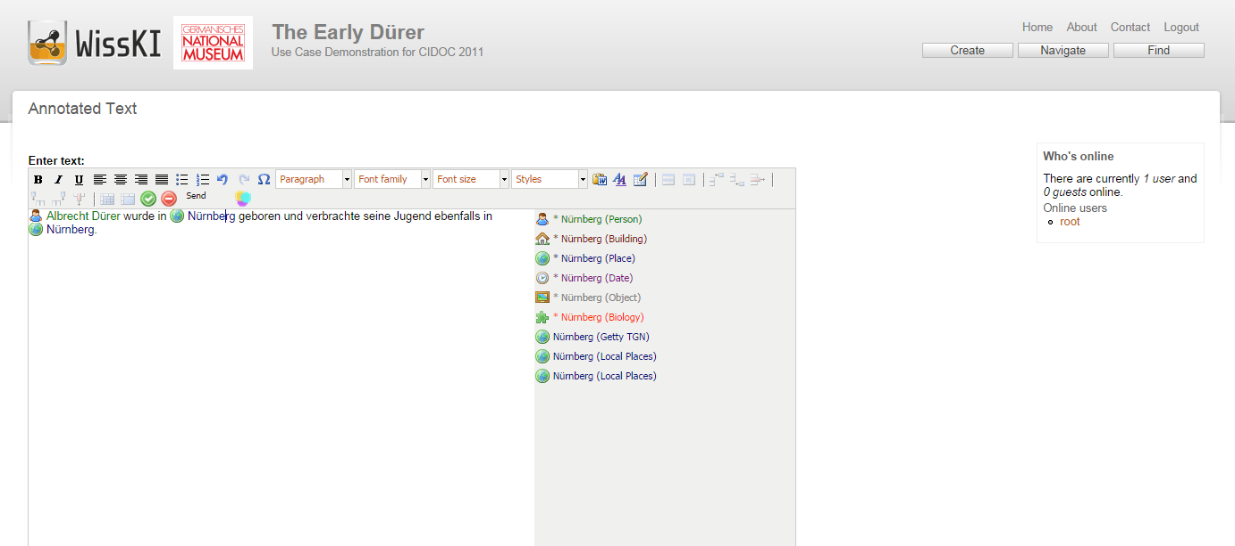
Annotation of texts

Slide 19
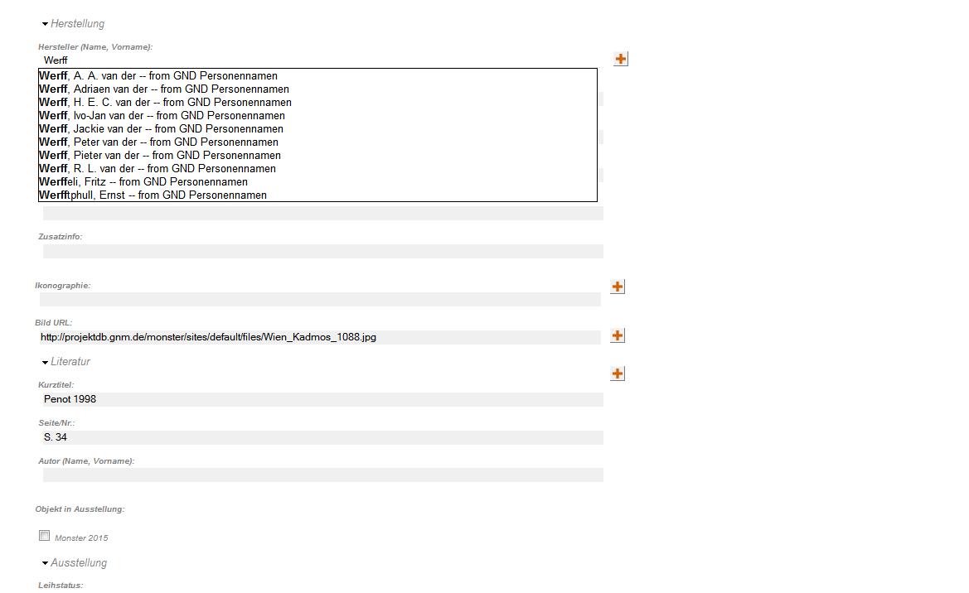
Auto-complete in textfields

Slide 20
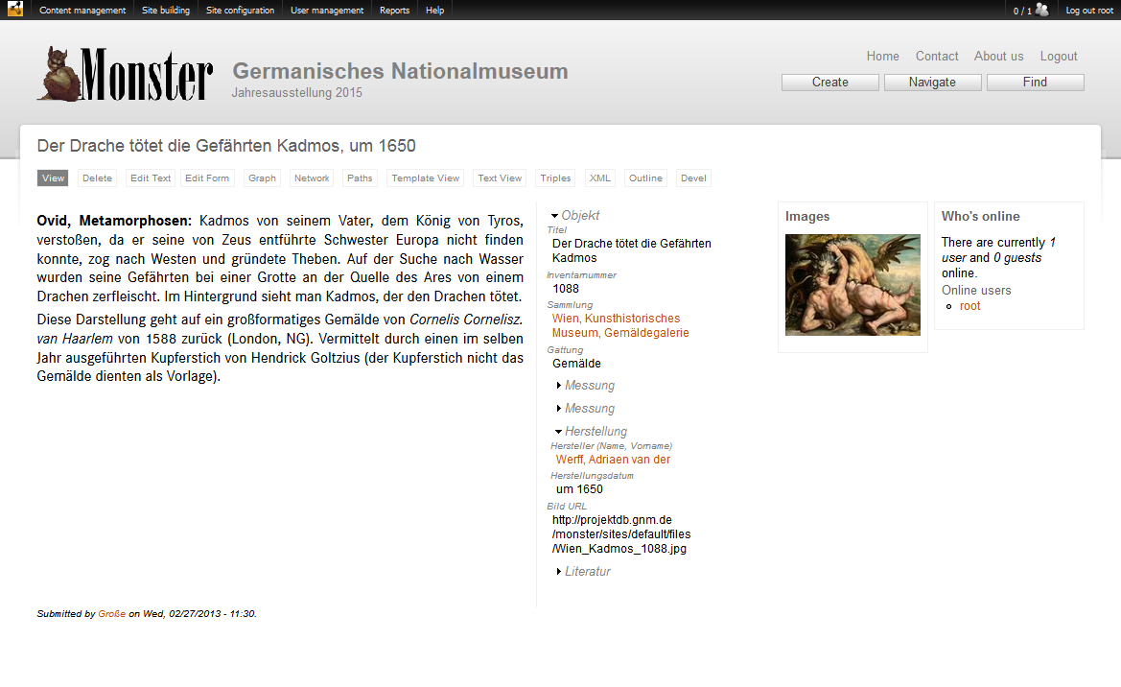
Automatic linking

Slide 21
Use cases for the WissKI System
Virtual research environment in research projects
In use at: Germanisches Nationalmuseum, Zoologisches Forschungsmuseum Alexander Koenig
University of Erlangen-Nuernberg, GCDH Göttingen, Herder Institut,
Bayerische Akademie der Wissenschaften, Deutsches Museum, ...
Exhibition preparation and planning system
In use at: Henlein Exhibition
Monster Exhibition
In use at: Gesichter des DKA http://gesichter-des-dka.gnm.de/
Patrimonium.net http://www.patrimonium.net/
Medienarchiv http://projektdb.gnm.de/medienarchiv-tafelmalerei/
Virtual exhibition & presentation system

Slide 22




in Progress - Updates
Version 7
Version 5.6
ISO 21127:2014 + recent Draft Versions

Slide 23
in Progress - Fields API
enhance your object information with data of any kind
text
images
files
maps
colors
entity references
...

Slide 24
in Progress - Templates
easier access to your knowledge via
ready-to-use domain ontologies
path templates
GUI/form templates
query patterns
experience reports and best practices gathered by the competence centre

Slide 25
- Conclusion
technical updates to recent standards
recurring updates of the base ontology
enhanced Drupal integration (Fields API, Themes, entityreference)
further knowledge processing (reasoning, truth maintenace)
easy start thanks to templates and best practices
user support

Slide 26
and
- where to buy
remember: WissKI is open source
free to achieve
free to use
feel free to contribute
WissKI is available via
  wiss-ki.eu
  and on GitHub
WissKI² will be available soon

