Slide 1
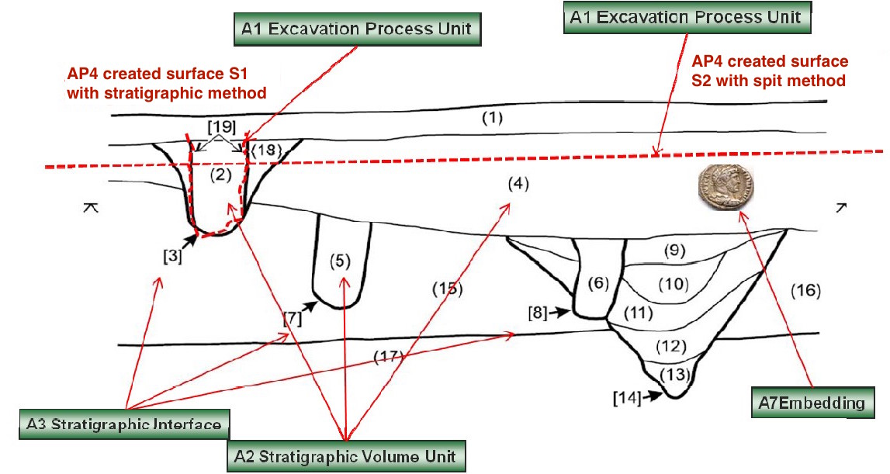
Figure 4 from CRMarcheo 1.4.7
Fig. 4: Section drawing with A3 Stratigraphic Interfaces in square brackets [], A2 Stratigraphic Volume Unit in round brackets (), the surfaces S1 and S2 created through A1 Excavation Process Units using different methodologies and an A7 Embedding of a coin.

Slide 2
Figure 4 from CRMarcheo 1.4.7
A10 Excavation Interface
A10 Excavation Interface
Assume that S2 was create first, that is a mechanical layer cut through 2, 3, 18 and 19. How do we model the relation between S2 (A10 Excavation Interface) and 2, 3, 18 and 19 (A8 Stratigraphic Unit)? A more common example would be a vertical profile cut through 2, 3, 18 and 19 . The modelling issue is identical

Slide 3
Stratigraphic Genesis and Excavation Genesis
A10 Excavation Interface and its physical relation to A8 Stratigraphic Unit
S18 Alteration
E7 Activity
AP13 has stratigraphic relation
S17 Physical Genesis
A5 Stratigraphic Modification Event
A1 Excavation Process Unit
A process resulting in the displacement of a limited amount of matter which has settled into a relatively stable form
AP1 produced
S10 Material Substantial
S20 Physical Feature
A4 Stratigraphic Genesis
AP9 took matter from
AP4 produced surface
S20 Physical Feature
S11 Amount of Matter
AP7 produced
AP8 disturbed
?
A10 Excavation Interface
AP yy has physical relation
AP11 has physical relation
A8 Stratigraphic Unit
S22 Segment of Matter
AP22 is confined by
P9 is part of
A2 Stratigraphic Deposit Unit
AP24 is or contains remains of
A3 Stratigraphic Interface
E18 Physical Thing
AP12 is confined by
Notes:
A4 Stratigraphic Genesis
A process resulting in the displacement of a limited amount of matter which has settled into a relatively stable form, often a deposition, consisting of homogeneous parts. Typology of processes.

Slide 4
Amendment: Drop AP12 is confined by, use O7 confined (was confined by).
Move AP11 has physical relation (+ AP11.1) up to S20 Rigid Physical Feature as a new Oxx has physical relation (+ Oxx.1)
S10 Material Substantial
AP9 took matter from
S18 Alteration
O7 confined (was confined by)
[used instead of AP12 and a AP22]
S11 Amount of Matter
S17 Physical Genesis
AP13 has stratigraphic relation
AP15 is or contains
remains of
E53 Placel
E26 Physical Feature
A5 Stratigraphic Modification Event
S22 Segment of Matter
S20 Rigid Physical Feature
Oxx has physical
Relation
[was AP11 and APyy]
A4 Stratigraphic Genesis
P9 is part of
AP8 disturbed
AP7 produced
A10 Excavation Interface
AP1 produced
A8 Stratigraphic Unit
A7 Embedding
AP4 produced surface
AP19 is embedding in
(contains embedding)
A1 Excavation Process Unit
A3 Stratigraphic Interface
A2 Stratigraphic Volume Unit
AP18 is embedding of (is embedded)
AP6 intended to approximate
(was approximate)
AP21 contains (is contained in)
E18 Physical Thing
Notes:
A4 Stratigraphic Genesis
A process resulting in the displacement of a limited amount of matter which has settled into a relatively stable form, often a deposition, consisting of homogeneous parts. Typology of processes.

