Slide 1
CRM-SIG
Prato, Feburary 2016
Original presentation:
Digital Heritage 2015
Granada, 1st October 2015
Building an Argumentation Platform for 3D Reconstruction
using CIDOC-CRM and Drupal
A. Guillem (UL-FGG) & G. Bruseker (ICS-FORTH)

Slide 2
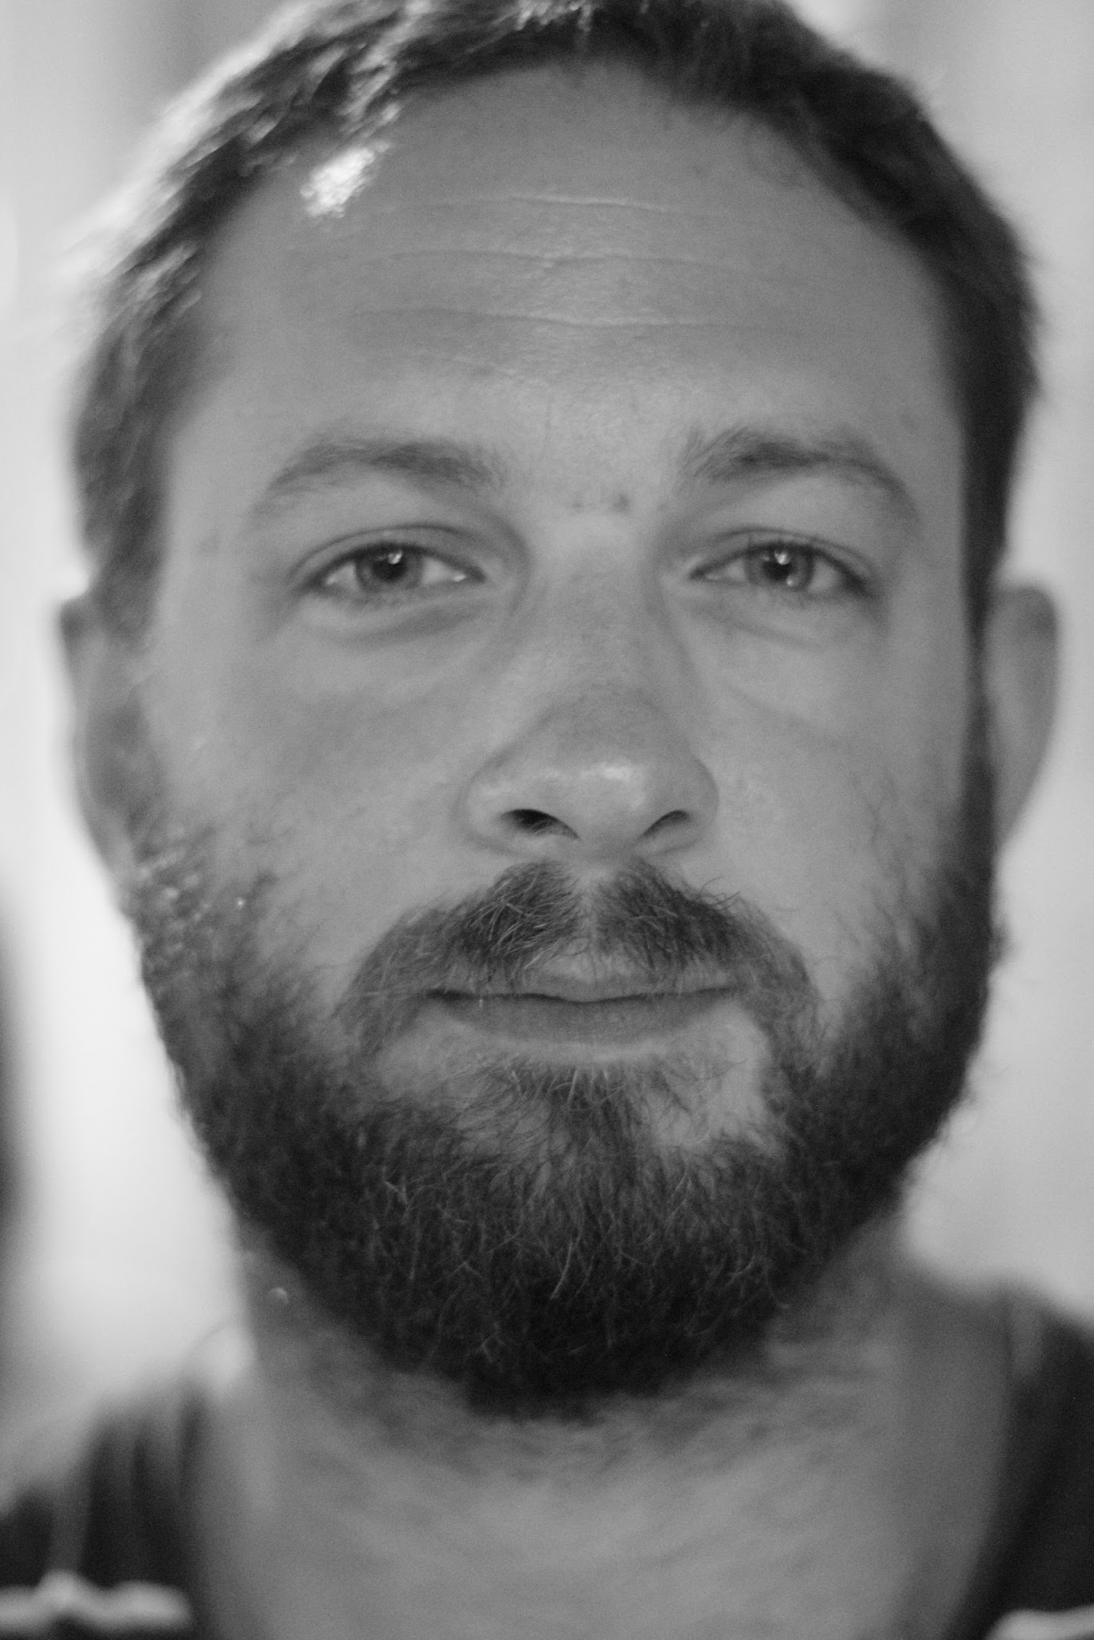
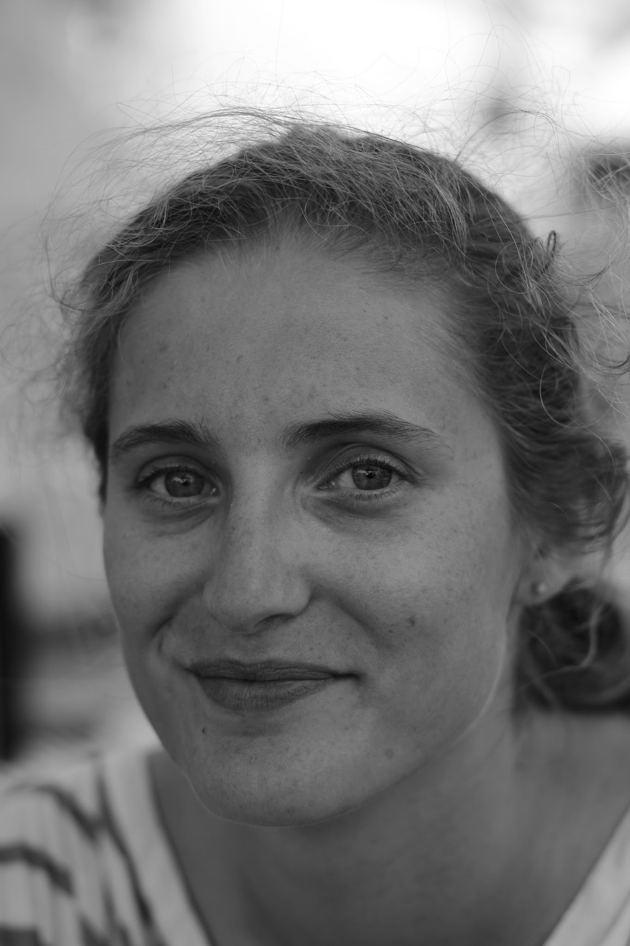



Building an Argumentation Platform for 3D Reconstruction using CIDOC-CRM and Drupal
Introduction / Proposal / Implementation / Results / Next steps
George Bruseker
ICS-FORTH
Anaïs Guillem
UL-FGG
Natalia Markaki
ICS-FORTH
Original Paper Authors
Drupal Development

Slide 3
Building an Argumentation Platform for 3D Reconstruction using CIDOC-CRM and Drupal
Introduction / Proposal / Implementation / Results / Next steps
The main question/challenge
Can we build a project documentation and argumentation platform that would support the collaborative work of specialists in Built Cultural Heritage and digital modelling to document the argumentation behind their virtual reconstructions?

Slide 4
Building an Argumentation Platform for 3D Reconstruction using CIDOC-CRM and Drupal
Introduction / Proposal / Implementation / Results / Next steps
Goal:
Build a Communication Environment
for Storing Reasoning on 3D Reconstruction
To enable the scientific use of models
To save and display research alongside visualizations
To support critical appraisal of visualizations by interested individuals
To aid in sustainable re-use of research and models

Slide 5
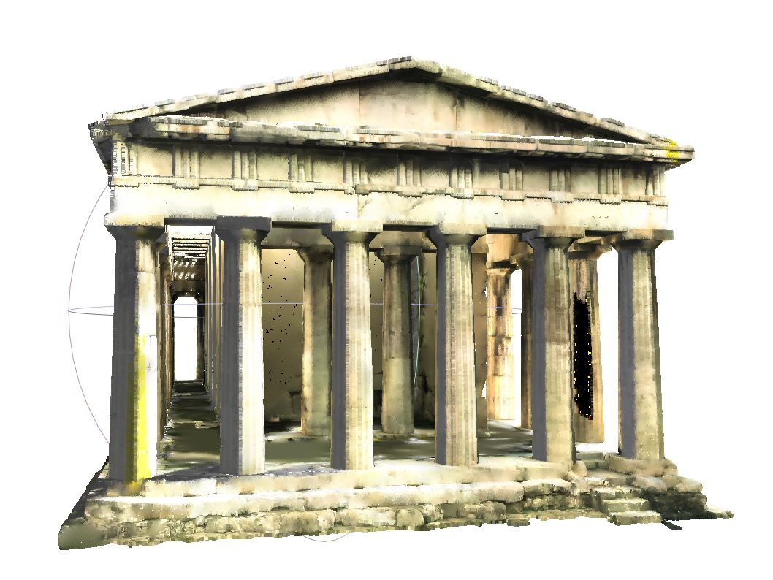
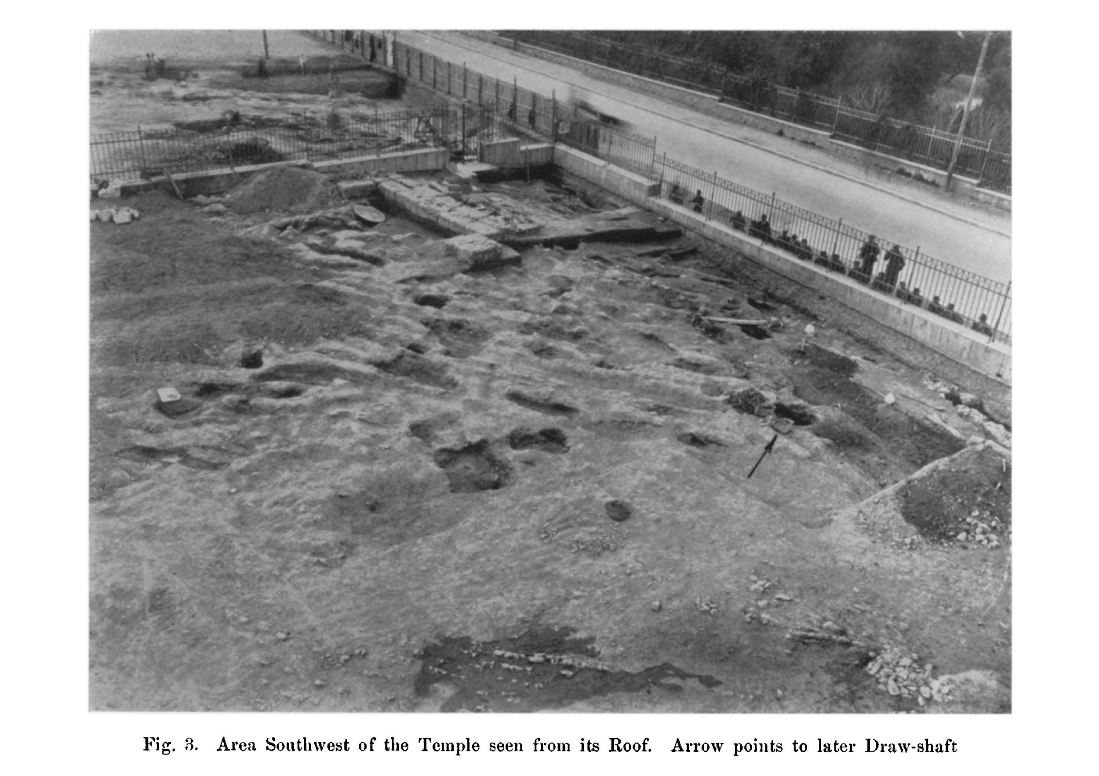
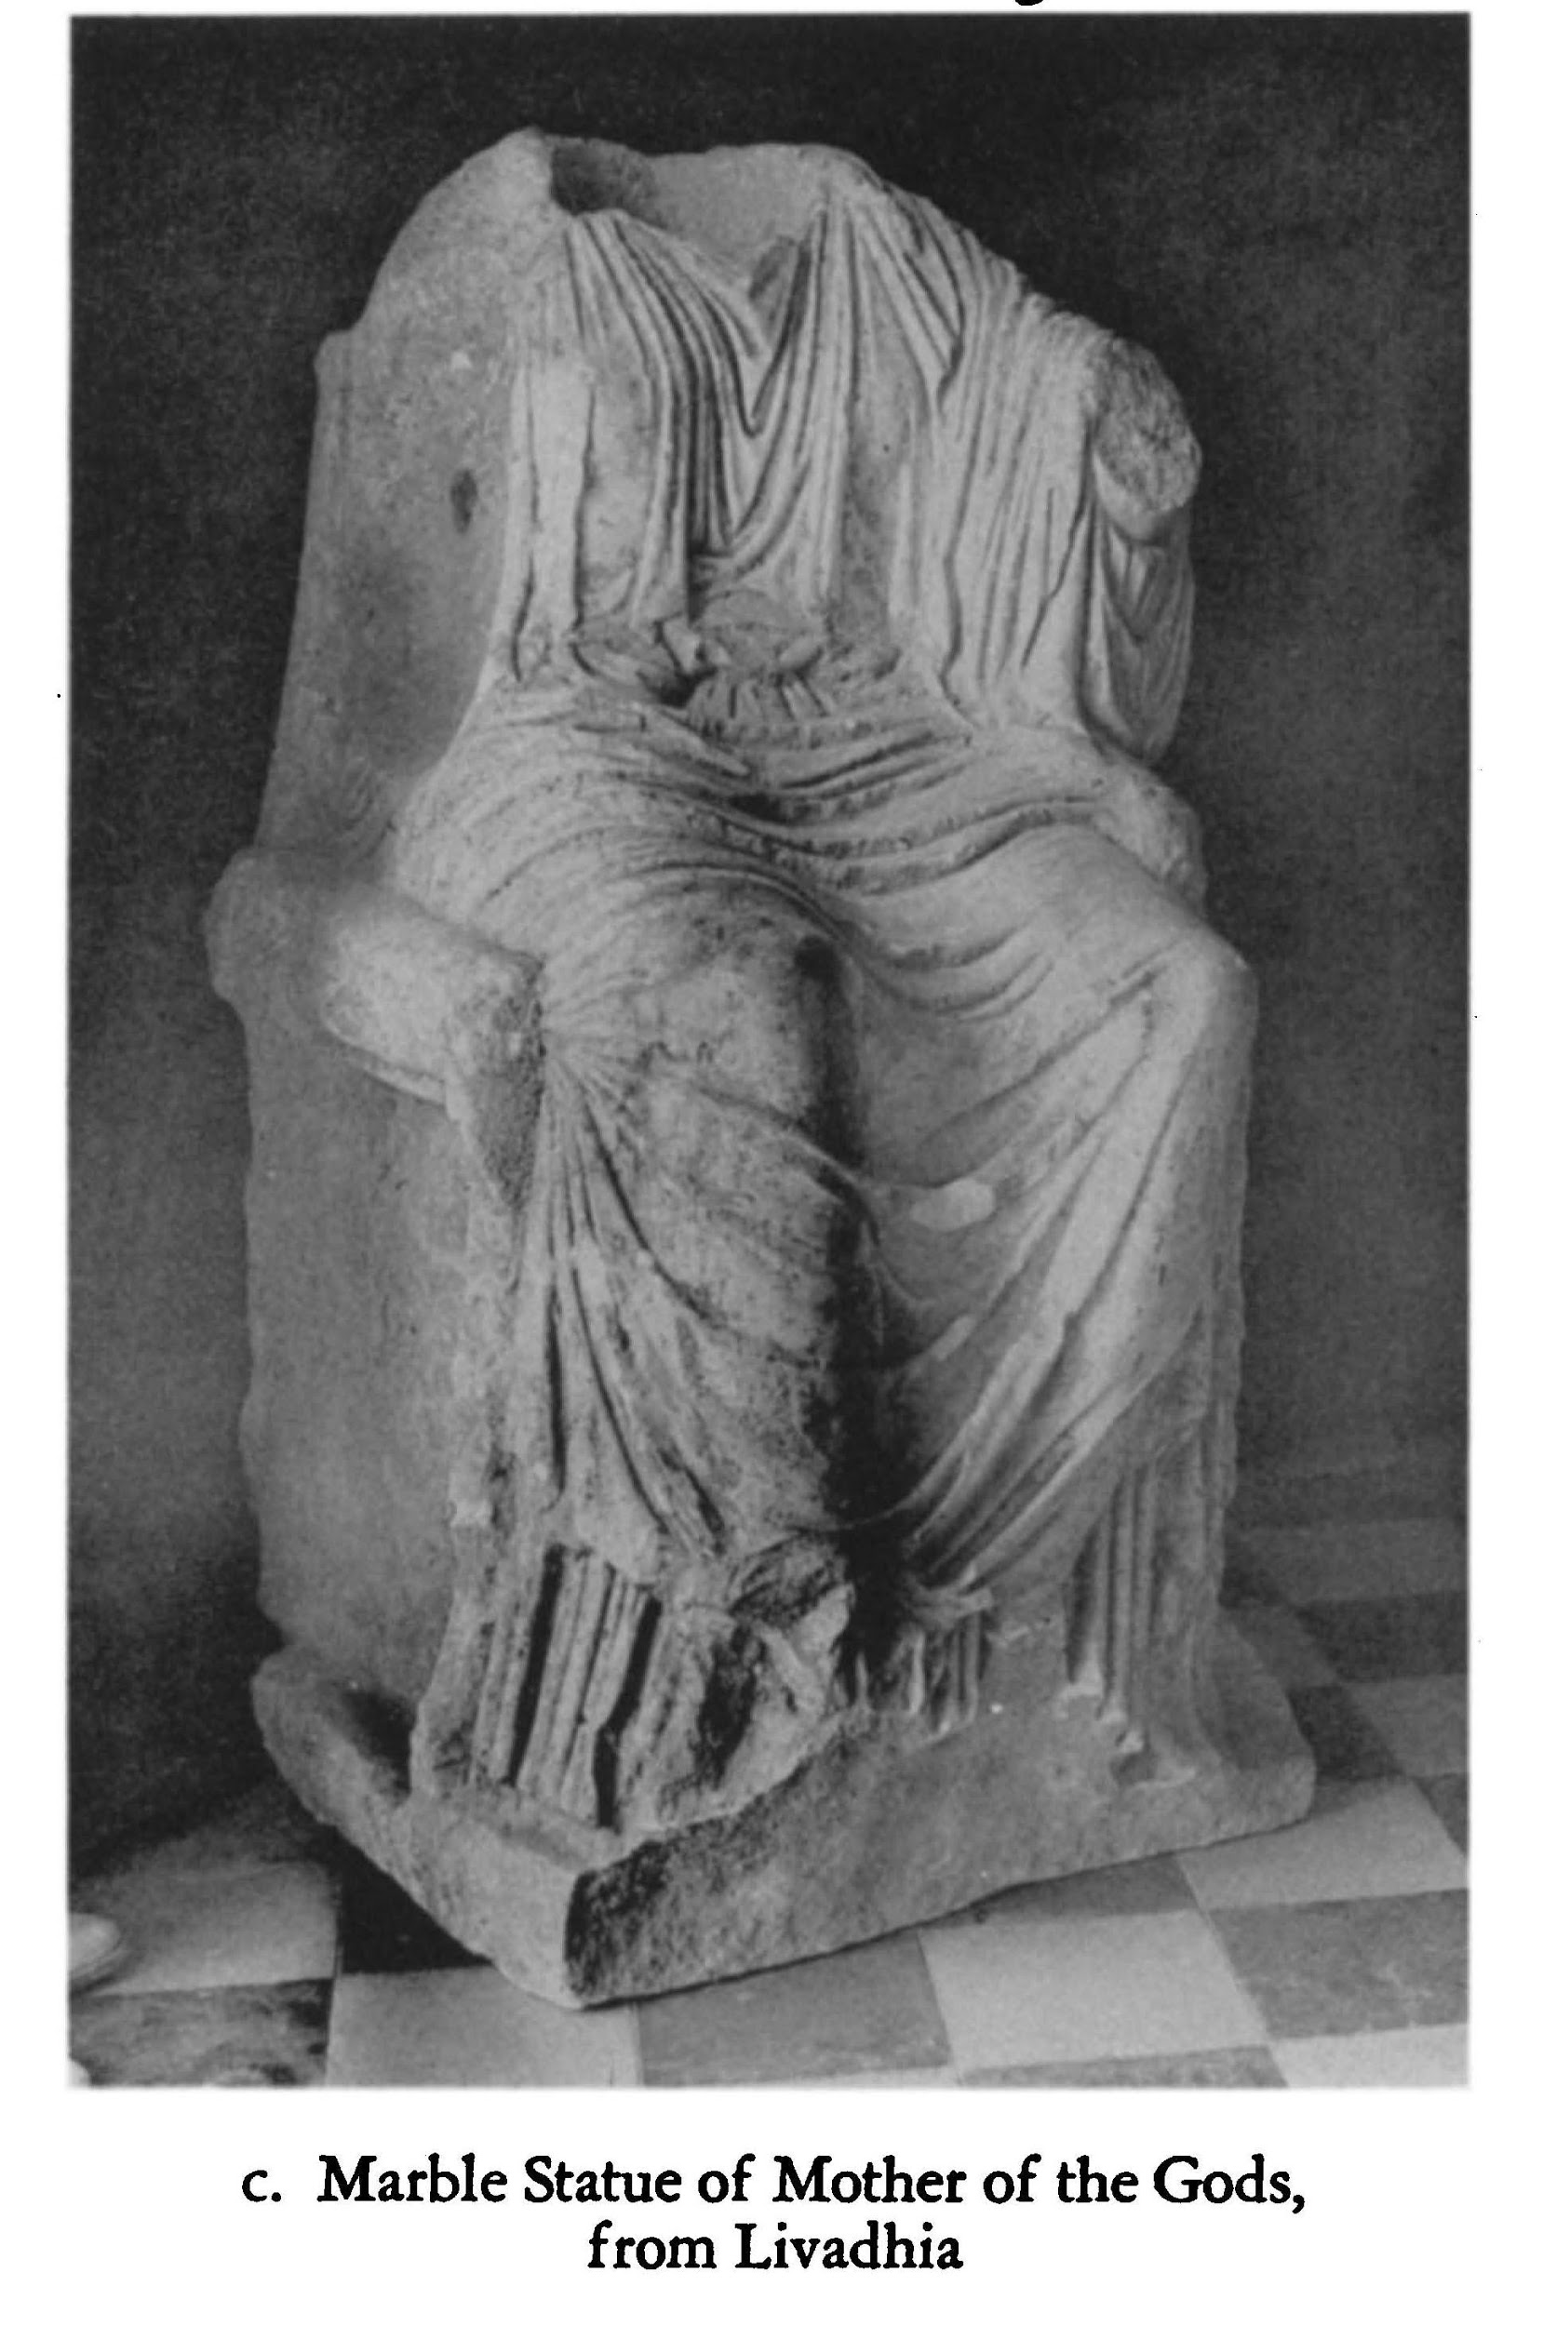
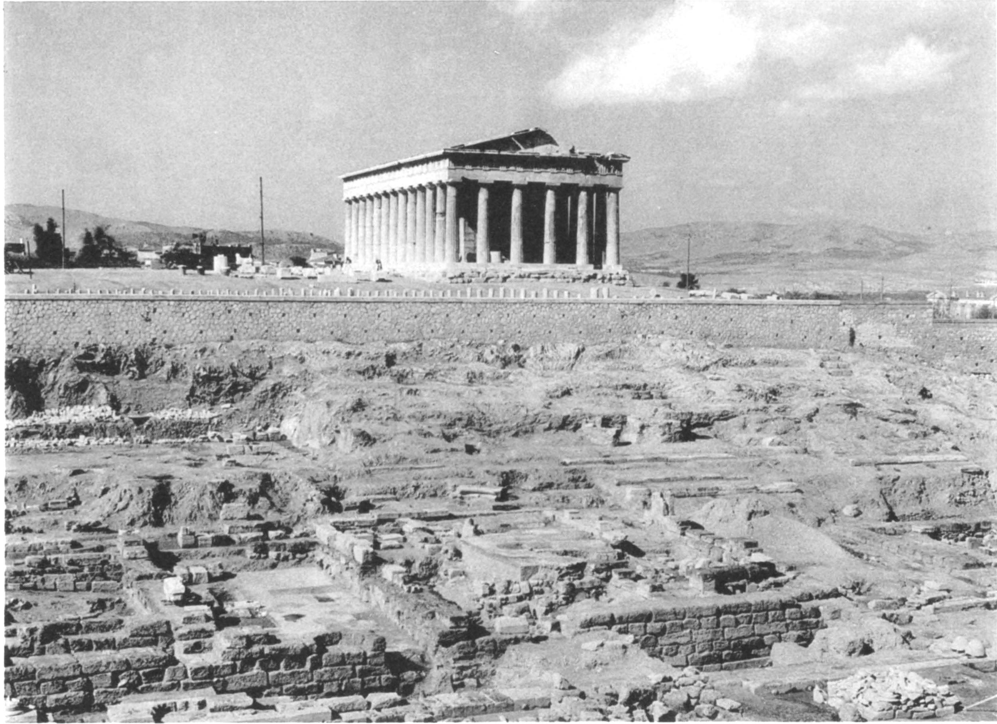
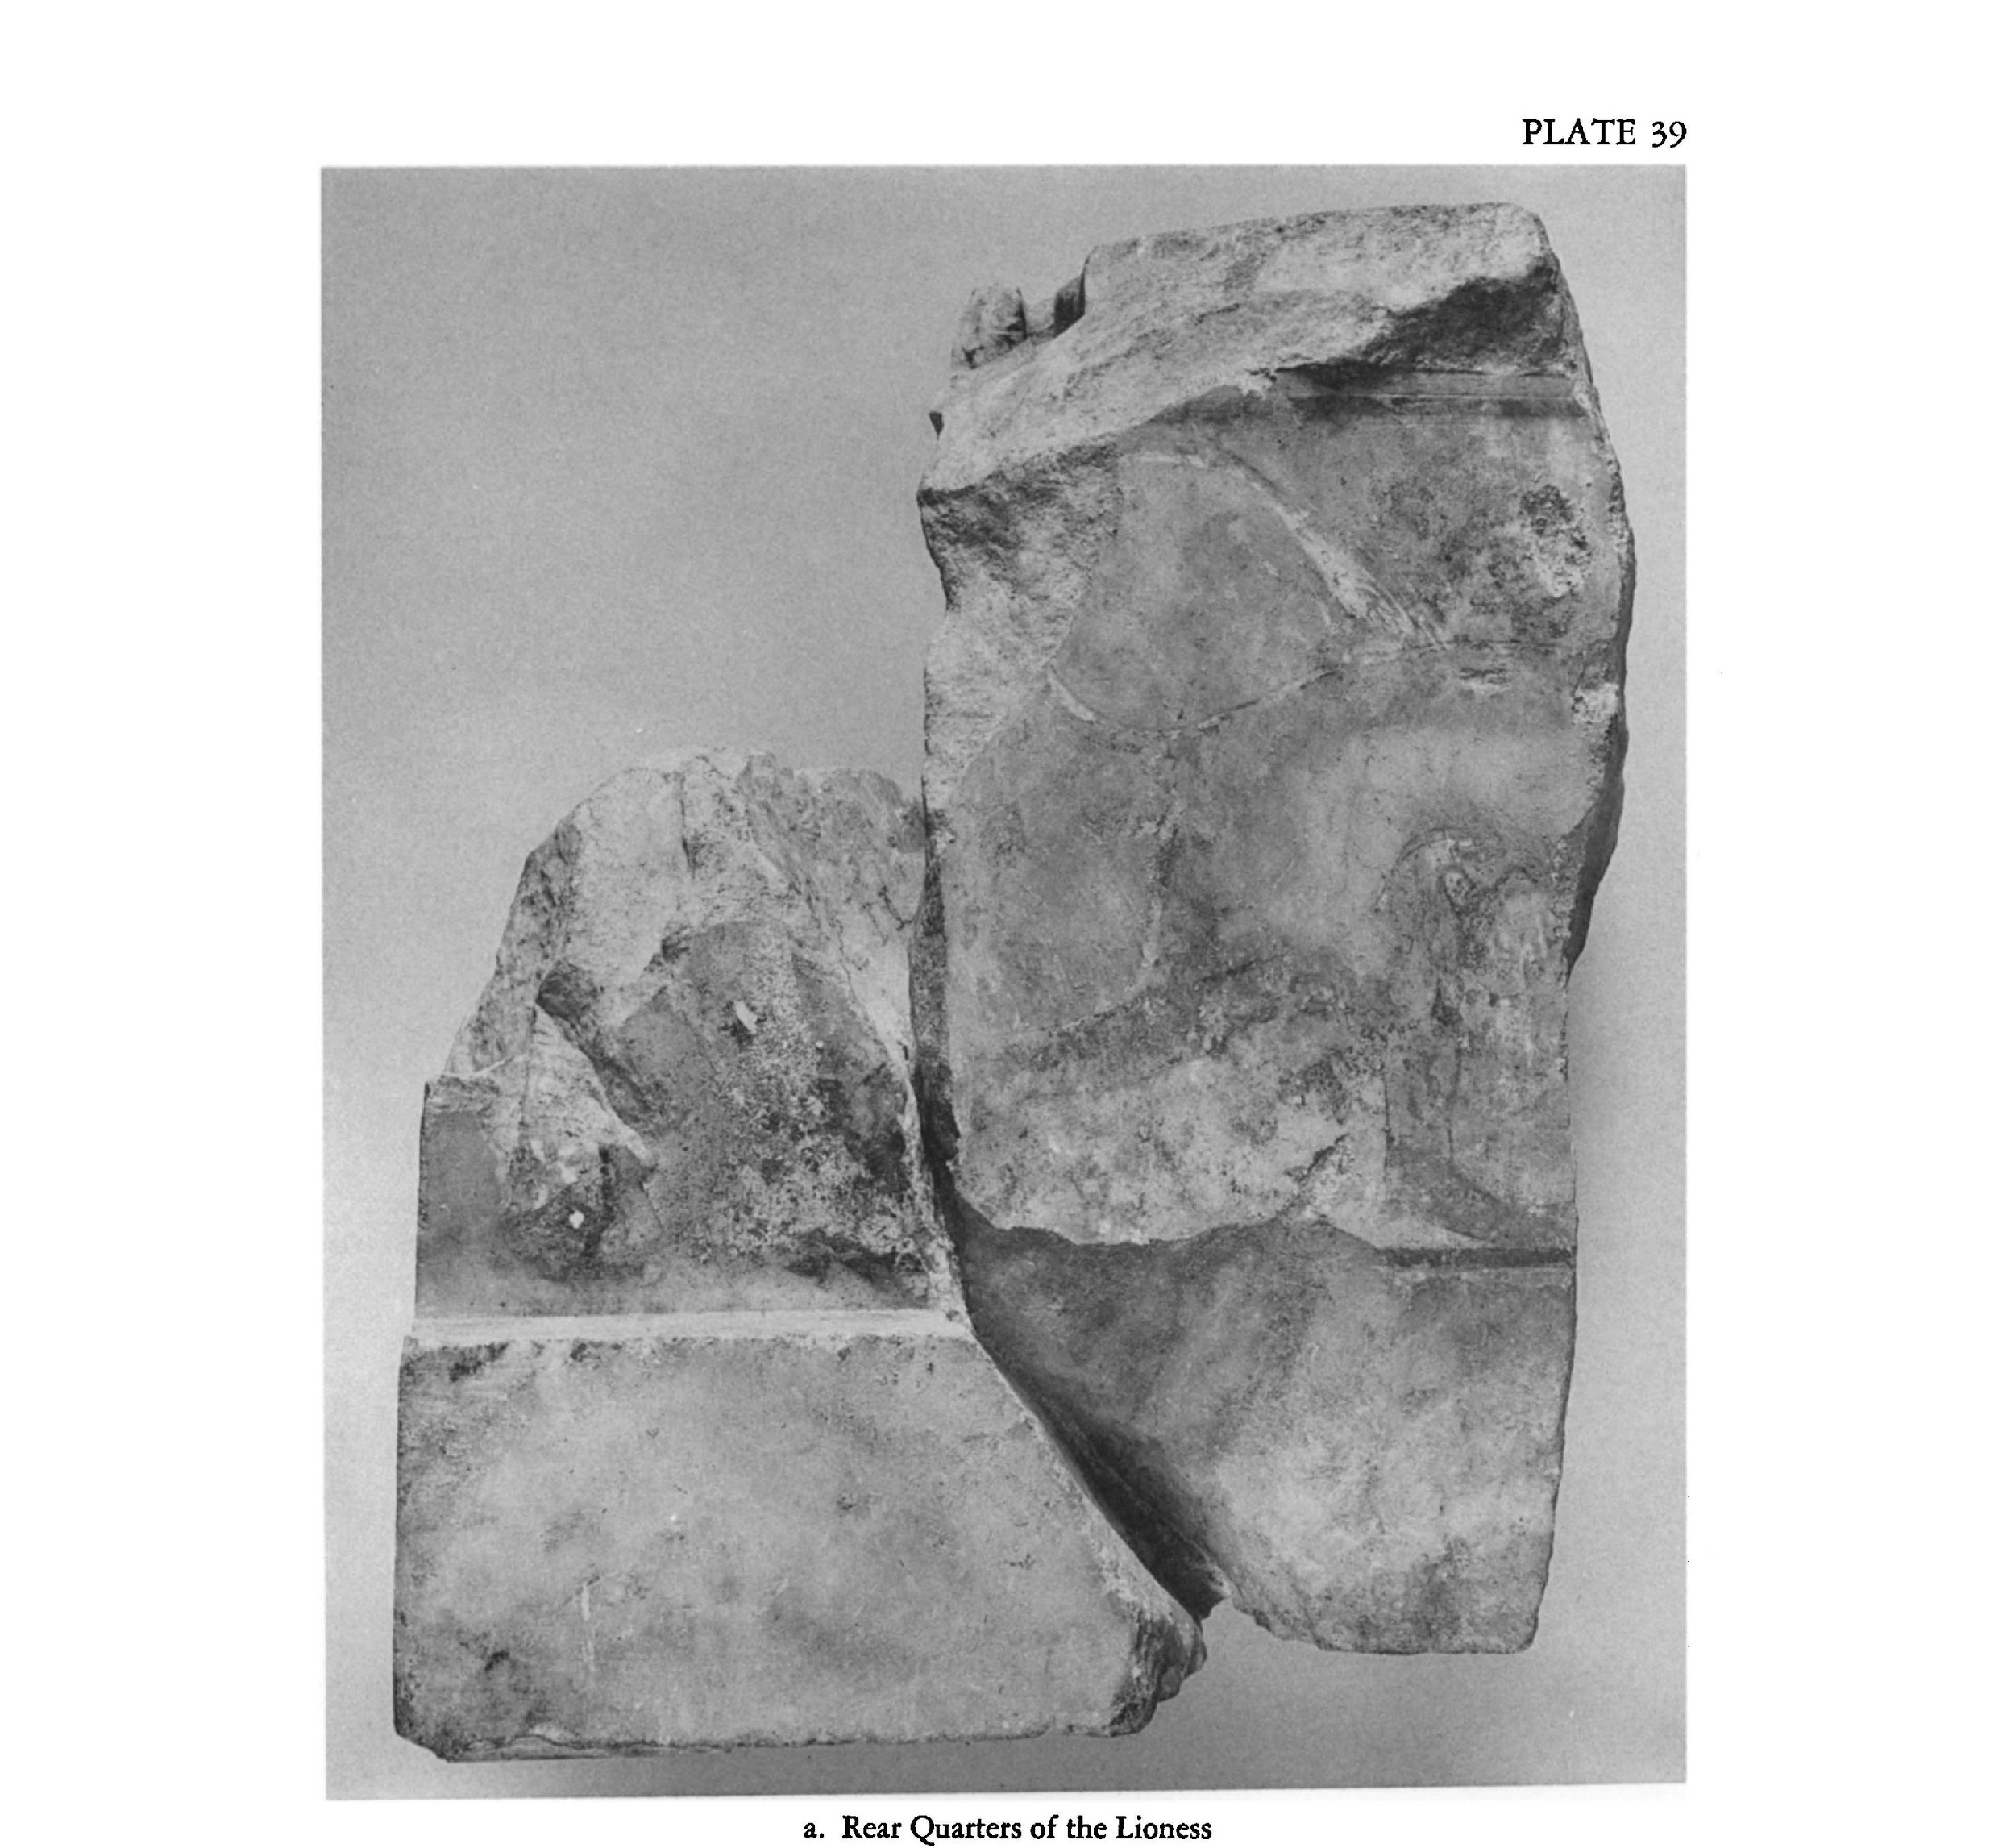
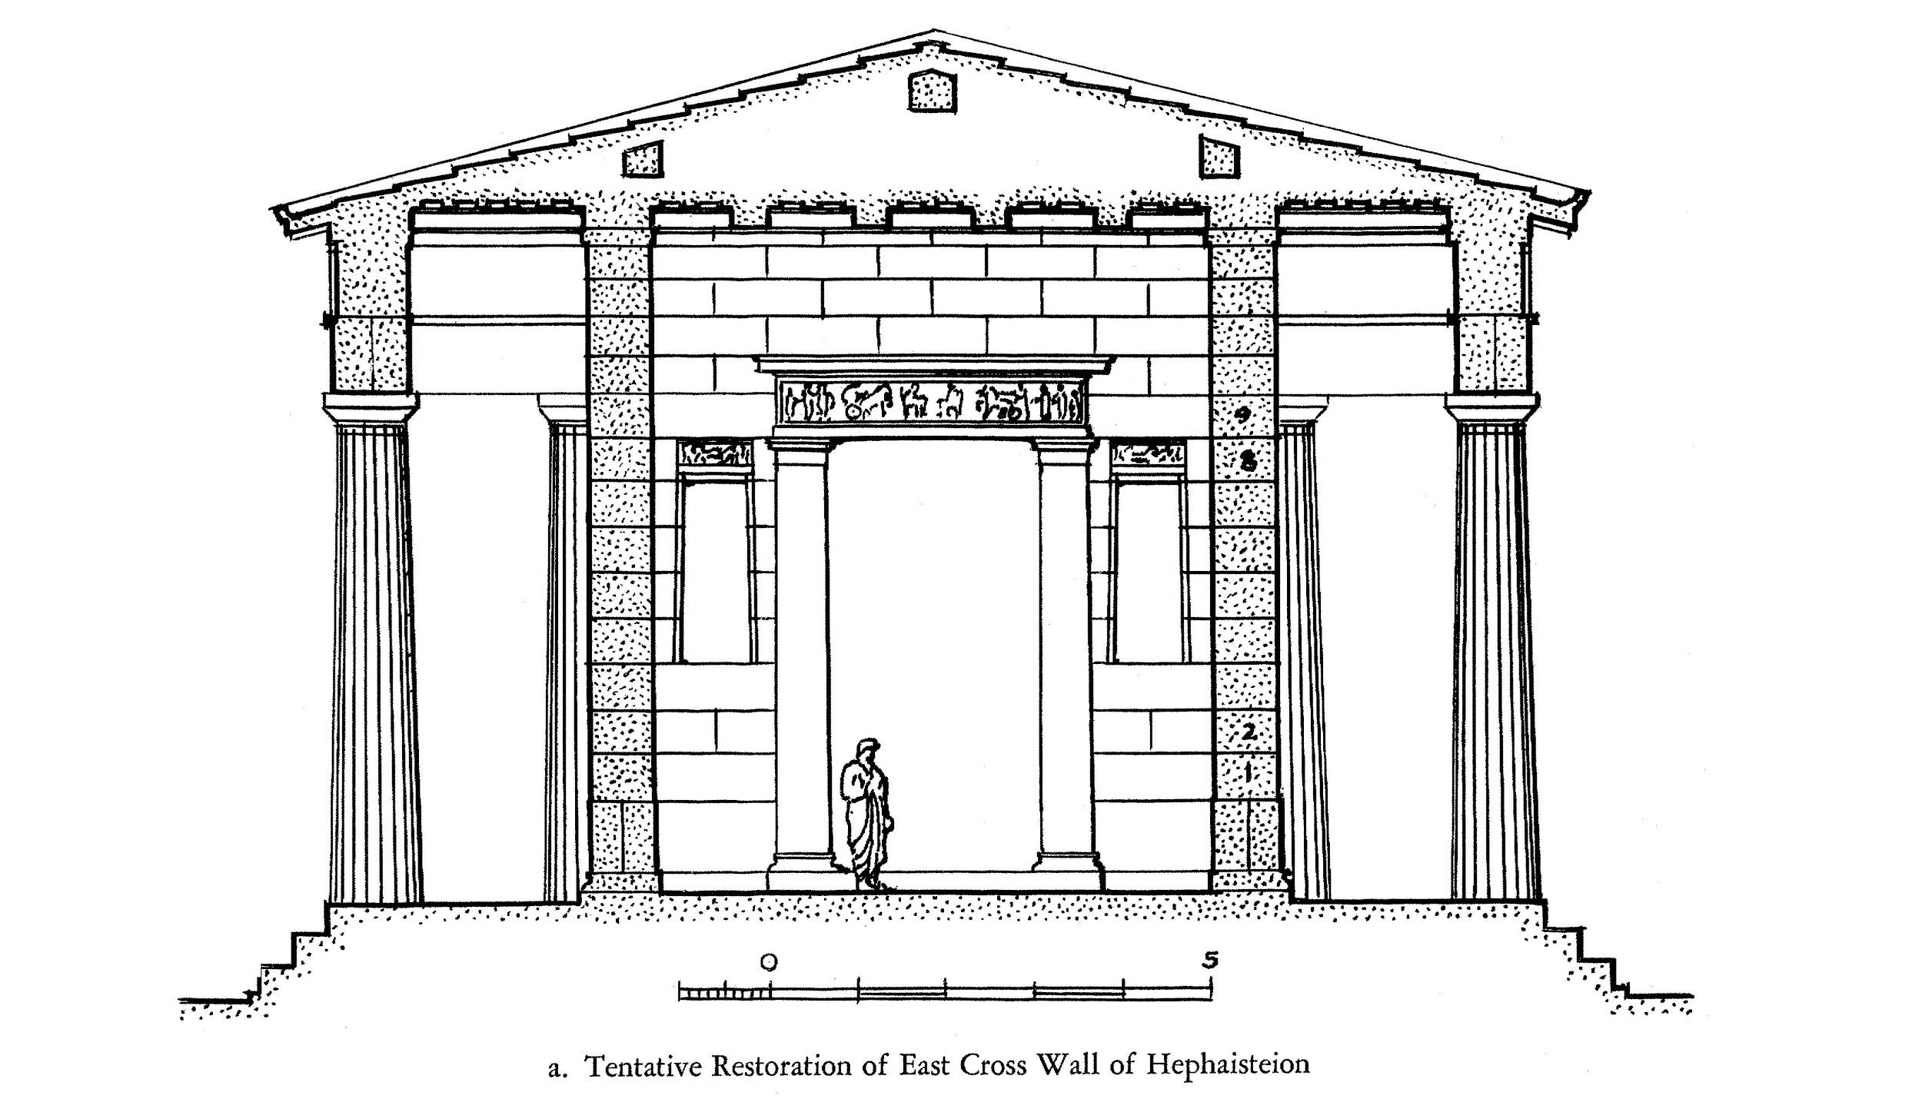
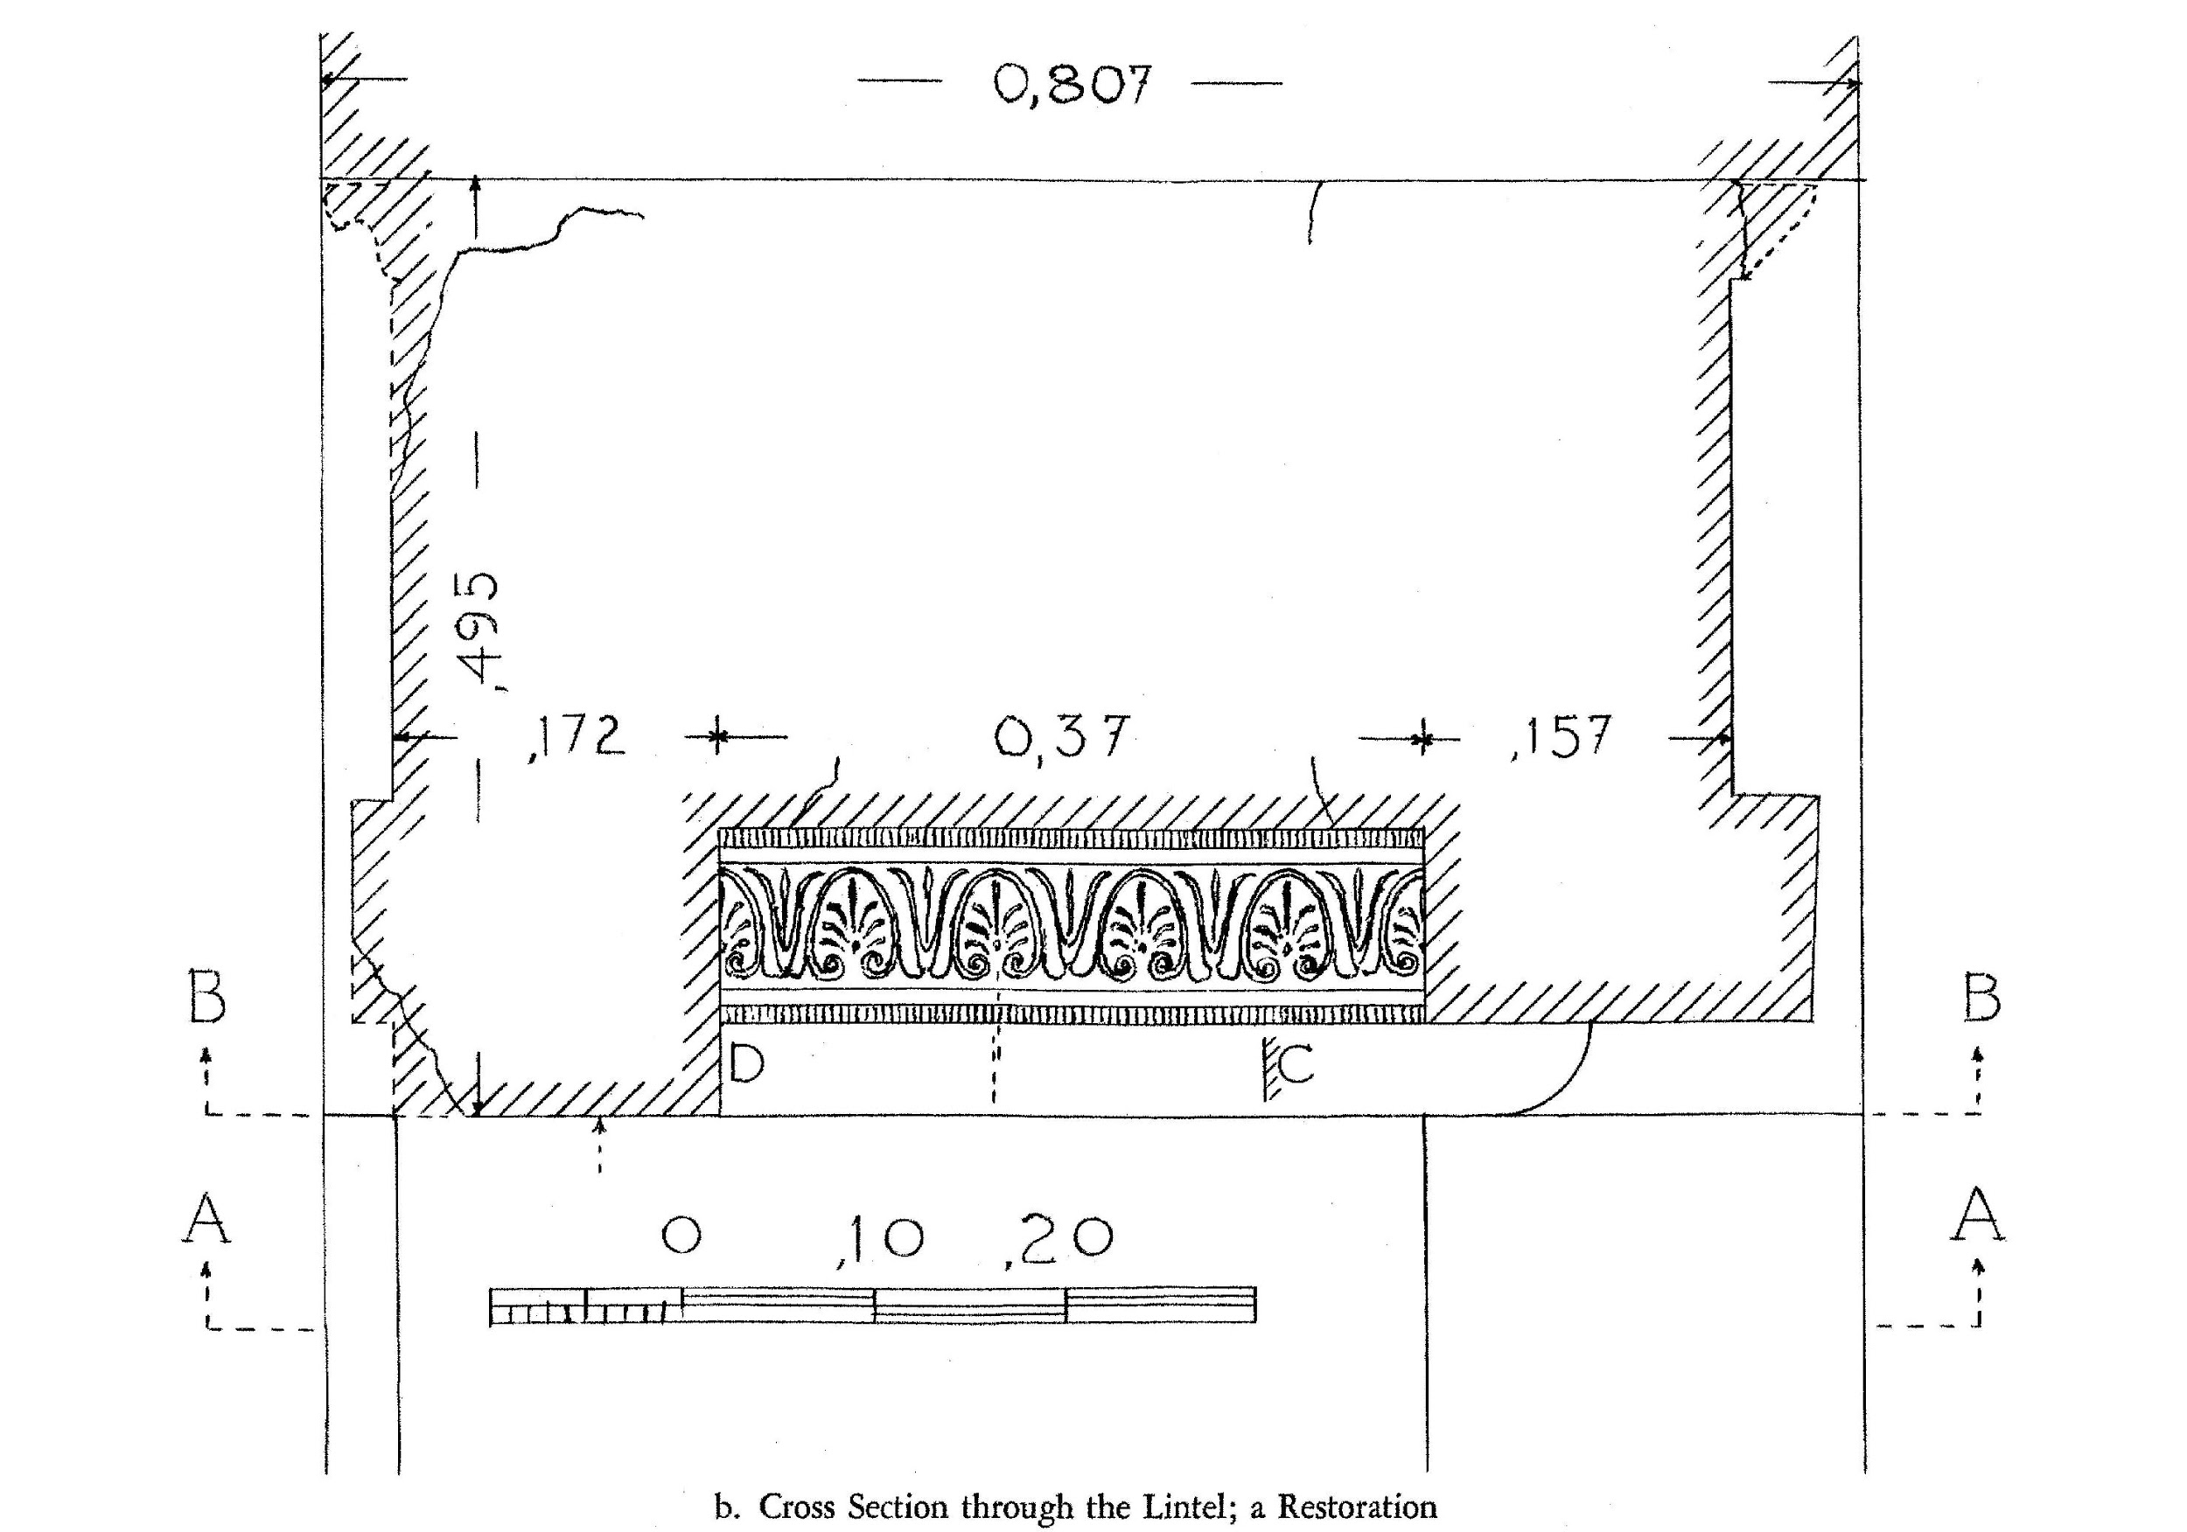
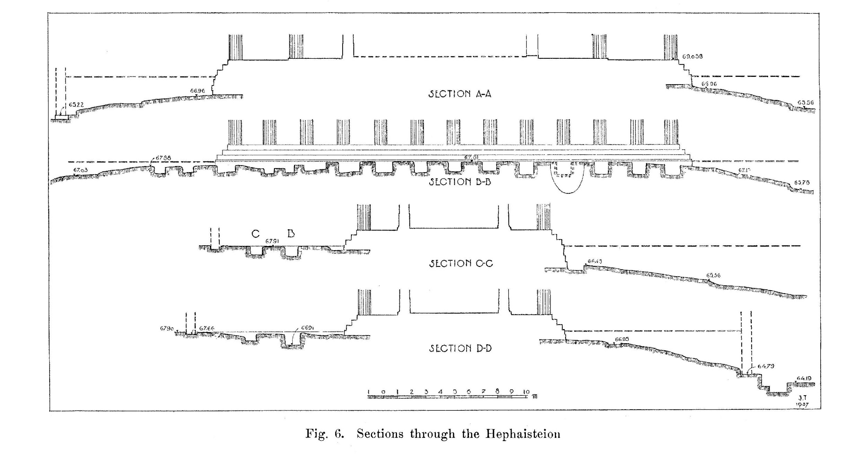
Building an Argumentation Platform for 3D Reconstruction using CIDOC-CRM and Drupal
Introduction / Proposal / Implementation / Results / Next steps
Test case:
Hephaisteion

Slide 6
Building an Argumentation Platform for 3D Reconstruction using CIDOC-CRM and Drupal
Introduction / Proposal / Implementation / Results / Next steps
Requirements:
Ability to implement model using CRM and CRMinf
Ability to display 3D data and connect to research data
Provide a system with a reasonable ease of use

Slide 7
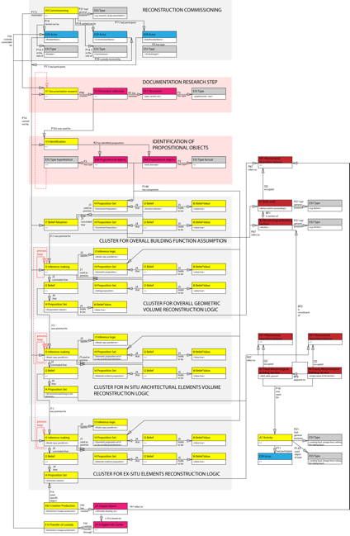


Building an Argumentation Platform for 3D Reconstruction using CIDOC-CRM and Drupal
Introduction / Proposal / Implementation / Results / Next steps
Proposed Approach:
1/Ontology
2/Knowledge provenance model
3/CMS implementation

Slide 8
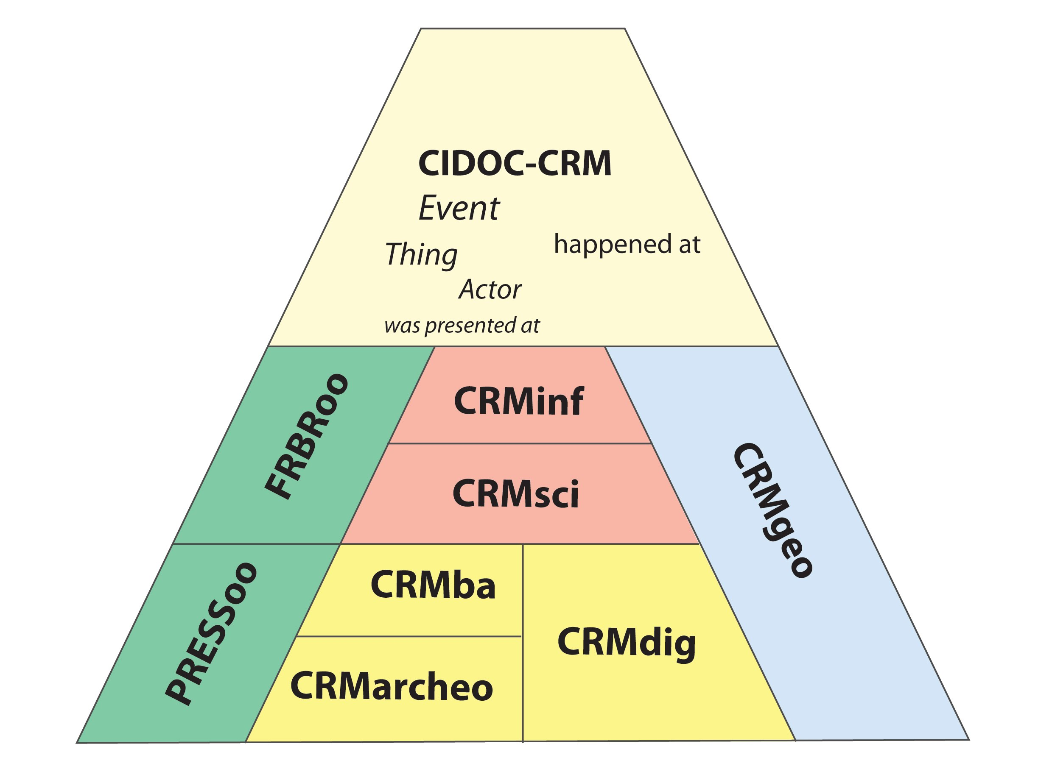
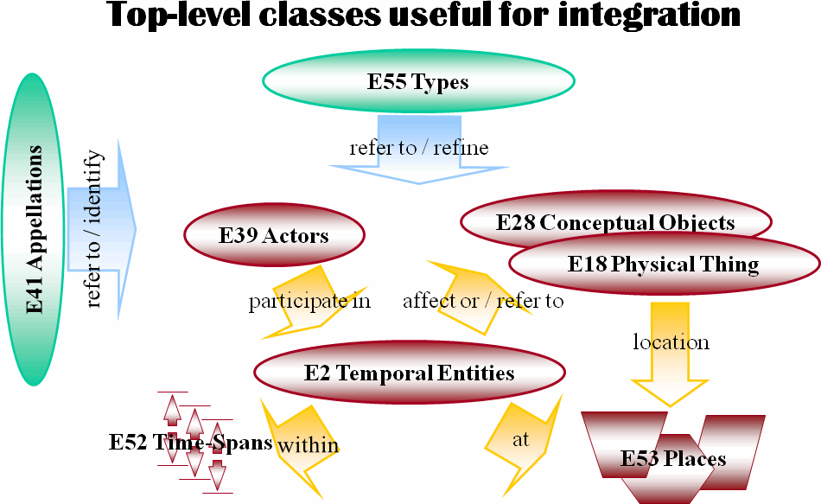
Building an Argumentation Platform for 3D Reconstruction using CIDOC-CRM and Drupal
Introduction / Proposal / Implementation / Results / Next steps
1/CIDOC-CRM Data Modelling Approach
CRM and its family of extensions
CRM and top level classes

Slide 9
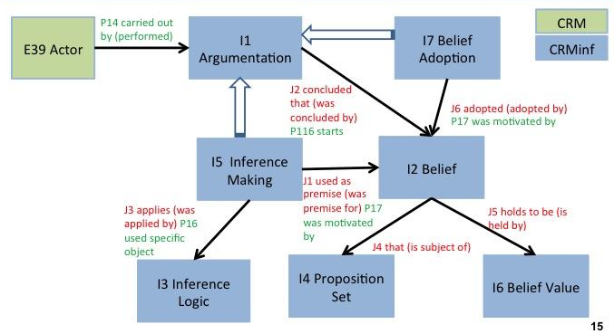
Building an Argumentation Platform for 3D Reconstruction using CIDOC-CRM and Drupal
Introduction / Proposal / Implementation / Results / Next steps
1/Argumentation Model, CRMinf
Paveprime Ltd. (2014). CRMinf: the Argumentation Model An Extension of CIDOC­CRM to support argumentation.

Slide 10

Building an Argumentation Platform for 3D Reconstruction using CIDOC-CRM and Drupal
Introduction / Proposal / Implementation / Results / Next steps
1/What is an argument?
that
I4 proposition set
‘All men are mortal’
I2 Belief
J1
used as premise
J5 holds to be
E39 Actor
P14
carried out by
I5 Inference making
that
I6 Belief value
‘True’
All men are mortal

Slide 11
Building an Argumentation Platform for 3D Reconstruction using CIDOC-CRM and Drupal
Introduction / Proposal / Implementation / Results / Next steps
1/What is an argument?
that
I4 proposition set
‘All men are mortal’
I2 Belief
J1
used as premise
J5 holds to be
E39 Actor
P14
carried out by
I5 Inference making
that
I6 Belief value
‘True’
I2 Belief
that
I4 proposition set ‘Socrates is a man’
J5 holds to be
I6 Belief value
that
‘True’
Socrates is
a man

Slide 12
Building an Argumentation Platform for 3D Reconstruction using CIDOC-CRM and Drupal
Introduction / Proposal / Implementation / Results / Next steps
1/What is an argument?
that
I4 proposition set
‘All men are mortal’
I2 Belief
J1
used as premise
J5 holds to be
E39 Actor
P14
carried out by
I5 Inference making
that
I6 Belief value
‘True’
J3 applies
I3 Inference logic: syllogism
I2 Belief
that
I4 proposition set ‘Socrates is a man’
J2
concluded that
J5 holds to be
I6 Belief value
that
‘True’
Socrates
is mortal
I2 Belief
that
I4 proposition set ‘Socrates is mortal’
J5 holds to be
I6 Belief value
that
‘True’

Slide 13
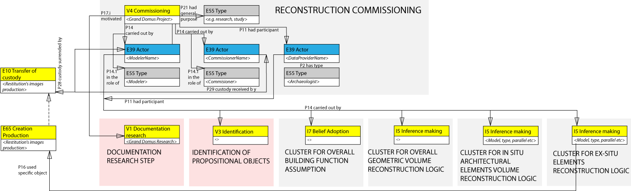
Building an Argumentation Platform for 3D Reconstruction using CIDOC-CRM and Drupal
Introduction / Proposal / Implementation / Results / Next steps
2/Knowledge Provenance Model:
8 Steps from Commissioning to Production
Bruseker, G., Guillem, A., and Carboni, N.: Semantically Documenting Virtual Reconstruction: Building a Path to Knowledge Provenance
ISPRS Annals of the Photogrammetry, Remote Sensing and Spatial Information Sciences, Volume II-5/W3, 2015

Slide 14

Building an Argumentation Platform for 3D Reconstruction using CIDOC-CRM and Drupal
Introduction / Proposal / Implementation / Results / Next steps
3/ Design Choice of CMS system (Drupal)
Criteria:
prototype
easily replicable
off-the-shelf
strong development community, re-use of existing modules
3D Model Viewer Support
can respect CIDOC-CRM model

Slide 15
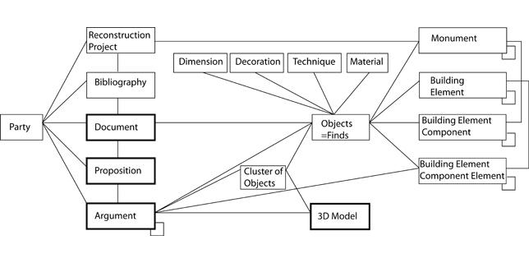
Building an Argumentation Platform for 3D Reconstruction using CIDOC-CRM and Drupal
Introduction / Proposal / Implementation / Results / Next steps
Implementation of Entities and Relations

Slide 16
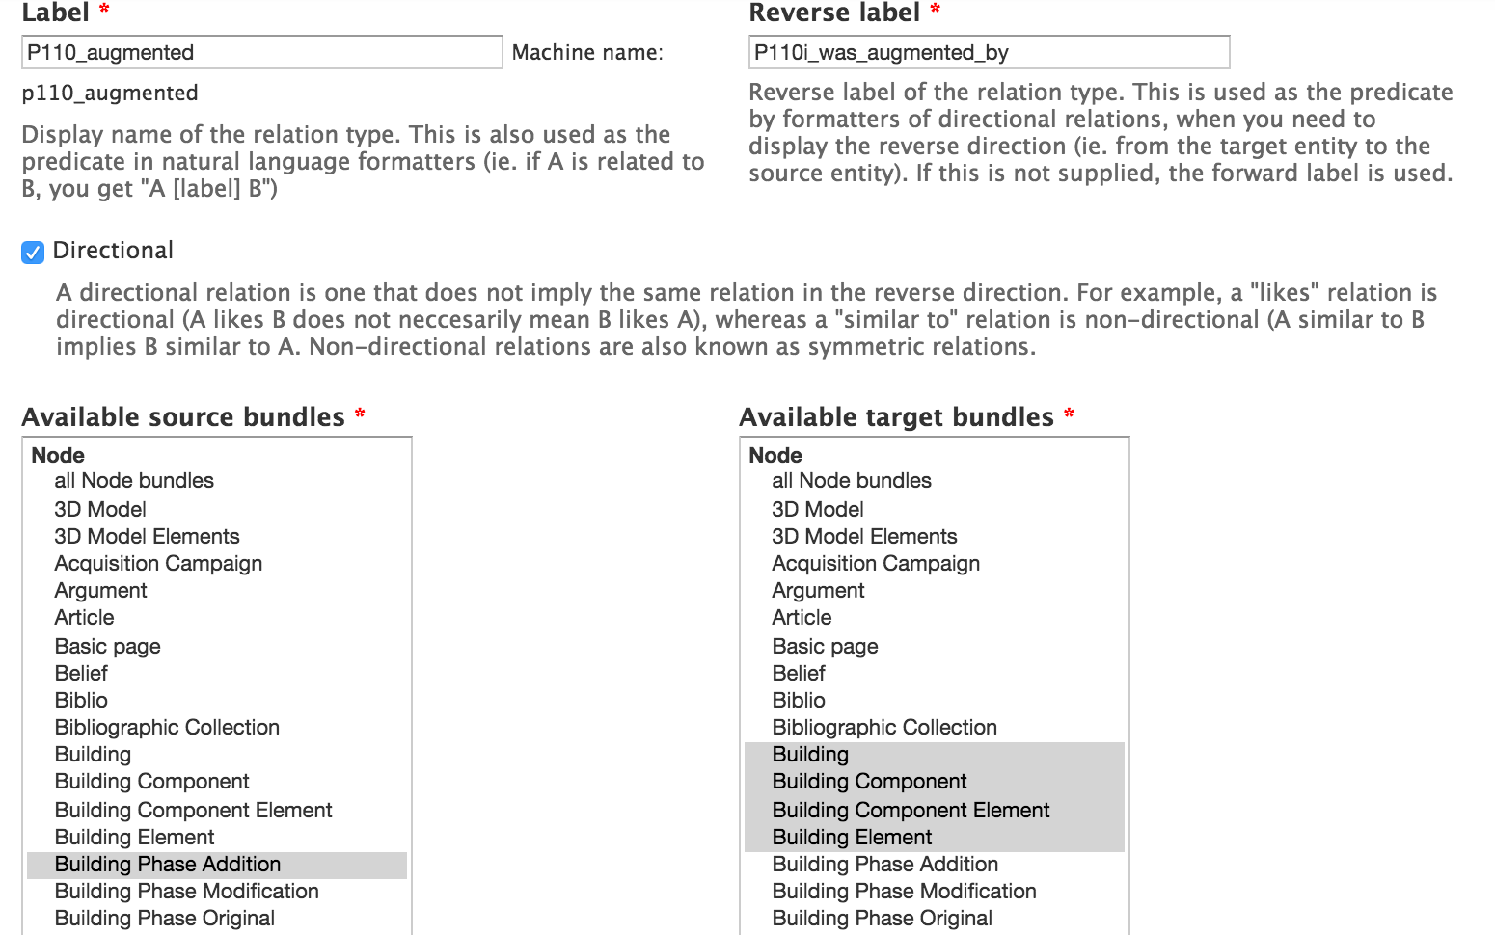
Building an Argumentation Platform for 3D Reconstruction using CIDOC-CRM and Drupal
Introduction / Proposal / Implementation / Results / Next steps
Drupal Modules Setup
Relations module (to create an accurate E-R-E data structure)

Slide 17
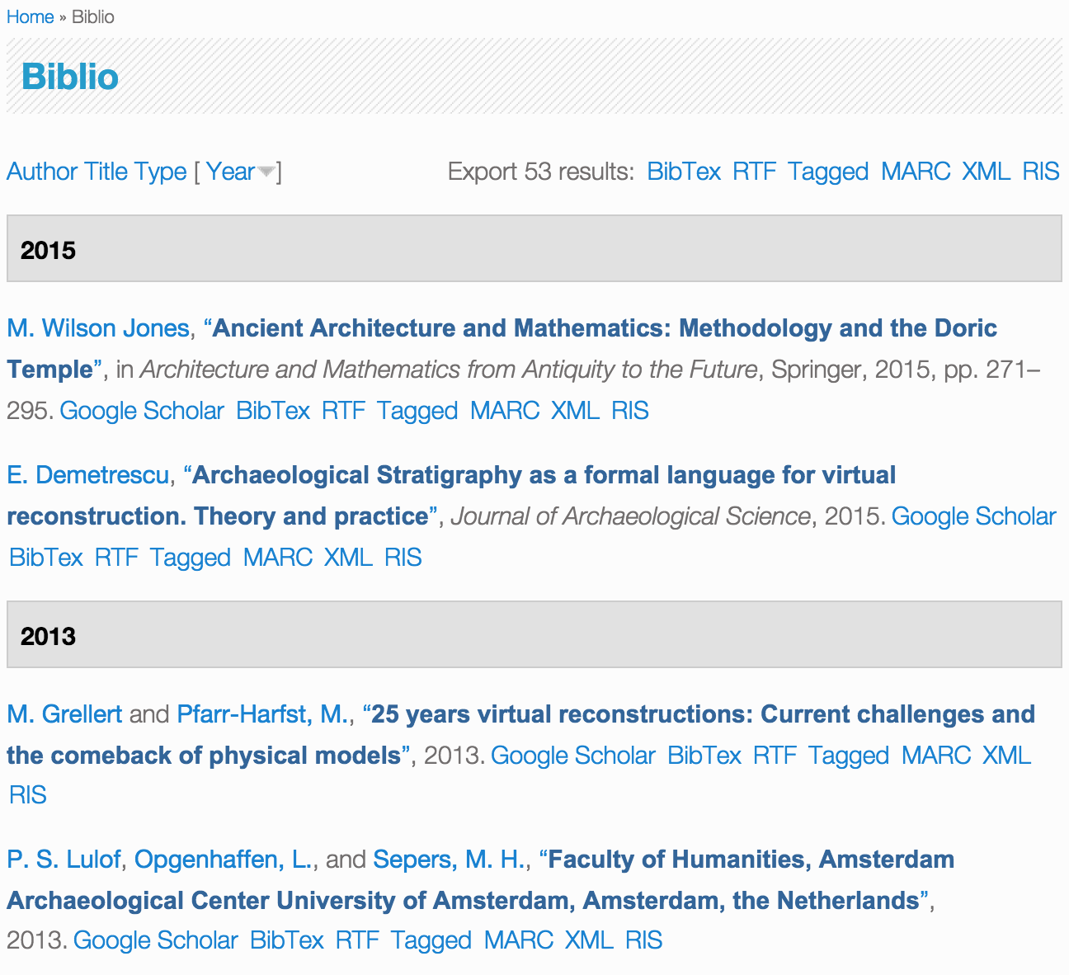
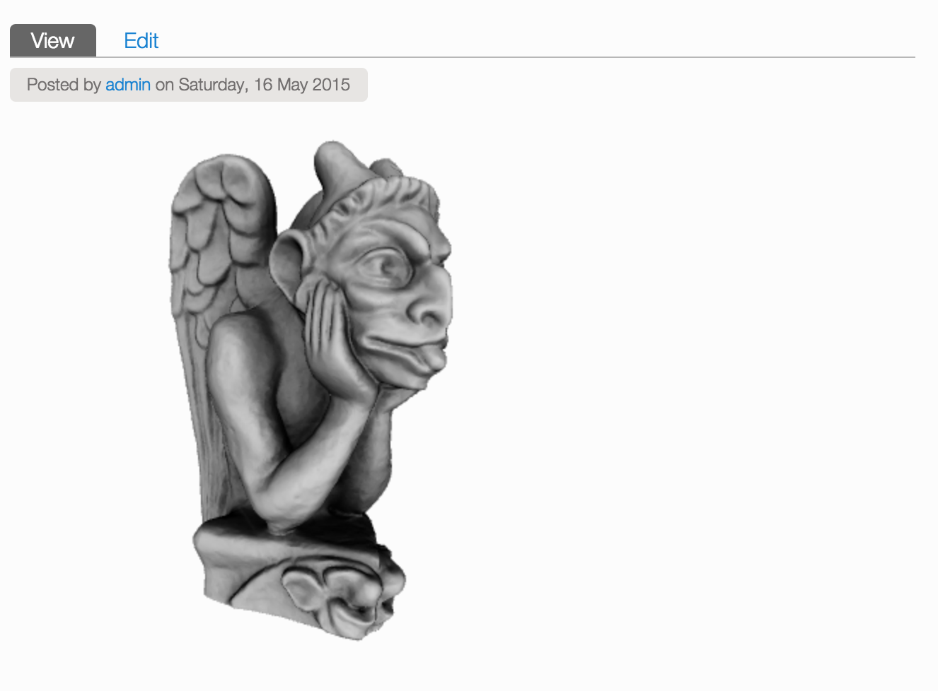
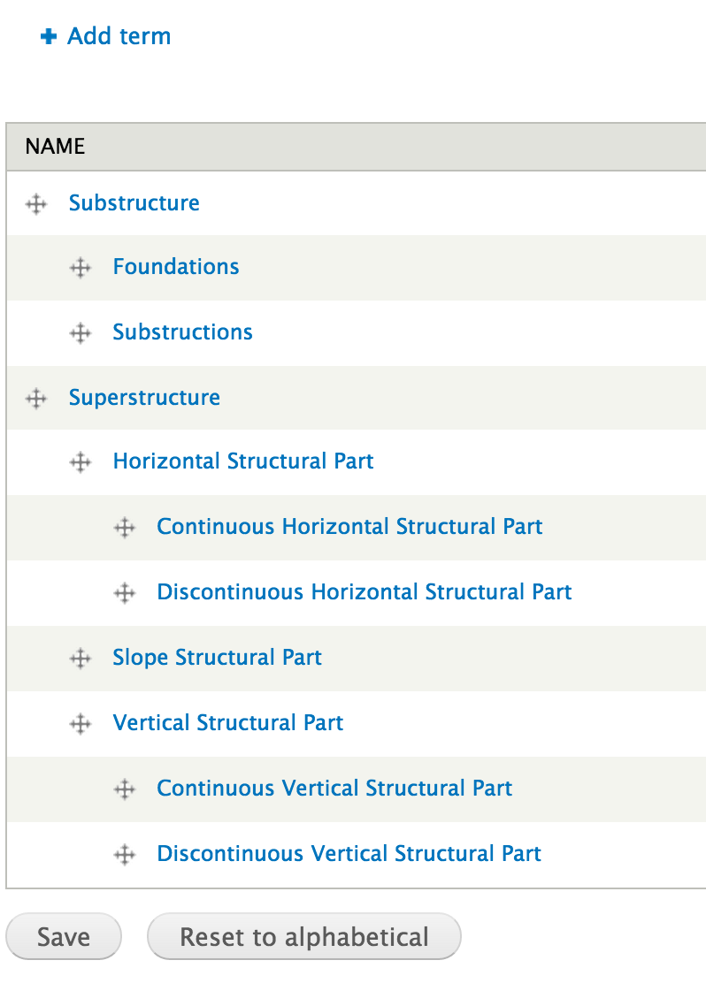
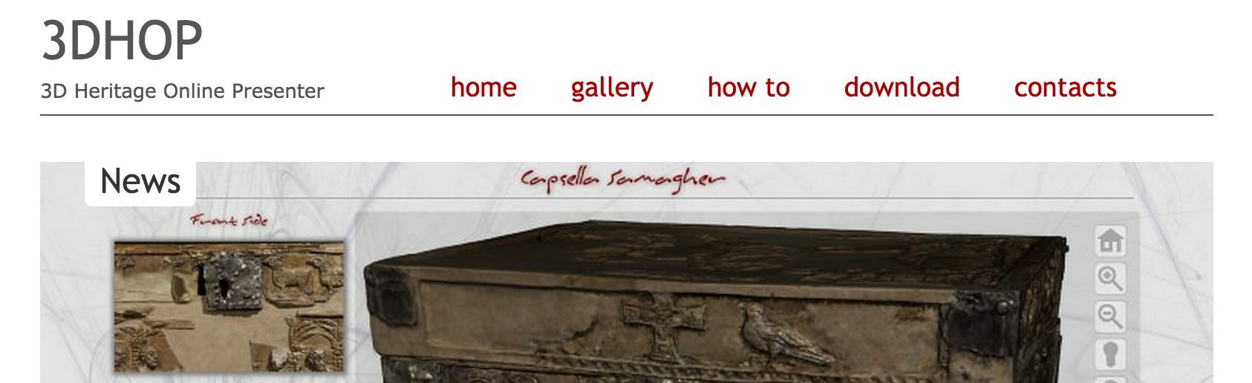
Building an Argumentation Platform for 3D Reconstruction using CIDOC-CRM and Drupal
Introduction / Proposal / Implementation / Results / Next steps
Drupal Modules Setup
Bibliography
3D Viewer, 3DHOP etc…
Taxonomy

Slide 18
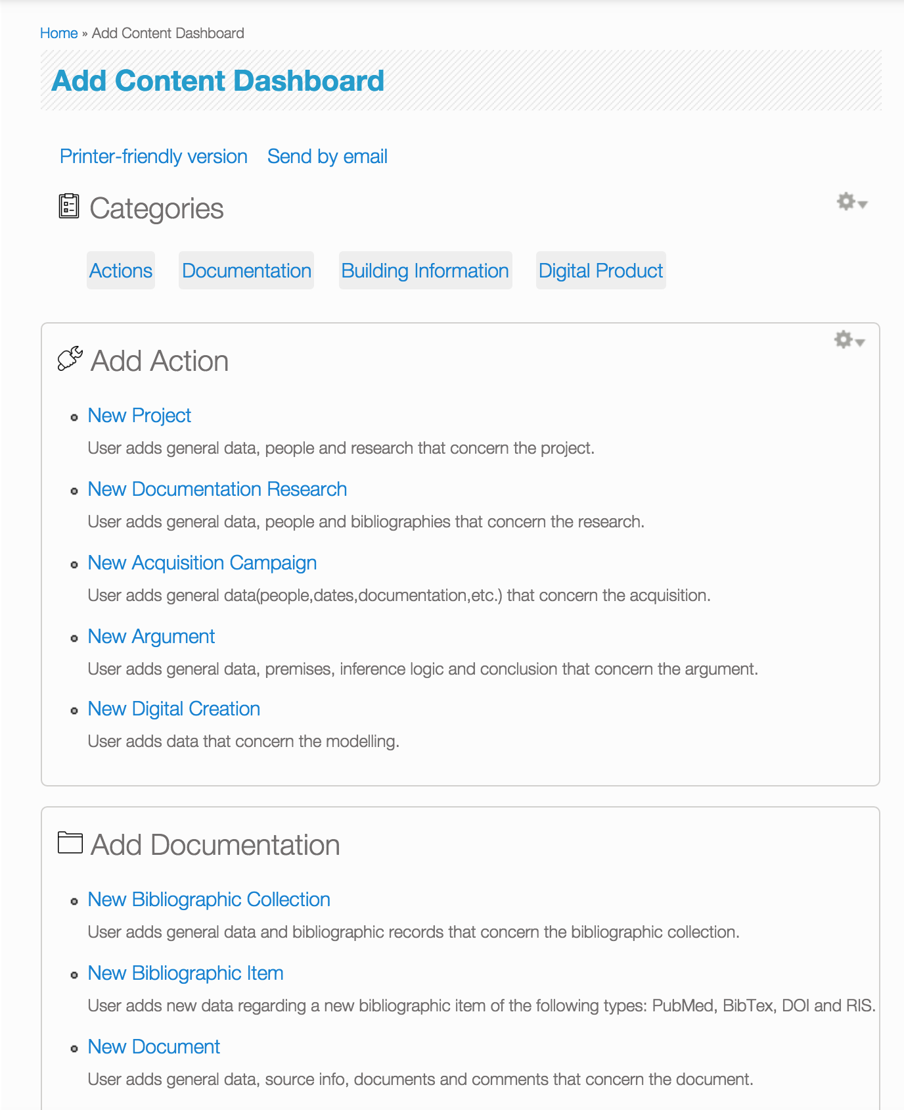
Building an Argumentation Platform for 3D Reconstruction using CIDOC-CRM and Drupal
Introduction / Proposal / Implementation / Results / Next steps
Result - Integrated Metadata for:
Actions
Project
Documentation Research
Acquisition Campaign
Argumentation
Modelling
Documentation
Bibliographic Collections
Bibliography
Documents
Propositions
Buildings
Building
Building Element
Models
3D Model

Slide 19
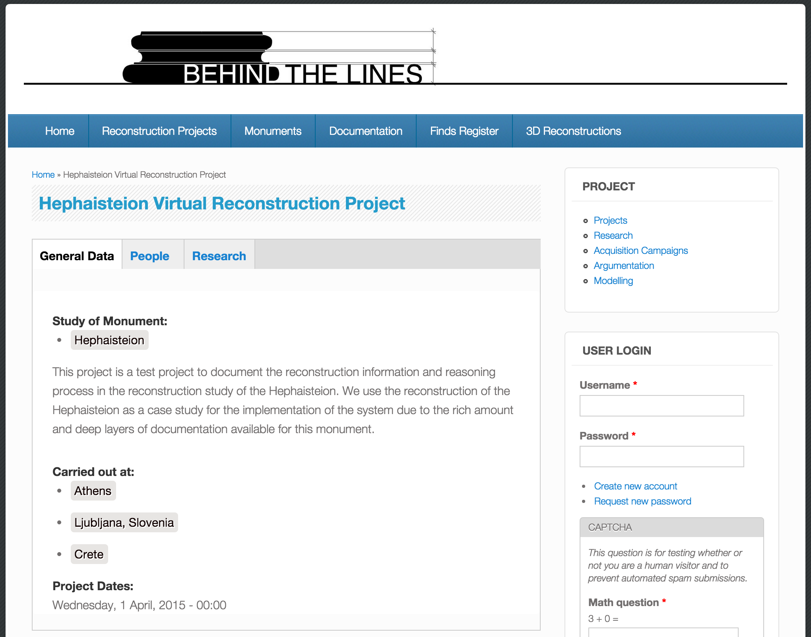
Building an Argumentation Platform for 3D Reconstruction using CIDOC-CRM and Drupal
Introduction / Proposal / Implementation / Results / Next steps
Action Metadata
Actions
Project
Documentation Research
Acquisition Campaign
Argumentation
Modelling

Slide 20
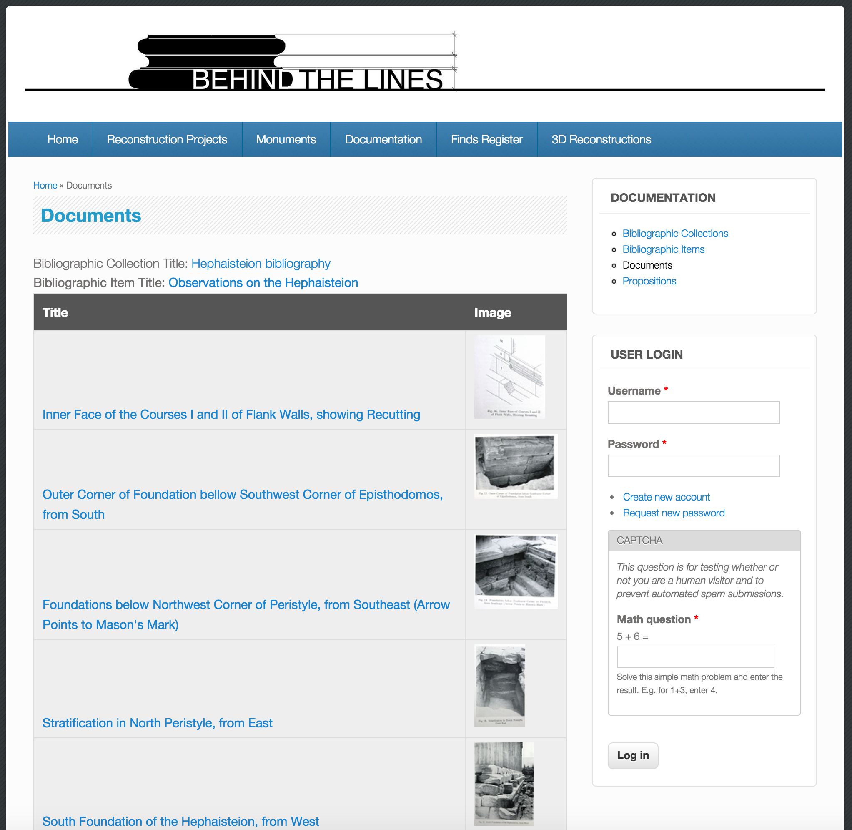
Building an Argumentation Platform for 3D Reconstruction using CIDOC-CRM and Drupal
Introduction / Proposal / Implementation / Results / Next steps
Documentation Metadata
Documentation
Bibliographic Collections
Bibliography
Documents
Propositions

Slide 21
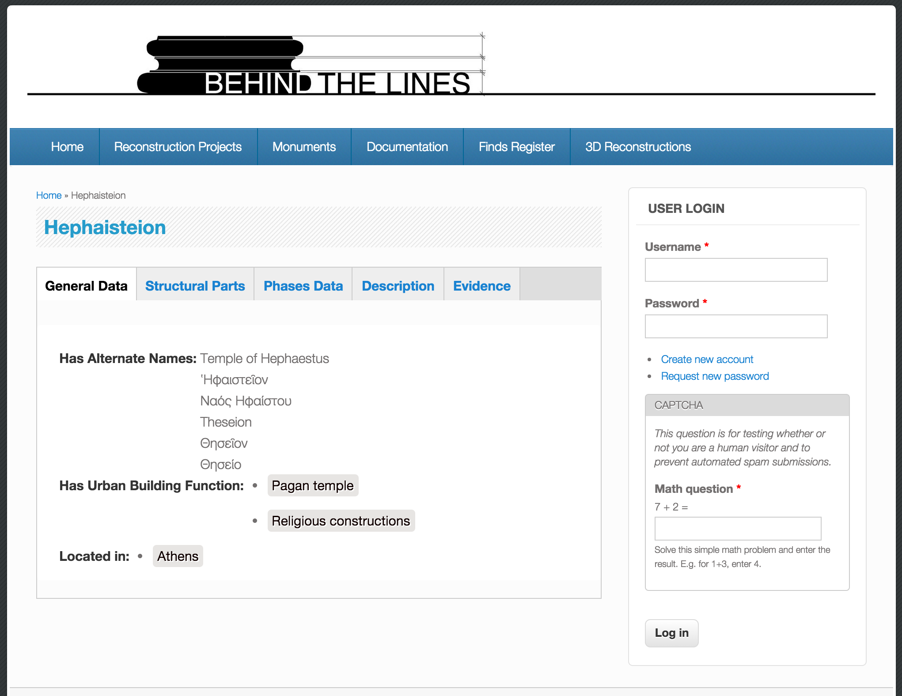
Building an Argumentation Platform for 3D Reconstruction using CIDOC-CRM and Drupal
Introduction / Proposal / Implementation / Results / Next steps
Buildings Metadata
Buildings
Building
Building Element

Slide 22
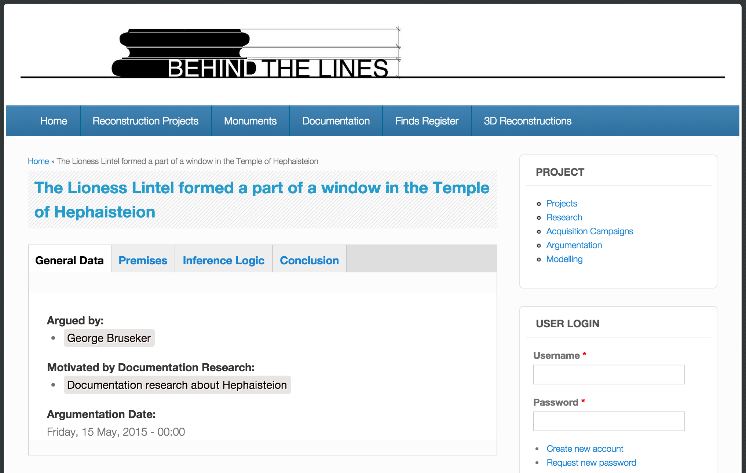
Building an Argumentation Platform for 3D Reconstruction using CIDOC-CRM and Drupal
Introduction / Proposal / Implementation / Results / Next steps
Argumentation Metadata
Actions
Project
Documentation Research
Acquisition Campaign
Argumentation
Modelling

Slide 23
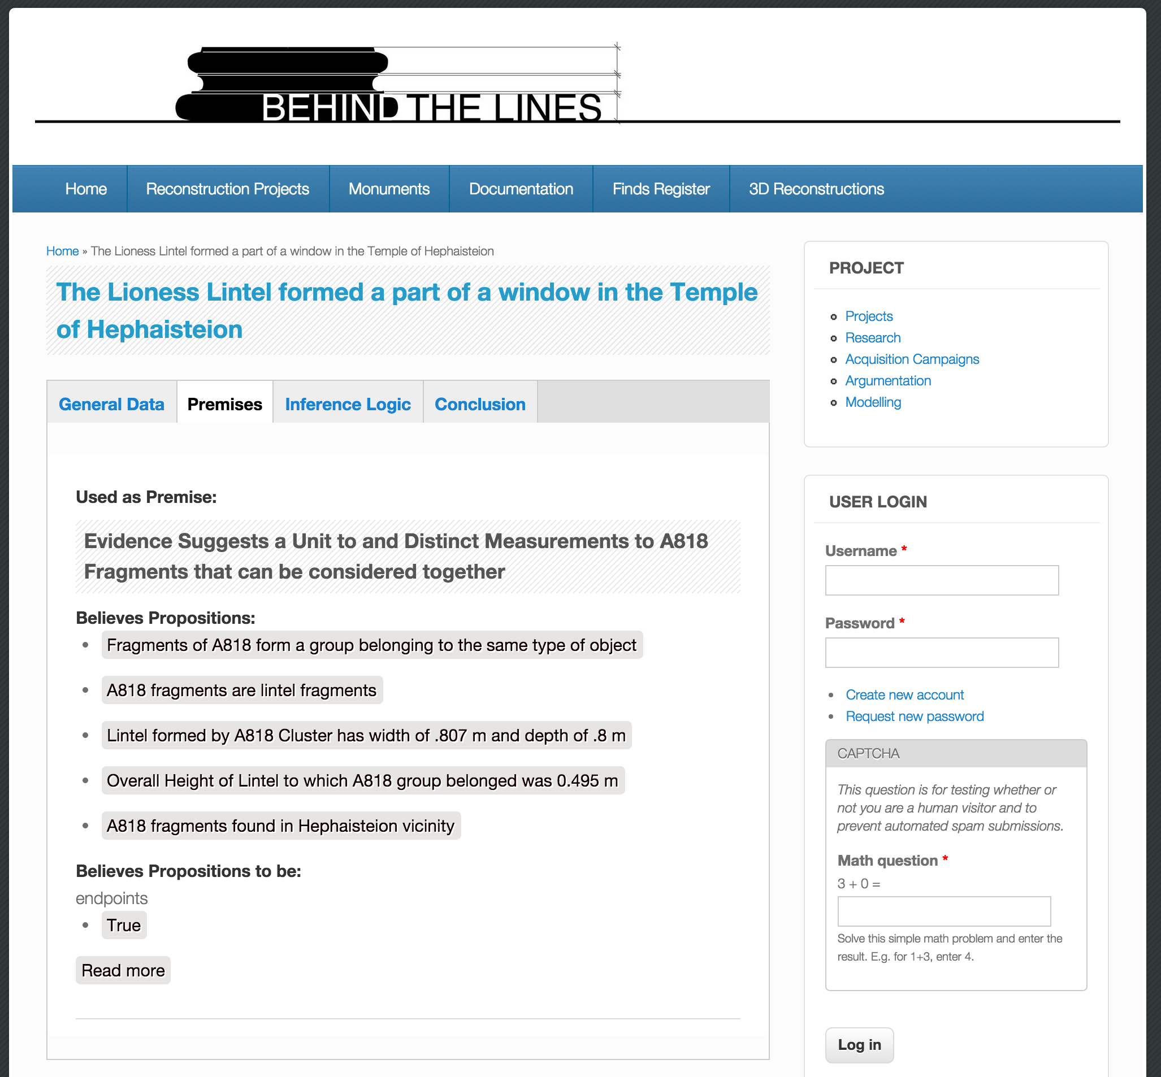
Building an Argumentation Platform for 3D Reconstruction using CIDOC-CRM and Drupal
Introduction / Proposal / Implementation / Results / Next steps
Argumentation Metadata
Actions
Project
Documentation Research
Acquisition Campaign
Argumentation
Modelling

Slide 24
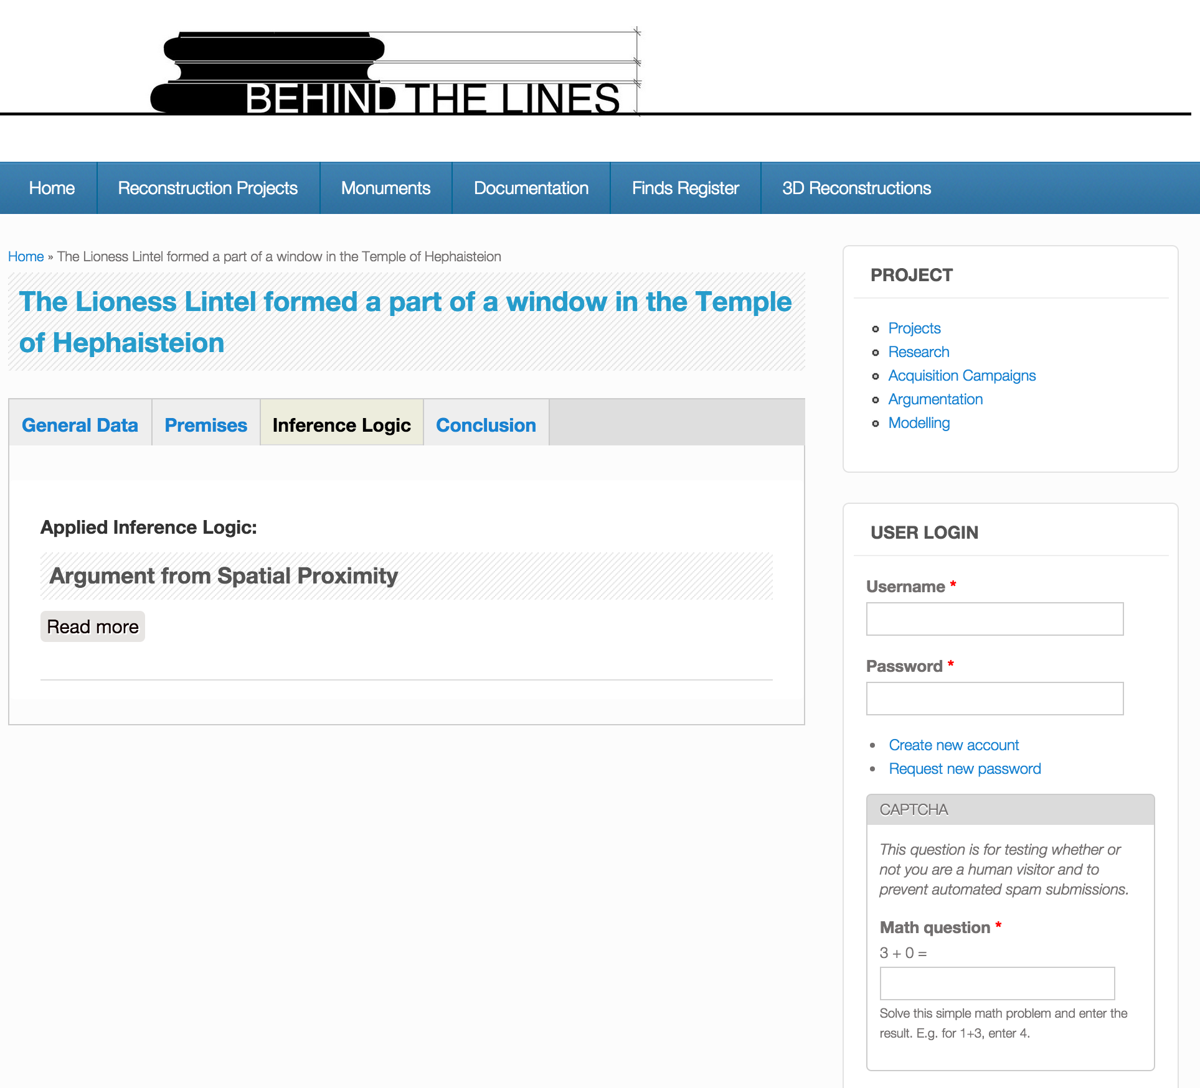
Building an Argumentation Platform for 3D Reconstruction using CIDOC-CRM and Drupal
Introduction / Proposal / Implementation / Results / Next steps
Argumentation Metadata
Actions
Project
Documentation Research
Acquisition Campaign
Argumentation
Modelling

Slide 25
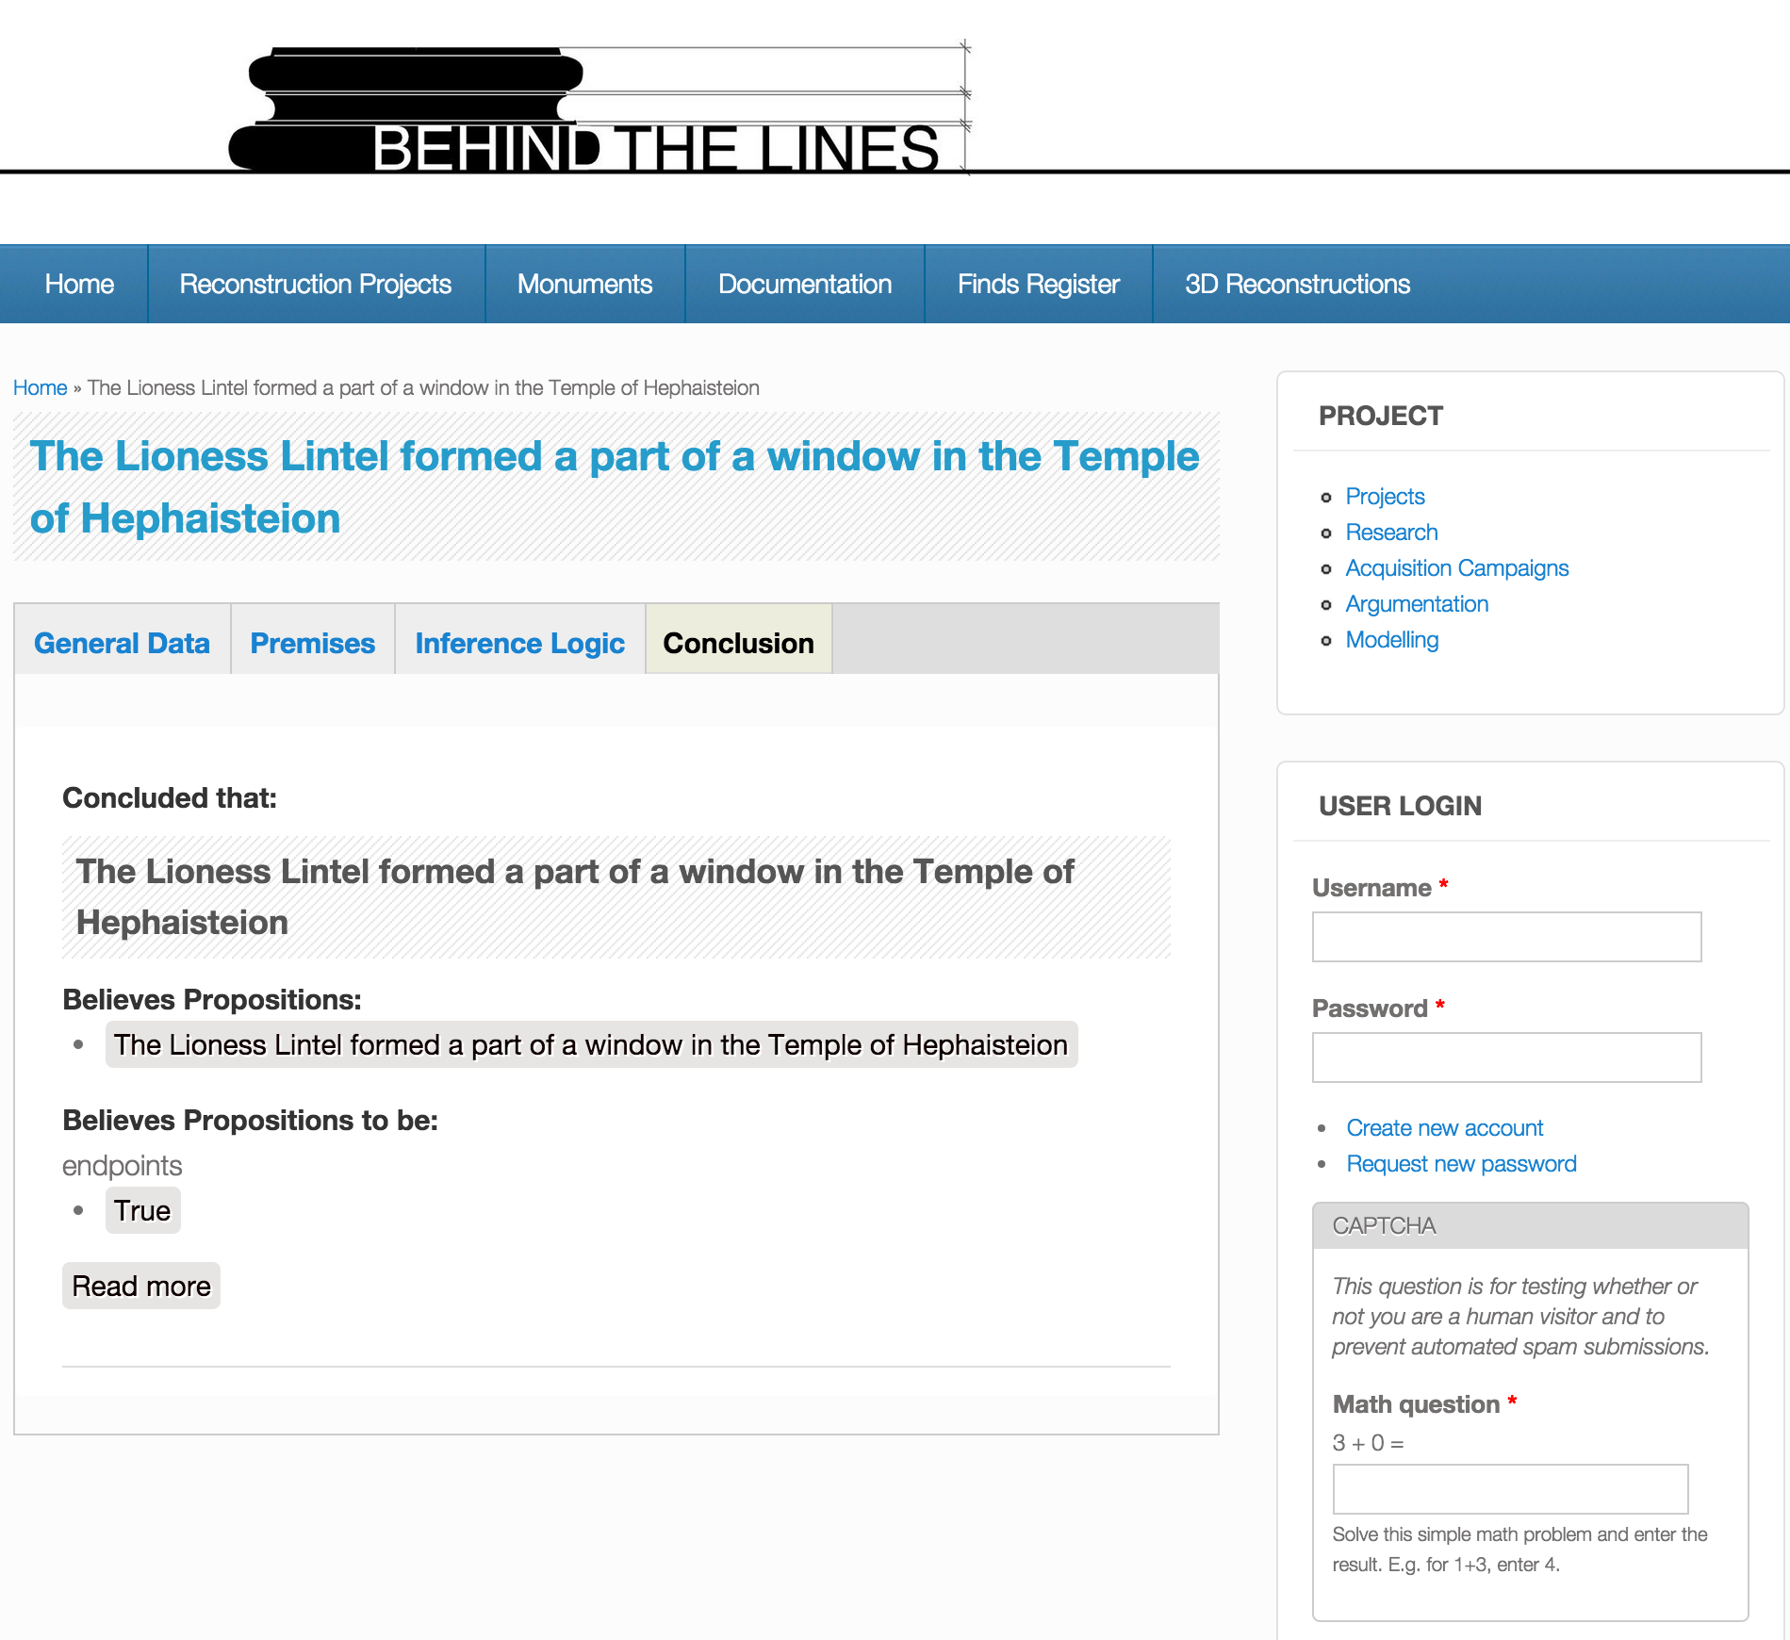
Building an Argumentation Platform for 3D Reconstruction using CIDOC-CRM and Drupal
Introduction / Proposal / Implementation / Results / Next steps
Argumentation Metadata
Actions
Project
Documentation Research
Acquisition Campaign
Argumentation
Modelling

Slide 26
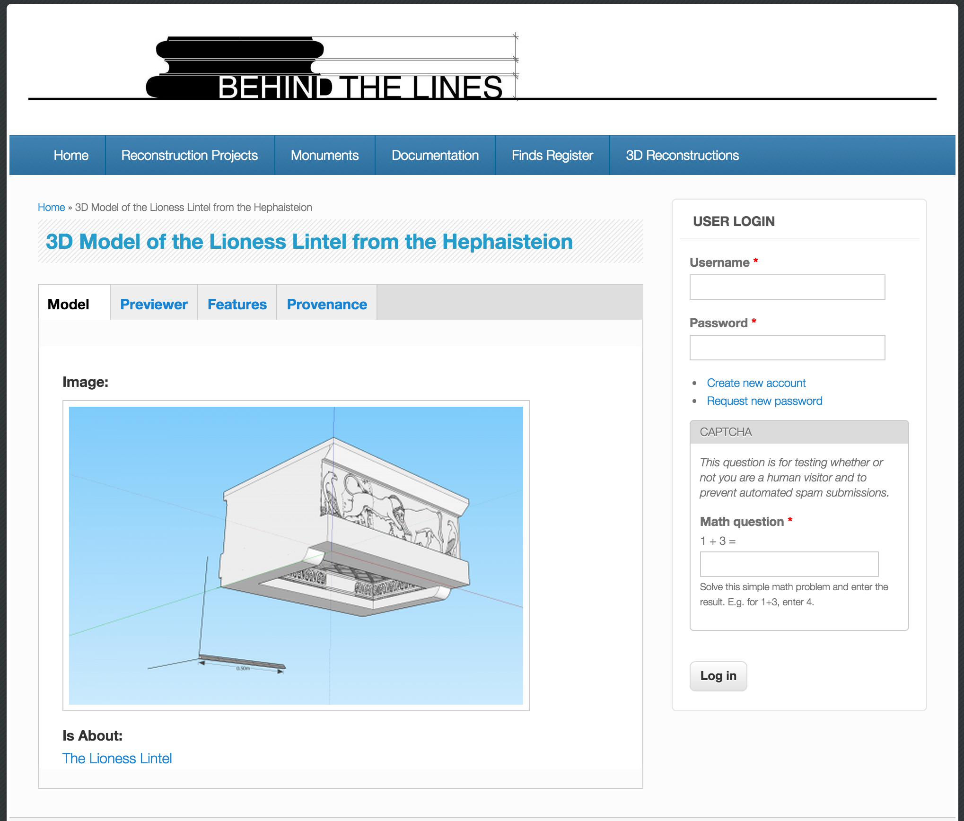
Building an Argumentation Platform for 3D Reconstruction using CIDOC-CRM and Drupal
Introduction / Proposal / Implementation / Results / Next steps
3D Model Metadata
Models
3D Model

Slide 27
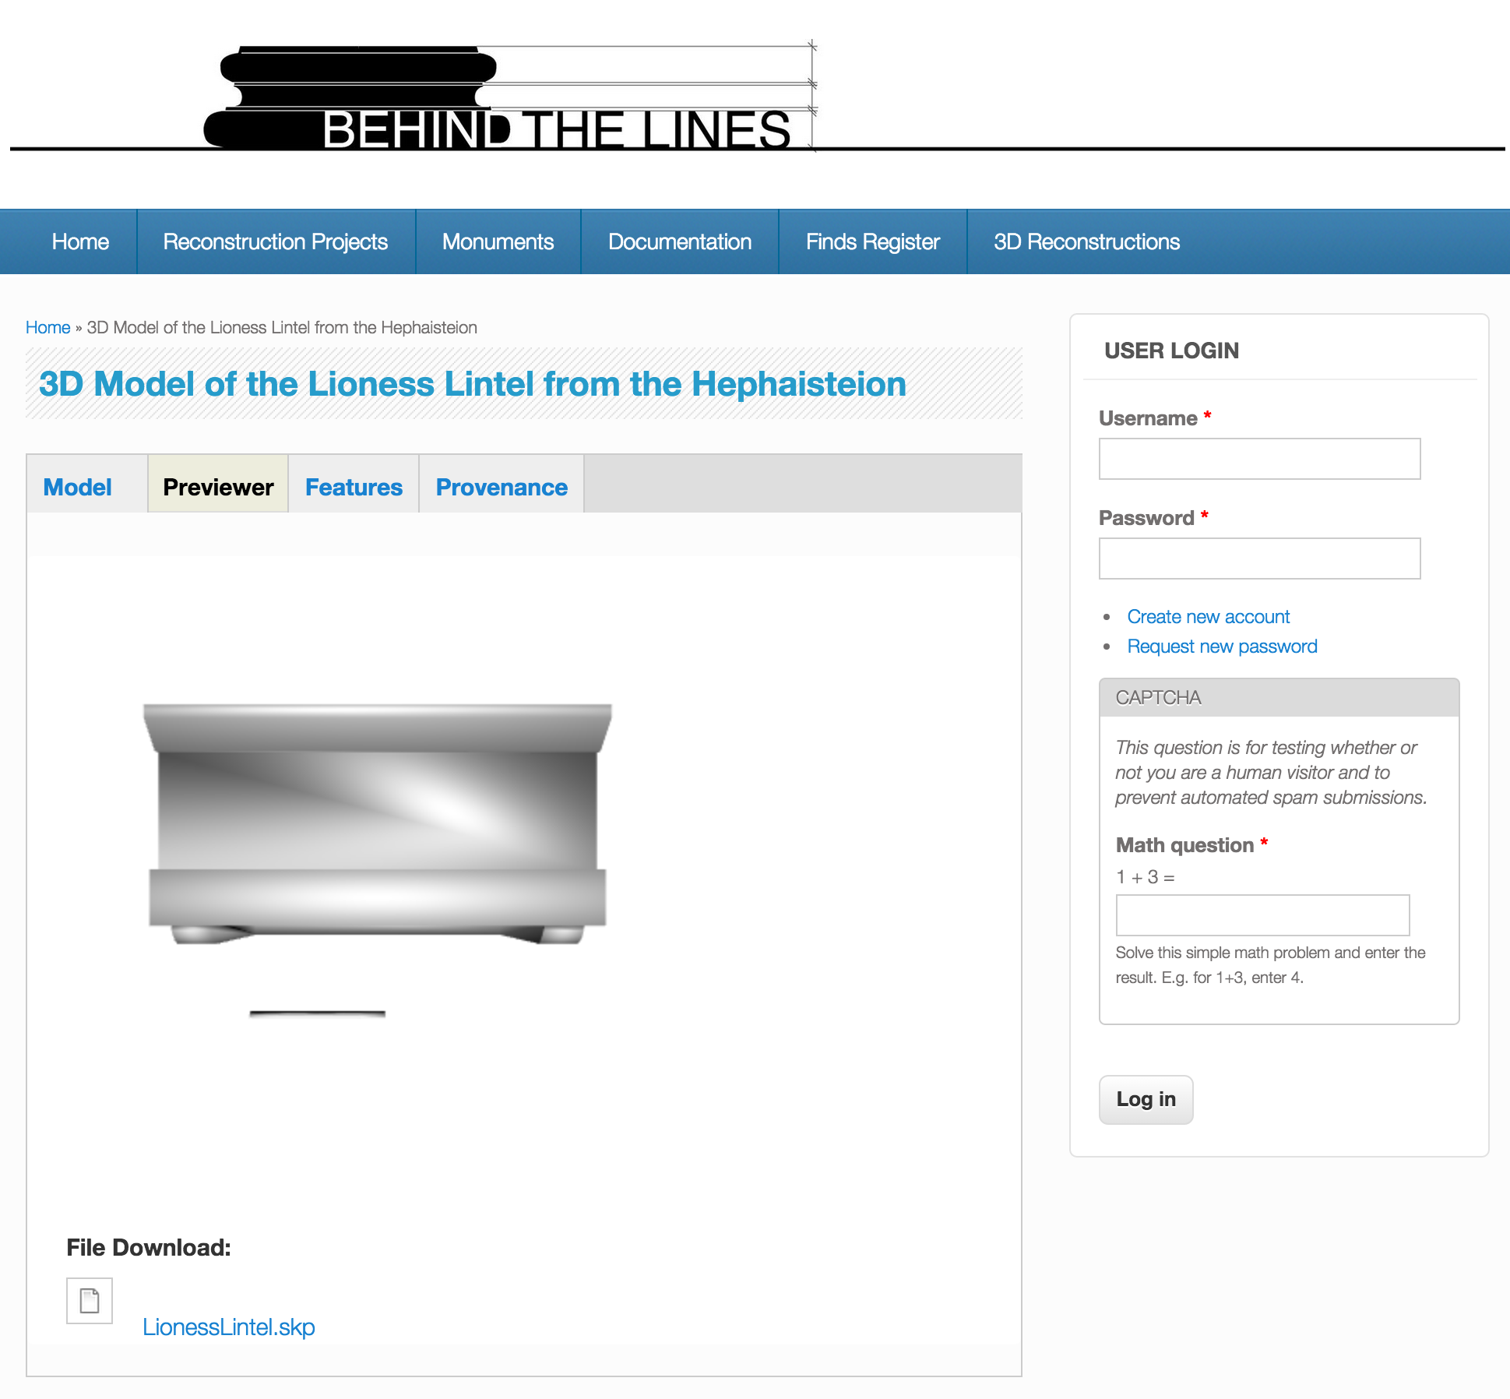
Building an Argumentation Platform for 3D Reconstruction using CIDOC-CRM and Drupal
Introduction / Proposal / Implementation / Results / Next steps
3D Model Metadata
Models
3D Model

Slide 28
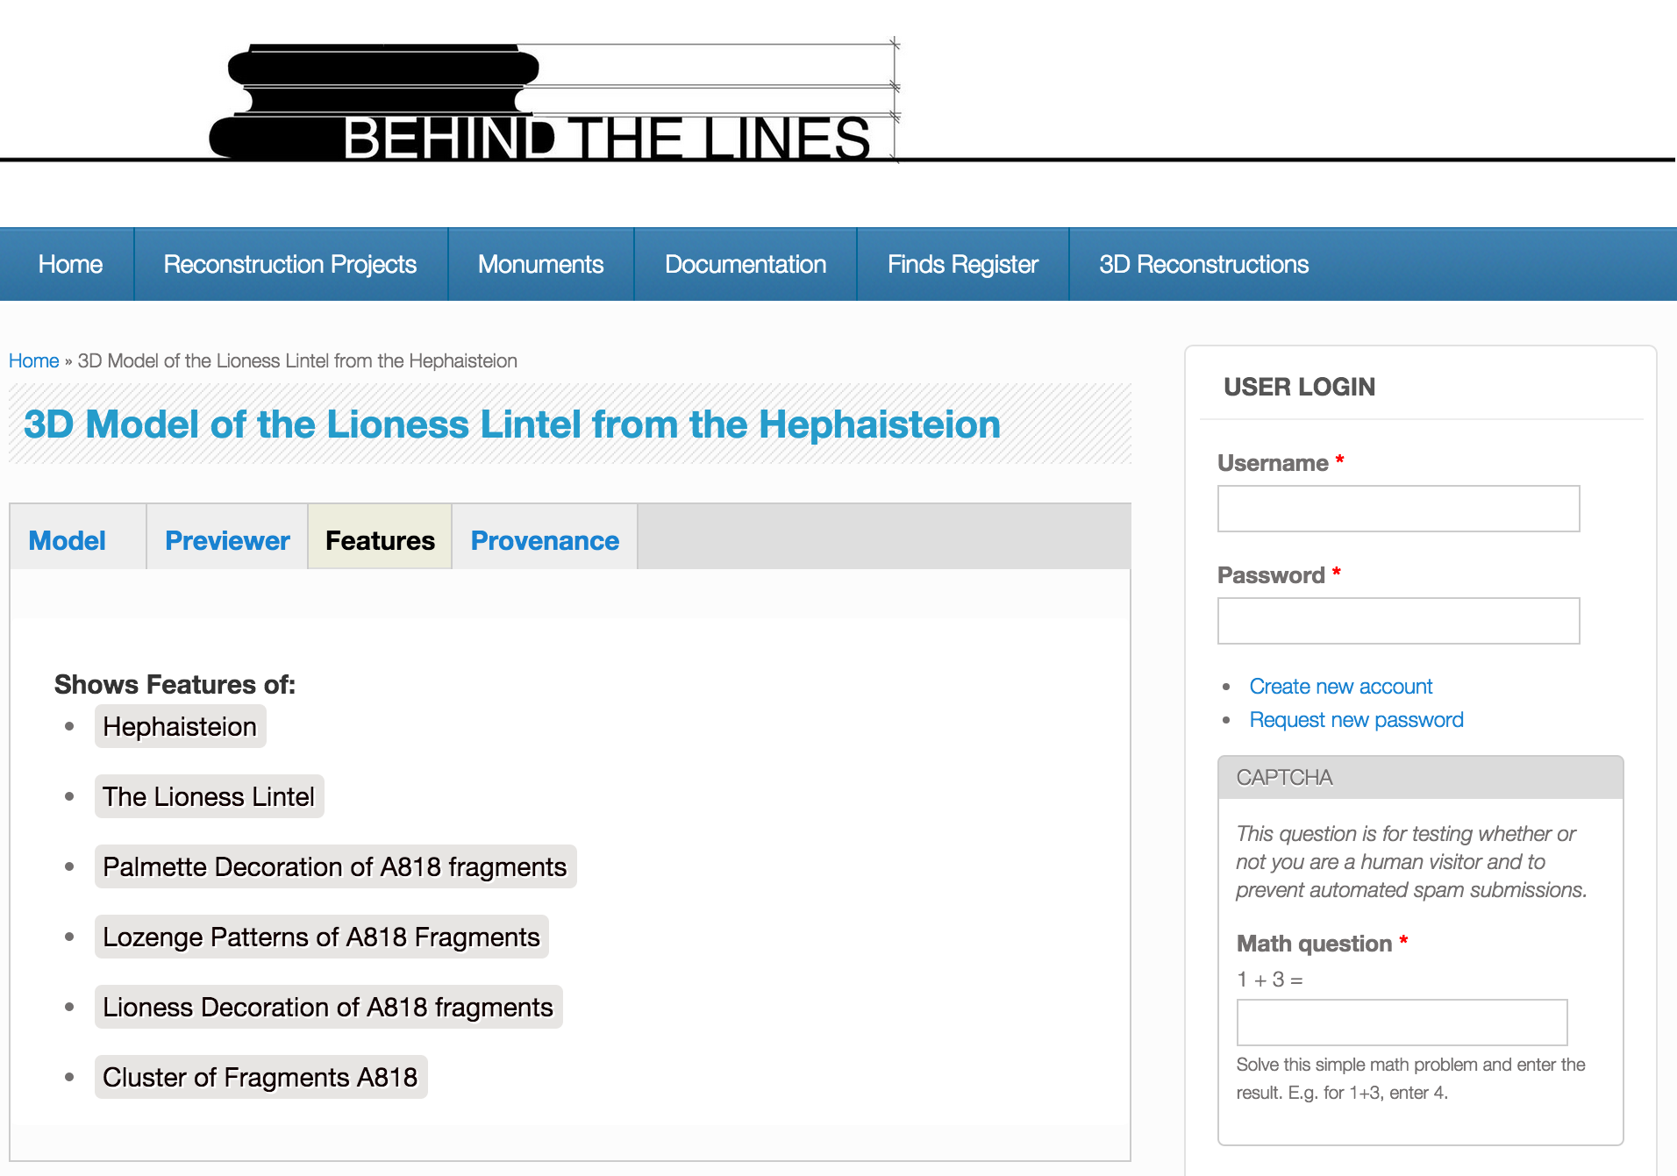
Building an Argumentation Platform for 3D Reconstruction using CIDOC-CRM and Drupal
Introduction / Proposal / Implementation / Results / Next steps
3D Model Metadata
Models
3D Model

Slide 29
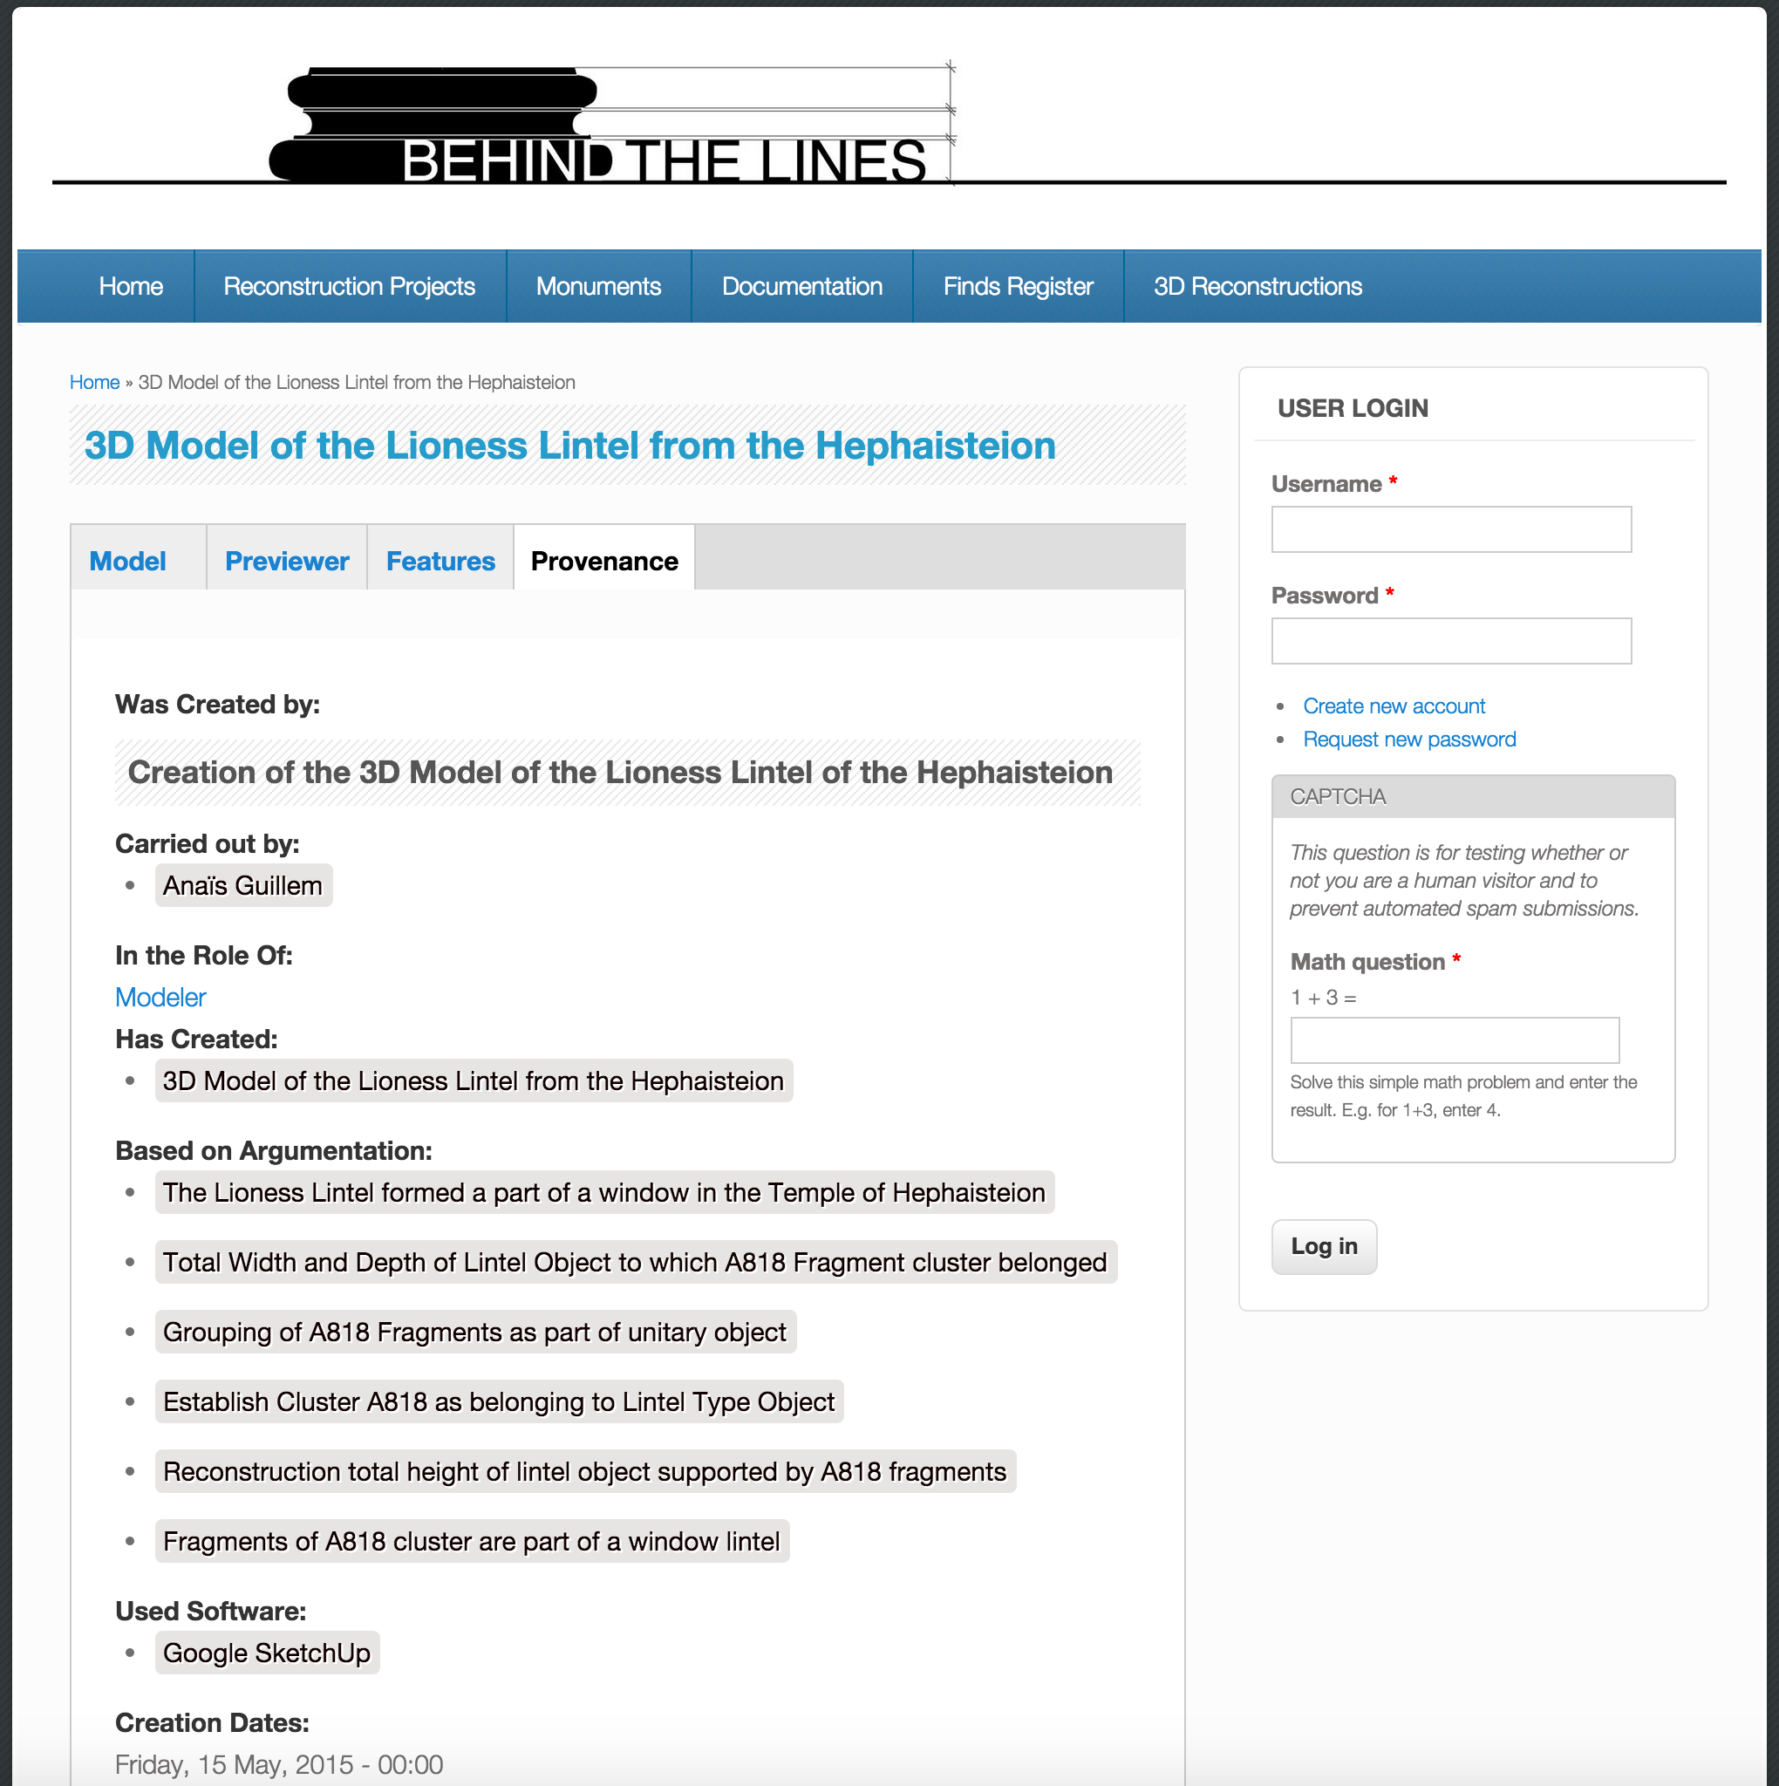
Building an Argumentation Platform for 3D Reconstruction using CIDOC-CRM and Drupal
Introduction / Proposal / Implementation / Results / Next steps
3D Model Metadata
Models
3D Model

Slide 30
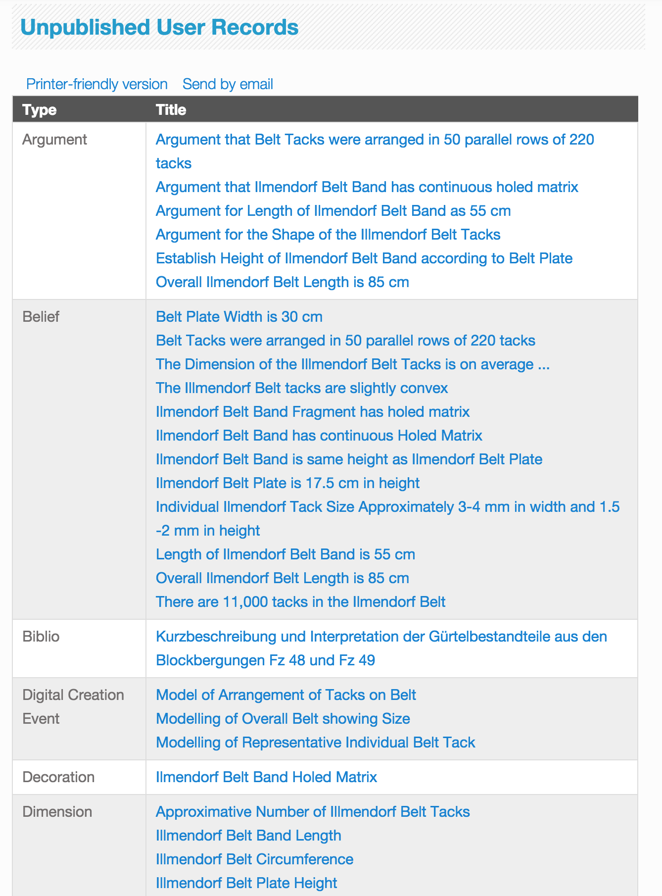
Building an Argumentation Platform for 3D Reconstruction using CIDOC-CRM and Drupal
Introduction / Proposal / Implementation / Results / Next steps
Result - Integrated Data Review for:
Actions
Project
Documentation Research
Acquisition Campaign
Argumentation
Modelling
Documentation
Bibliographic Collections
Bibliography
Documents
Propositions
Buildings
Building
Building Element
Models
3D Model

Slide 31
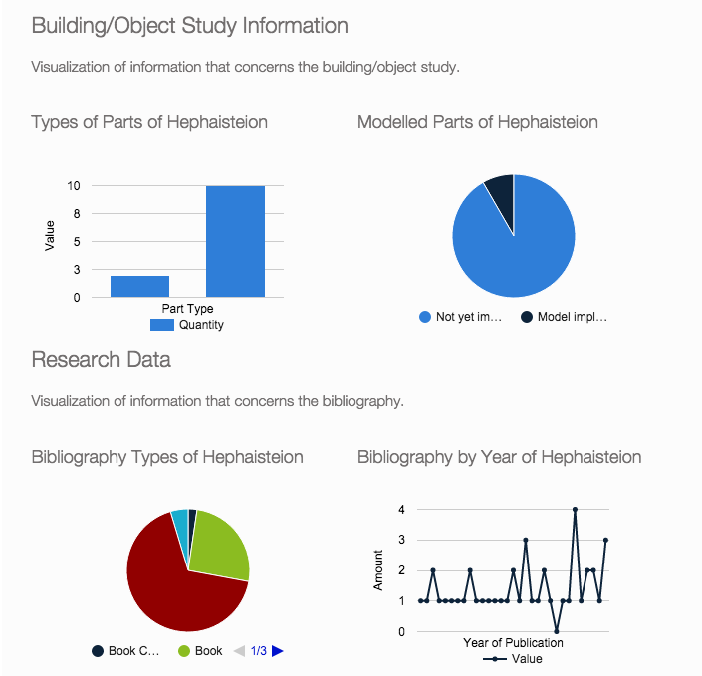
Building an Argumentation Platform for 3D Reconstruction using CIDOC-CRM and Drupal
Introduction / Proposal / Implementation / Results / Next steps
Project Data Overview Graphs (in dev)
Actions
Project
Documentation Research
Acquisition Campaign
Argumentation
Modelling

Slide 32
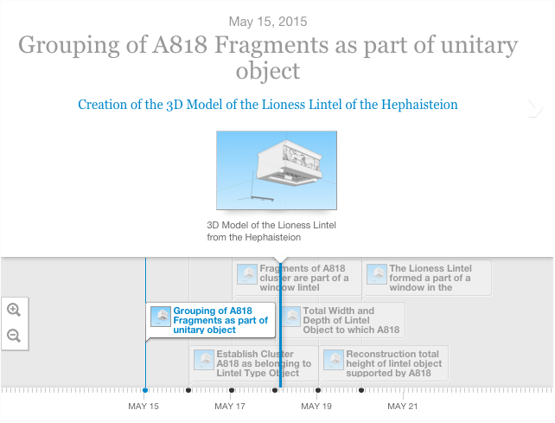
Building an Argumentation Platform for 3D Reconstruction using CIDOC-CRM and Drupal
Introduction / Proposal / Implementation / Results / Next steps
Project Argumentation Timeline Presentation (in dev)
Actions
Project
Documentation Research
Acquisition Campaign
Argumentation
Modelling

Slide 33
Building an Argumentation Platform for 3D Reconstruction using CIDOC-CRM and Drupal
Introduction / Proposal / Implementation / Results / Next steps
Conclusions
Positive
Problematic
Implemented a project based system that links 3D models to provenance data
Implementation of Complex Data Model which is reasonably easy to use
Nice demonstration of possible aggregation of data
Where to draw the line in argumentation?
Difficulty practically of entering argumentation information
Lack of sophistication of 3D tool applied (show which part shows what, what happens when argumentation changes?)

Slide 34
Building an Argumentation Platform for 3D Reconstruction using CIDOC-CRM and Drupal
Introduction / Proposal / Implementation / Results / Next steps
Next steps
Further elaboration of Hephaisteion Case (parts to whole)
More Test Cases with different monuments and objects
Systemization of Argument Logics
test against / aline with Demetrescu EM system
Visualizations through Graphs (module exists but unusable)
RDF Expression (Downloadable or Queryable)
Interactive Interface between 3D Viewer and DB
Parametric Object Library

Slide 35
Building an Argumentation Platform for 3D Reconstruction using CIDOC-CRM and Drupal
Introduction / Proposal / Implementation / Results / Next steps
Thank you!
behindthelines.eu
CRM-SIG
Prato, Feburary 2016

