Slide 1
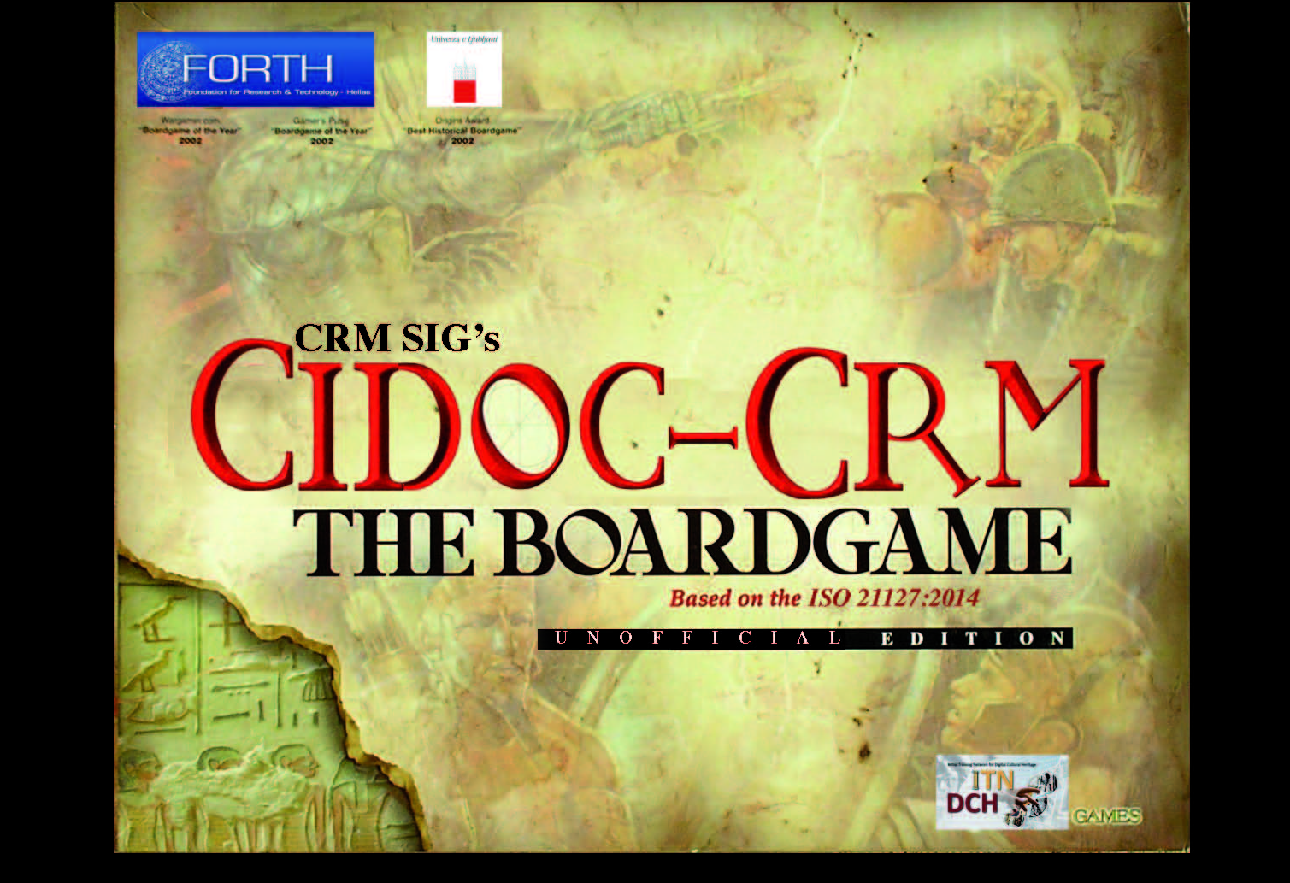
CIDOC CRM Game / CRM SIG / 02-2016

Slide 2





Initial Training Network - Digital Cultural Heritage
George Bruseker
ICS-FORTH
Anaïs Guillem
UL-FGG
Research Activity undertaken in context of ITN-DCH Marie Curie Secondment Exchange

Slide 3
A Serious Game for Hands-on CRM Learning
Concept:
Create a tool for introducing formal ontology/CRM concepts to workshop participants and have them practically interact with the method.
Solution:
Deliver a short, practical introduction to Formal Ontology, its use, its meaning and its functional properties, specifically focussing on methods of mapping as an introduction to:
CRM Game, a CRM based card game, having decks of cards representing CRM Classes and Relation as well as a Case-Study Source Data card set, to allow learners to work in groups to apply concepts introduced above.

Slide 4
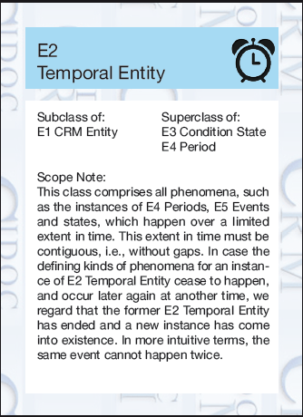

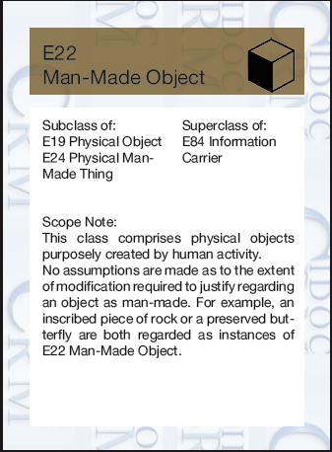
CIDOC CRM Game/ Entities Cards Set
Set of Entity Cards:
Front / Back / Color Code:
Temporal Entities
Actors
Physical things
Conceptual things
Appellation
Types
Places

Slide 5
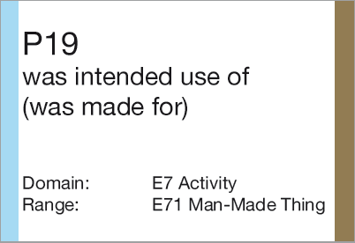
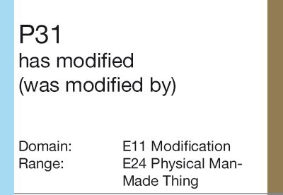
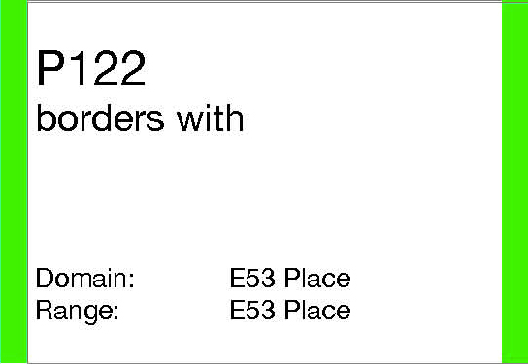
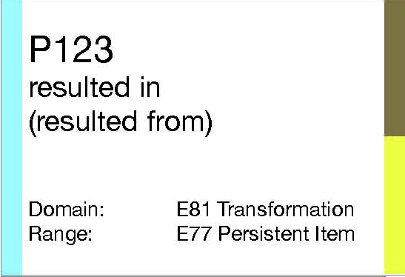
CIDOC CRM Game/ Property Cards Set
Set of Property Cards:
Front / Back / Color Code:
Temporal Entities
Actors
Physical things
Conceptual things
Appellation
Types
Places

Slide 6
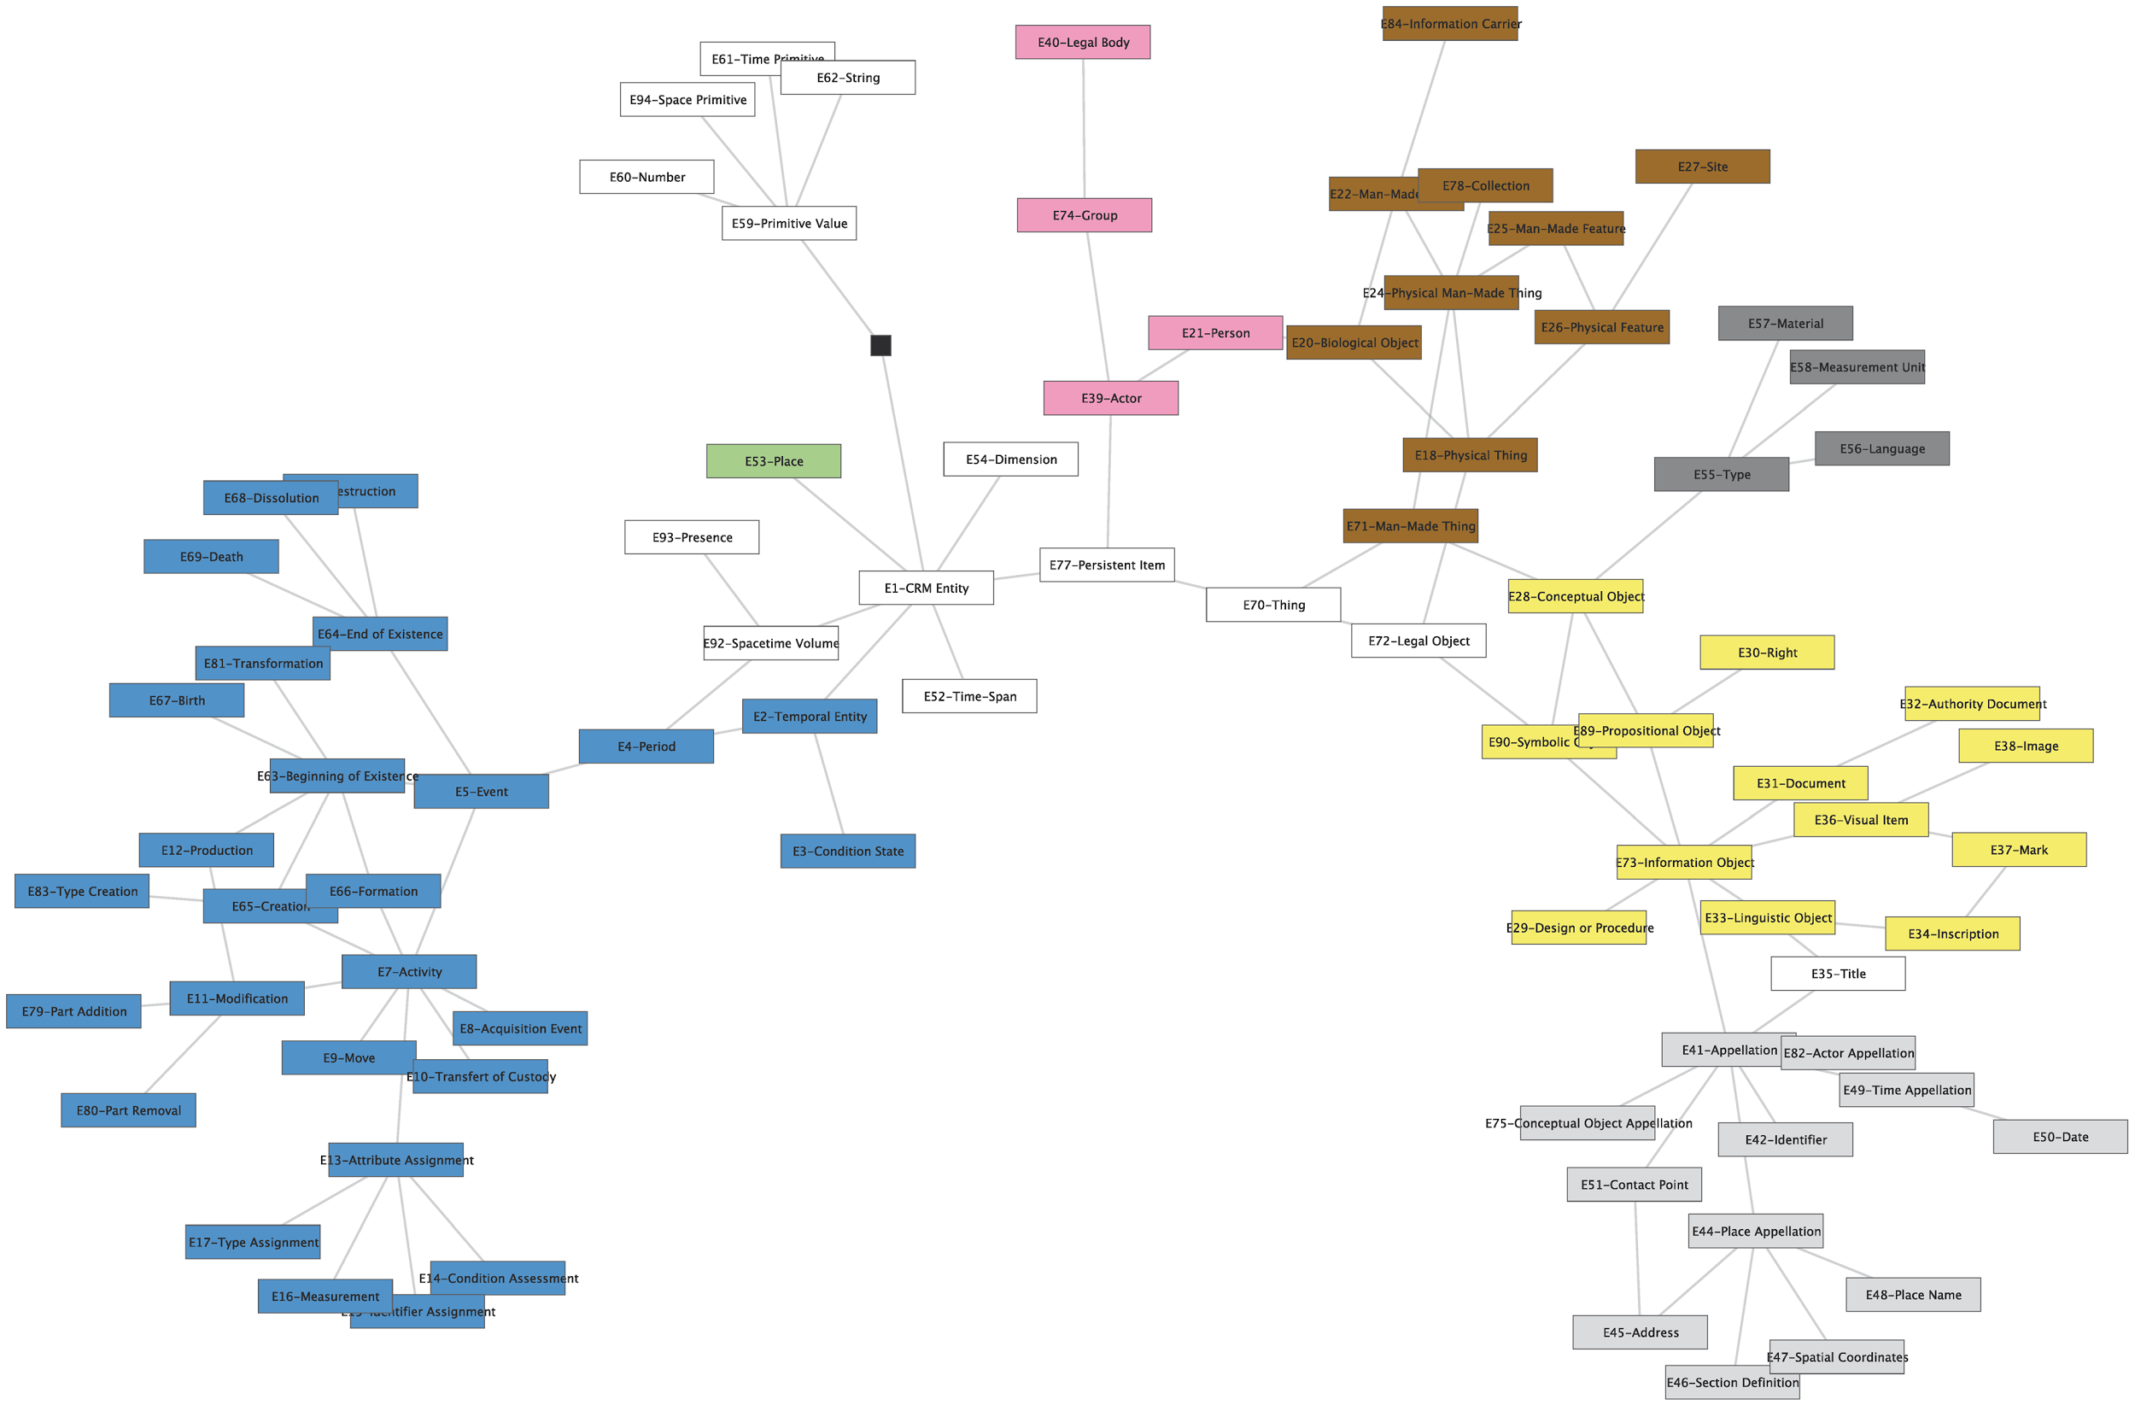
Core-CRM Graph to help the location of Entities in the CRM IsA hierarchy

Slide 7
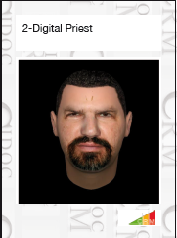
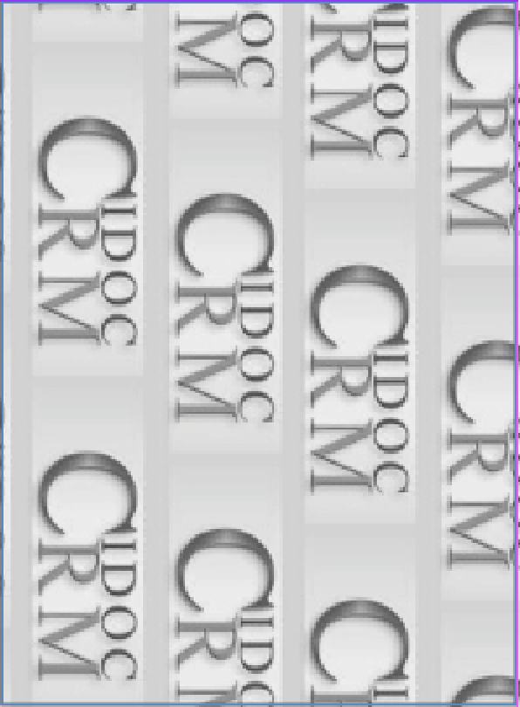
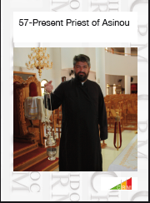
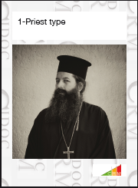
CIDOC CRM Game/ Case-study Cards Set
Case-Study Cards Set:

Slide 8
Initial CRM Game Mechanism Concept
Players separated into teams that work together collaboratively.
For each round, two parts:
5 class cards drawn from CRM Entities Deck and 5 from Case Study Deck.
Goal: try to match instances represented by Case-study cards to Classes of CRM.
Extra points given for creating connections (allowed to use all relation cards) between drawn cards, appropriately applying relations.
At end of each round (10 mins), teams assess score with help of game supervisor.
1 point for each correct match of instance to class,
2 points for each correct relation.
Photo taken of solution (useful to show both correct interpretations, but also common mistakes in the raw).

Slide 9
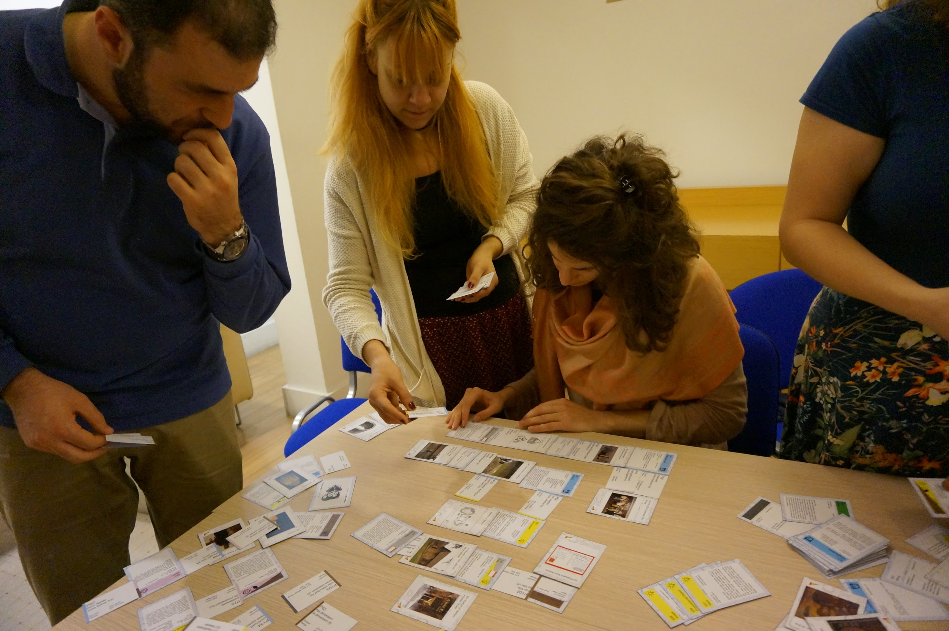
The Game Activity: how to use CRM Entities and Properties? What is a Scope Note?

Slide 10
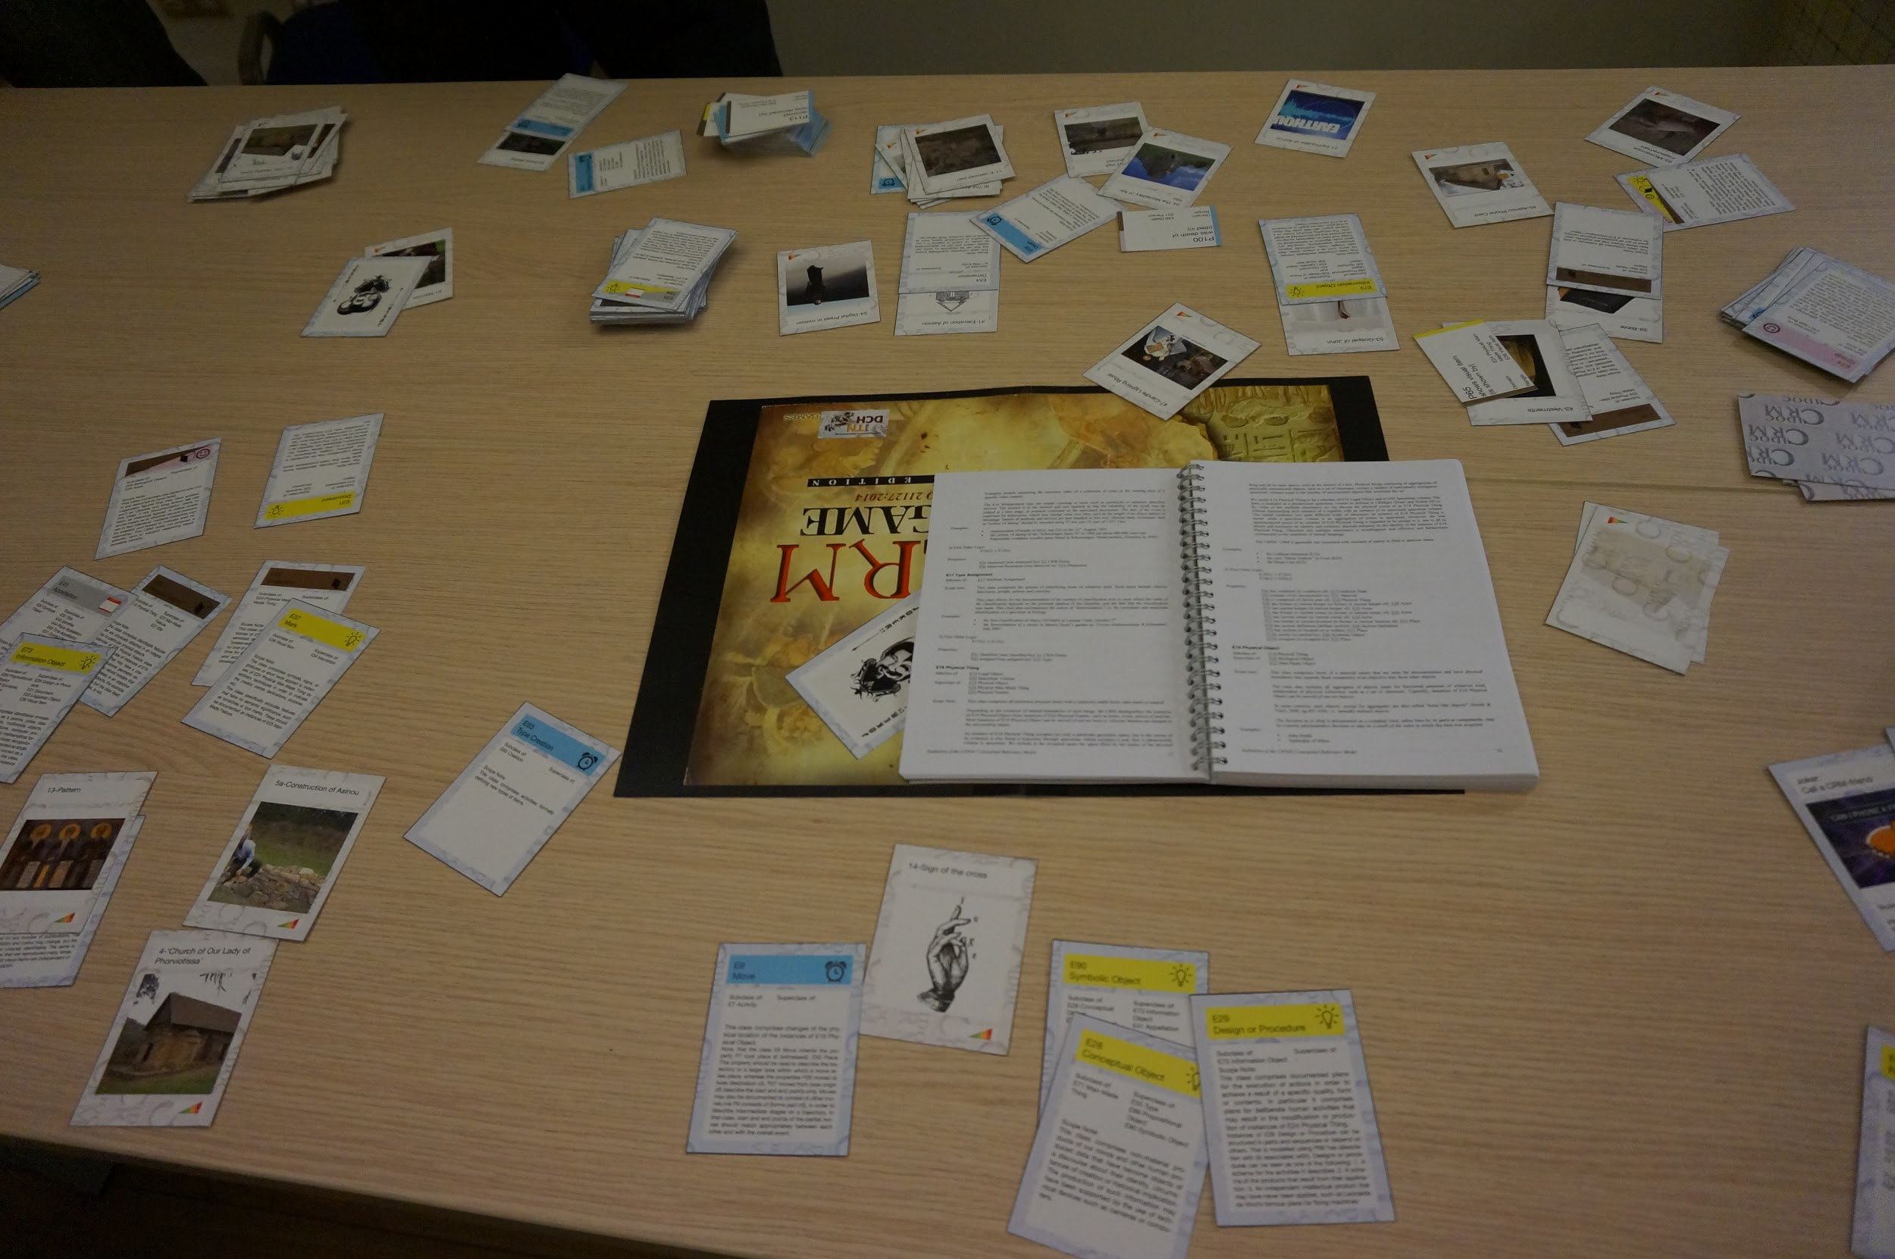
The Game Activity: CRM manual (A5 format) to check the Scope Notes

Slide 11
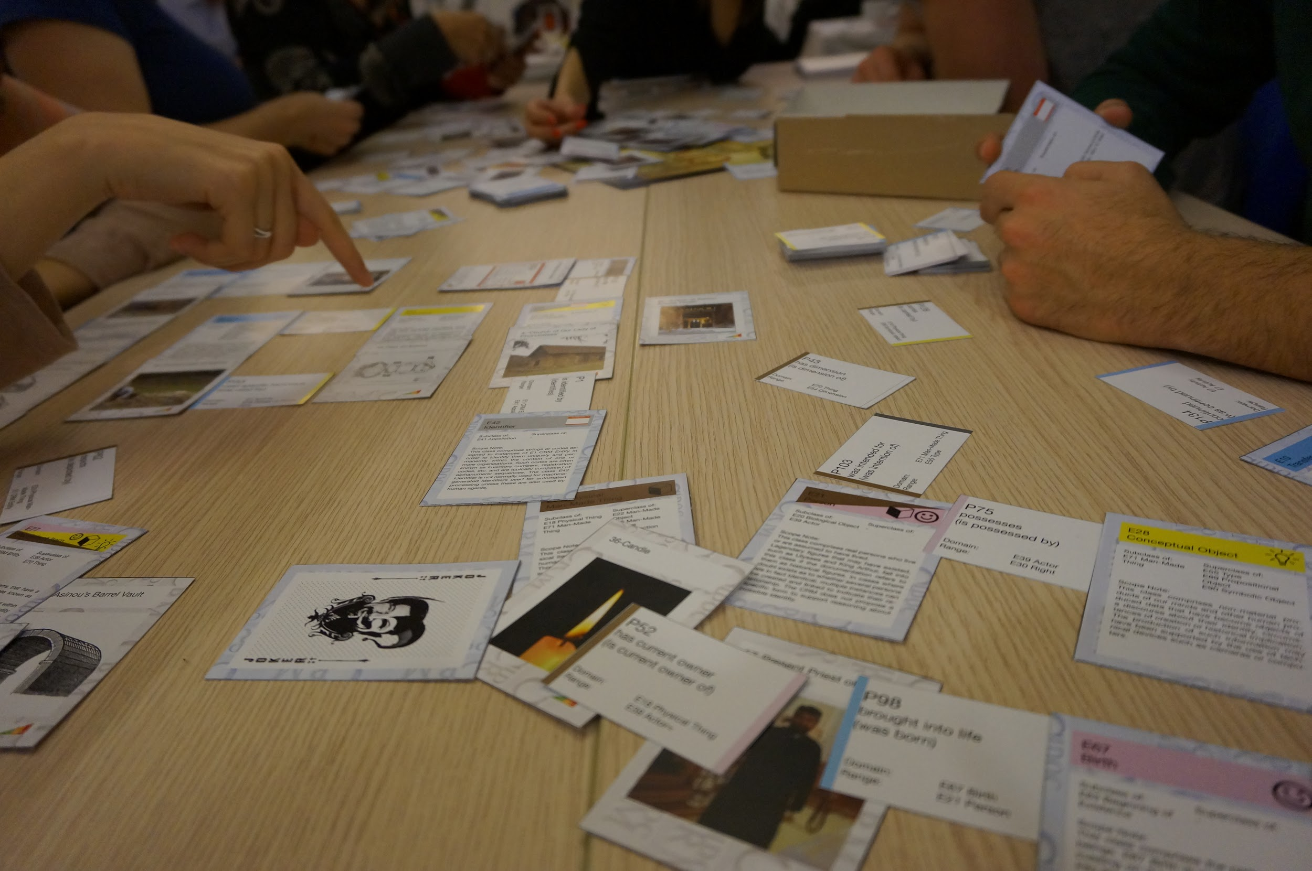
The Game Activity: discussion about the Entity that could fit with an Instance Card

Slide 12
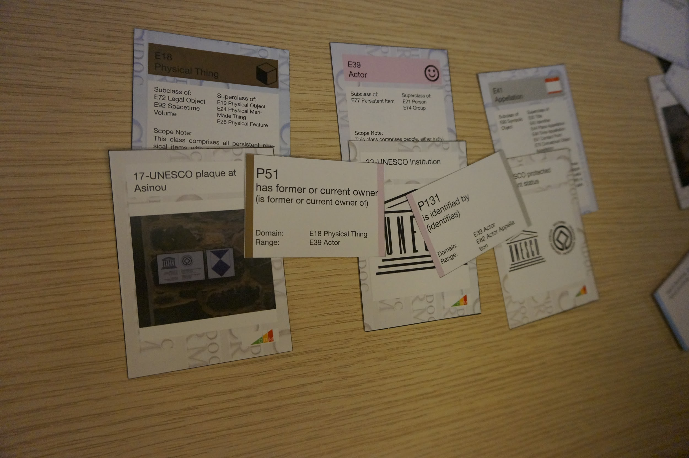
The Game Activity: Example of Matching Results at the end of the activity

Slide 13
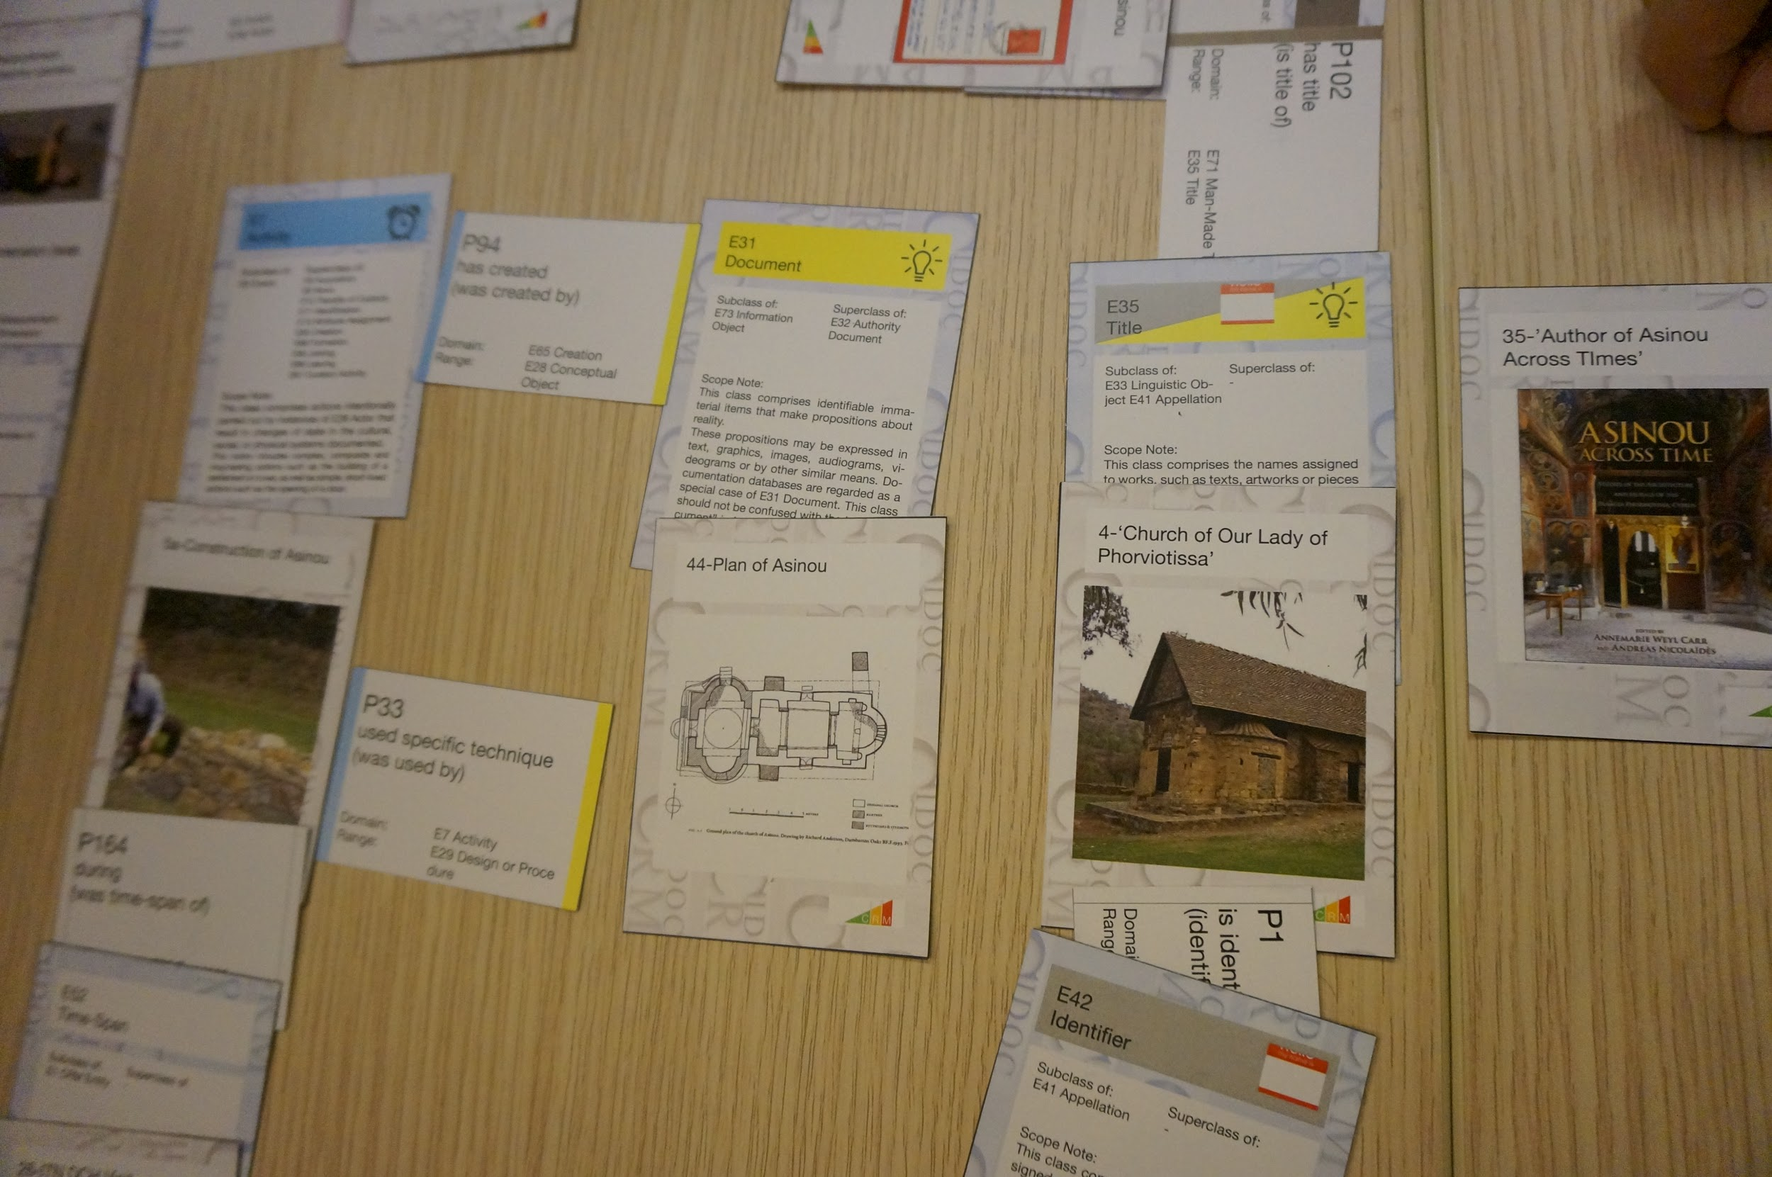
The Game Activity: Example of Matching Results at the end of the activity

Slide 14
Feedback & Questionnaire: Questions (Google QUestionnaire):
-Background questions:
Had you heard about CIDOC-CRM before the workshop? How did you hear about CIDOC CRM?Which affirmation best represents you? Do you think that CIDOC-CRM is interesting and/or relevant to your work? In what way do you think that CRM is interesting and/or relevant your work?
-Formal Ontology / CRM Presentation Feedback:
Did you attend the presentation about CIDOC-CRM and formal ontology given before the game activity? Did the presentation before the workshop help you to understand and to play the CRM game? In what way did the presentation help you to understand and play the CRM game?
-CRM Game Feedback:
Did you participate in the CRM game activity? Did you enjoy the CRM game activity? What aspects did you like or dislike about the CRM game? Do you believe the CRM game helped you understand CIDOC-CRM? After the CRM game would you say you understand CIDOC-CRM?
-Next Steps Feedback:
Would you be interested in further training in CIDOC-CRM? What kind of additional CIDOC-CRM training would be of interest to you? Do you have any comments or feedback to improve the training activity you participated in?

Slide 15
Feedback & Questionnaire: Answers:
-Participants to the activity: -around 15 people,
during ITN-DCH workshop in Nicosia,
Dec. 2015
-Answers to the questionnaire: -9 answers
-Participant demographic: -PhD students, Professionals, Professors
-Fields: -CH researchers with various backgrounds
-Familiarity with CIDOC-CRM: -low

Slide 16
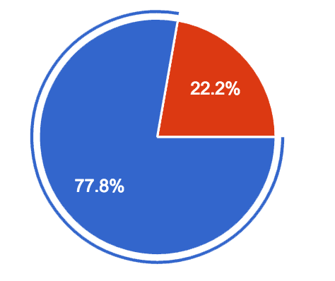
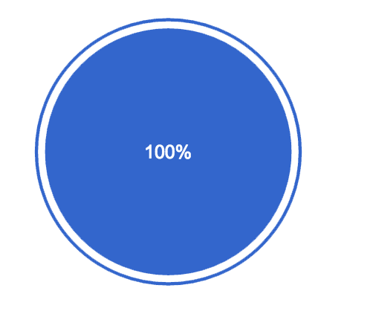
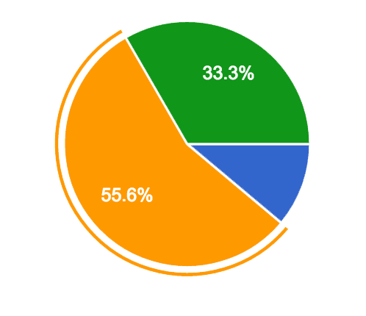
Feedback & Questionnaire: Background questions (1/3)
Had you heard about CIDOC-CRM before the workshop?
How did you hear about CIDOC CRM?
Which affirmation best represents you?
Yes
No
Presentation
Other answers possible: Training, Personal Research, Other
I am beginner in CIDOC-CRM
I don't know anything about CIDOC-CRM
I am expert of CIDOC-CRM

Slide 17
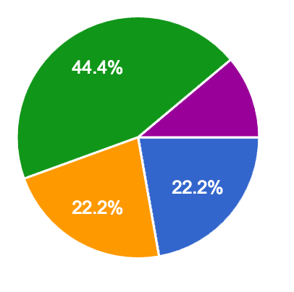
Feedback & Questionnaire: Background questions (2/3)
Do you think that CIDOC-CRM is interesting and/or relevant to your work?
Somewhat
Yes/Maybe
I don’t know
No

Slide 18
Feedback & Questionnaire: Background questions (3/3)
In what way do you think that CRM is interesting and/or relevant your work?
-Better organization of data and especially easier interpretation of outputs among different stakeholders.
-It will make my drawing pretty pictures seem more like science! No, seriously, being able to prove what you know and how you know it is very helpful for reconstructions...
-it's awesome.
-Maybe it is helpful to make me understand how the data I collect are linked among them or with other kind of data.
-Overall, i think is interesting at the work planning step, in order to implement a CIDOC CRM schema we have to have very clear what we have to do, the actors involved, the requirements, the equipment and its characteristics... and most important, the relations between them. And of course, a well planned work is normally a well done work. Also, at the processing step, i find very useful to record all the processing metadata in order to be able to distribute the results obtained.
-Data organisation, classification archiving.
-In order to organize and management all the information which is relevant in a CH project.

Slide 19
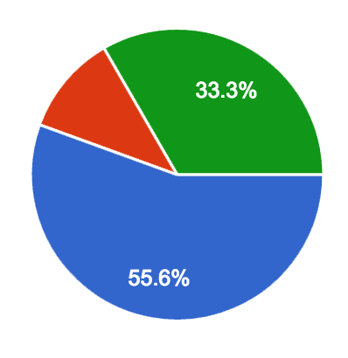
Feedback & Questionnaire: Formal Ontology / CRM Presentation Feedback (1/2)
Did you attend the presentation about CIDOC-CRM and formal ontology given before the game activity?
Did the presentation before the workshop help you to understand and to play the CRM game?
Yes
No
Yes
No
Somewhat
I don’t know/ Maybe

Slide 20
Feedback & Questionnaire: Formal Ontology / CRM Presentation Feedback (2/2)
In what way did the presentation help you to understand and play the CRM game?
-Understanding the CRM concept is crucial for CRM game. Since I am a beginner in CRM, the presentation gave me an important overview and understending of this concept.
-It helped me understand.
-It explained the theory.
-Overview of what the different categories/connections are.
-In the way that it was simple, concrete, without verbiage that i normally don't understand as it's not my field.
-To understand the connection among data.
-In understand how the different elements can be connected.

Slide 21
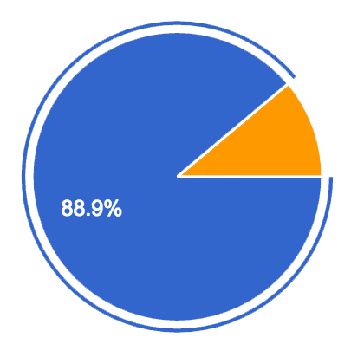
Feedback & Questionnaire: CRM Game Feedback (1/3)
Did you participate in the CRM game activity?
Did you enjoy the CRM game activity?
Yes
No
Yes
No
Somewhat

Slide 22
Feedback & Questionnaire: CRM Game Feedback (2/3)
What aspects did you like or dislike about the CRM game?
-I liked the cards
-I liked the fact that the game forces you to use the documentation and standards of interchange of cultural heritage information. In this way you can comprehend the concept.
-Cons: Very complex, a lot of categories, needs time Pro: challenge, interactive activity, open discussion, lots of thinking and abstraction capability needed.
-I liked the discussion and collaboration with other fellows in order to understand and connect data.
-I didn't really understand the categories/classes, e.g. "object". I got somehow familiar with them during the game, but I would like to have some more information. Otherwise I found it really nice to make us get involved with the concept in a practical way, because the presentations do not really help (at least me).
-It is not easy to understand because CIDOC-CRM is a complex concept, but the game is really a good option in order to improve the knowledge of the whole sytem.
-Gamification FTW - but it was a bit frustrating to have so many "useless" cards and have the ones that fit everywhere be gone very quickly. Needs more balance as an actual game - like Scrabble doesn't have an equal number of Qs and Es...
-I like the fact of practising with the CRM game, asking myself what is required in each field, being aware of the list of possibilites you have in CIDOC CRM, and trying to fit my needs to them I dislike the time period that was given for the activity, it would have been useful to perform and complete a full process.

Slide 23
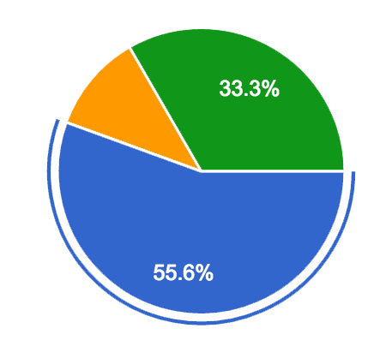
Feedback & Questionnaire: CRM Game Feedback (3/3)
Do you believe the CRM game helped you understand CIDOC-CRM?
After the CRM game would you say you understand CIDOC-CRM?
Yes
More
Same
Less
Somewhat
Maybe

Slide 24
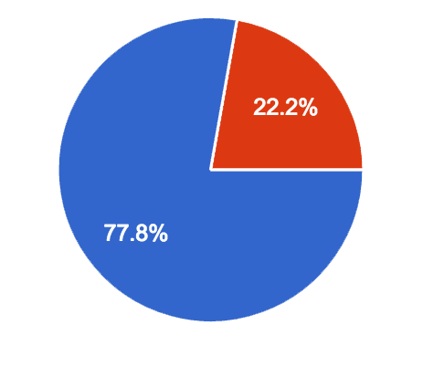
Feedback & Questionnaire: Next Steps Feedback (1/1)
Would you be interested in further training in CIDOC-CRM?
What kind of additional CIDOC-CRM training would be of interest to you?
-More activities like that, to learn the basic. No need to get into details, it's too complicated.
-How to build an actual schema? How to pass from the schema to implementing an actual Database?
-I woud like apply to a real case
-Practical one
-Honestly: I appreciate that someone's taken time to figure out a system for classfying connections and data relations like that so I don't have to. I'd like to learn to use it properly *if* it's relatively simple and *if* more people use it, so it's not just a niche thing, but a relevant tool. A bit like a programming language, I suppose. I learn C# to get a job done, not as an end in and of itself...
Yes
No

Slide 25


Game Mechanism Evaluation
What worked in game mechanism?
-Haptic engagement with concepts of Classes, Relations, IsA hierarchy, harmonization to a Standard encouraged interest.
-Grouping into teams created situation of positive dialogue where real ontological modelling and mapping issues were naturally raised and discussed.
-Higher level categorization of Classes and Relations using colour thematic helped learners frame inquiry.
-Convenient sized (A5) CRM manual, became an active tool for learners who learned the importance of consulting scope notes.
-Case-Study set was very good for engaging learners who were deeply familiar with the data in question (humorous cards and card combinations highly encouraged participation).
Interactive,
hands-on,
team activity
Dialogue to discover
Interesting and entertaining case study cards

Slide 26
Game Mechanism Evaluation
What didn’t work in game mechanism?
-The physical number of cards is a pragmatic issue, each team given one set of classes and relations but in fact some cards probably needed much more than others.
-Difficulty level of grasping the mapping problem and especially relations building problem meant game rounds were much longer than 10 minutes (not so game like).
-Colour thematic was misleading to some users, making them believe they could match Classes and Relations just based on colour.
-A clear and complete presentation of class and relation hierarchies would have helped the comprehension of application of IsA much better (as important as CRM manual).
# of cards
Game scenario
Risk of misinterpretations
of Colour Scheme

Slide 27
Concept Learning Evaluation
What concepts seemed best grasped?
Top level class in CRM between Things, Concepts, Actors etc. and how they are distinct was well received.
Power of CRM to represent a wide array of CH data sets.
Join of Classes to Classes through relations that are restricted.
Evaluations stress that ‘complexity’ of CRM was made less daunting by working with concepts directly rather than listening to presentations.

Slide 28
Concept Learning Evaluation
What concepts seemed to pose greatest challenge?
Full expressivity of IsA hard to communicate/grasp in practical context immediately.
Application of mapping beyond game in real world systems.
Full meaning of Domain-Target Restrictions of application of relations, not fully comprehended by all participants.
Bias against perceived ‘complexity’ of CRM not overcome.

Slide 29
Next Steps?
New Game Mechanism Ideas.
Determination of Proper Card Numbers (Scrabble analogy).
Building Case Study deck with general familiarity and provoking appropriate modelling/mapping problem discussions.
Further testing of game in workshops for ability to communicate concepts/engage learners.
Consider means of reusing mapping solutions (good and bad) as teaching material.
Explore method to connect this ‘play’ to real CRM application scenarios (strong desire to see implemented systems/implementation of systems) - could be topic of workshop on top of this one.

Slide 30


