Slide 1
CRMgeo: Integration of CIDOC CRM with OGC Standards to model spatial information
Martin Doerr, Gerald Hiebel,
Institute of Computer Science
Foundation for Research and Technology – Hellas, Crete, Greece
May, 2013

Slide 2
Overview - Methodology
  Refining the place concept of the CIDOC CRM ontology
    Phenomenal Place based on Spacetime Volume and Reference Space
    Declarative Place based on Place Expression and Coordinate System
  Geoinformation Standards
    Abstract and Implementation Specifications
    “GeoSPARQL” Standard
  CRM Extension in RDFS implements refined Place concepts to link CRM with GeoSPARQL
  Model applied to Gazetteers
  Spatiotemporal extension CRMgeo

Slide 3
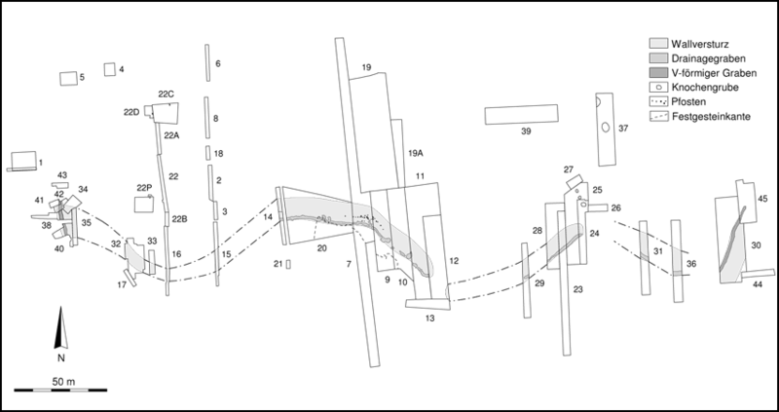
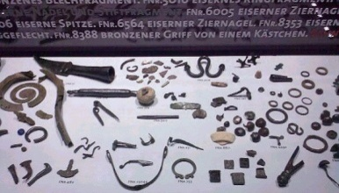
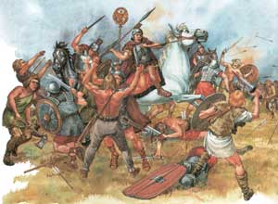
Phenomenal and Declarative Place
Example of the Varus battle
Excavation, Documentation
& Measurement
Evidence from remains and tombs
Gathering and burying of roman remains
Battle remains and tombs
Varus battle 9 AD
Archaeologists
Roman Source
Battle
remains
Romans
Germans
Romans

Slide 4
  Phenomenal Places based on Spacetime Volumes and Reference Spaces
  The Varus battle was a true event -> it happened in a Phenomenal Space Time Volume
  It happened in a Reference Space that still exists (a space at rest in relation to today's middle european continental plate)
  The event of the Varus Battle has a reasonable projection on the reference space which we want to call a “Phenomenal Place”
  Phenomenal Places derive their identity through events or physical things over the phenomenal spacetime volume that they occupy

Slide 5
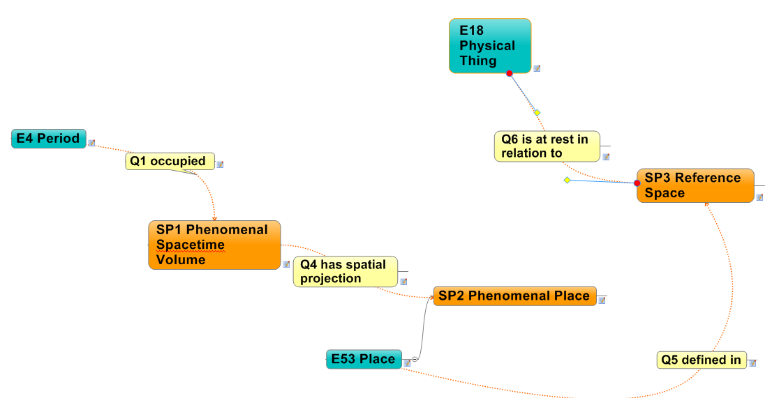
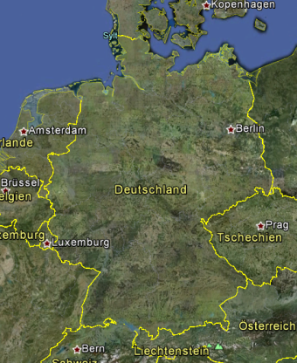
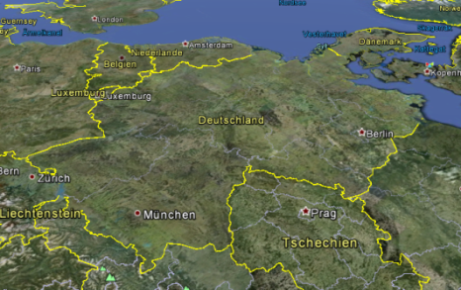


  Phenomenal Places
middle european continental plate
9 AD
Notes:
This class comprises the (typically Euclidian) Space (S) that is at rest (I) in relation to an instance of E18 Physical Thing and extends (U) infinitely beyond it. It is the space in which we typically expect things to stay in place if no particular natural or human processes occur.

Slide 6
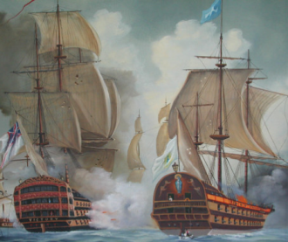





Moving Reference Spaces
Trajectory HMS
Reference Space HMS Victory
Battle Spacetime Volume
Phenomanal place
of the battle on the ship
Spanish ship is sunken
Battle snapshots
Spanish ship sinks - maximal extent of battle in ship reference space
Time
Spanish ship is on fire
Reference
Space
Seafloor
Fight starts
Remains of battle & spanish ship on seafloor
Phenomanal place of the battle on the seafloor

Slide 7
  Declarative Places based on Coordinate Systems and Place Expressions
  Locations within the Reference Space can be described using some kind of Spatial Coordinate Reference System that is fixed on Reference Points (Features)
  Geometric Place Expressions can be expressed in this Spatial Coordinate Reference System either to:
    state hypothesis of the location of the battle place derived of historic sources
    describe locations of measurements and interpolations
  Geometric Place Expressions define “Declarative Places” that are believed to approximate real locations (“Phenomenal Places”) of the battle or of measurements
  Declarative Places derive their identity through Place Expressions
  Declarative Places may approximate Phenomenal Places

Slide 8

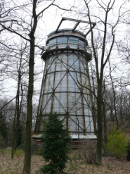
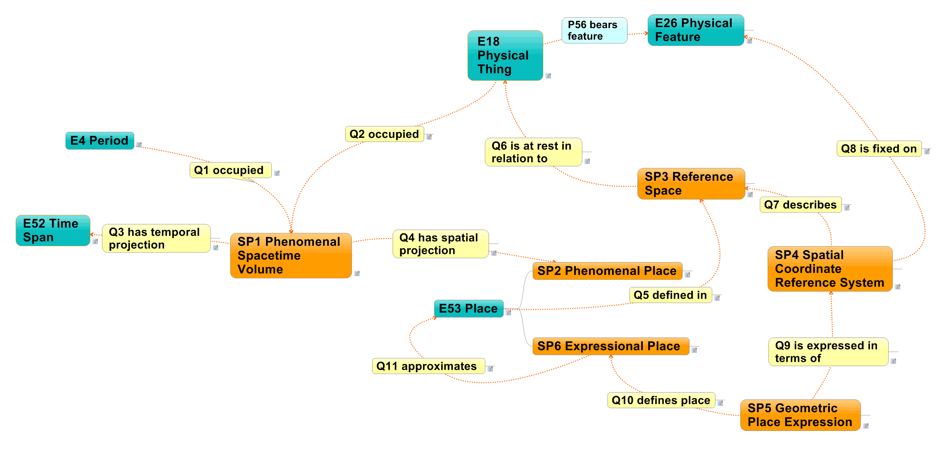

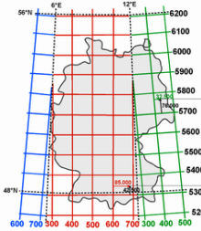

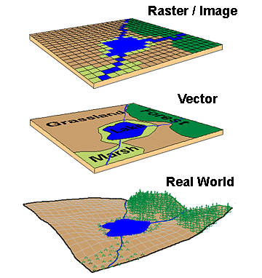
Declarative Places
middle european continental plate
9 AD

Slide 9
Standards in Geoinformation-
OGC and ISO 19100 Series
Open Geospatial Consortium (OGC)
Purpose: development of open standards for geospatial content
ISO/TC 211 (Geographic Information/Geomatics) ->
ISO 19100 Series - Geographic information
extensive volume of ISO Standards on Geographic Information
Abstract Specifications – defined in UML
e.g. Spatial Schema, Temporal Schema, Spatial Referencing by Coordinates or Geographic Identifiers
Implementation Specifications
e.g. Geography Markup Language (GML), Portrayal Services (WMS, WFS,…)
Notes:
9

Slide 10
OGC Standard “GeoSPARQL”
Overview
framework how to implement the OGC Standards (Abstract and Implementation Specifications) with semantic technologies through RDF/OWL encoding
definitions of SPARQL queries
OGC :
The goal for the OGC GeoSPARQL standard is to support representing and querying geospatial data on the Semantic Web. GeoSPARQL defines a vocabulary for representing geospatial data in RDF, and it defines an extension to the SPARQL query language for processing geospatial data.
Notes:
The OGC Standard “GeoSPARQL” is a framework how to implement OGC Standards (Abstract and Implementation Specifications) with semantic technologies through RDF/OWL encoding. Moreover it defines which SPARQL queries have to be available in an implementation in order to be compliant with the GeoSPARQL standard.
GeoSPARQL was submitted as Candidate Standard in 2011. The Standards Working Group adopded it on 12.6.2012.
10

Slide 11
5 Components of GeoSPARQL
Core
Topology Vocabulary Extension
Geometry Extension
Geometry Topology Extension
Query Rewrite Extension
Notes:
GeoSPARQL consists of 5 components.
A core component defines top-level RDFS/OWL classes for spatial objects. A geometry component defines RDFS data types for serializing
geometry data, RDFS/OWL classes for geometry object types, geometry-related RDF properties, and non-topological spatial query functions for geometry objects. A geometry topology component defines topological query functions. A topological vocabulary component defines RDF properties for asserting topological relations between spatial objects, and a query rewrite component defines rules for transforming a simple triple pattern that tests a topological relation between two features into an equivalent query involving concrete geometries and topological query functions.
11

Slide 12
GeoSPARQL Core Component
Core Component
  top-level RDFS/OWL classes for spatial objects
  SpatialObject
  superclass of everything feature or geometry that can have a spatial representation
  root class within the hierarchy of the GeoSPARQL ontology
  Feature
  Superclass of everything feature in GeoSPARQL
  “A feature is an abstraction of a real world phenomenon" [ISO 19101]
Notes:
Two main classes are defined: SpatialObject and Feature.
SpatialObject is the superclass of everything feature or geometry that can have a spatial representation and is the root class within the hierarchy of the GeoSPARQL ontology.
Feature is defined as superclass of everything feature in GeoSPARQL.
Within the ISO 19100 series a feature is an abstraction of a real world phenomenon.
The nature of features will be discussed in more detail, when we try to map it to the CRM.
12

Slide 13
GeoSPARQL - Geometry Component
  RDFS/OWL classes for geometry object types
  Geometry: root geometry class
  subclass of SpatialObject
  RDFS data types for serializing geometry data
  Serialization: coordinates are stored in a format which defines the sequence of the characters
    Well Known Text (WKT) as defined by Simple Features or ISO 19125
    Geography Markup Language (GML) as defined in ISO 19136
    These specifications (ISO 19125, ISO 19136) are also the base for subclasses of the geometry class. An RDF/OWL class hierarchy can be generated from the WKT or GML schema
POINT(49.40 -123.26)
<gml:Point srsDimension="2" srsName="http://www.opengis.net/def/crs/EPSG/0/4326">
<gml:pos>49.40 -123.26</gml:pos>
</gml:Point>
Notes:
This requirements class defines a vocabulary for asserting information about geometry data and it defines query functions for operating on geometry data.
As part of the vocabulary, an RDFS dataype is defined for encoding detailed geometry information as a literal value. A literal representation of a geometry is needed so that geometric values may be treated as a single unit. Such a representation allows geometries to be passed to external functions for computations and to be returned from a query.
A single root geometry class is defined: Geometry as a subclass of the SpatialObject class defined in the core component. In addition, properties are defined for describing geometry data and for associating geometries with features.
To represent the actual coordinates of a geometry, a so called Serialization is used. That means that the coordinates are stored in a format which defines the sequence of the characters.
Two formats are specified. One is Well Known Text (WKT) Serialization as defined by Simple Features or ISO 19125 and the other is a GML Serialization as defined in ISO 19136.
These specifications (ISO 19125, ISO 19136) are also the base for subclasses of the geometry class.
An RDF/OWL class hierarchy can be generated from the WKT or GML schema that implements GM_Object from ISO 19107 or its core profile ISO 19137.
13

Slide 14
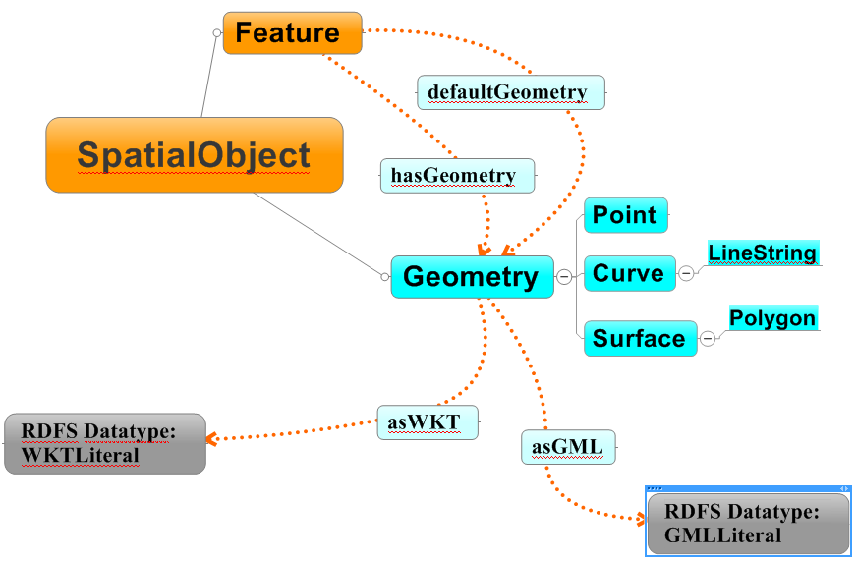
GeoSPARQL - Geometry Component
Notes:
This illustration shows the Core component classes (SpatialObject, Feature) and Geometry Class with its Properties. The Properties „asWKT“ and „asGML“ relate to the Serialization of a Geometry either in Well Known Text (WKT) or in Geography Markup Language (GML).
14

Slide 15
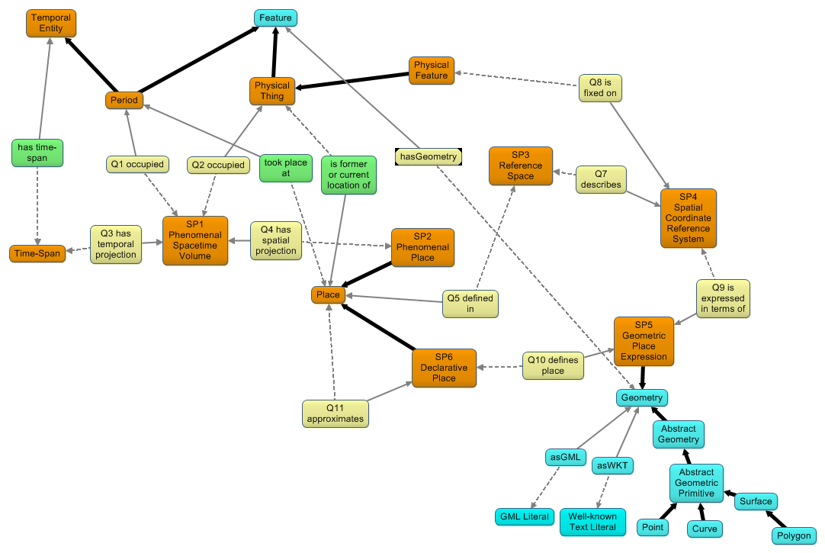
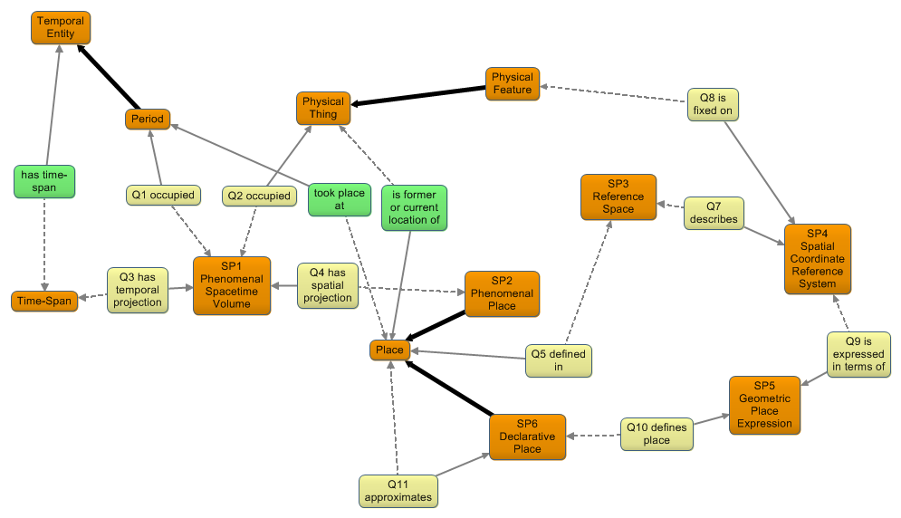
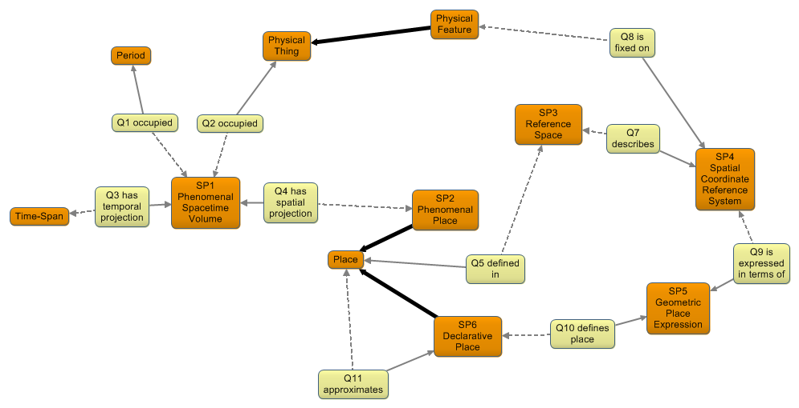

    Integration of CRM and GeoSPARQL
CIDOC CRM + CRM_{spatial}
Existing CRM properties
GeoSPARQL + RDF data types

Slide 16
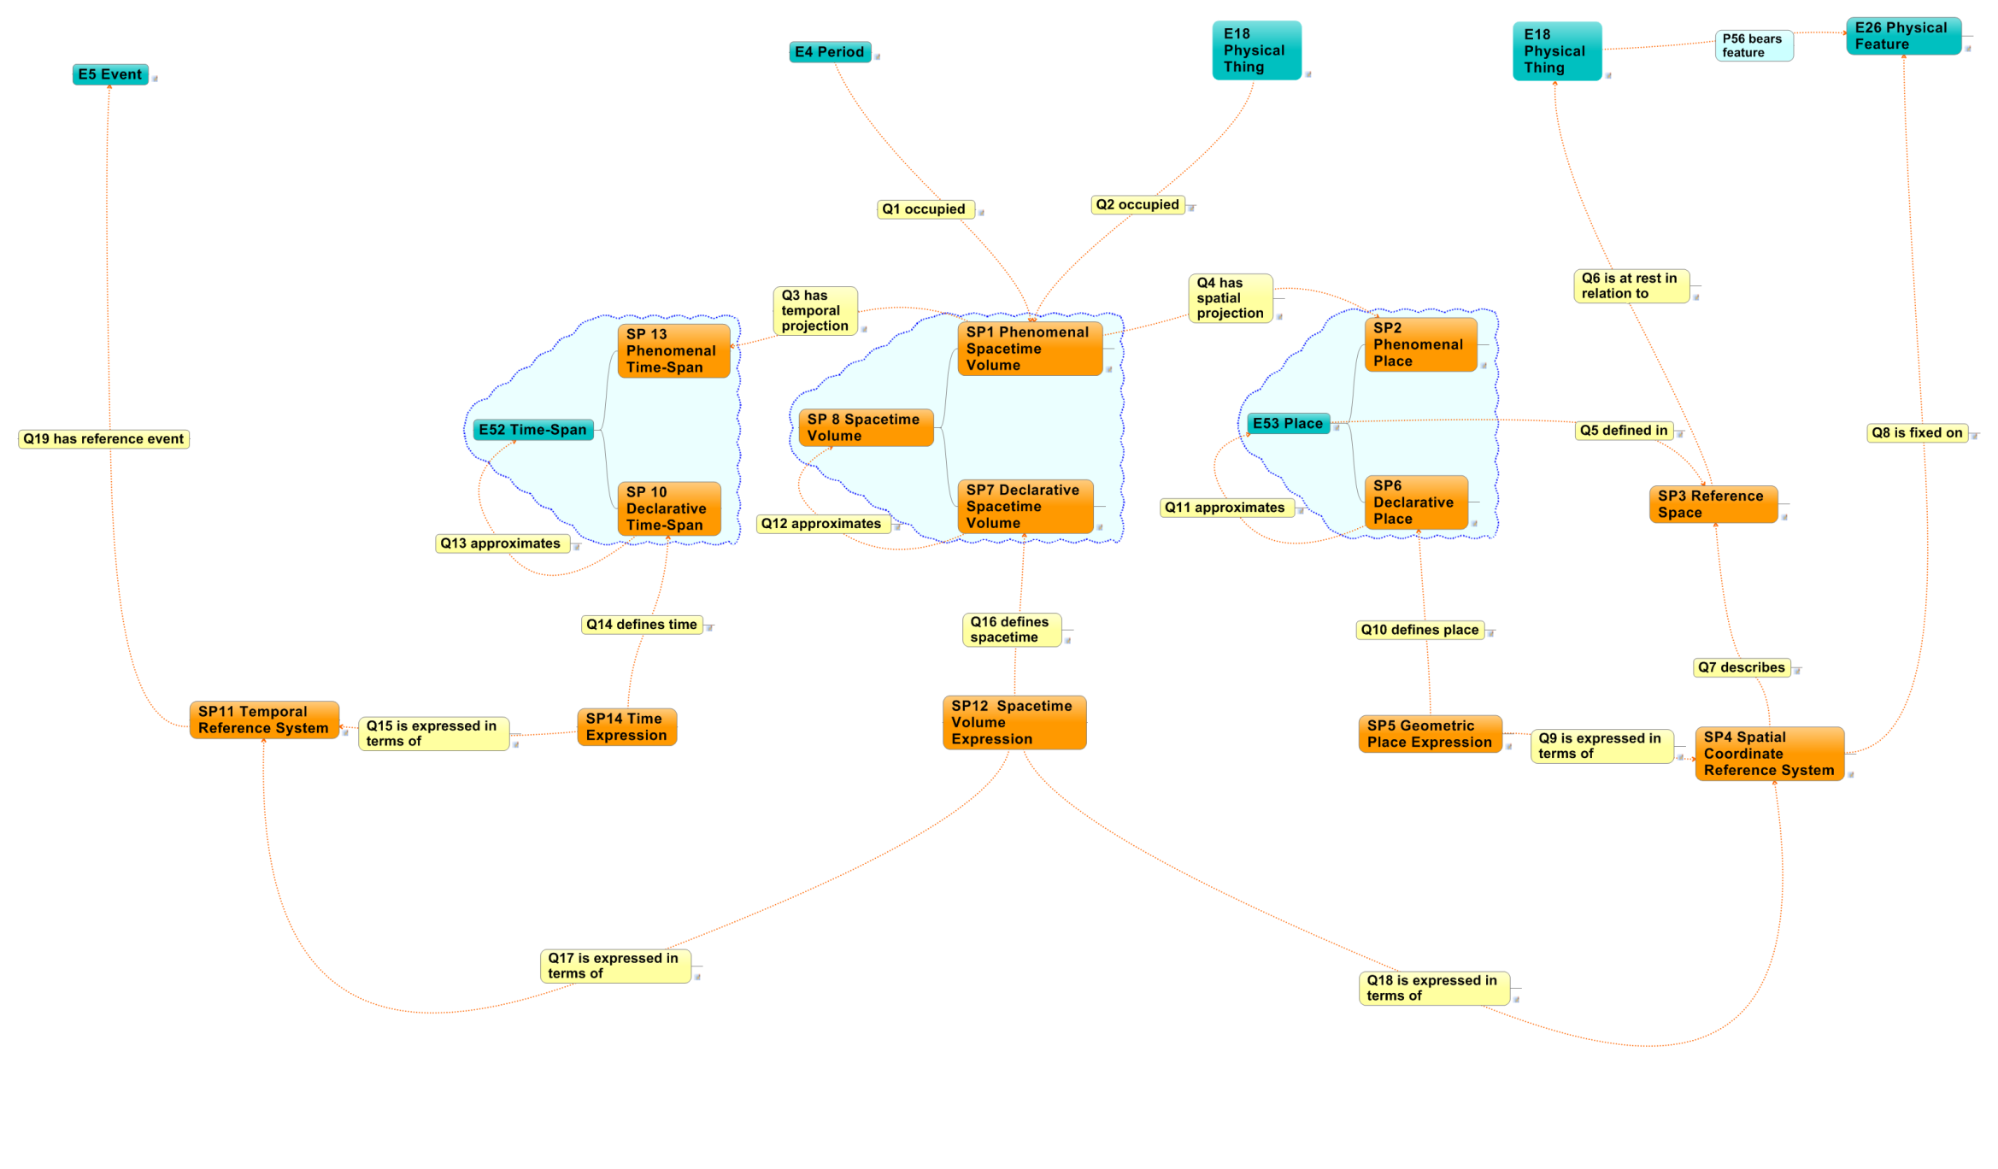
  Spatiotemporal extension CRMgeo
  1.1. Real world phenomena
  1. Phenomenal world
1.2. Space and time occupied by real world phenomena
2.2. Space and time defined by human expressions
  2. Declarative world
2.1. Human expressions to define space and time

Slide 17
Gazetteers
Gazetteers (as defined in ISO 19112) for Phenomenal Places
Location Types define the kind of phenomenal places
    e.g. countries, cities, physiographic features, mountains
Gazetteer Hierarchy can be split in phenomenal (is part of) and locational hierarchy (falls within)
    e.g. Mt. Everest (a mountain) is part of the Himalaya (mountain range)
    e.g. Stonehenge (archaeological site) falls within United Kingdom(country)
Coordinates in Gazetteers are Geometric Place Expressions that create Declarative Places with the goal to approximate Phenomenal Places
As Phenomenal Places are a projection of a Spacetime Volume the time of the phenomena is important information which is often not provided

Slide 18
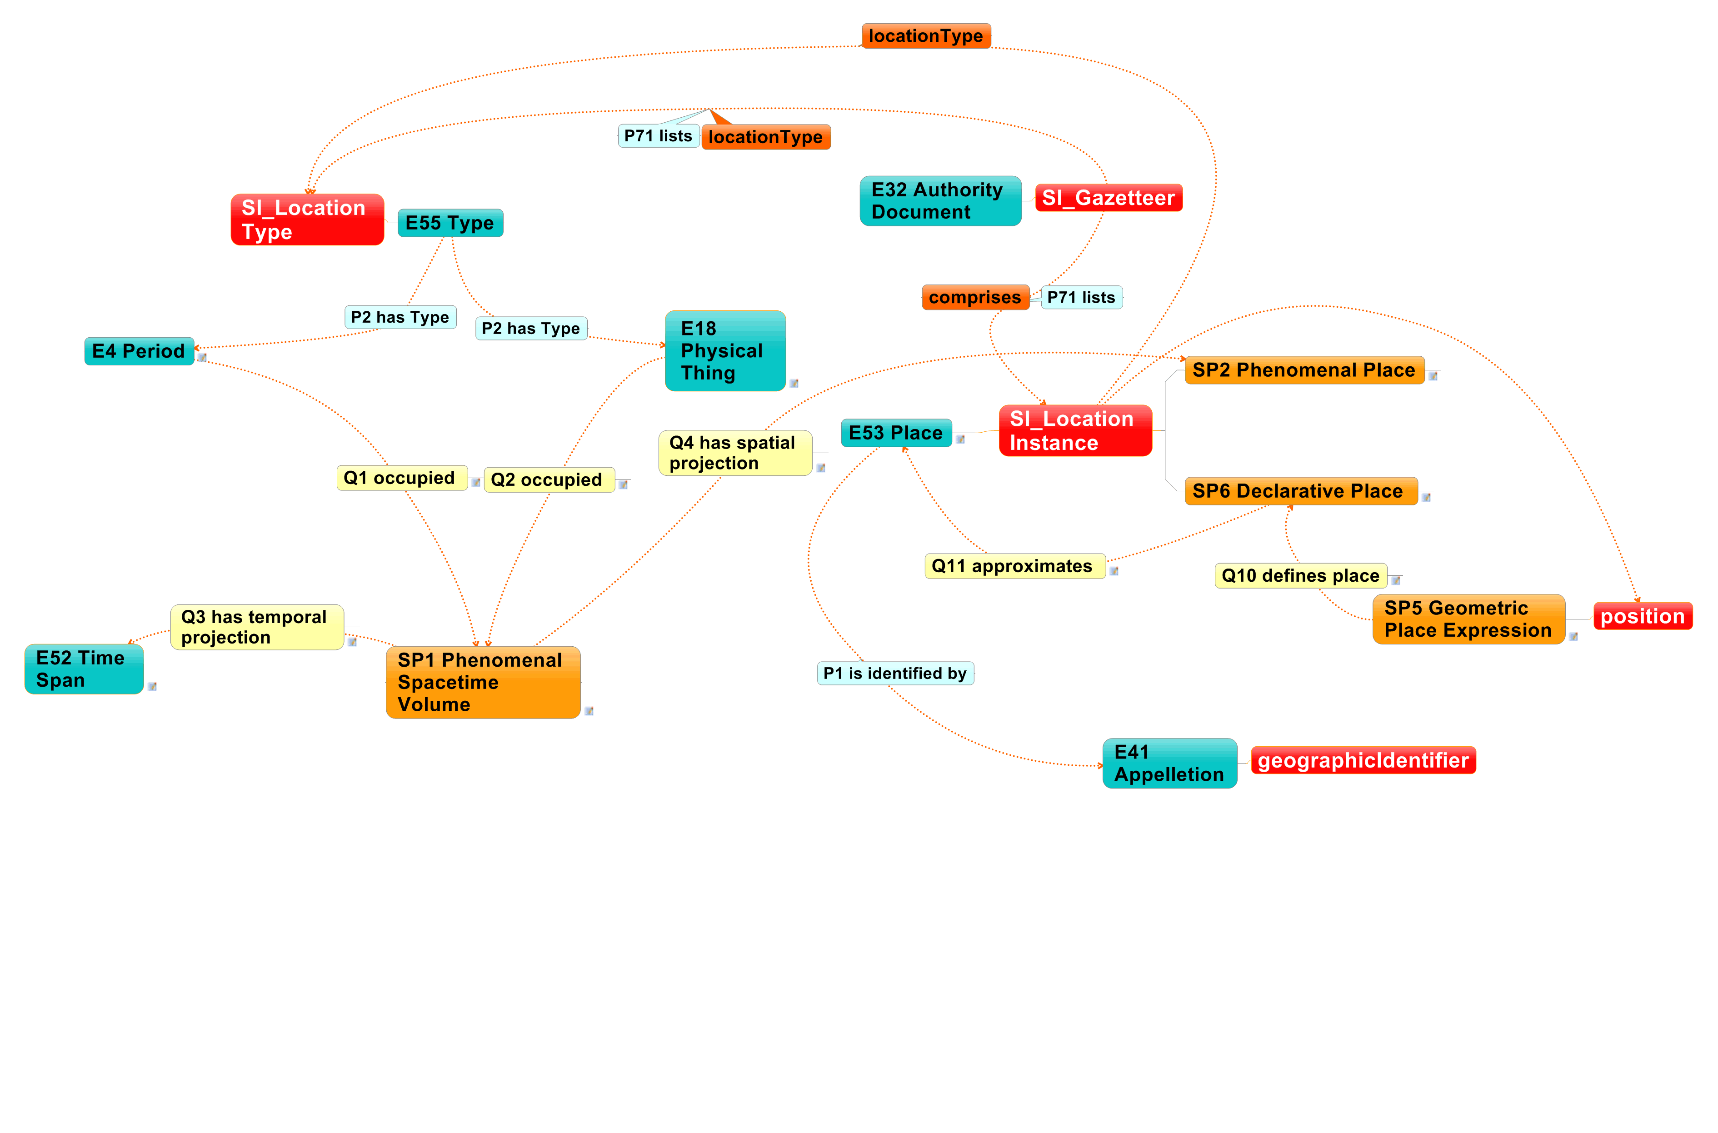
Mapping of Gazetteers
(ISO 19112 Spatial referencing by Geographic Identifiers)

Slide 19
Thank you
This research project has been funded within the Marie Curie Actions—Intra-European Fellowships (IEF) Funding scheme under project number 299998

Slide 20
INSPIRE based on OGC/ISO standards
Inspire is the EU initiative to establish an infrastructure for spatial information in Europe that will help to make spatial or geographical information more accessible and interoperable
Potential
  Standards and methodology to build an interoperable infrastructure because services and encoding are well defined
  Software to implement standards available
  Examples for implementation available
  EU Directive , politicaly enforced
Pitfalls
  ISO/OGC standards are very extensive
  34 different topics which are not semanticly integrated

