Slide 1
Temporal Primitives
Manos Papadakis & Martin Doerr
Institute of Computer Science
Foundation for Research and Technology - Hellas
Workshop: Extending, Mapping and Focusing the CRM
19th International Conference on Theory and Practice of
Digital Libraries (TPDL2015)
September 17, 2015, Poznań, Poland
Notes:
Manos Papadakis obtained his BSc and MSc in Computer Science from the University of Crete. His MSc thesis topic was “Temporal Topology on Fuzzy SpaceTime Volumes”. He is currently pursuing a PhD in Geoinformatics at the University of Salzburg. His PhD thesis topic is “Place-based GIS and place-based objects”. His main research interests include: Spatiotemporal modeling, inference and reasoning, Knowledge Representation and Data Visualization.

Slide 2
Past phenomena (1/2)
Past is a collection of phenomena manifested in space and time
  Minoan Period: cultural phenomena related to the Minoan civilization
  Human lifetime: birth, aging, activities related to a specific person
CIDOC CRM refers to constituents of the past as Temporal Entities
  Groups of coherent and related phenomena
    Periods, Events, Activities etc.
  They form finite and continuous time frames
Temporal Entities main information components
  Context: interactions of things, people and places
  Temporal confinement: time extent of comprising phenomena on timeline
Notes:
The substance of the past is considered as a set of phenomena that manifested
before a given point in time. For instance, a past era such as the Minoan Period
comprises a set of cultural phenomena related to the Minoan civilization. The
CIDOC conceptual reference model refers to the constituents of the
past as temporal entities that cover a finite and continuous time frame over
the timeline.
The main information components that frame a temporal entity include the
context and the time extent. The semantics that comprise the description and
identification of a temporal entity i.e. interactions of things, people and places,
determine its context, whereas the temporal projection confines the modeled
phenomenon's extent over time.

Slide 3
Past phenomena (2/2)
Description of the past includes
  Definition of Temporal Entities
  Introduction of semantic associations between them
  Conclusion of relevant temporal topology => a possible scenario of the past
Semantic association between Temporal Entities
  Inclusion and exclusion relations: is part of, cannot co-exist with etc.
  Special cases: influence, initiation/termination, follows, survived, etc.
Temporal information and topology
  Temporal knowledge representation: Allen Interval Theory
  Topology expressed as sets of temporal relations: Allen operators

Slide 4
Allen Interval Algebra (1/2)
Time interval
  an ordered set of time points
  represents a time frame on the timeline
  it is denoted by its endpoints e.g. (As, Ae)
Temporal constraint
  Describe endpoint associations
  Valid interval constraint: As < Ae
    Every interval has a non zero duration
Allen operators
  Sets of endpoint constraints
  Describe 7 basic (plus 6 inverse) temporal relations
As
Ae
meets
A
B
Ae = Bs
Time

Slide 5
Allen Interval Algebra (2/2)
Allen operators
X
Y
X before Y
X meets Y
X overlaps Y
X during Y
X starts Y
X finishes Y
X equals Y
X
Y
X
Y
X
Y
X
Y
Y
X
X
Y

Slide 6
Motivation (1/3)
Temporal topology between Temporal Entities concluded
  Directly: Endpoint association between related intervals
  Indirectly: Semantic association implies possible temporal scenarios
Example of indirect topology: Influence → Continuation
  Activities: Recitation and Stenography of Homer’s epic poems
    In order to preserve knowledge about pieces of art
  Stenography is a logical continuation of Recitation
Extracted temporal topology: logical continuation
  An activity cannot continue another instance if it occurs after the former
  Recitation must start before the end of Stenography
Notes:
However, observation-driven elds such as stratigraphy, often extract vague
and sparse information about the modeled temporal entities. This is hindered
by the use of Allen operators, since they bound to the requirement of complete
temporal knowledge. Additionally, there are several cases in which semantic asso-
ciations between coherent phenomena can reveal only a fraction of their possible
temporal relation. Consequently, the representative Allen operators that describe
the concluded association form a set of possible alternative scenarios of temporal
relations, which blurs the total image.

Slide 7
Motivation (2/3)
Temporal constraint of continuation in time
  Let A and B be activities Recitation and Stenography, respectively
  Minimum knowledge that implies continuation: As < Be
    the starting point of Recitation must be before the end of Stenography
Corresponding set of Allen operators
  operators that express the continuation endpoint constraint
  {before OR meets OR overlaps OR starts OR during OR finishes}
Recitation
Stenography
Bs
Be
Time
before
meets
starts
during
finishes
overlapped-by
As
Ae
overlaps
Notes:
For the sake of simplicity, we assume that Recitation time-extent is less than Stenography, excluding multiple inverse Allen operators.

Slide 8
Motivation (3/3)
Disjunctive Temporal Information: set of possible Allen operators
  Against the monotonic knowledge generation sequence
  Theoretical and Practical issues:
    Deductive method that leads to a blurry image of possible interpretations
    Expensive queries that include UNIONS of selection clauses
Study of the past is intertwined with temporal imprecision and incompleteness!
Need for a more flexible representation of temporal knowledge
  Alternative to Allen operators
  Simple and yet plausible knowledge
  Conjunctive information

Slide 9
Temporal Primitives: Imprecision (1/10)
Fuzzy Temporal Algebra
  fuzzy intervals are confined by inner and outer boundaries
    Interior: definite set of time points (inner boundaries)
      the entity is considered as on-going
    Boundary: indefinite set of time points (outer boundaries)
      fuzzy layer – the entity is marked as possibly active
    Closure: Interior and Boundary points
Boundary XB
Fuzzy Interval X
Interior XI
Point-wise Time
Closure XC

Slide 10
Temporal Primitives: Imprecision (2/10)
Fuzzy interpretation of basic temporal constraints
  endpoint equality – boundary overlap
  endpoint inequality – total temporal ordering
A
B
A
B

Slide 11
Temporal Primitives: Incompleteness (3/10)
Temporal Primitives: an alternative to Allen operators
  Each primitive represents a simple-plausible endpoint constraint
    Two operands that refer to interval endpoints
    One operator that describes “less than” and “equals” (in time)
Based on the included constraint, primitives may describe
  Generalized state of temporal topology
    Disjunction of possible Allen operators
  Specific temporal association
    Particular Allen operator
Let A and B be two fuzzy intervals we propose seven basic primitives based on equality (=) and proper inequality (<)
Notes:
We define the notion of temporal primitives as a set of relations, which comprise the minimum possible and yet sufficient temporal knowledge, which may
hold between associated time intervals.

Slide 12
Temporal Primitives: Basic Primitives (4/10)
A starts before the start of B (As < Bs)
  {before OR meets OR overlaps OR includes OR finished-by}
A starts before the end of B (As < Be)
  {before OR meets OR overlaps OR starts OR started-by OR includes OR during OR finishes OR finished-by OR overlapped-by OR equals}
A ends before the start of B (Ae < Bs)
  {before}
A ends before the end of B (Ae < Be)
  {before OR meets OR overlaps OR starts OR during}
A starts at the start of B (As = Bs)
  {starts OR started-by OR equals}
A ends at the start of B (Ae = Bs)
  {meets}
A ends at the end of B (Ae = Be)
  {finishes OR finished-by OR equals}
Notes:
Basic primitives and the corresponding Allen operators

Slide 13
Temporal Primitives: Negative Evidence (5/10)
Cases of negative evidence lead to generalized relations
  Example: exclusion → inability of coexistence
    An activity cannot start after another instance
      The former must start before or at the end of the latter activity
Such cases cannot be described by single basic primitives
  Need for generalized operators – improper inequality
    Less or equal to (≤)
We introduce four generalized primitives based on improper inequality
  Form combinations of basic primitives
  Group expressiveness of comprising temporal constraints

Slide 14
Temporal Primitives: Generalized Primitives (6/10)
A starts before or at the start of B (As ≤ Bs)
  {before OR meets OR overlaps OR starts OR started-by OR includes OR finished-by OR equals}
A starts before or at the end of B (As ≤ Be)
  {before OR meets OR met-by OR overlaps OR overlapped-by OR starts OR started-by OR includes OR during OR finishes OR finished-by OR equals}
A ends before or at the start B (Ae ≤ Bs)
  {before OR meets}
A ends before or at the end of B (Ae ≤ Be)
  {before OR meets OR overlaps OR starts OR during OR finishes OR finished-by OR equals}
Notes:
Basic primitives and the corresponding Allen operators

Slide 15
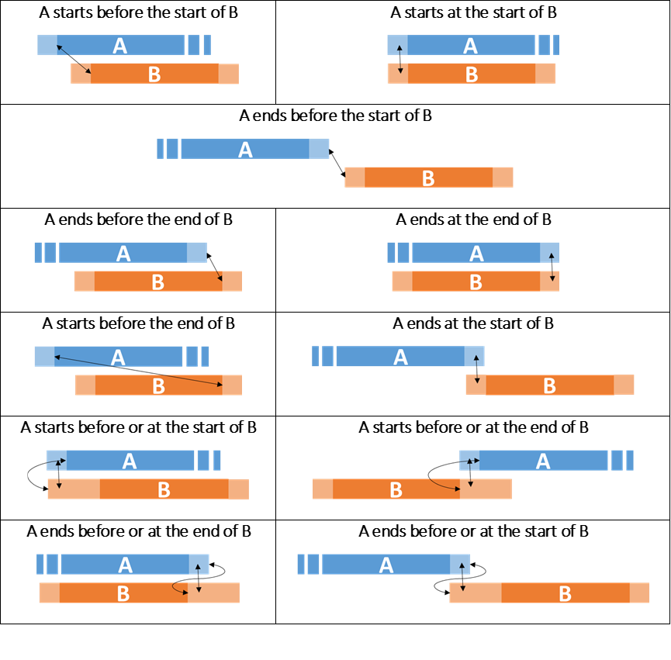
Temporal Primitives: Visualization (7/10)
Notes:
Basic primitives and the corresponding Allen operators

Slide 16
Temporal Primitives: Expressiveness (8/10)
Temporal Primitives conform to principles
  Completeness & minimality
    Every temporal association can be described by exactly one Temporal Primitive
ISA Hierarchical Subsumption
  Primitives with stronger interpretations subsume weaker ones
  Upper levels refer to generalized temporal topologies
  Lower levels describe more strict temporal scenario
Allen Alternative Representation
  Allen operators can be expressed using primitives
  Either single or conjunctive sets of temporal information

Slide 17
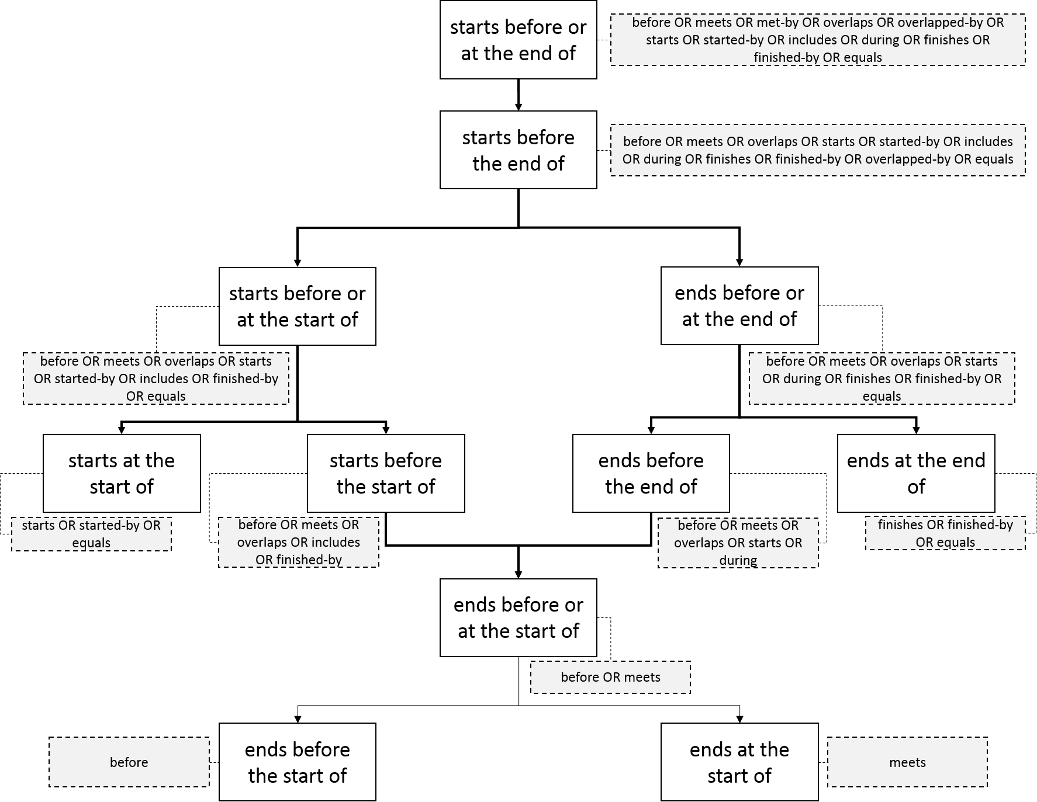
Temporal Primitives: ISA Hierarchy (9/10)
Notes:
Archaeology association:
A starts before the start of B: A predates B
A ends before the end of B: A outlived B or B survived A
A starts before the end of B: A could influence B or B could be influenced by B
A starts at the start of B: A begins simultaneously with B
A ends at the end of B: A ends simultaneously with B
A ends at the start of B: A meets B
A ends before or at the start of B: A is followed by B or B follows A

Slide 18
Temporal Primitives: Allen Operators (10/10)
Allen operator | Temporal Primitives
A before B | A “ends before the start of” B
A meets B | A “ends at the start of” B
A overlaps B | A “starts before the start of” B & B “starts before the end of” A & A “ends before the end of” B
A starts B | A “starts at the start of” B & A “ends before the end of” B
A during B | B “starts before the start of” A & A “ends before the end of” B
A finishes B | B “starts before the start of” A & A “ends at the end of” B
A equals B | A “starts at the start of” B & A “ends at the end of” B

Slide 19
Conclusion
We propose an alternative to Allen operators: Temporal Primitives
  Based on simple Temporal Constraint
  Describe every possible scenario of Temporal Association
    Generalized
    Specific
  Conforms to the monotonic knowledge gain
  Generalized scenarios expressed as conjunctive set of primitives
    Improves query execution time, excluding UNION of selections
  Deal with temporal imprecision
    adapts the fuzzy interval model interpretation
  Introduce an ISA Hierarchy between the comprising primitives
    Subsume expressive power – useful on knowledge refinement

Slide 20
Contact info
Manos Papadakis, Martin Doerr
FORTH - Institute of Computer Science, Greece
{mpapad, martin}@ics.forth.gr
Notes:
Manos Papadakis obtained his BSc and MSc in Computer Science from the University of Crete. His MSc thesis topic was “Temporal Topology on Fuzzy SpaceTime Volumes”. He is currently pursuing a PhD in Geoinformatics at the University of Salzburg. His PhD thesis topic is “Place-based GIS and place-based objects”. His main research interests include: Spatiotemporal modeling, inference and reasoning, Knowledge Representation and Data Visualization.

Slide 21

Questions
“It is free,
but it's priceless.
You can't own it,
but you can use it.
You can't keep it,
but you can spend it.
Once you've lost it
you can never get it back.”
Thank you

