Slide 1
A request-based framework for
FRBRoo graphical representation:
With emphasis on
heterogeneous cultural information needs
Maliheh Farrokhnia
Den Haag, National Archives
3rd April. 2014

Slide 2



Slide 3
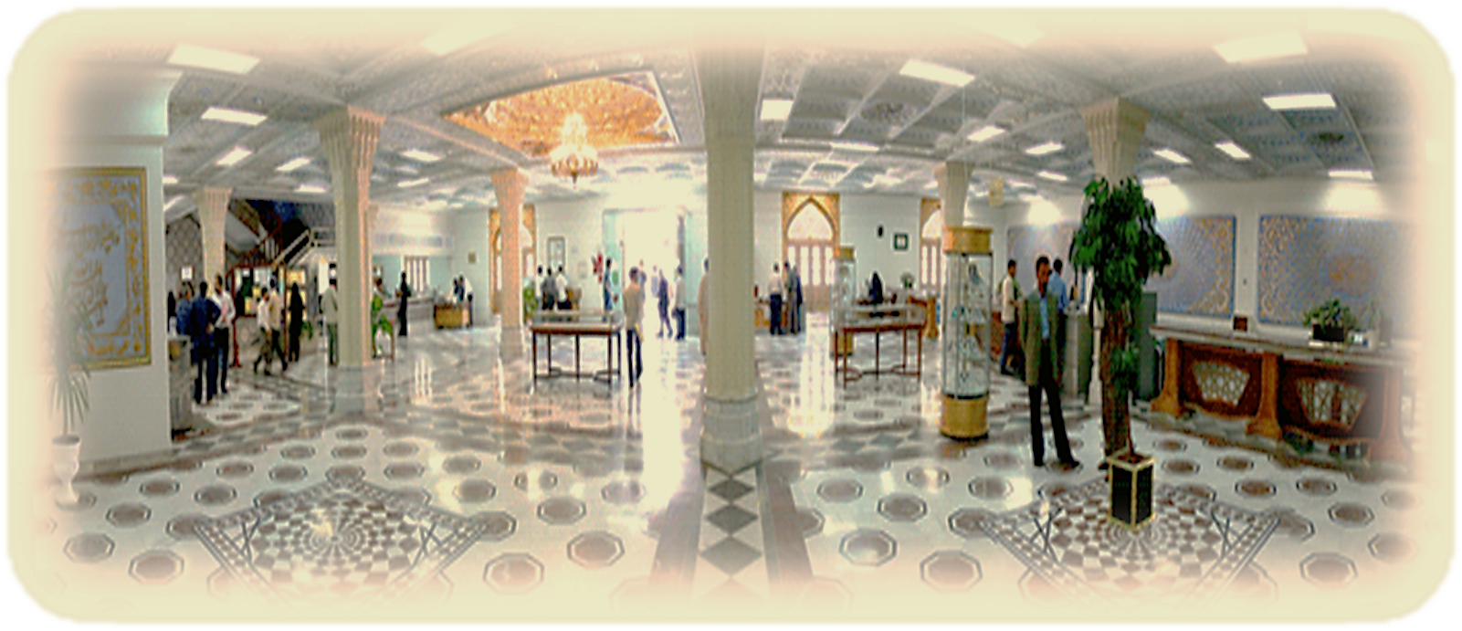
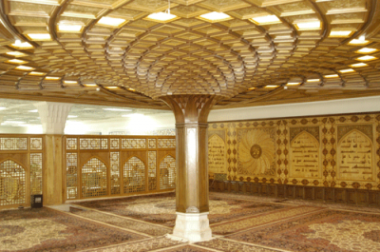
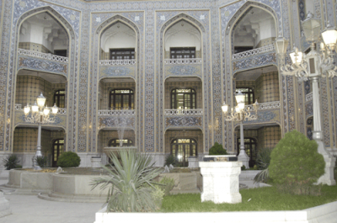
The organization of libraries, museums and
documents center of Astan Quds Razavi
(www.aqlibrary.ir)

Slide 4
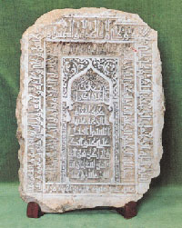
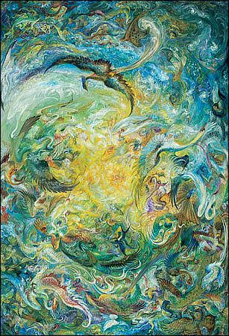
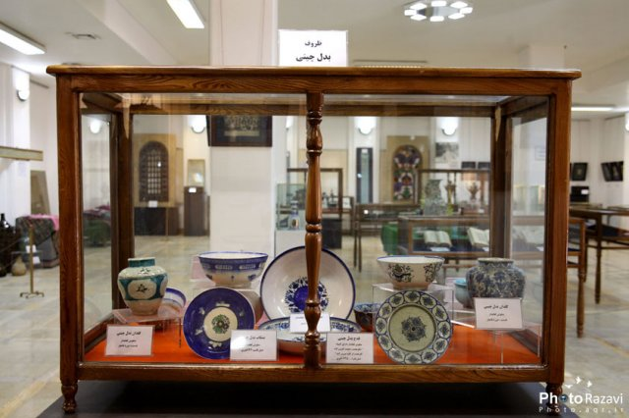
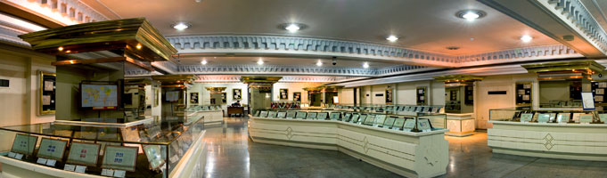
The museums of the Astan Quds Razavi
1937 CE.
11 specialized galleries: Holy Quran G., Carpet G., Great Leader’s Presents G., Sea-Shell G., Stamp & Bank-Note G., Coin& Medals G., Visual arts G., astronomical Instruments & watches G., vessels G., Weaponry G. and History of Mashhad G.

Slide 5
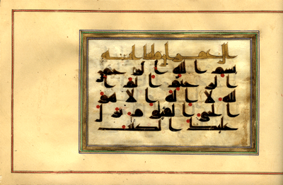
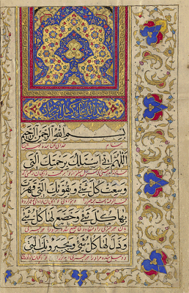
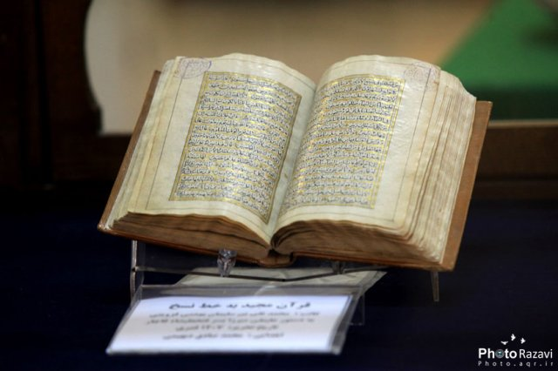
Central library of Astan Quds Razavi
363 AH.(about 1072 years ago)
Over 2.5 milion volumes of works
In 64 currently spoken language
+ 60000 rare manuscripts
+ 40000 old lithographic books
47000 microfilms

Slide 6
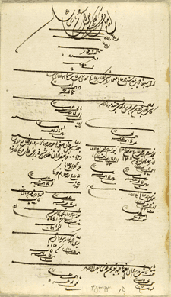
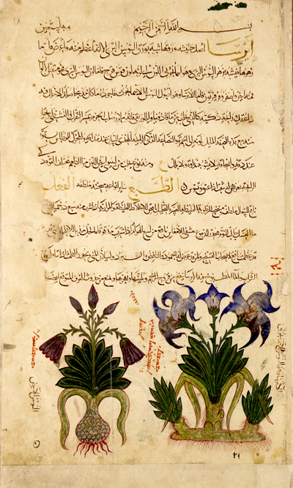
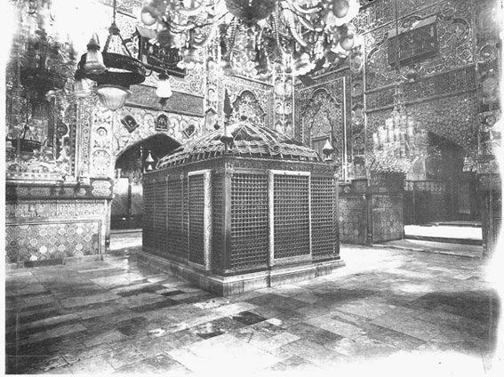
Documents Center of Astan Quds Razavi
+ 8 milion pieces of historical documents: (official documents, decrees & edicts, photoes, video tapes, etc.)
+ 1 milion copies of ancient & precious periodicals

Slide 7
Introduction
Implementing FRBRoo model in integrated systems as an effort toward a unified conceptualization of information produced by libraries, museums and archives
Challenges of heterogeneities not only in materials and their organizing but also in users
Understand a topic as the ultimate goal of user’s seeking instead of get an object
The necessity of determining relation with other resources in the world while describing a resource
Linear display is not still the one that supports users with semantic information representation

Slide 8
Graph data structure as a more accepted representational medium
provides actual information about the subject of one's query rather than just a list of links
Not just the answer to what user asked , but also the answers to the questions he probably should have asked
In cases of existing inherent relationships among data elements, graph visualization methods applies to support the better understanding

Slide 9
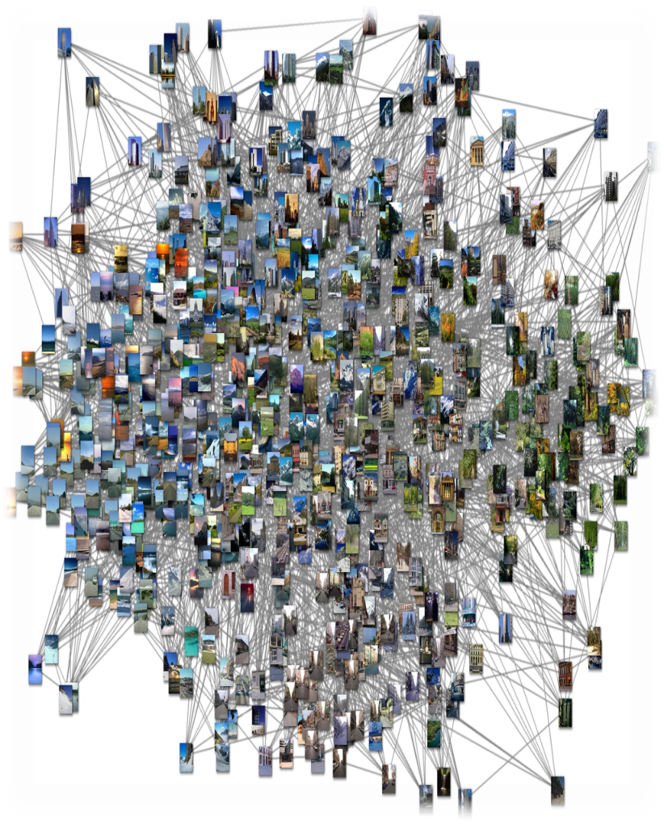

Limitation:
“size” of the graph in systems
with huge amount of information
Solution:
reducing the size of the graph to display in order to overcome the issue of viewability or usability
For example by discovering clusters within the data

Slide 10

MyM
My Project

Slide 11
Objective:
Propose an alternative request-based graphical visualization of information based on FRBRoo model considering user’s needs and requirements in different domains of memory institutions

Slide 12
My assumption:
There are
different preferred core information elements and relationships
for
different information items held in libraries, archives and museums
according to
the users in each of these different domains.
Fore example:

Slide 13
Research questions:
What are the fundamental categories in information resources held in archives, libraries and museums?
What are the most frequently information elements that users use in their search queries in archives, libraries and museums?
What are the most important information elements that users pay attention in the information presentation of each information resource in archive systems, library systems and museum systems or in an integrated system?
Which kinds of FRBRoo properties (relationships) are the most important for users? And how much it differs from user to user and from material to material in different domains?
How is the request-based framework for FRBRoo graphical visualization in an integrated system?

Slide 14
Research design:
Identifying categories among:
- FRBRoo classes (Fs) and properties (Rs)
- Information Resources held in different memory institutions
Perparing a questionnaire in the form of a matrix
Distibuting matrix among highly-specialized professionals
observation of selected participants searching and using information systems in each domains for the type of information being searched and the type of information needs
Conducting complementary semi-structured interviews to gather qualitative information from the research population
Data analyzing
Proposing framework being used in graphical representation of integrated information based on FRBRoo classes and relations considering users’ needs

Slide 15
At the end:
I hope my request-based approach on FRBRoo graphical representation based on real heterogeneous cultural information needs in different cultural heritage domains will help to have a better semantic graphical visualization

Slide 16
Refrences
Andresen, L. (2007). Common presentation of data from archives, libraries and museums in Denmark. available at:
http://biblstandard.dk/abm/doc/Common_presentation_of_data_from_archives_libraries_and_museums_Denmark.pdf
Doerr, M., Iorizzo, D. (2008). The dream of a global knowledge network - A new approach, Journal on Computing and Cultural Heritage (JOCCH), Volume 1, Issue 1.
Bountouri, L. and Gergatsoulis, M. (2011), “Mapping encoded archival description to CIDOC CRM”, Proceedings of the First Workshop on Digital Information Management, Corfu, Greece, March 30-31, pp. 8-25.
Farrokhnia, M. and Zarei, M. (2013) “Integrated access to cultural heritage information pieces in Iran over Imam Reza’s 4th Zarih (burial chamber) as a sample”. Program: electronic library and information systems, vol. 47, No. 3, pp. 304-319.
Doerr, M., Ore, C. E. and Stead, S. (2007) "The CIDOC Conceptual Reference Model - A New Standard for Knowledge Sharing", 26th International Conference on Conceptual Modeling (ER 2007), Australian Computer Society, Inc. Vol. 83, 2007, pp.51-56.
Z Žumer, M. and Le Boeuf, P. (2006). ”Conceptual models: museums & libraries: towards an object-oriented formulation of FRBR aligned on the CIDOC CRM ontology”. ELAG 2006 “New tools and new library practices”, Bucharest, 26 April 2006.
Le Boeuf, P. (2012). “A Strange Model Named FRBROO”. Cataloging & Classification Quarterly, 50:422–438.

Slide 17

Thanks a lot
for
Your attention

