Slide 1


A CRM-based Ontology for Narratives
Carlo Meghini, Valentina Bartalesi

Slide 2
The Problem
The traditional search functionalities of Digital Libraries respond to a web-like query with a list of digital objects based only on the metadata descriptors
No semantic relation among the returned objects is usually reported which can help the user obtaining a more complete knowledge on the subject of the search

Slide 3
Our Vision
We believe that DLs should be able to provide narratives to their users instead of lists of objects
Narratives are networks of events related to each other and to the DL resources by semantic links
Such information structure should allow DLs to provide more sophisticated information services to the users, going beyond the current state

Slide 4
Narratives
In order to create an ontology for representing narratives, we reviewed some fundamental notions from:
the theory of narratology
the Event Calculus

Slide 5
Narratology
Russian formalism distinguishes between:
Fabula that refers to the sequence of events of the narrative in chronological order
Plot is the way in which these events are presented in a narrative

Slide 6
Event Calculus
Fluents
Actions or Events
Generalized events
Narrative

Slide 7
A CRM-based Ontology
Our ontology is divided in two main parts:
The fabula contains the events (and actions), connected by the properties representing the mereological, temporal occurrence and causality relations
The narration contains a text, along with its structure and narrator
In addition, we added the provenance that contains the inferential process of the narrator who composes a narrative from primary sources whose contents are propositions about the events in the fabula

Slide 8
Fabula 1/2
CLASSES
Event → E5 Event
Action → E7 Activity
Time interval → E52 Time-Span
Place → E53 Place
Person → E39 Actor
Object → E77 Persistent Item
Concept → E89 Propositional Object
PROPERTIES
Mereological relation → P9 consists of
Event occurrence → P4 has time-span. If the period of occurrence of an event is not known → from P114 to P120
Causality relation → O13 triggers of CRMSci ???

Slide 9
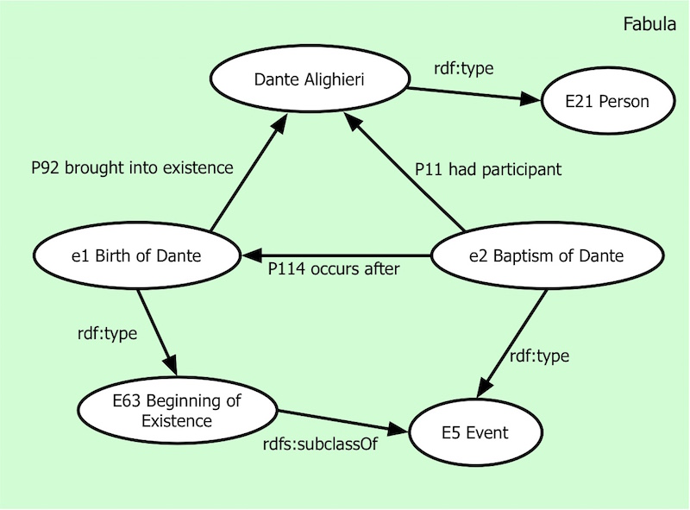
Fabula 2/2

Slide 10
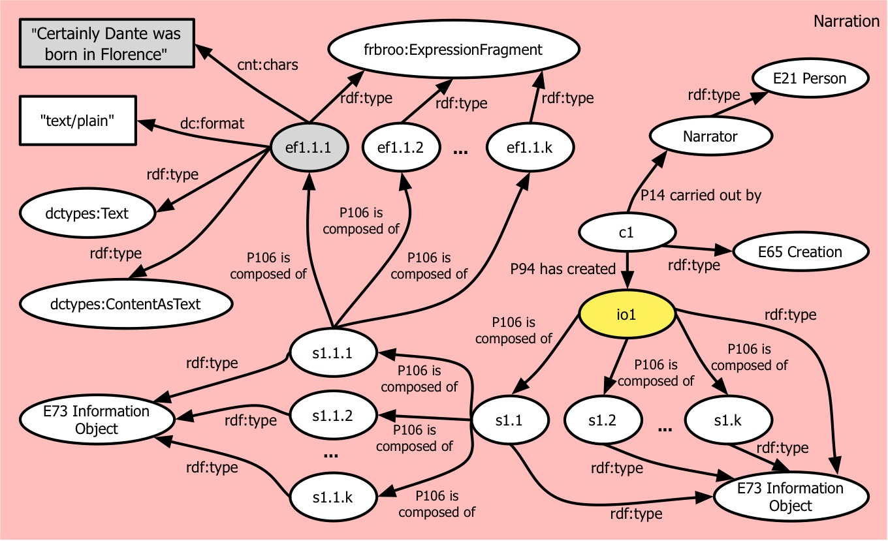
Narration
The text written by the narrator → E73 Information Object
Chapters, paragraphs → E73 Information Object
Fragment → ExpressionFragment of FRBRoo
Narrator → E21 Person

Slide 11
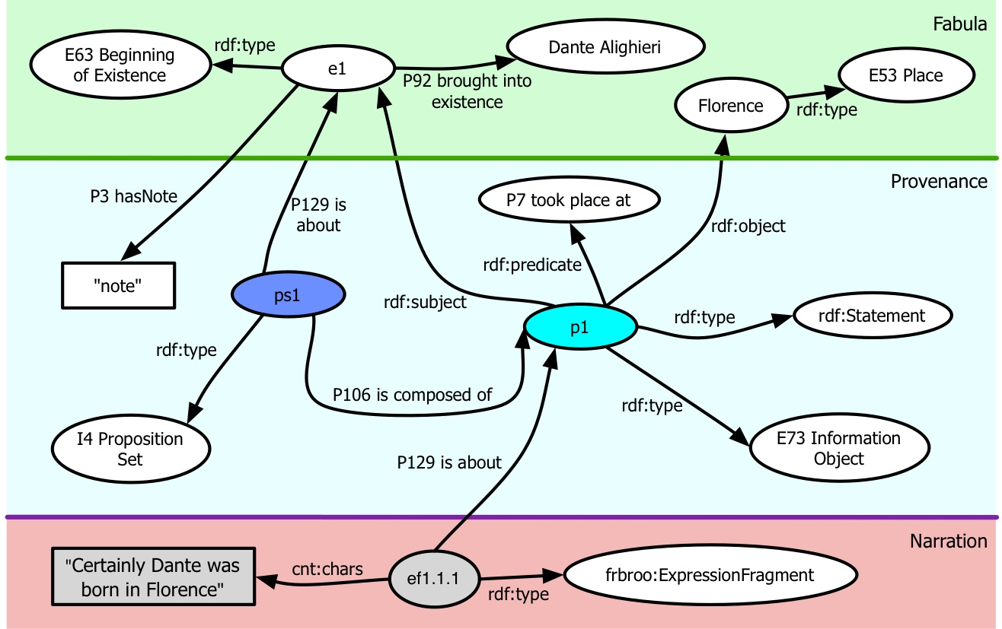
Provenance 1/2
To represent the inferential process of a narrator we have used CRMinf

Slide 12
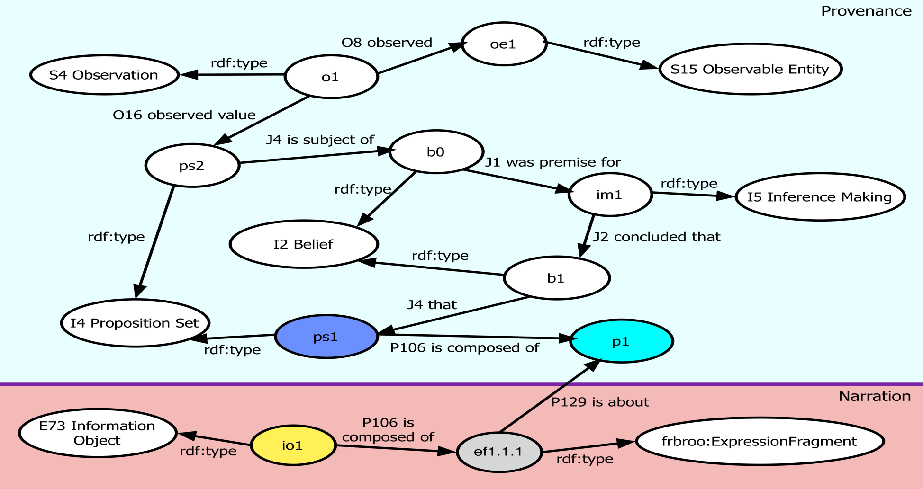
Provenance 2/2

Slide 13
Open Problems
Role → The P14.1 in the role of property of the property P14 carried out by allows to specify the nature of an actor’s participation. We would give a role also to the persons who do not have an active partecipation to the event → we would propose to extend the property P 14.1 to P11 had participant
Causality relation → between the events that compose a general narrative, it is very difficult to use the property O13 triggers of CRMsci that defines a direct causality relation. The property P17 was motivated by can be used for actions but not for events
We are evaluating the introduction of a new property to represent a causality dependency between events when the event X is one of the causes of the event Y
Which is the CRM class that can represent a narrative?

Slide 14

Thank you

