Slide 1




Developing an archaeological data archive at the Austrian Academy of Sciences: the ‘A puzzle in 4D’ project
Edeltraud Aspöck, Gerald Hiebel, Matej Ďurčo

Slide 2
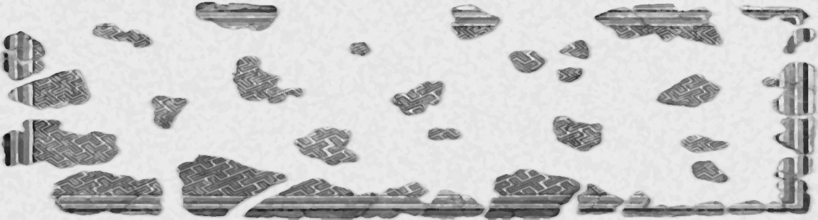
Project & Aims
A puzzle in 4D:
digital preservation and reconstruction of an Egyptian palace
Digital long-term preservation of ressources from Austrian excavations at Tell el Daba (Egypt)
Funding: Austrian Academy of Sciences digital long-term preservation program (ÖAW/ACDH Digital Humanities) & ARIADNE (FP7-313193)
February 2015 – January 2020
OREA & ACDH (Austrian Academy of Sciences)
Case study to develop archaeology data archive at the Austrian Academy of Sciences
Cooperations with:
Ludwig Boltzmann Institute ArchPro
Chicago University
Österreichisches Archäologisches Institut, Grabung Tell el Dab‘a
Archaeology Data Service
PIN Scri - Polo Universitario "Città di Prato"
Notes:
P4D is a project that started in February 2015
Its main aim is the long-term preservation of the resources from the Austrian excavations at tell el daba in Egypt
The project will run for five years
Carried out by the Institute for Oriental and European Archaeology and the Austrian Center f Digit Humanities, both Austrian Academy of sciences
With many other cooperation partners for other project parts

Slide 3
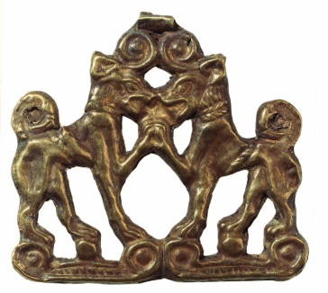
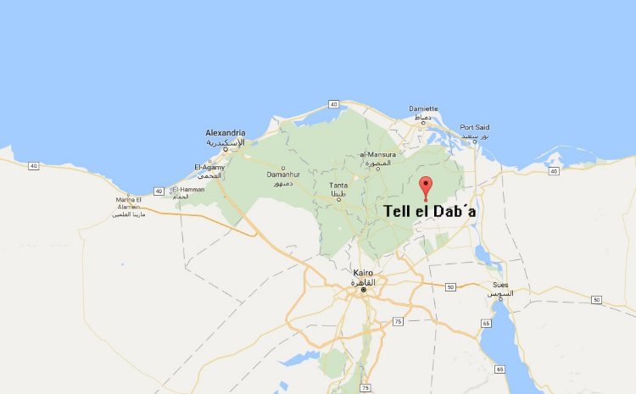
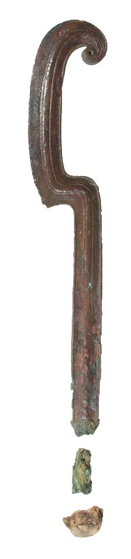
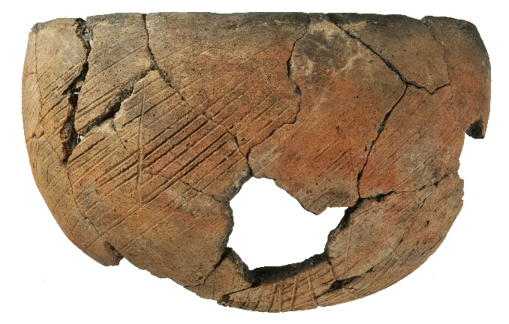
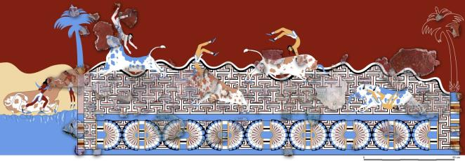
Tell el Daba (TED)
12th – 18th Dynasty (early second millenium BC)
Wealthy society with contacts to eastern Mediterranean and Minoan culture
TED wall painting depicting bull leapers
Notes:
First a few words on the excavations
Tell el Daba is an archaeologyical site in the eastern Nile delta in Egypt
It dates to the early second millennium BC, Bronze Age
It is associated with many historical places, for example Avaris
Wealthy society with many residential buildings, tombs temples and palaces
With contacts to the eastern Medieterranean
And famously to the Minoan culture – here you can see a wall painting that from Tell el Daba and there are nearly identical wall paintings have been found on Crete

Slide 4
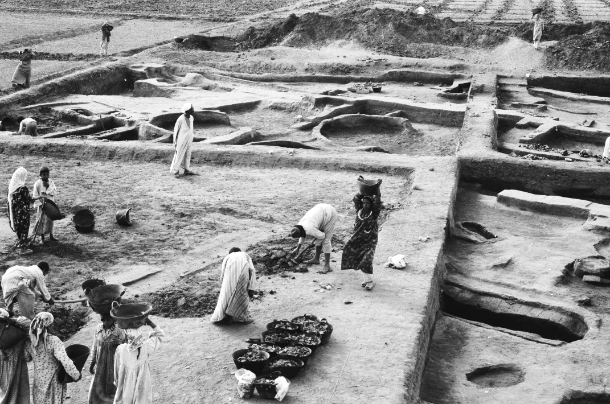
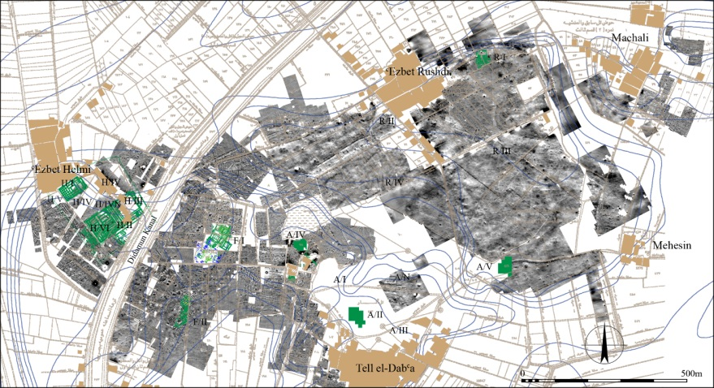
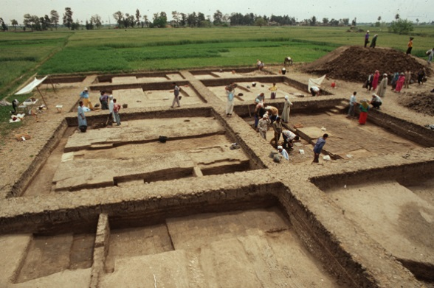
Excavation
Since 1966
8 excavation areas
88 fieldwork campaigns
Notes:
Excavations at Tell el Daba have been carried out by the Austrian Archaeologist Manfred Bietak since 1966
88 fieldwork campaigns have been carried out resulting in a large quantity of documentation

Slide 5
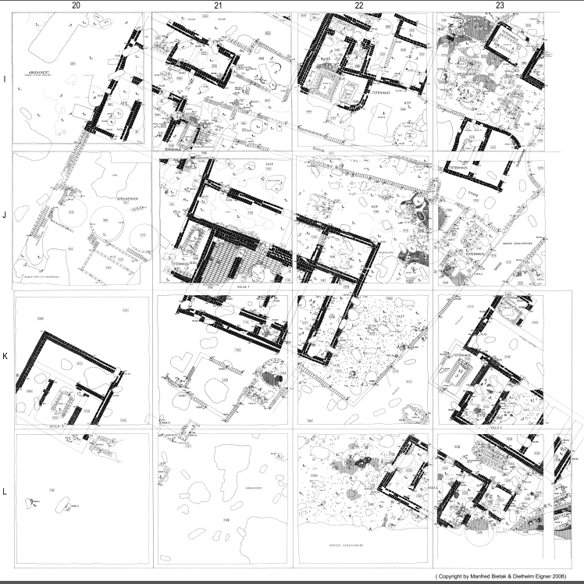
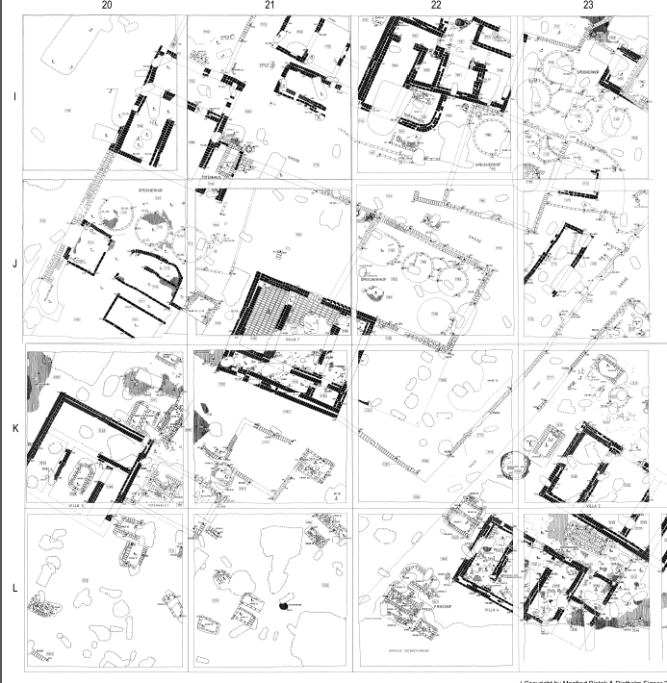
Excavation methodology
Planquadrate - squares

Slide 6
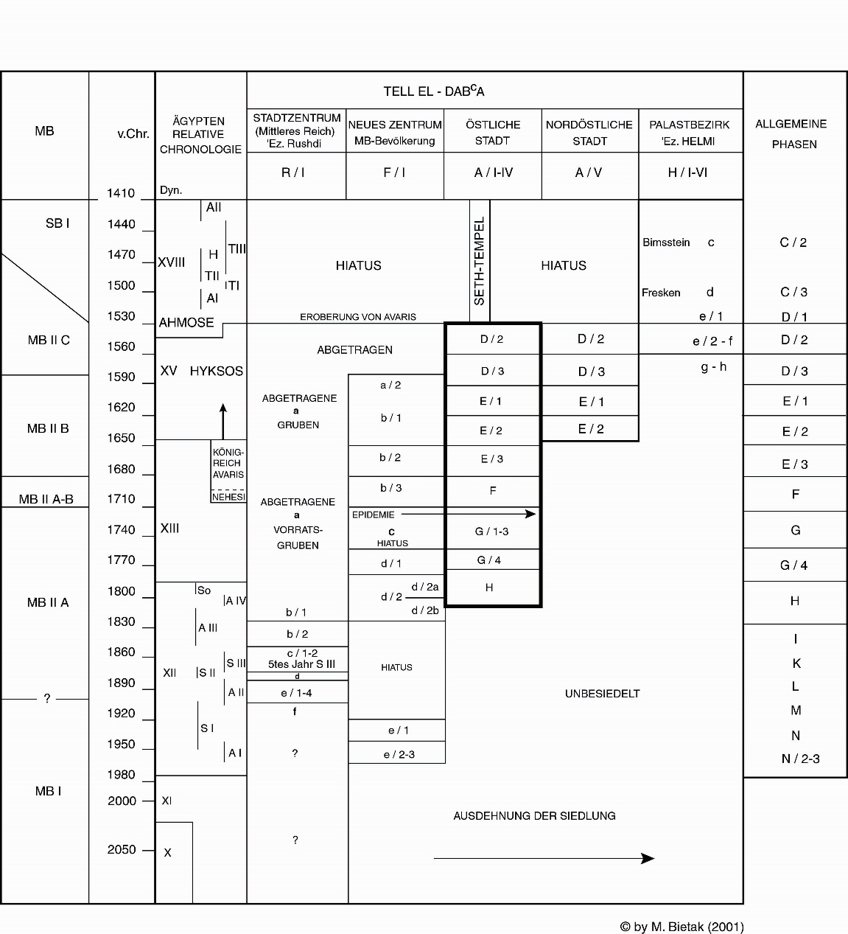
Chronology/Stratigraphy
Stratum a/1: graves
Stratum a/2: temple with offering pits (V. Müller 2008), graves
Stratum b/1: settlement with large villae, cemeteries
Stratum b/2: villae, with houses of the dead; Alleyways
Stratum b/3: villae Egyptean style; Graves & cemeteries
Stratum c: Squatter, mass graves
Stratum d/1: palace (=Villa) 2 phases; Wall painting fragments; 2. gardens; Large cemetery (Schiestl 2009)
Stratum d/2: Syrian-style house: oldest building of the first settlers
Stratum e: settlement for workers (Czerny 1999)

Slide 7
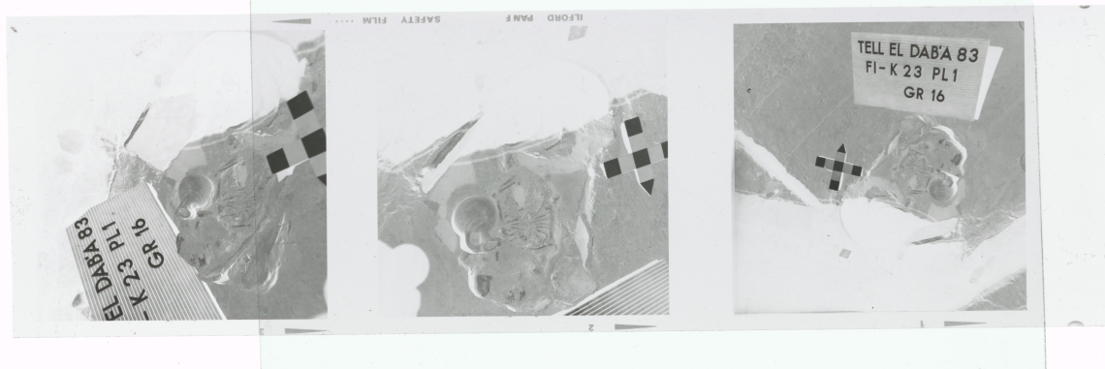

ANALOGUE documentation
Photos
15 000 photos
200 000 photo negatives of which 1/3 are 6x6 negatives
45 000 slides
Drawings
find drawings: 15 200 pencil on cardboard + 8000 ink on cardboard
35 000 field drawings (plana, sections, details): colour pencils on millimeter paper
4500 plans, nearly all DIN A2 or A1: ink on tracing paper
Written documentation
5 folders of excavation protocols - 300 pages each
Lists, find cards, etc.
Notes:
That includes around …
Exxcavation protocols:

Slide 8
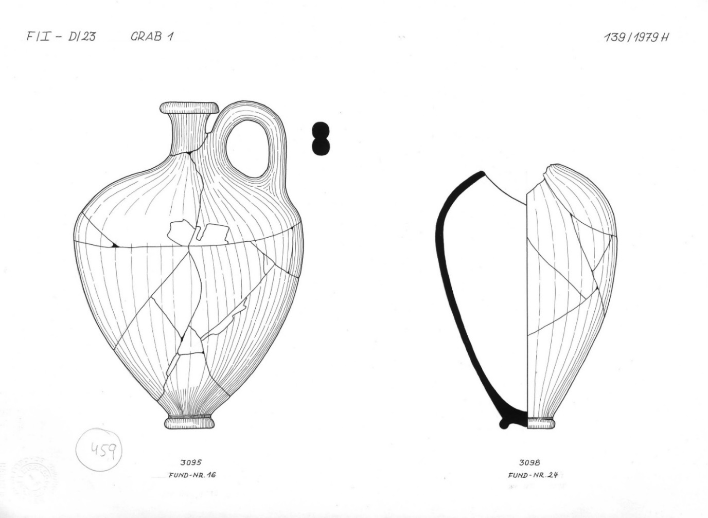
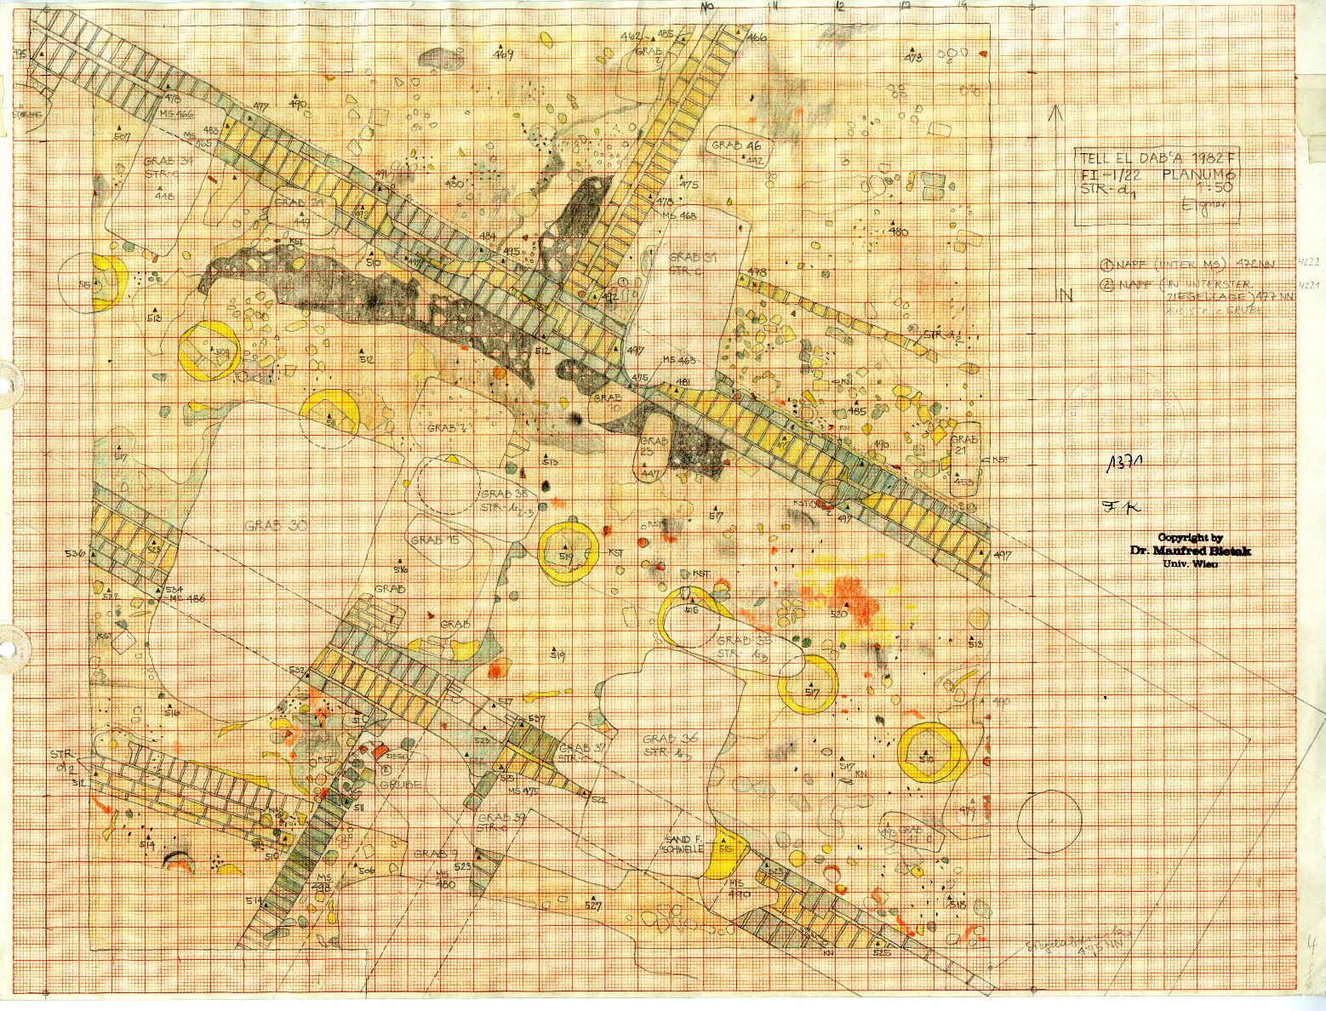
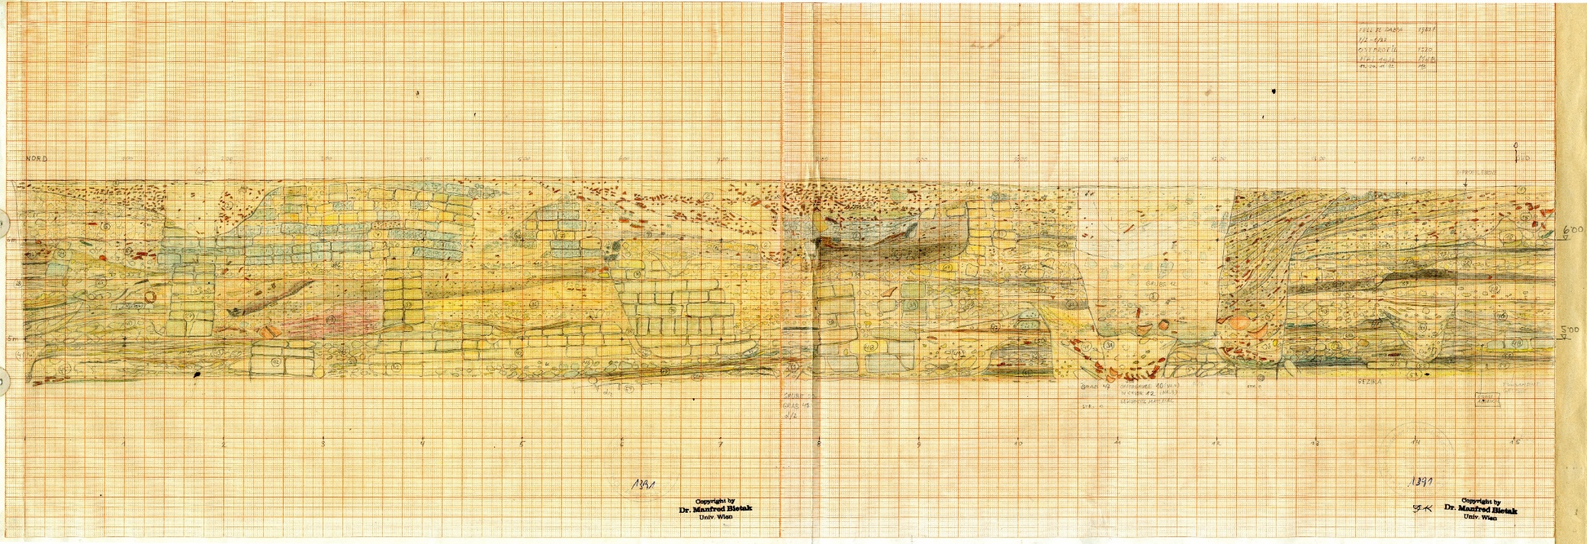
ANALOGUE resources
Profile drawing
Ground plan drawing
Find drawing

Slide 9
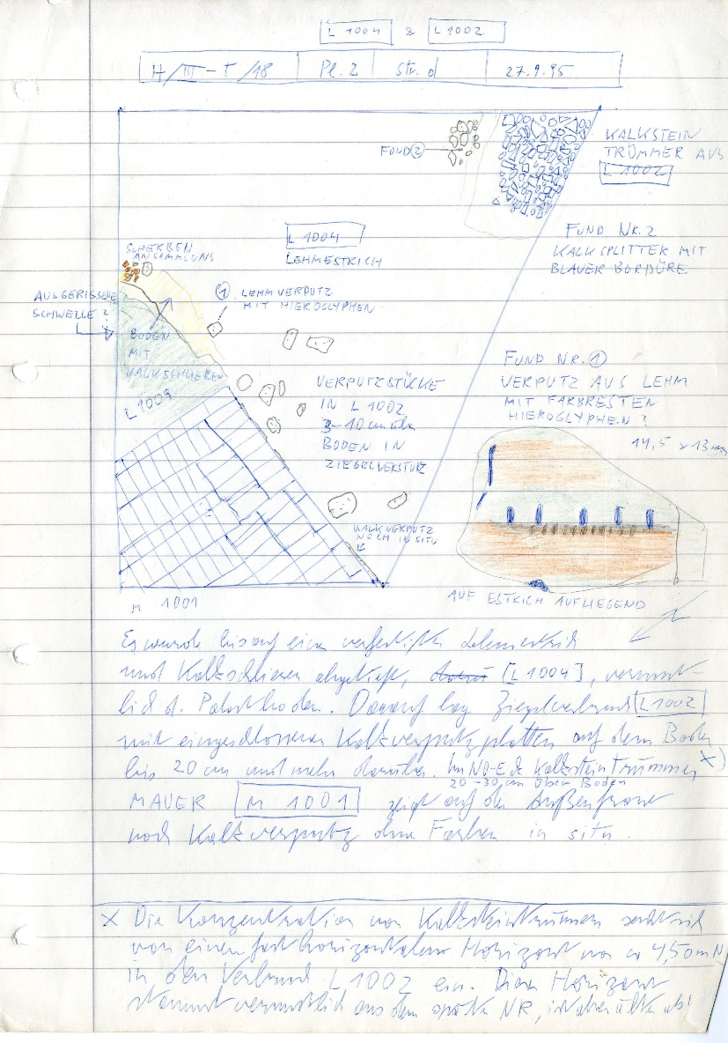
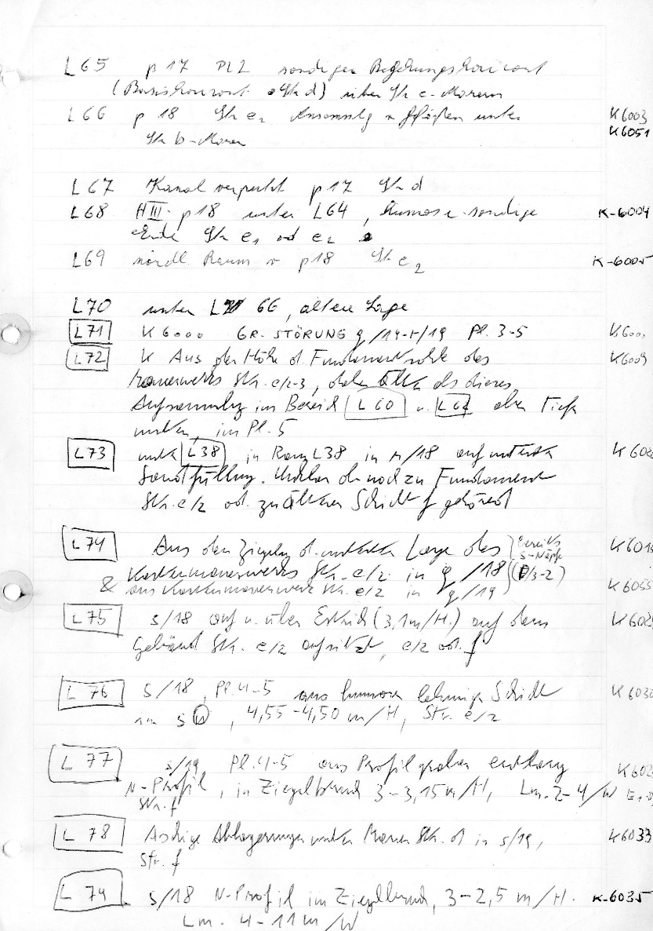
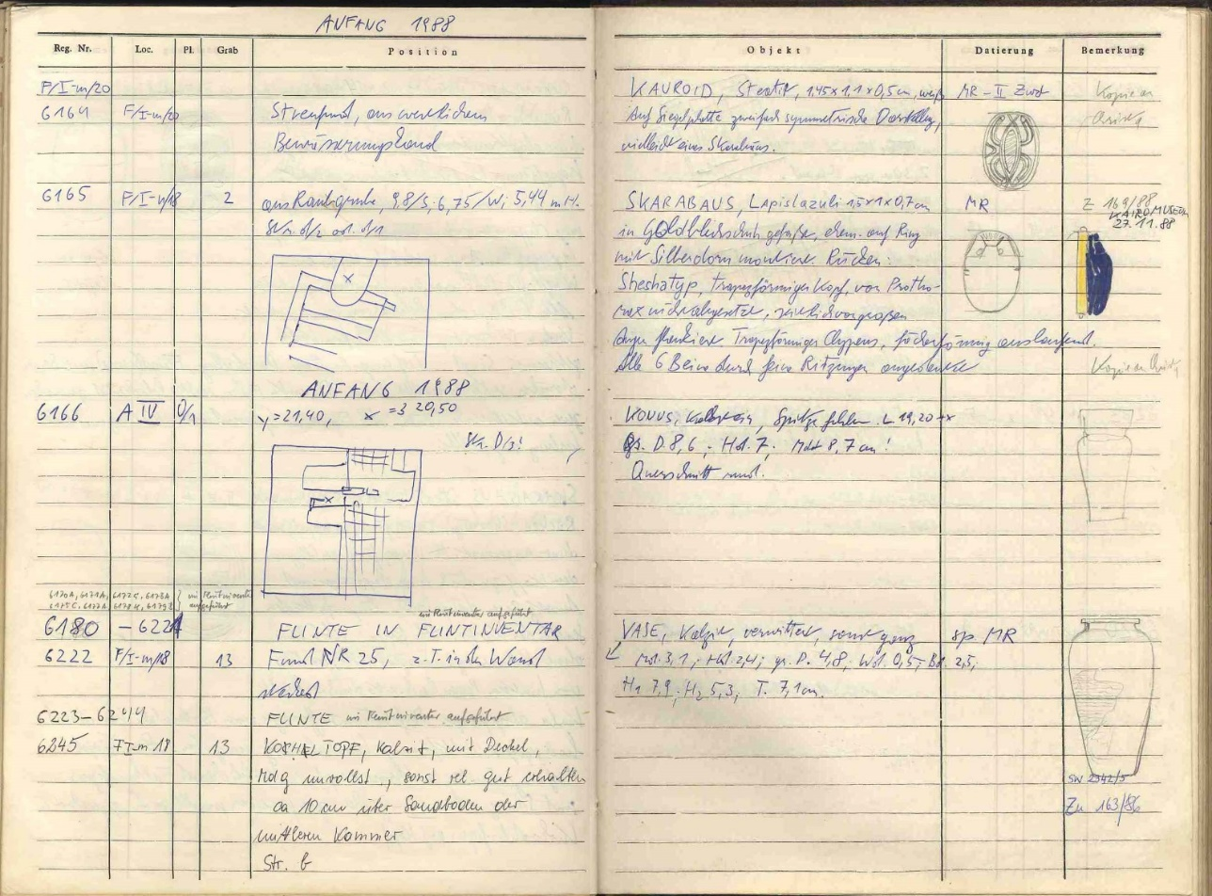
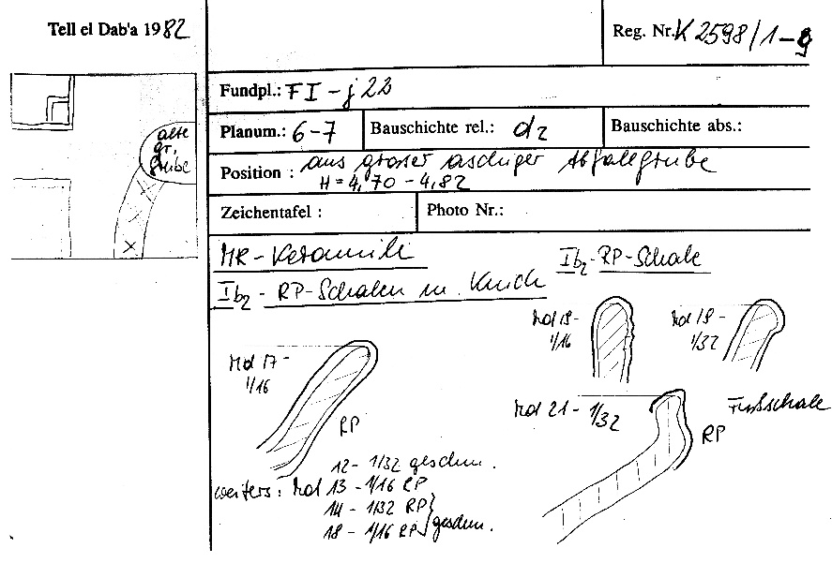
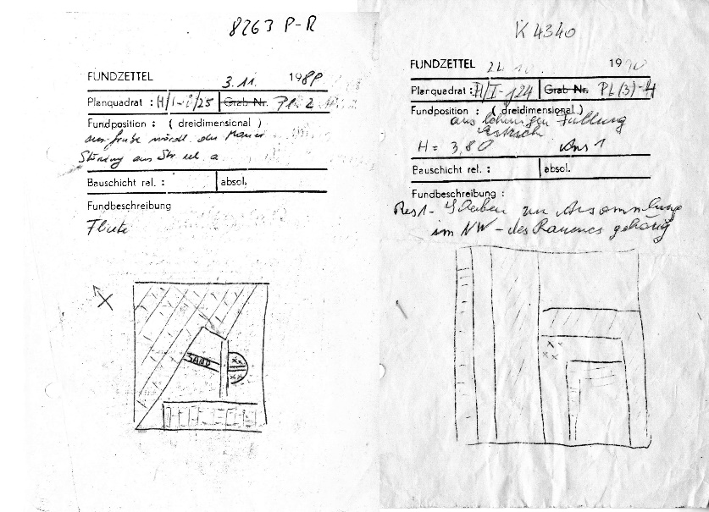
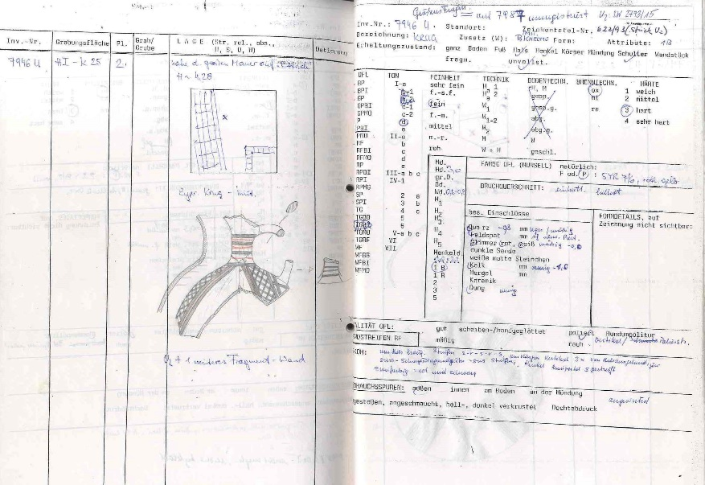
ANALOGUE resources
Convolute card
Find card
Protocol
Locus lists
Inventories
Ceramics inventory

Slide 10
DIGITAL resources
Photos
Photos: field- and finds-photos, since 2007
Drawings
AutoCAD Plans: fieldplans of some areas digitized
Scans of finds drawings, since 2011 complete, before only occasionally
Written documentation
TED Documentation access database, since 2007 (protocol-, locus- &wall lists)
Scans of inventories of Pottery and small finds (complete)
Other
Databases: wall painting fragments, stone tools, human remains, animal bones, botanic remains, seals
Spreadsheets: C14 measurements
Geophysical surveys (geo-magnetic and geo-physics)
GPS-plans
Various maps
Illustrator files: reconstruction drawings

Slide 11
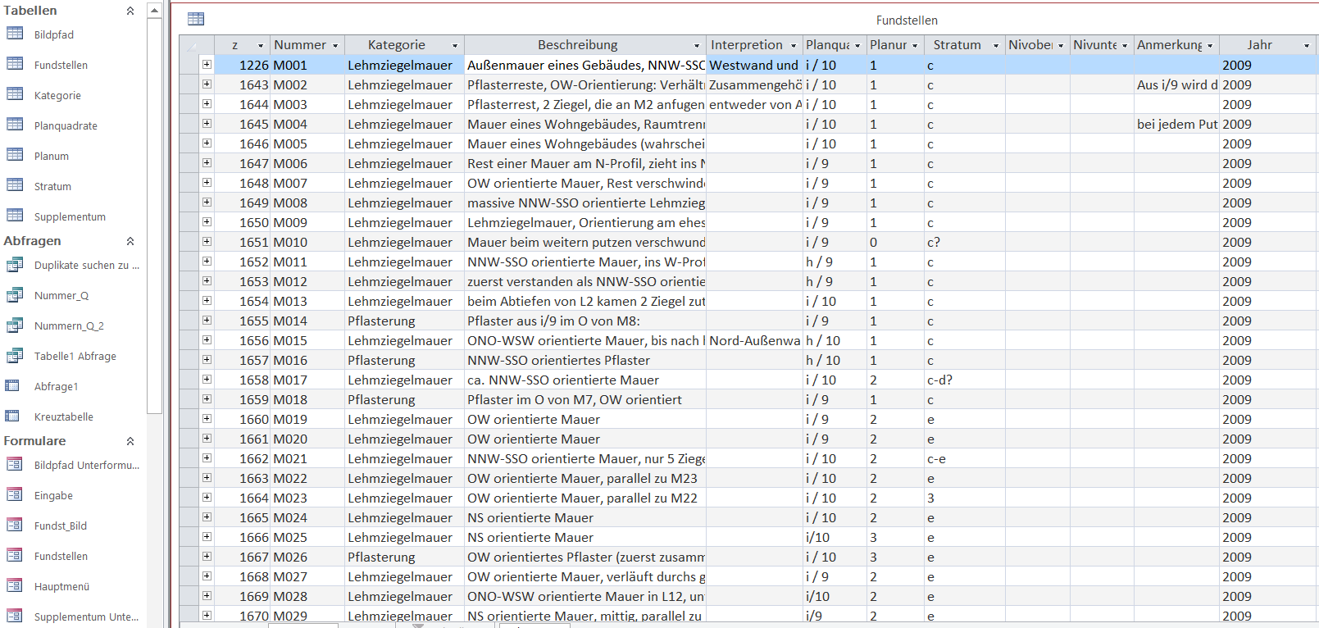
DIGITAL resources
Database
Photos
Plans

Slide 12

Challenges
Large amount of data
Technological challenges
Data modelling
Homogeneous documentation
Notes:
Large amount of data – how to organise digitization, how to select and prioritize what to digitise
Technological challenges: Long-term preservation + implementation (data entry, storage, retrieval)
Data modelling: how do the different types of resources relate to each other

Slide 13
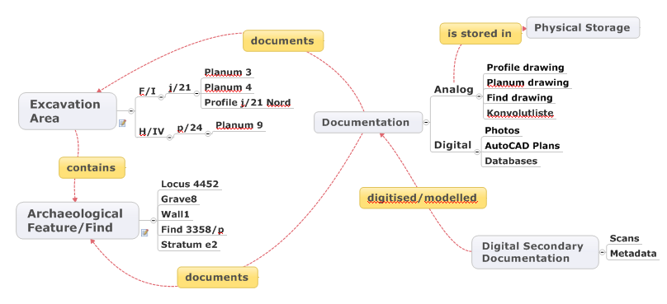
Data model
CIDOC CRM & Extensions
Excavation obj. – archaeological obj.
CRMscience & CRMarchaeo
CRMdig

Slide 14
What questions do we want to answer with our Metadata
All documents for an excavation object (e.g. Site TD ,Area F/1, SQUARE j/21, Planum 3)
All documents for an archaeological object type (e.g. grave, wall , vase, ….)
All documents for an archaeological object (e.g. grave 5 and walls in Site TD - Area F/1 - SQUARE j/21 - Planum 3)
All archaeological objects of a specific type in an area
How to create identifiers for (... in what context is a name unique) :
Documents
Archaeological objects
Excavation objects
Physical storage
Files
How do documents, excavation objects and archaeological objects relate
“Grave2” in “Site TD - Area F/1 - Square j/21 - Planum 3” and “Planum 4”
Planum drawing “FZ 3771” shows “Site TD - Area F/1 - Square j/21 - Planum 3”

Slide 15
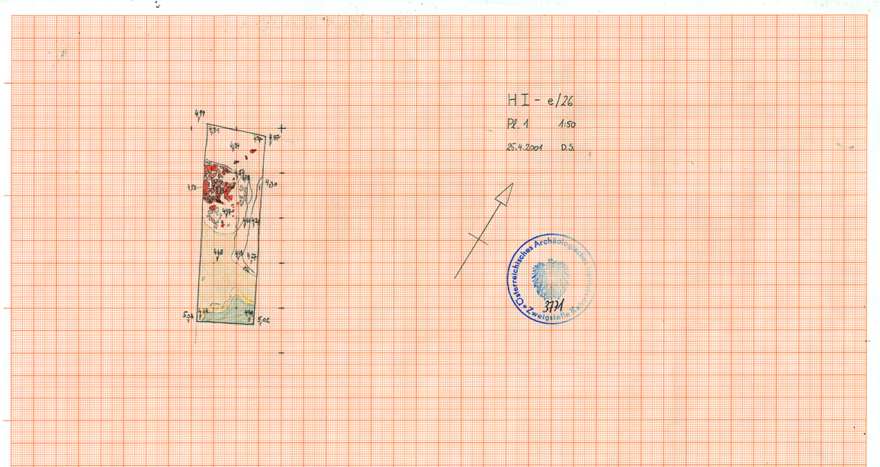
Test data – field drawing
Filename | Scan_Titel | Scan_Date | Creator | Equipment | Resolution_dpi | Dokument_ID | Mappe | Dokumententyp | DT_Abk | Dokumenten_Detailtyp | DDT_Abk
TD_H-I_e26_Planum1__TD_FZ_3771 | TD_H-I_e26_Planum1 | 15.04.2016 | Natalie Monschein | EPSON expression 10000XL | 600 | TD_FZ_3771 | H I_e/26 Pl. Det. Prof. | Feldzeichnung | FZ | Planum | PL
Inventar | Inventar_Sig | Datum | Jahr | Saison | Monat | Zeichner | Zeichner Monogramm | Copyright | Maßstab | Typ | Fundstelle
3771 |  | 25.04.2001 | 2001 | F | April | Dieta Svoboda | DS | ÖAI | 1:50 | Millimeterpapier | TD
Excavation obj ID
Areal | Planquadrat_Schnitt | Planum | Locus | Profilrichtung | Stratum | Grabungs_objekte ID | Arch_objekte ID | Feldbeobachtung_Aufarbeitung | Blattvermerk | Scanvermerk
H-I | e26 | 1 |  |  |  | TD_H-I_e26_Planum1_2001F |  | Feldbeobachtung

Slide 16
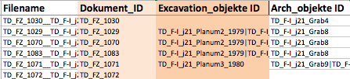
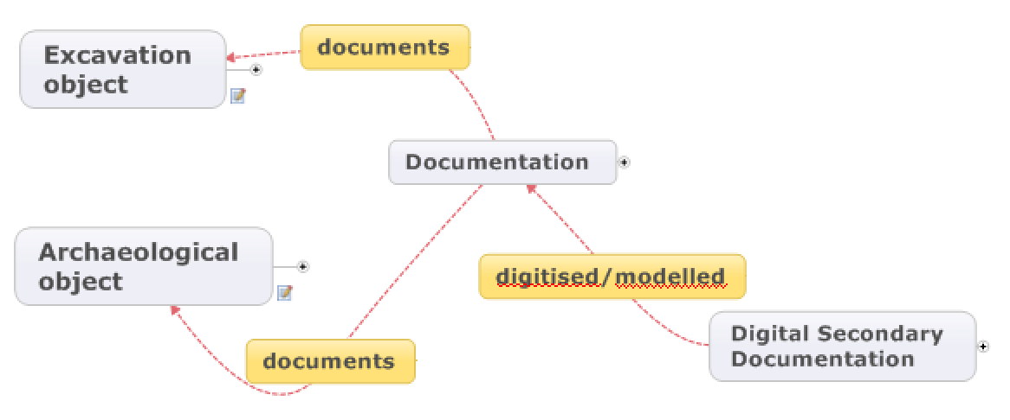
Metadata entry - expert users
Excel with macros to allow 1:n relations
data validation for controlled vocabularies (Identifiers & Terms)
Physical Documentation - Field Drawings

Slide 17
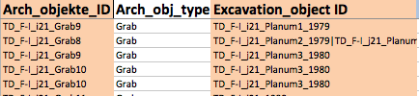
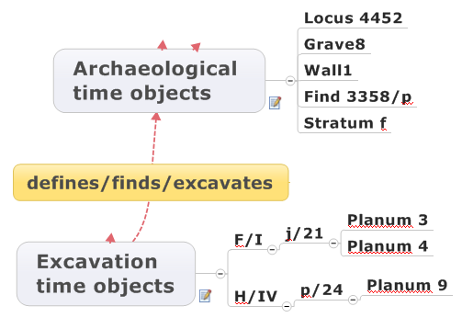
Metadata entry
Identifiers, hierarchies, terms and relations
for Excavation Objects and Archaeological Objects

Slide 18
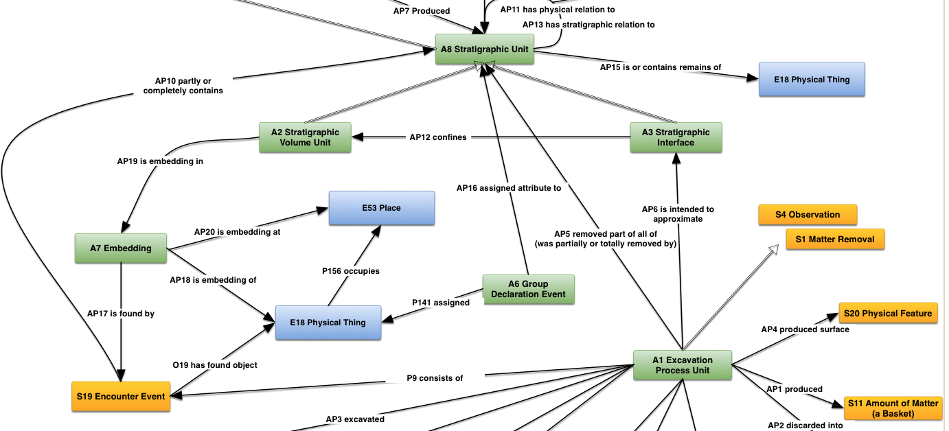

Slide 19
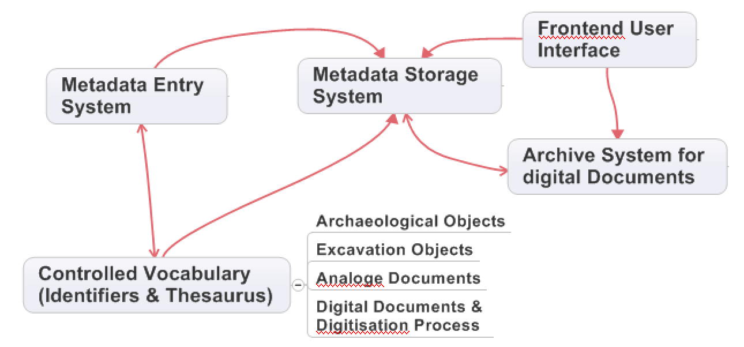
System architecture
System architecture
???
Triple Store
Excel
Fedora 4.0 ?
Excel & SKOS
Independent system components (ideally open source) –
open interfaces between components – more important than open source !!!!

Slide 20
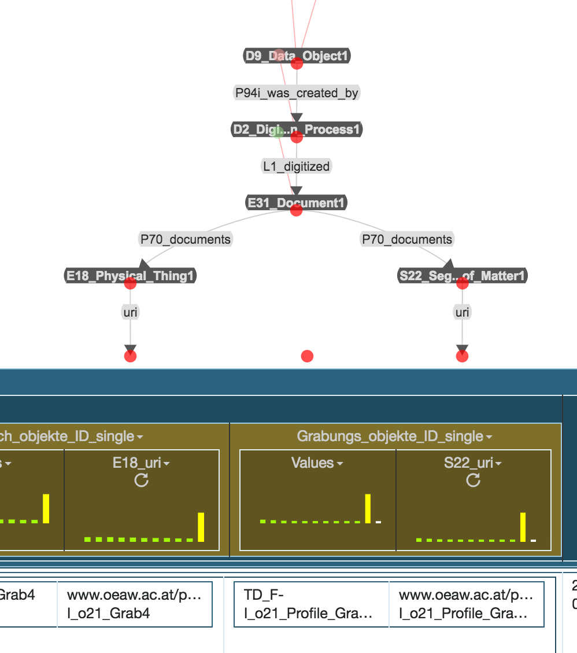
RDF creation
Metadata storage system – how to get the data in ?
File
e.g.
Karma tool
Transform Excel to RDF
CIDOC CRM & Extensions
Integrate data for different sources
Field Drawings
Fotos
…....
Controlled Vocabularies
Archiving System (file locations)
Field Drawing
Archaeological object
Excavation object

Slide 21
Metadata querying
Simple querying to
test data model
test triple store implementation
make quality control
Queries like:
All documents for an excavation areas (e.g. Site TD, Area F/1, SQUARE j/21)
All documents for an archaeological feature/find type (e.g. grave, wall, vase,...)
All documents for an archaeological feature/find (e.g. grave 5 and walls in Site TD - Area F/1 - SQUARE j/21 - Planum 3)
Possible workflows
a) Denormalize data from Triple Store through SPARQL Query -> import to Excel
-> Use Excel filter functions for the queries
b) Query directly in Triple Store via SPARQL (with predefined queries) c) Simple web application allowing browsing and search working on a snapshot of the data from triple store

Slide 22

Thank you for your attention!

