Slide 1
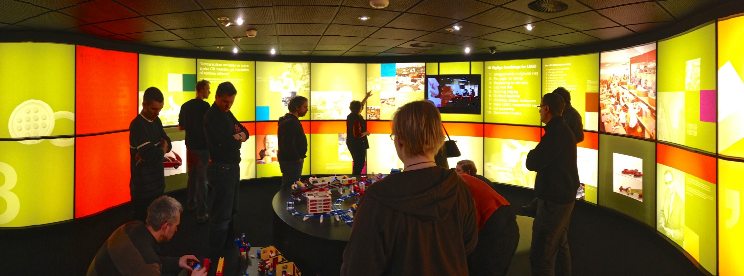

Social Semantic Information Space
An Interactive Learning Environment Fostering Creativity
Grant agreement no: 318552
32nd CIDOC CRM-SIG & 26th FRBR CRM Harmonization Meeting
Chryssoula Bekiari
Oxford
February 2015

Slide 2
The goal
IdeaGarden aims to develop a creative environment that leverages state of the art hard- and software technologies to support practitioning designers/innovators from EOOS and LEGO and students from Muthesius Academy of Fine Arts and Design during all phases of the creative process.

Slide 3
Core use cases
Give me all the assets** that are connected to an idea/to a project/ to an insight
Give me a set of similar or dissimilar assets to the one that I have here
Give me an indication of the differences from the previous versions
** A self-contained chunk of information such as a sketch, photo or phrase. In combination with other graphical elements more complex visual information assets can be created

Slide 4
Social Semantic Information Space
Solution :
Integration of enterprise knowledge
Linked metadata of creative processes and products
Data cloud
File system
database
Enterprise knowledge
Linked Metadata Repository
Middleware
User Interface
**Store data in a certain structure
Notes:
The solution we envisage
Middleware contains, directory services, metadata extractor, mapping services, query manager (application logic interfaces java/ c#/ servlets..)
Linked metadata contains, interconnected metadata following an integration schema

Slide 5
Social Semantic Information Space
WP 5
Integration schema (ontology) for collected metadata
The Idea:
  Creative processes and their products are initiated and controlled by human activity in physical space-time!
  Things, data, people, times and places are causally related by events.
  Other relations are either deductions from events or found by creativity events.
  => we represent these relationships in linked metadata
  => we complement missing metadata by reasoning along the links
  Therefore we derive the integration scheme from our experience with ISO21127 and its adaptations to digital provenance and creative processes in KP-Lab !

Slide 6
The Social Information Space Ontology for Creativity (SSIS)
  is a core ontology,
  permits integration of information in an Open World,
  describes the semantics on intermediate and final products of Creativity,
can generate meaningful networks of knowledge by the abstraction:
creativity as meetings of people, things and information,
is comprehensible to both documentation experts and information scientists,
is inspired by ISO 21127 (CIDOC CRM and CRM Core), it is a collaboration with the three testbeds (LEGO, MK, EOOS),
can be encoded to various machine-readable formats:
  RDF Schema, OWL, etc. (ontology)
  RDF, XML, OWL, etc. (instances)
Notes:
monotonic in the sense of Domain Theory: that is, the existing SSIS’ constructs and the deductions made from them should remain valid and well-formed, even as new constructs are added to the SSIS.

Slide 7
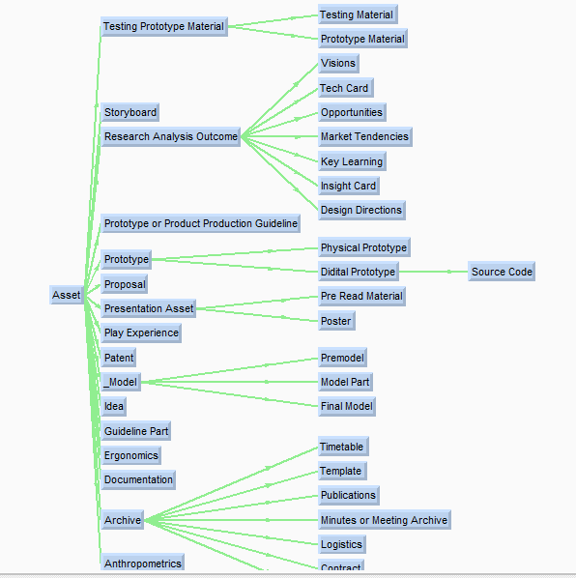
contract
award

Slide 8
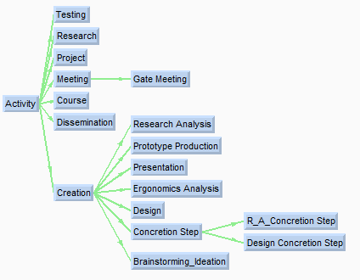
Activities are classified according to the outcomes produced during them

Slide 9
Thing
consists of
describes the continuation of an activity about a certain subject or idea which improves the idea or the subject[LEGO]
used (used by)
continues
concretizes (is concretized by)
took place
Activity
Place
carried out by
consists of concretion step
has designer
Actor
describes the decomposition of an instance of a real activity into concretion steps [LEGO]
has participant
has starting date
has ending date
has status
on going at
Concretion Step
Time-Span
Status

Slide 10
Entity
Activity
Thing
is based on
is informed by (inform)
is related to
has part(is part of)
is alternative
has version (is version of)
has derivative(is derivative of)
intellectual creations of models, sketches and designs, which will result in the production of final product or not
Creation
are processes during which the design objects are formulated into a final form/object.
[LEGO]
Design
Concretion Step
Asset
designed(is designed by)
Design Concretion Step
R_A_Concretion Step
Model
design processes during which the design objects are formulated into a final form/object.
[LEGO]
are processes of the research analysis during which the research objects are formulated into a final form/object..[LEGO]
Final Model
Model Part
Pre model

Slide 11
Entity
Thing
Activity
Asset
Creation
Idea
activities that collect images and other material, related to the design and the project requirements .[CORE]
created
Brainstorming /
Ideation
Ergonomic Analysis
Production
produced
Research
collected
Ergonomics
produced
Prototype
Prototype Production
Digital Prototype
Physical Prototype

Slide 12
Entity
Thing
assemblies of persons communicating within a face-to-face setting or via networked interactions between co-located and/or geographically distributed participants or a mix of both. Meetings may follow a particular Agenda. Meetings may imply the production of collaborative artefacts such as minutes. Meetings may include sessions, states, discussions made to decide and produce assets, sketching processes, etc.[CORE]
Activity
Asset
Meeting
Archive
document
Gate Meeting
produced
meetings between LEGO designers and the Stakeholders, which imply the production of collaborative artefacts such as minutes, presentations, and scorings. Those meetings have the purpose to guide the continuation of the design process.
Prototype
Minutes or Meeting Archive
Digital Prototype
Physical Prototype

Slide 13
User question: | Who collected the Information Asset “User testing”?
Answer: | “Insight Team”
The asked information is not immediately connected to a person or an actor “ but to the “Project”. However the system is able to answer this question by traversing the links.
Goal
a simple example of reasoning
“Design a game for boys”
has goal
Type
Project
Photograph
“Tank Truck”
collected
participated in
has type
Group
Information Asset
“Insight Team”
“User testing”
Notes:
Following this ontology we are able to answer the following queries discussed with LEGO

Slide 14
User question: | Give me all assets from “Design a game for girls”
Answer: | Insight “Girls like heroes”, Design Direction “Game for girls with hero”, Concept “Sketch1”, Concept “Sketch2”, Concept “Sketch3”, Final Product “Club girl”..
Type
Type
Type
Type
Type
Video
Insight
Design Direction
Concept
Final Product
has type
has type
has type
has type
has type
Information asset
refers to
Information asset
Information asset
Information asset
Information asset
Information asset
“User testing 4.6.2013”
“Girls like heroes”
Information asset
“Sketch1”
“Club girl”
“Game for girls
with heroes”
“Sketch2”
“Sketch1”
refers to
Information asset
“User testing 8.6.2013”
is version of
is version of
is version of
has type
is used by
Contextually related metadata
Type
Photograph
Project
Goal
r
“Club girls”
used
“Design a game for girls”
Notes:
Example of complexitry we can manage

Slide 15
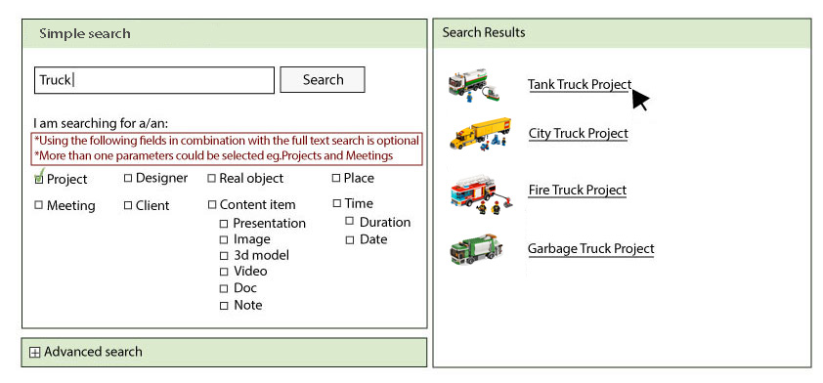
Application of Social Semantic Information Space
wireframes of Search interface – simple search (1)

Slide 16
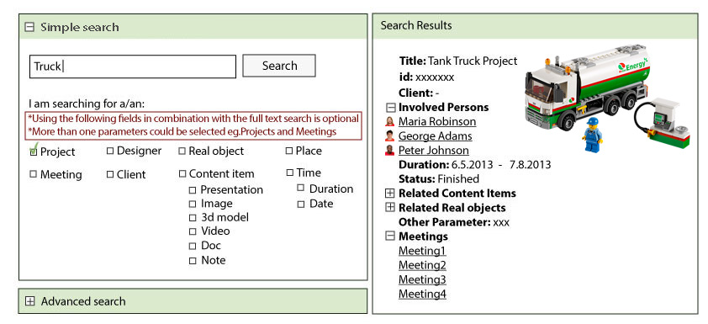
Application of Social Semantic Information Space
wireframes of Search interface – simple search (2)

Slide 17
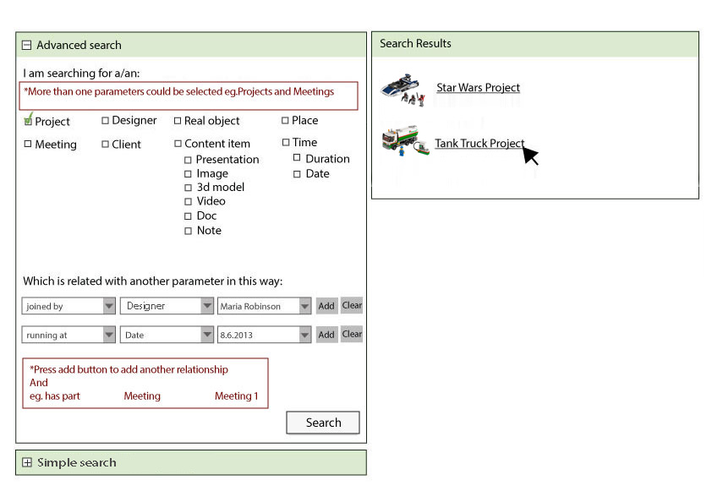
Application of Social Semantic Information Space
wireframes of Search interface – advanced search (1)

