Slide 1
CRM Inf erence
Supporting Facts by arguments
CIDOC 2018, Heraklion, Crete
Martin Dörr
Center for Cultural Informatics,
Institute of Computer Science
Foundation for Research and Technology – Hellas

Slide 2
Knowledge and Provenance
In science and humanities we seek to disseminate “the best of our knowledge”
but what is knowledge?
- a “justified belief”
…such as “I know Cesar was murdered, Nero did not sing in Rome while it was burning, Tut-Ankh-Amun died from a wound at his knee”. Beliefs have a strength, they consolidate into knowledge when they are multiply backed-up, plausible and consistent with other facts.
(Here we do not consider knowledge of mathematical inferences)

Slide 3
Knowledge and Provenance
But then what is an acceptable justification?
- a set of comprehensible arguments
i.e., relating/deriving beliefs from sources
potentially accessible to other people
by known forms of reasoning
sources are: material evidence, literature, witnesses. Accessible as
long as extent, not hidden, access devices available, physically reachable….
reasoning means: using categorical hypotheses, logic and comprehensible thought processes for interpretation, deduction/ induction/ abduction, trust or observation techniques, even including subjective “expert experience/feeling”.

Slide 4
Knowledge and Provenance
What matters is that other researchers can follow the argument, verify, falsify or criticize, if they have the means.
Consequently,
Reasoning may be subjective. The comprehensibility of the argument matters, not its rigor, not its conclusiveness.
All truth/validity depends ultimately on the sources. An argument is also a source. Sources must be objective/ unambiguous in their existence. They are the
Provenance of knowledge
We distinguish three forms of argument or provenance of knowledge by how they can be verified, : Observation, Inference, Belief Adoption

Slide 5
CRM Inf: Observation
All world knowledge roots ultimately in observation. Its truth refers to reality.
e.g., “I found a male skeleton”
Observations are supported/questioned/falsified by:
independent repetition => back to reality
independent observation with different method (e.g., DNA) => back to reality
Observations are supported/questioned by inference:
critique of instrument/senses and signal-to-value hypothesis (e.g., skull shape, occipital protuberance)
critique of method and process (e.g., cleaning, calibration, environment)
plausibility/ consistency with other information! (e.g., context)

Slide 6
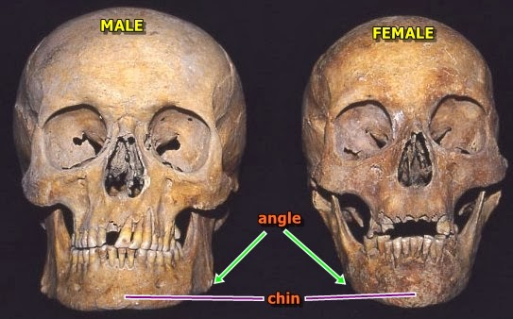
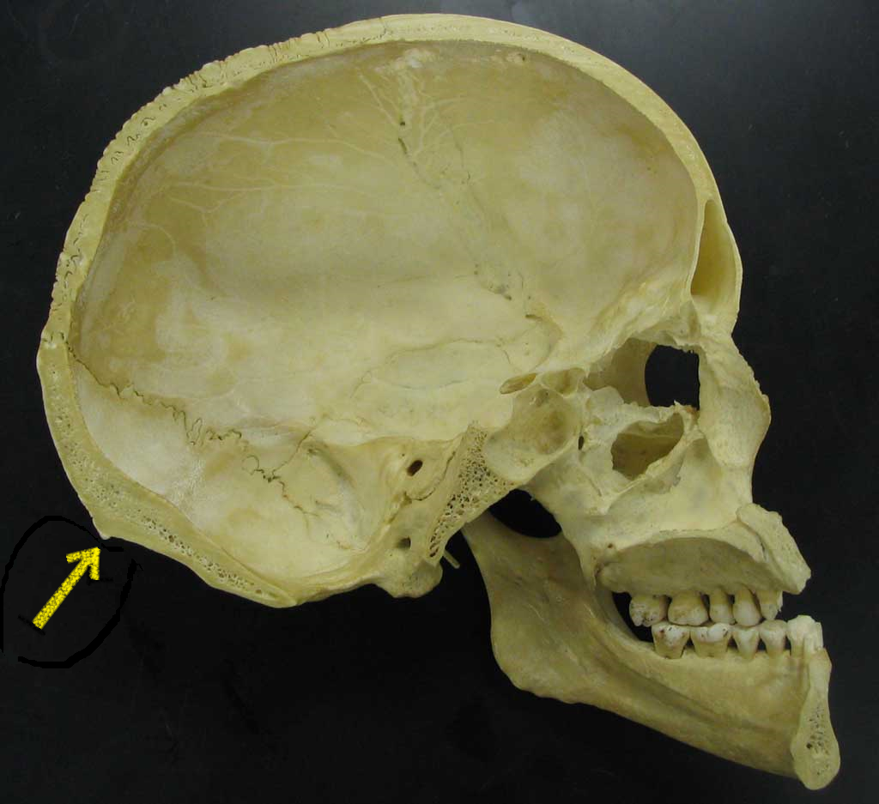
CRM Inf: Observation

Slide 7
CRM Inf: Inference
Interpretation (inferences) follows observation. Its validity is relative to premises.
e.g., “The skeleton was clad in armour => hence it was male”
False premises invalidate applicability of an (even correct) inference, but not the result.
Probabilistic or subjective inferences may be valid and premises be true, but results be false!
Inferences are supported/ verified/ falsified by:
critique of hypothesis (e.g., only men wore armour ?/ mostly men wore armour?) => back to source
critique of application of logic (e.g. no armour = female)
Results of inferences are supported/ verified/falsified by:
review of premises (e.g., was it really armour?) => back to source
plausibility/ consistency with other information! => other sources

Slide 8
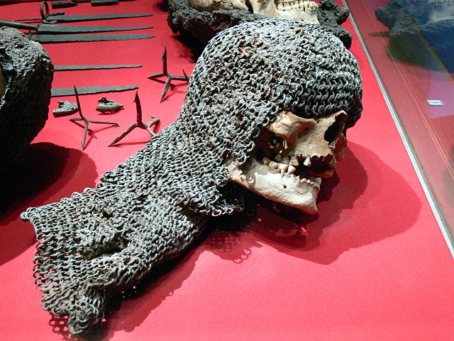
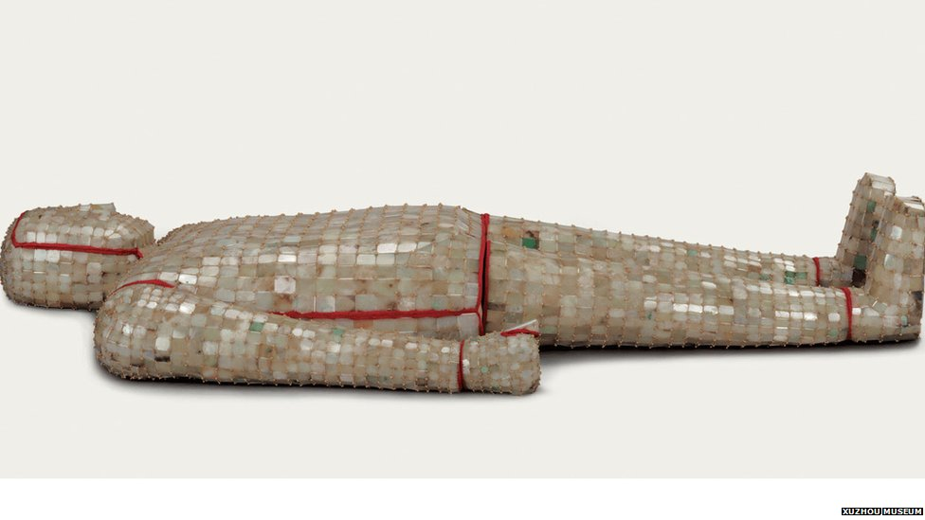
CRM Inf: Inference
Second King of Chu, he died in 175BC
By Wolfgang Sauber –
Own work, CC BY-SA 3.0, https://commons.wikimedia.org/w/index.php?curid=6319170

Slide 9
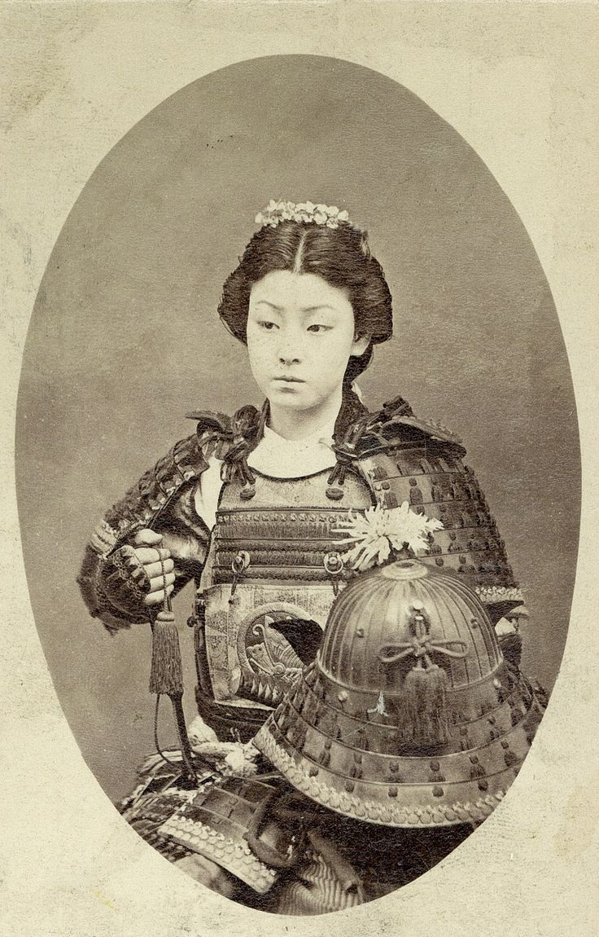
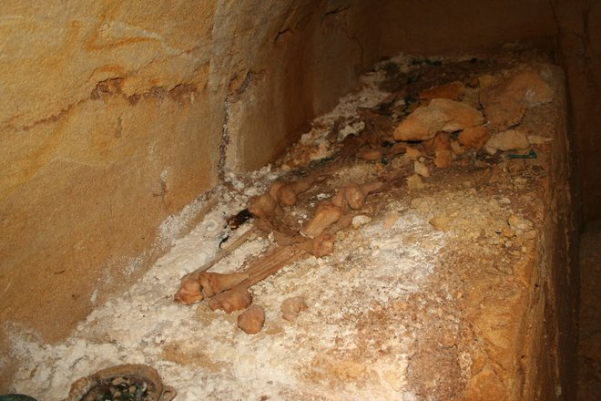
CRM Inf: Inference
A 2,600-year-old tomb unearthed in Tuscany, thought to hold a warrior prince actually contains the remains of a middle-age warrior princess holding a lance.
https://www.livescience.com/40530-etruscan-warrior-prince-is-a-princess.html
Female Onna Bugeisha c. late 1800s Meiji Era

Slide 10
CRM Inf: Belief Adoption
We adopt (most) knowledge from other people, typically referred to by citations. Belief in it is mostly based on trust.
e.g., “(Stevenson 1921) writes: I found a skeleton was clad in armour”
knowledge from other people is supported/ questioned by:
Critique of referred inference, if there is any and is exhaustively described => the only “self-contained” source of knowledge
Trust in authenticity of source => back to source of source
Trust in truth of referred method of observation if any => back to other sources of/about authors, back to reality (if extant).
Trust in referred provenance of sources => back to sources (if extant), back to other sources of/about authors
plausibility/ consistency with other information! (e.g., context) => back to other sources

Slide 11
CRMinf :
“why is it true that?”
status:

Slide 12
The Three Sources of Scientific Knowledge
has belief
time
E52 Time-Span
Here is CRMInf:
starts
that
I4 Proposition Set
I1 Argumentation
J2 concluded
that
I2 Belief
is
I6 Belief Value
I5 Inference Making
I7 Belief Adoption
(True, False, Unknown
probable, unlikely…..)
S4 Observation
(Here is CRMSci)
property
CRM Entity
CRMSci Entity
IsA
CRMInf Entity

Slide 13
The Three Sources of Scientific Knowledge
Here is the provenance!
carried out by
E73 Information Object
E39 Actor
E7 Activity
P94 has created
P148 has
component
E65 Creation
has belief
time
E52 Time-Span
that
I4 Proposition Set
I1 Argumentation
J2 concluded
that
I2 Belief
is
I6 Belief Value
I5 Inference Making
I7 Belief Adoption
S4 Observation
property
CRM Entity
CRMSci Entity
IsA
CRMInf Entity

Slide 14
The Three Sources of Scientific Knowledge
carried out by
E73 Information Object
E39 Actor
E7 Activity
P94 has created
P148 has
component
E65 Creation
has belief
time
E52 Time-Span
that
I4 Proposition Set
I1 Argumentation
J2 concluded
that
I2 Belief
is
I6 Belief Value
I5 Inference Making
I7 Belief Adoption
S4 Observation
S6 Data Evaluation
S8 Categorical
Hypothesis Building
S7 Simulation
or Prediction
CRMSci extends Inference Making
property
CRM Entity
CRMSci Entity
IsA
CRMInf Entity

Slide 15
Inference Making:
has belief
time
E52 Time-Span
that
I4 Proposition Set
I1 Argumentation
J2 concluded
that
I2 Belief
is
I6 Belief Value
J1 used as
premise
(True, False, Unknown)
I5 Inference Making
Here is the provenance!
J3 applies
I3 Inference Logic
Validity is relative to truth of premise.
“I3 Inference Logic” comprises all categorical
hypotheses and logic
property
CRM Entity
CRMSci Entity
IsA
CRMInf Entity

Slide 16
Belief Adoption
has belief
time
E52 Time-Span
…is made my own belief!
that
I4 Proposition Set
I1 Argumentation
J2 concluded
that
I2 Belief
is
I6 Belief Value
J6 adopted
belief
(True, False, Unknown)
I7 Belief Adoption
another person’s belief…
Here is the provenance!
J7 is based on evidence from
E73 Information Object
Belief Adoption may be merged
with I5 Inference making.
property
CRM Entity
CRMSci Entity
IsA
CRMInf Entity

Slide 17
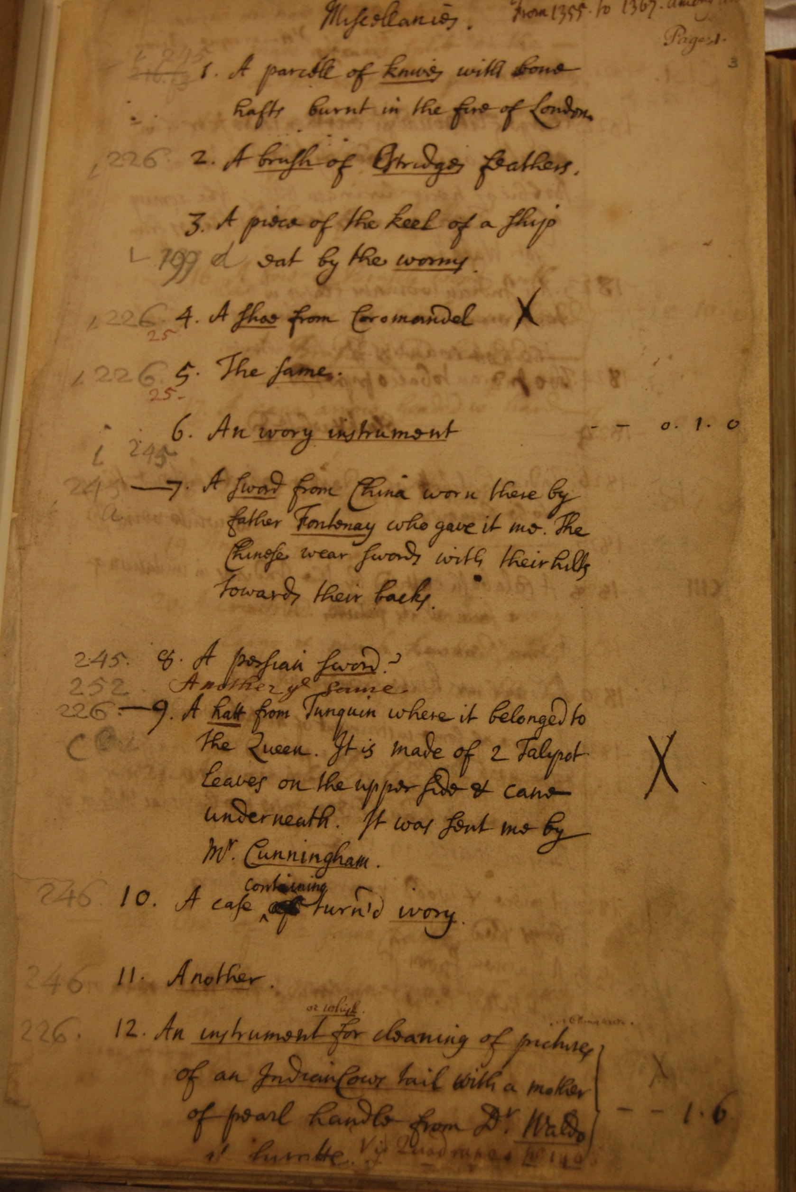
Modelling beliefs in the evolution of a text and inventory
E39 Actor
P14 carried out by
I5 Inference Making
J2 concluded that
I2 Belief
Stephen
Evolution Decision
Stephen’s Belief in Evolution A of Misc 4
J1 used as premise
J3 applies
J4 that
J5 holds to be
I2 Belief
I3 Inference Logic
BM Belief in Spatial Relations of Misc 4
Catalogue Text Rules
I4 Proposition Set
I6 Belief Value
was written after
True
J4 that
J5 holds to be
I4 Proposition Set
I6 Belief Value
is left of main margin
True
Hans Sloane collection inventory entry
(slide taken from Stephen Stead, Paveprime Ltd)

Slide 18
CRM Inf: Current developments
Observations are well understood. Work on modelling multi-parameter observations and environmental situations. What is an observable entity?
CRMSci/ CRMdig - Knowledge from observation, measurement, scanning, data evaluation and (computer)simulation
Belief adoption: Modelling reasoning about textual sources:
Phase 1: From material object to transcript (observation: epigraphy), e.g.: “T e rabb t s eady f lun h”
Phase 2: From transcript to propositions (linguistic inference) e.g.: “The rabbit is ready for lunch” - sense 1: to eat, sense 2: to be eaten.
Phase 3: From proposition to referred fact (contextual inference) e.g.: “sense 2, refers to dinner at John Miller’s 22/3/1856”
Phase 4: From referred fact to reality (belief adoption) e.g.: “the dinner at John Miller’s was fiction”
Most frequently needed phase 4 only, but sometimes all of them.

Slide 19
Latest Discussion CRM Inf: using citations
J2 concluded that
(was concluded by)
I5/S5 Inference Making
I8 Conviction
J1 used as premise
(was premise for)
I2 Belief
I9 Citation
J8 understands
(is understood by)
E73 Information Object
J9 believes in provenance
(provenance is believed by)
Surprising: Using a Citation is a belief
in its provenance (authenticity) and
understanding its meaning,
not in its content.
I4 Proposition Set

Slide 20
CRM Inf: Challenges
Exhaustive documentation of reasoning in empirical sciences and humanities is practically impossible. Too much low-relevance or self-evident back-ground knowledge.
What makes a premise/ hypothesis note-worthy as argument?
Facts argued with, for and about are rarely in KR form, mostly in texts, often in images, but sometimes are important content of databases.,
Textual arguments are incomplete. They mention a few “tip-of-the-iceberg” facts, often indirectly related to database content.

Slide 21
CRM Inf: Challenges
How to connect efficiently database content with note-worthy facts in machine-readable form?
RDF reification is inefficient.
Need a model of premises & conclusions
generalizing over “named graphs” of database-content portions, textual and graphical representations of facts and arguments.
without introducing interpretational ambiguity between text and formal propositions (database fields)
still indexing relevant entities in text/graphic
Even if reasoning and hypotheses are incomplete, the sources and non-trivial hypotheses used can be documented efficiently!
Then, arguments can be comprehended and automatically be connected.

Slide 22
Conclusions
The typical AI endeavor of automatically resolving and guaranteeing validity of inference is the most difficult but least important part. It will never be complete. Plausibility arguments dominate and cannot be formalized (so far).
The sources, i.e. the provenance of knowledge, consisting of people knowing and documents and objects of evidence and hypotheses formulation
form a directed graph beginning with actual, reported or assumed observation.
Machine representation of this (even incomplete) graph allows for tracing the deep impact of positive and negative knowledge from not-before anticipated sources on current convictions and their mutual consistency.
CRMinf is effective to connect individual arguments into a provenance graph.
More work to be done to understand the nature and representation of the argumentation gaps, the “self-evident”, how to expand gaps on demand.

