Slide 1
CRM-SIG,Berlin, 8.12.2016
A co reference approach for spatiotemporal places with usage scenarios
Gerald Hiebel, Klaus Hanke, Unit for Surveying and Geoinformation, University of Innsbruck
Craig Knoblock, Pedro Szekely, ISI, University of Southern California
Claudia Posch, Gerhard Rampl, Institute for Linguistics, University of Innsbruck
Notes:
The next 15 minutes we are going to deal with “Titel”. Unfortunately one of the co-authors, Joachim Lutz can‘t be here today – I will try to answer your questions with all the tools he tought me until now.

Slide 2
CRM-SIG,Berlin, 8.12.2016
Overview
Representing Place Information with CRM and CRMgeo
CRMgeo model overview
Relations between places
Information Sources
Gazetteers
A semantic model of co referencing places in information sources to gazetteers
Usage scenarios?
Help in the Co reference of museum artists to wikipedia artists
Semantics for Mountaineering History
Notes:
The next 15 minutes we are going to deal with “Titel”. Unfortunately one of the co-authors, Joachim Lutz can‘t be here today – I will try to answer your questions with all the tools he tought me until now.

Slide 3
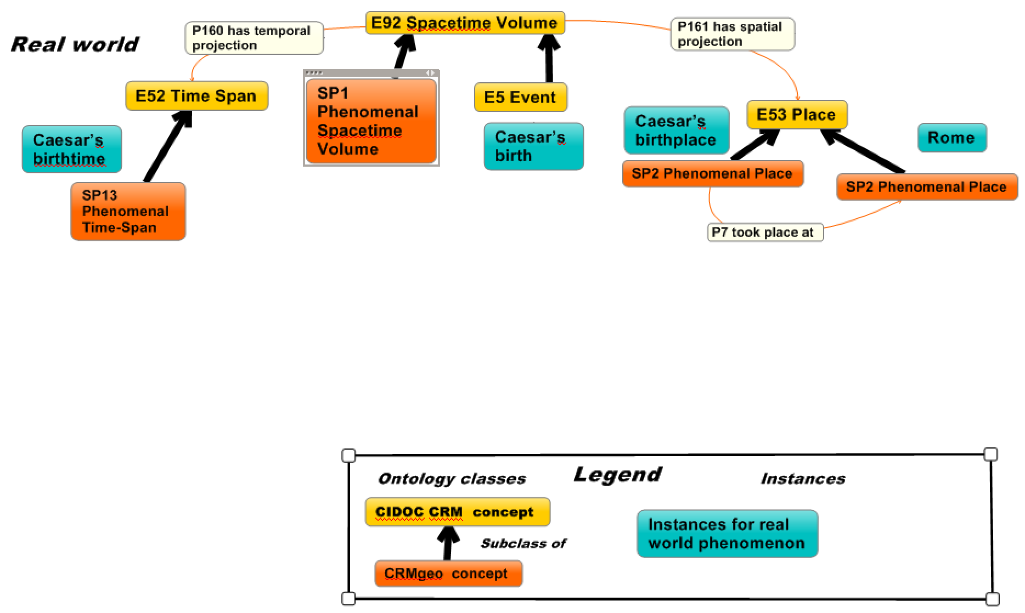
CRM-SIG,Berlin, 8.12.2016
CRMgeo Model Overview
Caesar’s Birth in the real world
Notes:
The next 15 minutes we are going to deal with “Titel”. Unfortunately one of the co-authors, Joachim Lutz can‘t be here today – I will try to answer your questions with all the tools he tought me until now.

Slide 4
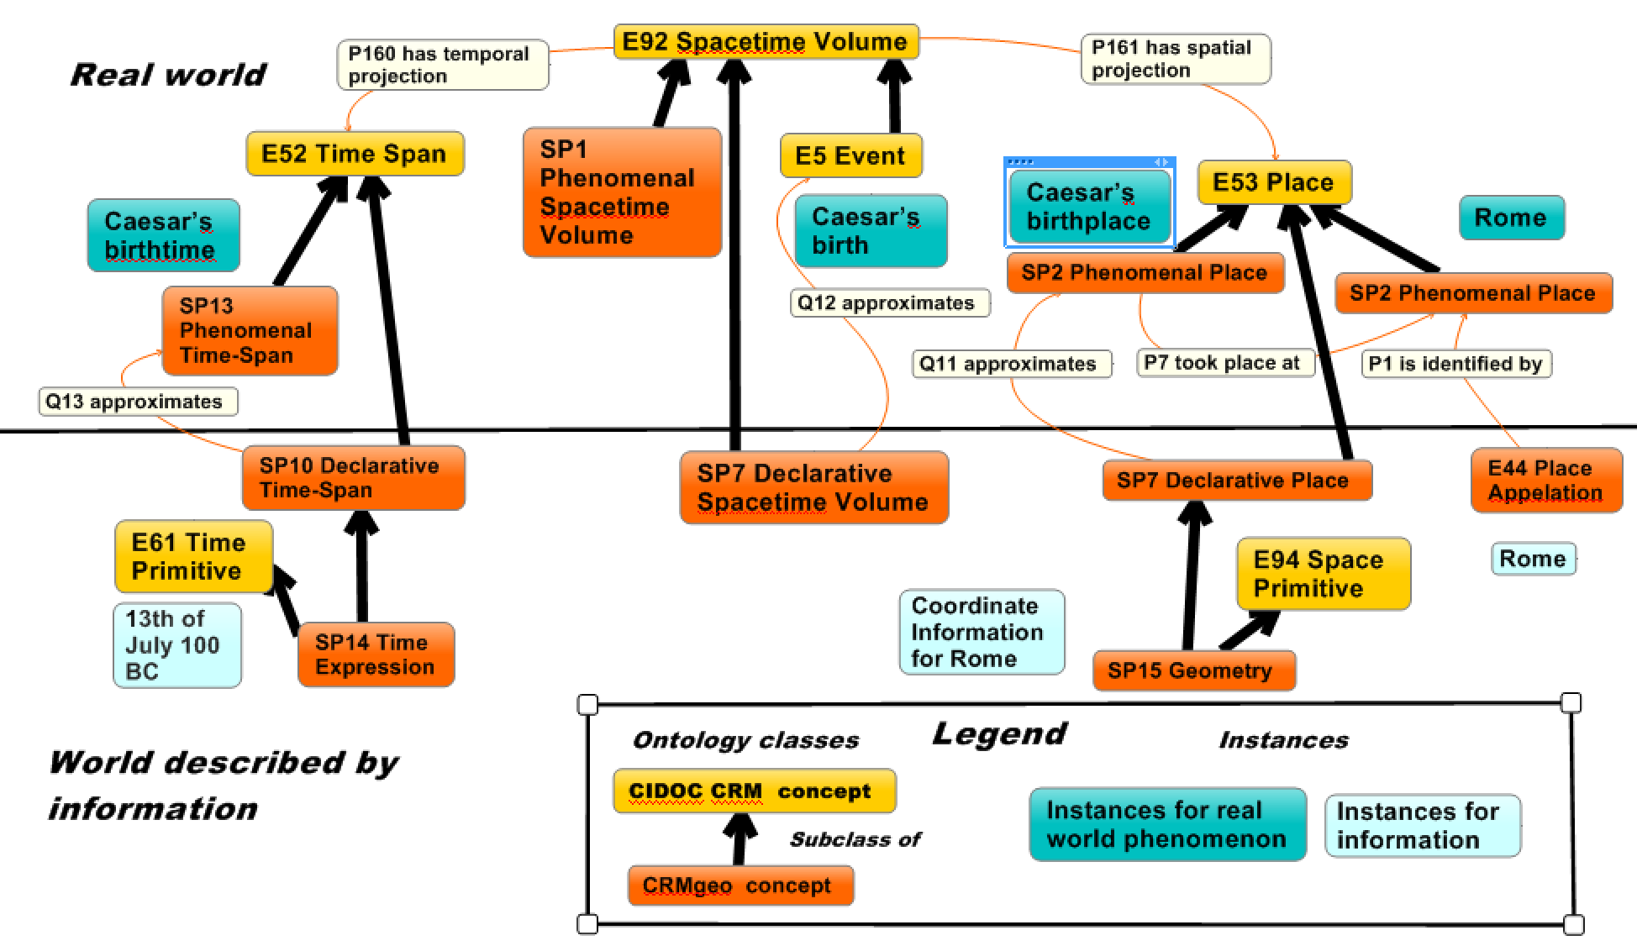
CRM-SIG,Berlin, 8.12.2016
Model Overview
Caesar’s birth in the world described by information
Identity criteria for places - CRMgeo
Notes:
The next 15 minutes we are going to deal with “Titel”. Unfortunately one of the co-authors, Joachim Lutz can‘t be here today – I will try to answer your questions with all the tools he tought me until now.

Slide 5
CRM-SIG,Berlin, 8.12.2016
Relations between places
CRM:
P10 falls within, P9 consists of, P132 overlaps with, P46 is composed of, P133 is separated from (spatiotemporal)
P89 falls within, P121 overlaps with, P122 borders with, P7 took place at (spatial)
CRMgeo:
Q11, Q12 approximates (spatial/spatiotemporal)
GeoSPARQL:
sfcontains, sfborders,… (spatial)
Owl:
same as
Notes:
The next 15 minutes we are going to deal with “Titel”. Unfortunately one of the co-authors, Joachim Lutz can‘t be here today – I will try to answer your questions with all the tools he tought me until now.

Slide 6
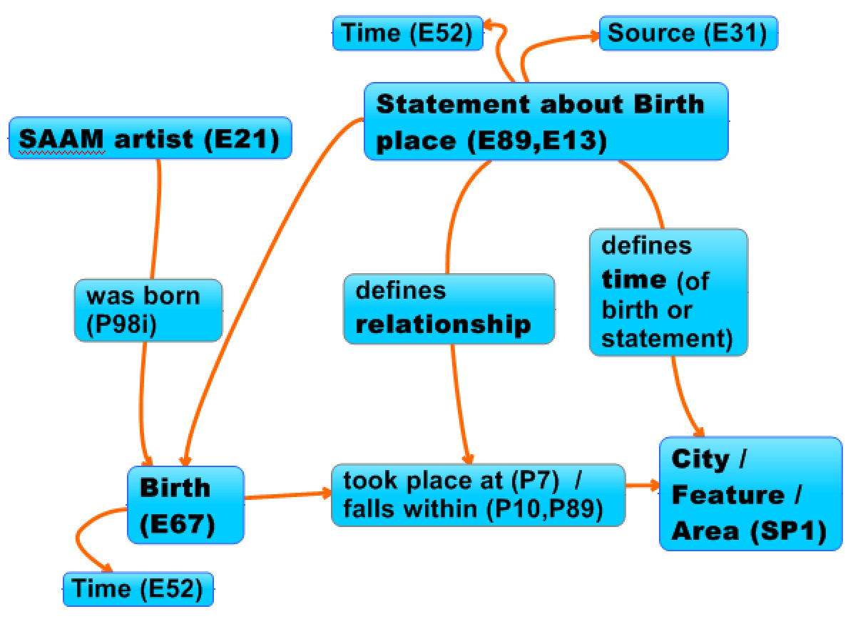
CRM-SIG,Berlin, 8.12.2016
Representing Information Sources with CRM and CRMgeo
e.g. Smithsonian American Art Museum (SAAM)
Birth places of artists
Notes:
The next 15 minutes we are going to deal with “Titel”. Unfortunately one of the co-authors, Joachim Lutz can‘t be here today – I will try to answer your questions with all the tools he tought me until now.

Slide 7
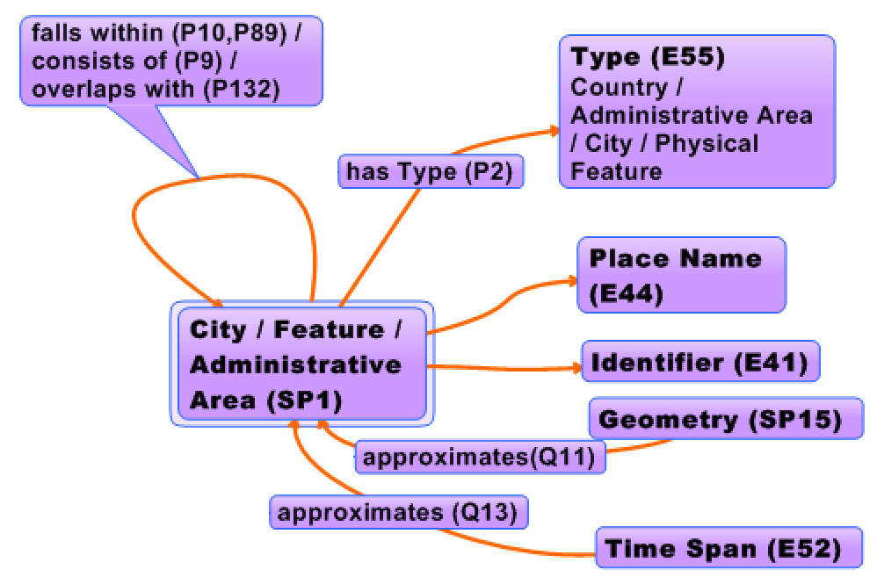
CRM-SIG,Berlin, 8.12.2016
Representing Gazetteers with CRM and CRMgeo
Gazetteers
Notes:
The next 15 minutes we are going to deal with “Titel”. Unfortunately one of the co-authors, Joachim Lutz can‘t be here today – I will try to answer your questions with all the tools he tought me until now.

Slide 8
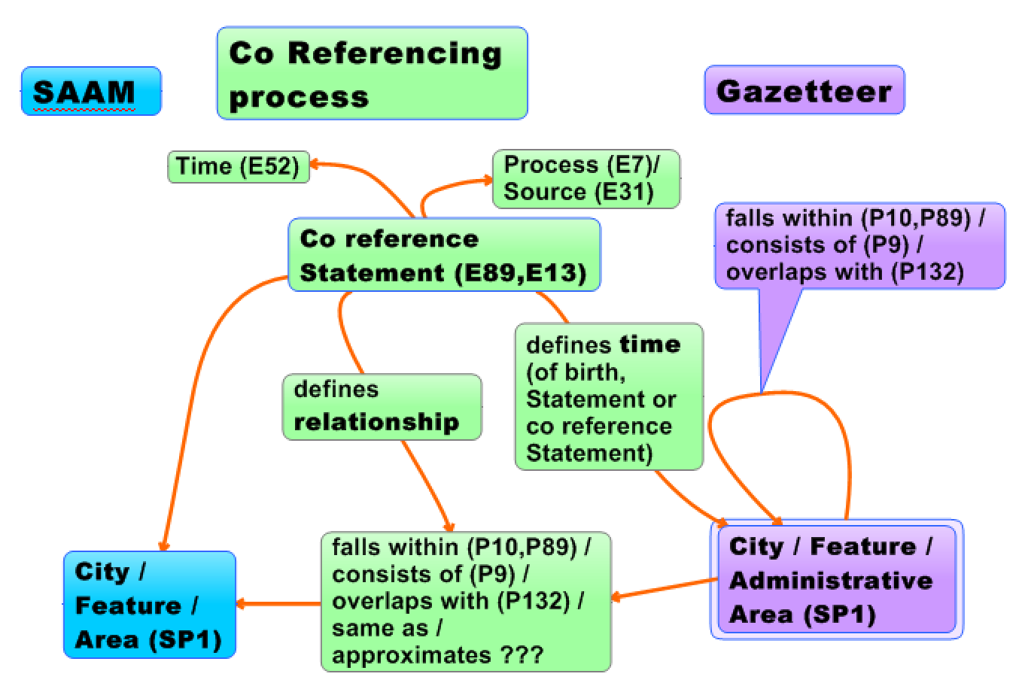
CRM-SIG,Berlin, 8.12.2016
Representing the co referncing process
Gazetteers
Notes:
The next 15 minutes we are going to deal with “Titel”. Unfortunately one of the co-authors, Joachim Lutz can‘t be here today – I will try to answer your questions with all the tools he tought me until now.

Slide 9
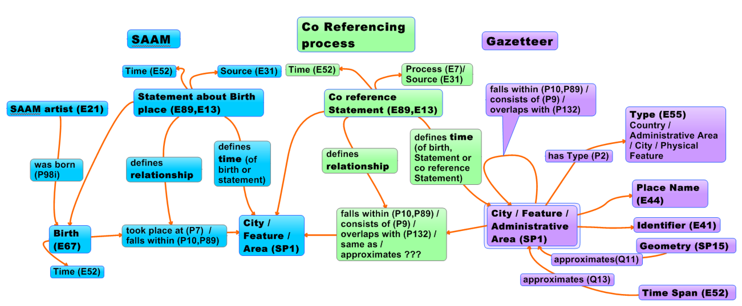
CRM-SIG,Berlin, 8.12.2016
Representing the co refernce process
Overview
Notes:
The next 15 minutes we are going to deal with “Titel”. Unfortunately one of the co-authors, Joachim Lutz can‘t be here today – I will try to answer your questions with all the tools he tought me until now.

Slide 10
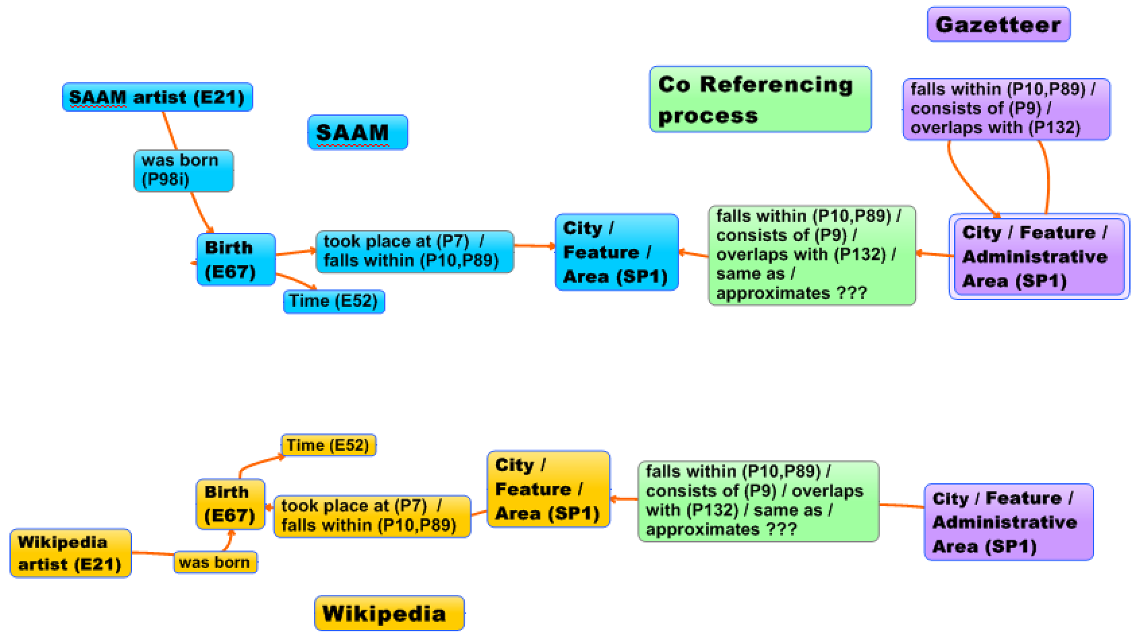
CRM-SIG,Berlin, 8.12.2016
Usage scenarios
Co refer SAAM Artists and Wikipedia Artists
1. Co refer Gazetteer for both sources
Notes:
The next 15 minutes we are going to deal with “Titel”. Unfortunately one of the co-authors, Joachim Lutz can‘t be here today – I will try to answer your questions with all the tools he tought me until now.

Slide 11
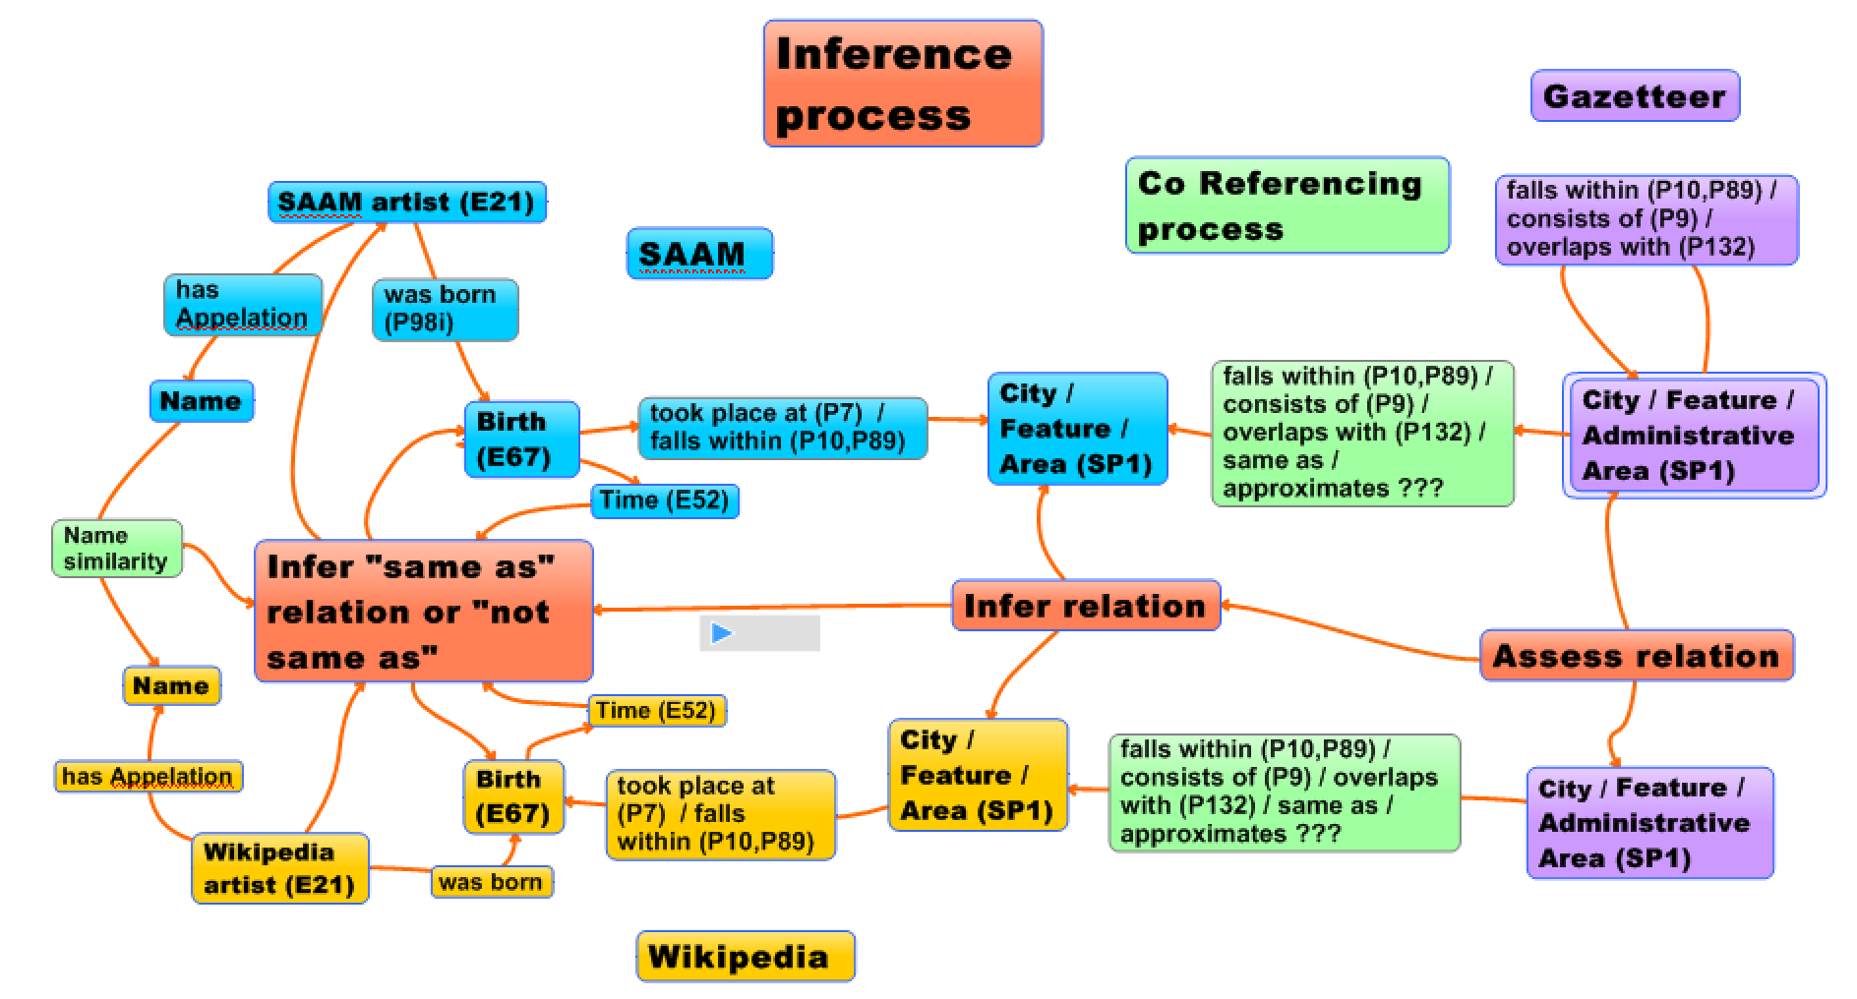
CRM-SIG,Berlin, 8.12.2016
Usage scenarios
Co refer SAAM Artists and Wikipedia Artists
2. Inference based on Gazetteer relations
Notes:
The next 15 minutes we are going to deal with “Titel”. Unfortunately one of the co-authors, Joachim Lutz can‘t be here today – I will try to answer your questions with all the tools he tought me until now.

Slide 12

CRM-SIG,Berlin, 8.12.2016
Usage scenarios: Semantics for Mountaineering history
The Austrian Alpine Journal as a Corpus (1869-today)
scientific essays, expedition and mountaineering reports, route descriptions, descriptions of mountains and mountain ranges, alpine literature
total: 42.118 pages
The go!digital project Alpenwort (2014 - 2017) has turned the Austrian Alpine Club Magazine documenting 146 years of mountaineering history into the linguistically annotated Alpenwort corpus.
Notes:
The next 15 minutes we are going to deal with “Titel”. Unfortunately one of the co-authors, Joachim Lutz can‘t be here today – I will try to answer your questions with all the tools he tought me until now.

Slide 13
CRM-SIG,Berlin, 8.12.2016
Project: Semantics for Mountaineering history
Goal: Identify locations, people and first ascent events in the Alpenwort corpus
Sources:
Alpenwort corpus:
POS- (Parts of Speech) tagged and TEI-encoded. Named entities are tagged.
Photo Index of the Austrian Alpine Club:
from the years 1927 to 1941 containing descriptions for approx. 32.000 photos of which 85 % depict places of some kind
Toponyms of Tyrol:
Over 125000 toponyms collected in a project of the linguistic institute
LOD Sources: Wikipedia, Geonames, Gemeinsame Normdatei
Notes:
The next 15 minutes we are going to deal with “Titel”. Unfortunately one of the co-authors, Joachim Lutz can‘t be here today – I will try to answer your questions with all the tools he tought me until now.

Slide 14
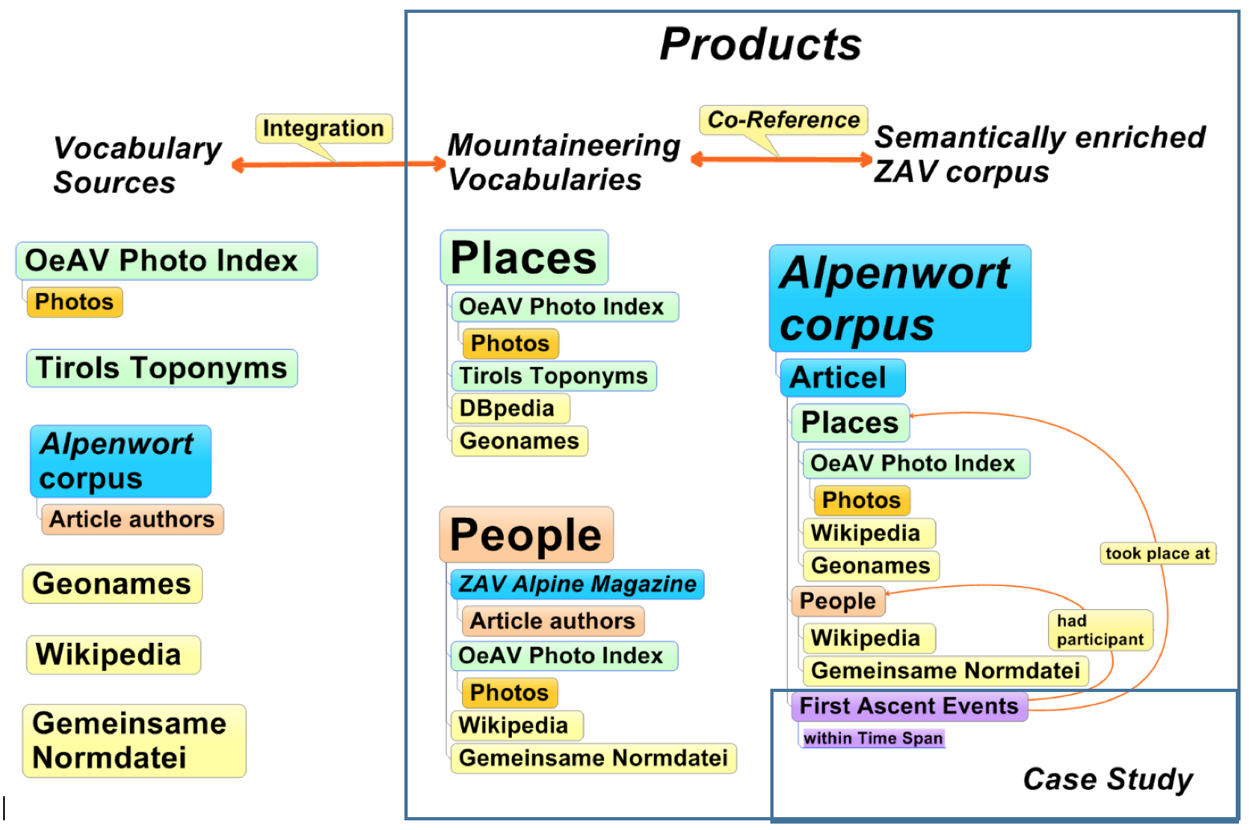
CRM-SIG,Berlin, 8.12.2016
Semantics for Mountaineering history
Notes:
The next 15 minutes we are going to deal with “Titel”. Unfortunately one of the co-authors, Joachim Lutz can‘t be here today – I will try to answer your questions with all the tools he tought me until now.

Slide 15
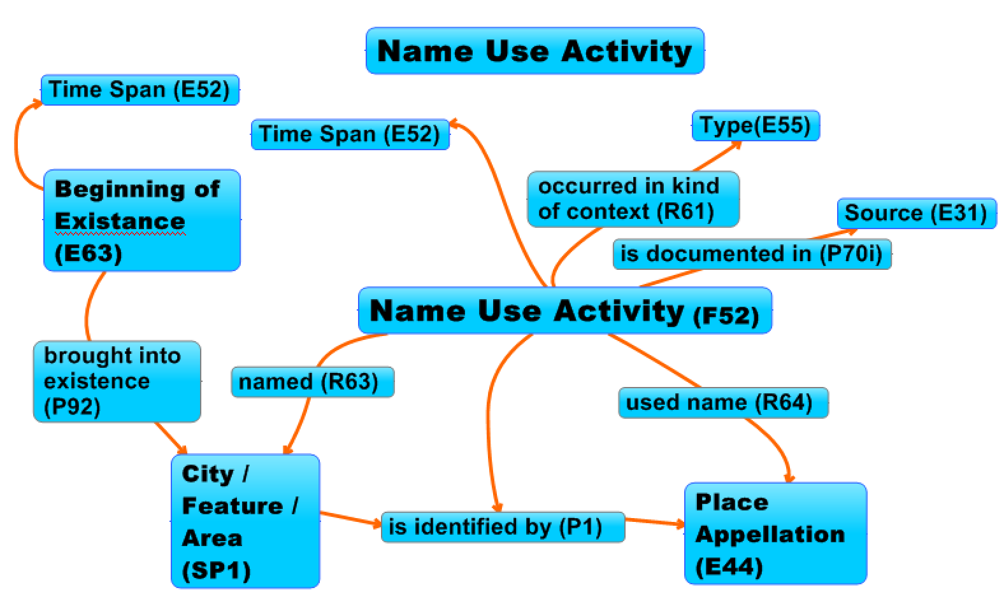
CRM-SIG,Berlin, 8.12.2016
Model Toponym Research
Notes:
The next 15 minutes we are going to deal with “Titel”. Unfortunately one of the co-authors, Joachim Lutz can‘t be here today – I will try to answer your questions with all the tools he tought me until now.

