Slide 1
CRMarcheo editorial issues
CRM SIG Athens February 2020

Slide 2
The Archaeological Digital Excavation Documentation – ADED
An infrastructure for all digitally born excavation data sets in Norway
  Project period 2018 – 2021
Data sets with geo-references objects:
  Structures, profiles, layers, points
  Structural relationships between object
  Text and visual documentation of the objects
The data sets will be included into a single searchable information system

Slide 3
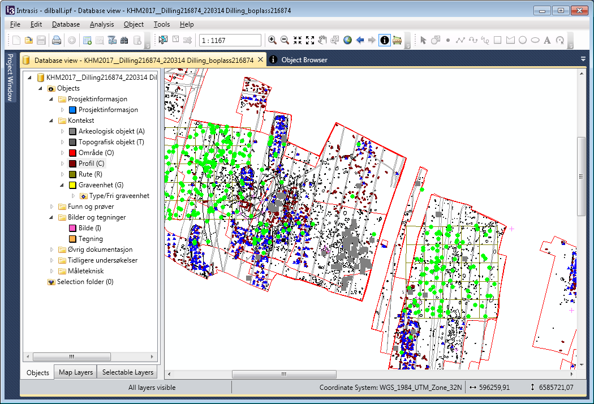
1200 excavation data set (Intrasis)

Slide 4
Data mapping
INTRASIS underlaying database is postgreSql + postGis
Export the data to a INTRASIS near format for documentation
Map the data to CRMarcheo compatible format
This format will be a used as
  an import format for the common database
  Intermediat format for linked data, ARIADNEplus
  Long term storage format

Slide 5
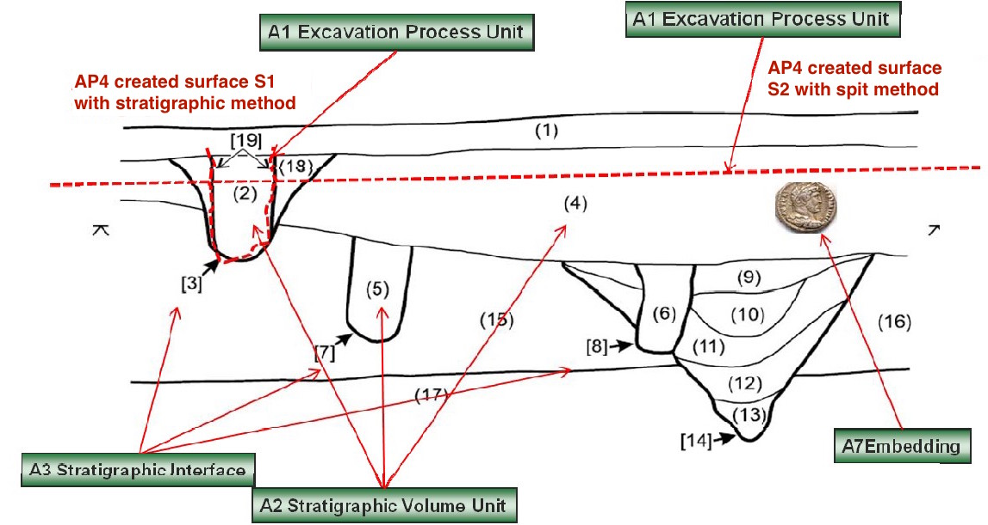
Figure 4 from CRMarcheo 1.4.7
Fig. 4: Section drawing with A3 Stratigraphic Interfaces in square brackets [], A2 Stratigraphic Volume Unit in round brackets (), the surfaces S1 and S2 created through A1 Excavation Process Units using different methodologies and an A7 Embedding of a coin.

Slide 6
Figure 4 from CRMarcheo 1.4.7
A10 Excavation Interface
A10 Excavation Interface
Assume that S2 was create first, that is a mechanical layer cut through 2, 3, 18 and 19. How do we model the relation between S2 (A10 Excavation Interface) and 2, 3, 18 and 19 (A8 Stratigraphic Unit)? A more common example would be a vertical profile cut through 2, 3, 18 and 19 . The modelling issue is identical

Slide 7
The archeological structures and excavation
E5 Event
AP14 justified by
E70 Thing
E7 Activity
S18 Alteration
AP13 has stratigraphic relation
S10 Material Substantial
E13 Attribute Assignment
S17 Physical Genesis
A5 Stratigraphic Modification Event
S11 Amount of Matter
S1 Matter Removal
S4 Observation
A4 Stratigraphic Genesis
AP9 took
matter from
E26 Physical Feature
AP1 produced
AP7 produced
AP8 disturbed
A1 Excavation Process Unit
E55 Place
AP2 discarded
AP5 removed part
or all of
AP4 produced
surface
S20 Rigid Physical Feature
AP11 has physical relation
A8 Stratigraphic Unit
AP10 destroyed
S20 Rigid Physical Feature
A3 Stratigraphic Interface
A2 Stratigraphic Volume Unit
S22 Segment of Matter
A10 Excavation Interface
AP12 is confined by
AP21 contains
AP15 is or contains remains of
E18 Physical Thing
S10 Material Substantial
Notes:
A4 Stratigraphic Genesis
A process resulting in the displacement of a limited amount of matter which has settled into a relatively stable form, often a deposition, consisting of homogeneous parts. Typology of processes.

Slide 8
The archeological structures and excavation
E5 Event
E7 Activity
S18 Alteration
AP13 has stratigraphic relation
E13 Attribute Assignment
S17 Physical Genesis
A5 Stratigraphic Modification Event
E70 Thing
A4 Stratigraphic Genesis
S10 Material Substantial
S1 Matter Removal
S4 Observation
AP9 took
matter from
E26 Physical Feature
E55 Place
AP7 produced
S11 Amount of Matter
AP1 produced
A1 Excavation Process Unit
AP8 disturbed
AP5 removed part
or all of
AP4 produced
surface
S20 Rigid Physical Feature
AP11 has physical relation
A8 Stratigraphic Unit
AP10 destroyed
S20 Rigid Physical Feature
A3 Stratigraphic Interface
A2 Stratigraphic Volume Unit
S22 Segment of Matter
A10 Excavation Interface
AP12 is confined by
AP21 contains
AP15 is or contains remains of
E18 Physical Thing
S10 Material Substantial
Notes:
A4 Stratigraphic Genesis
A process resulting in the displacement of a limited amount of matter which has settled into a relatively stable form, often a deposition, consisting of homogeneous parts. Typology of processes.

Slide 9
The archeological structures and excavation
E5 Event
AP14 justified by
E70 Thing
E7 Activity
S18 Alteration
AP13 has stratigraphic relation
S10 Material Substantial
E13 Attribute Assignment
S17 Physical Genesis
A5 Stratigraphic Modification Event
S11 Amount of Matter
S1 Matter Removal
S4 Observation
E26 Physical Feature
A4 Stratigraphic Genesis
AP7 produced
AP8 disturbed
AP1 produced
A1 Excavation Process Unit
E55 Place
AP5 removed part
or all of
AP4 produced
surface
S20 Rigid Physical Feature
AP11 has physical relation
A8 Stratigraphic Unit
AP10 destroyed
S20 Rigid Physical Feature
A3 Stratigraphic Interface
A2 Stratigraphic Volume Unit
S22 Segment of Matter
A10 Excavation Interface
AP12 is confined by
AP21 contains
AP15 is or contains remains of
E18 Physical Thing
S10 Material Substantial
Notes:
A4 Stratigraphic Genesis
A process resulting in the displacement of a limited amount of matter which has settled into a relatively stable form, often a deposition, consisting of homogeneous parts. Typology of processes.

Slide 10
E5 Event
E7 Activity
S18 Alteration
E11 Modification
E63 Beginning of Existence
AP13 has stratigraphic relation
S17 Physical Genesis
A5 Stratigraphic Modification Event
A4 Stratigraphic Genesis
S10 Material Substantial
E12 Production

