Slide 1
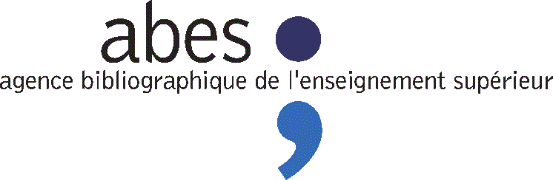
Using FRBRoo in a research context
ABES use case
29th CIDOC SIG meeting and the 22nd FRBR-CIDOC CRM Harmonization meeting
22th October - Heraklion, Crete
By Aline Le Provost

Slide 2






ABES in brief
The institution
In charge of the bibliographic infrastructure for French higher education institutions
A network composed of 157 institutions, corresponding to 1450 libraries : same tools & guidelines to use tools
The data
Bibliographic catalogue with :
10 Millions of bibliographic records
2 Millions of authority records
Archives and manuscripts catalogue
Referencing and archive PhD Thesis
Referencing PhD Thesis in progress
Access PhD thesis

Slide 3
THESES
SUDOC
Theses.fr
French doctoral thesis portal
PEB
Interlibrary loan
WinIBW
Cataloguing
PSI
OPAC
SudocMobile
Mobile App
STAR
Thesis e-deposit
CBS database
Sudoc’s heart
SudocAD & Qualinca
(research projects)
STEP
Ongoing thesis
IdRef
(Sudoc’s Authorities)
Colodus
Interface d’exemplarisation
CALAMES
XML database
Sudoc (copy)
SELF
Interface d’extraction des données
Manuscripts database
API Modification Exemplarisat° auto
(ABES)
WebServices
for IdRef
Numes
Digitized corpus
Demandes d’exemplarisation (utilisateurs)
MicroWebServices
(webservices)
Périscope
HUB de métadonnées
(ongoing project)
BASE XML & API SUDOC
XML database
A copie of CBS database in Marc/xml
Anable data manipulation and usability...
API Sudoc = services on top of sudoc data
IdRef
Colodus, Periscope, Webservices...
Licences Nationales
Semantic web developments
Data exposition in RDF
Project « metadata hub »
SudocAD & Qualinca
CBS
The Sudoc’s earth
A proprietary software for data production, storage and updating
ABES – octobre 2013

Slide 4
SudocAD & Qualinca projects : context
Fro m UNIMARC age to Web age -> Many advantages
Data exchanges
Document availability
Search services
And...
...quality issues : doubloons, missing authorities, linkage mistakes -> wrong coreferences
Links will be more and more important and present :
-> FRBR modeling
-> Semantic Web
Quality of linkage is a big issue.
Links between what ? Bibliographic records and authority records
What do we want to do ?
1.External issue : SudocAD to facilitate linkage to idref authorities
2.Internal issue : Qualinca actually deals with quality issues inside a given database
Why FRBRoo ?
To transform document database into a knowledge base
-data -> knowledge
allow to apply knowledge-based techniques, logical reasoning

Slide 5
SudocAD prototype
(2010-2011)
Publication : http://www.lirmm.fr/qualinca/sites/default/files/sudocAd.pdf

Slide 6

Which authority is the nearest from our Jean Dupont ?
To which authority should we link our document’s record ?
XML report for each authority candidate
Excel summary for all authority candidates
Decision-Aided
Automatic linkage
STEP 1 : Look for and select authority candidates for linkage
STEP 2 : Enrich authority candidates for linkage
STEP 3 : Compare criteria and give a linkage value for each authority candidate
Document whose author is Jean Dupont, recorded in an external database.
?
A) Give a comparison value for each criterion
B) Apply logical rules based on « expert rules » giving a combination of comparison values and give a value of linkage : strong,medium, weak, poor, neutral, unrelated, impossible
?
…
FRBRoo
Pseudo-authority
Enrichment
= Add attributs :
Denomination
Date
Language
Domain
Super-authority
…
Super-authority
Super-authority
To establish the linkage, we use the knowledge « surrounding » of…
…the author, in the record which has to be linked.
…the person described by each authority candidate for linkage.
=> denomination, date, language, domain

Slide 7
Qualinca
April 2012 - March 2016
ANR project (French National Agency for Research)
Partners : ABES, INA, LIRMM, LIG, LRI
http://www.lirmm.fr/qualinca

Slide 8
The project in brief
For SudocAD, the database is clean... but we know it isn’t true.
So, with Qualinca, we first want to develop mechanisms able to :
check out the validity of linkage inside the database
give a “trust note” on existing links
Then, it is possible to describe the quality level of the database
According to that : maintain & improve the quality of the database
Find and correct linkage mistakes (create or delate links)
Deduplicate authority records
Enrich authority records
Construct new authority records
Methods are based on :
Formalisation of existing knowledge
Individual entities (named entities) identification problem
Definition of a trust model suitable for reconciliation and different source information fusion
Discovery of entity identification characteristics
Publications : http://www.lirmm.fr/qualinca/?q=en/publi

Slide 9
The ontology "OntoSudocAD"
What is it ?
Domain ontology + linkage ontology (allows to express reasoning conclusions, not our part of work)
Not all UNIMARC fields have been converted (just what’s needed for the reasoning)
However, needed extensions : new classes and properties (to have more detailed information)
Mapping process
From MARC/XML to RDF/XML
Using xslt : 1 file for each type of record
Provide web service http://servicesweb.sudoc.fr/Sudocad/

Slide 10
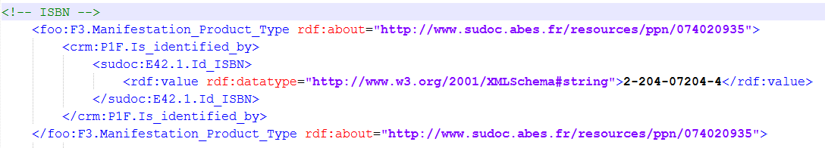
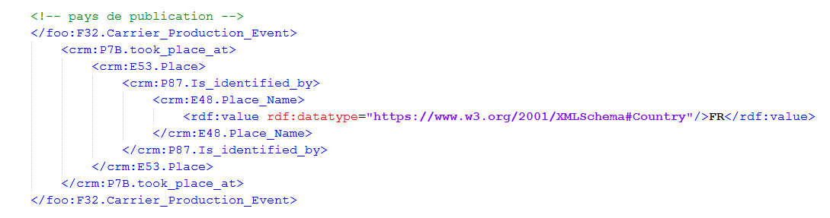
Concretly

Slide 11
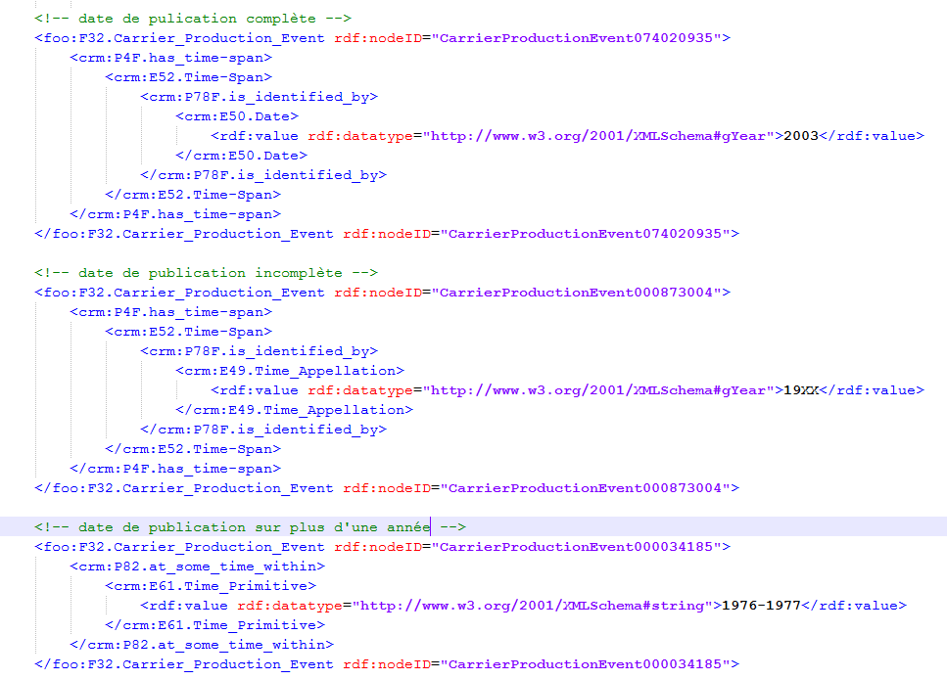

Slide 12
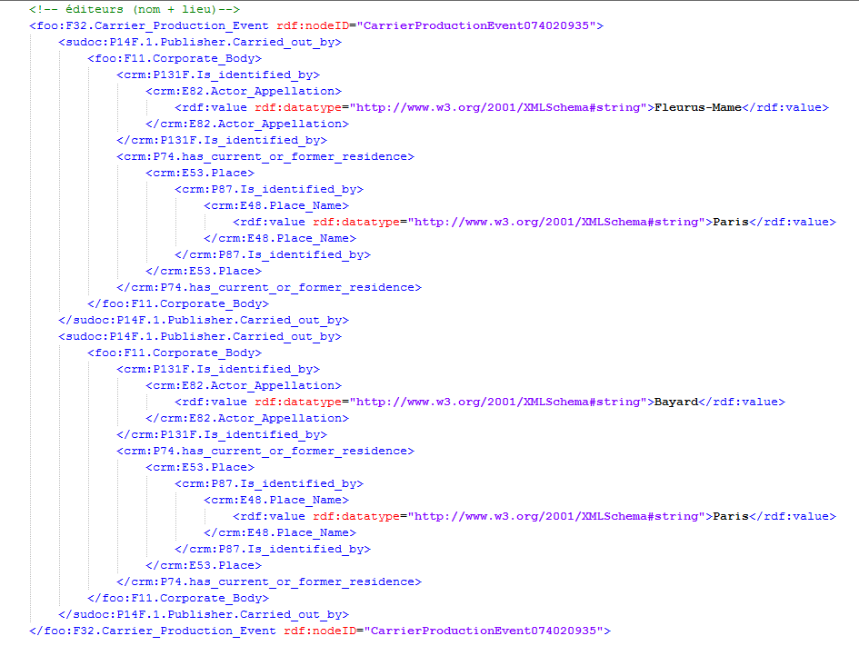

Slide 13
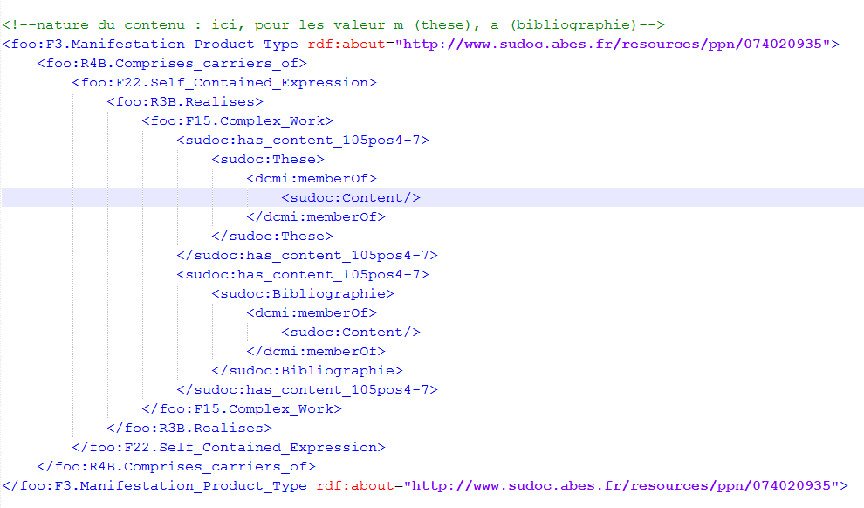

Slide 14
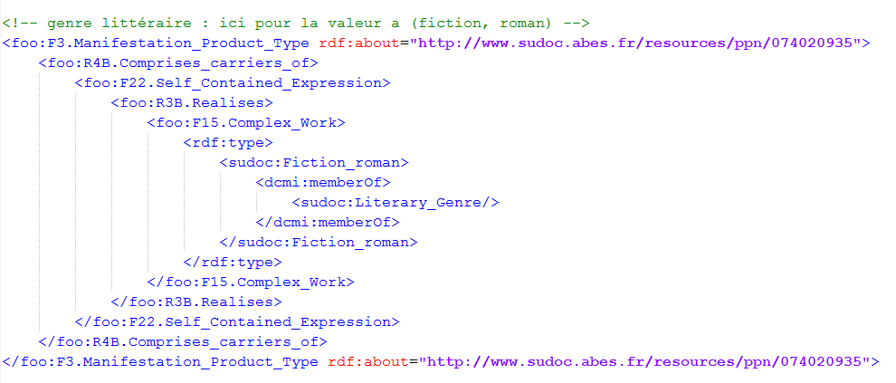

Slide 15
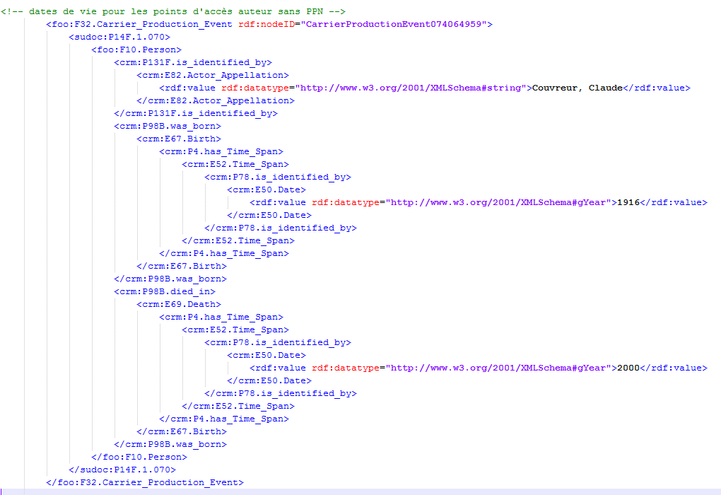

Slide 16
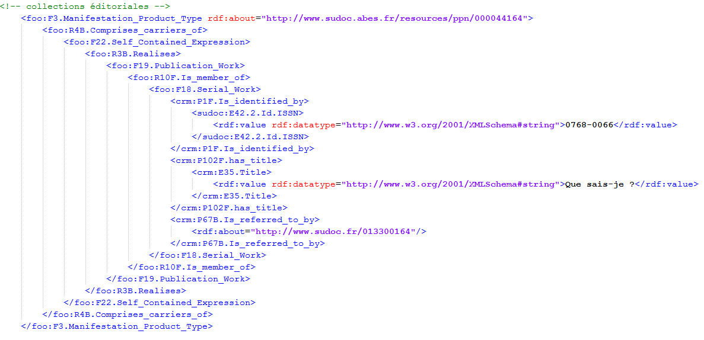

Slide 17
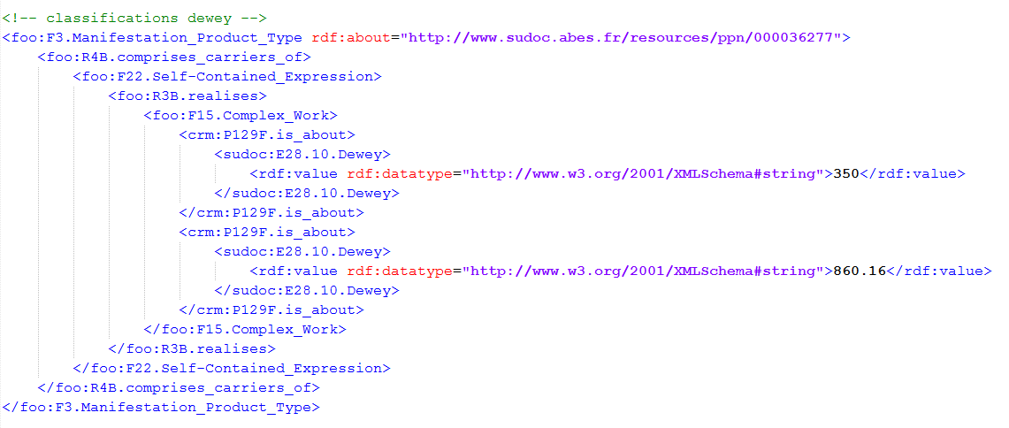

Slide 18
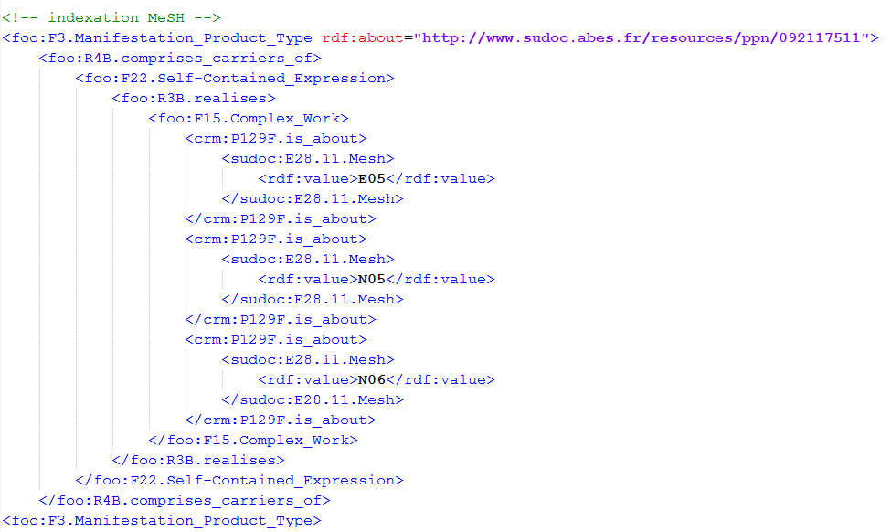

Slide 19
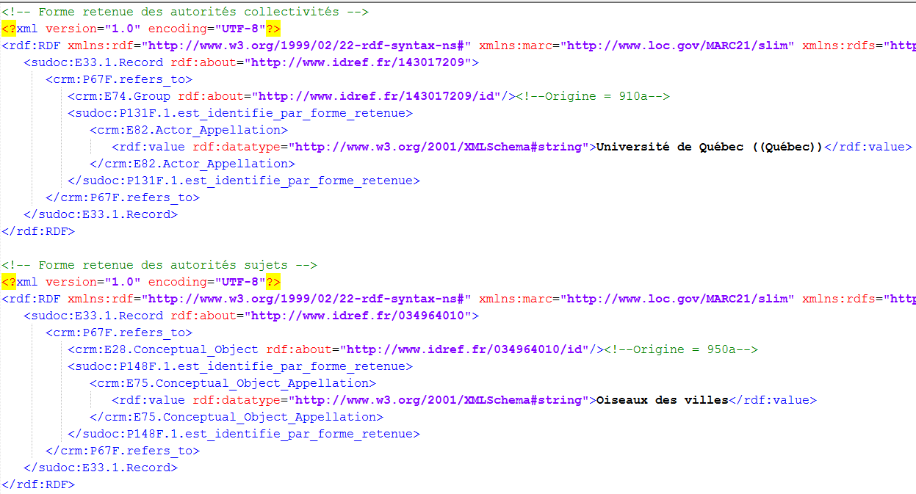

Slide 20
Mapping issues (1)
UNIMARC description is, sometimes, a complex imbrication of information
Dates linked to the manifestation
<datafield tag="100" ind1=" " ind2=" ">
<subfield code="a">19760507g19761977m y0frey50 ba</subfield>
</datafield>0
g -> specifies the nature of 1977
1976 -> always publication date (or assimilated)
1977 -> other date related to the manifestation
code | définition | Converti (1ère et 2ème date)
d | Publication within one calendar year | Oui
e | ​Reproduction of a document | Oui
f | date of publication uncertain | Oui
g | publication continues for more than a year | Oui
h | both actual and copyright/privilege date | Oui
i | ​both release/issue date and production date | Non (nombre de notices faible)
J | detailed date of publication | Non (JJMM pas pris en compte)
k | published in a certain year and printed in a different year | Non (nombre de notices faible)

Slide 21
Mapping issues (1)
Information description in UNIMARC has defaults
Cataloguing mistakes (human or machine)
Some rules stay vague and hard to interprete
How to adapt when converting ? Is it relevant to convert possibly erroneous data ?

Slide 22
105 $a/4-7 Form of contents codes
a = bibliography
b = catalogue
c = index
d = abstract or summary
e = dictionary
f = encyclopaedia
g = directory
h = project description
i = statistics
j = programmed text book
k = patent
l = standard
m = dissertation or thesis (original)
n = laws and legislation
o = numeric table
p = technical report
q = examination paper
r = literature surveys/reviews
s = treaties
t = cartoons or comic strips
v = dissertation or thesis (revised)
w = religious text
z = other
# = (blank) - value position not needed.

Slide 23
Mapping issues (2)
Difficulties to reveals the finess of information
Several publishers
RAMEAU syntax
What are properties of properties ?
Is it better to use typing than to create extensions ?

Slide 24
The Sudoc in RDF : go for FRBRoo ?
Sudoc & IdRef versions in RDF since 2011
Use vocabularies already existing in RDF : ISBD, RDA, Dublin Core, Bibo, Foaf
Not everything
Check out an example: http://www.sudoc.fr/127064583.rdf
Why FRBRoo is interesting ?
Granularity and level of detail
But : need shortcuts
The idea is to keep 2 output in RDF : one with mixed vocabularies and one in FRBRoo

Slide 25
What do we have to work out ?
Correct mistakes interpreting the model, for example :
F32.Carrier_Production_Event should be better a F30.Publication_Event
F15.Complex_Work may be better a F19.Publication_Work
Construct URI, in order to reduce the number of blank nodes
Find out whether typing should be used instead of creating extensions
Find out if combine FRBRoo with vocabularies such as dublin core or skos
Manage to use shortcuts to be able to reduce the number of triples

Slide 26
Thank you !

