Slide 1


Creating the Cultural Heritage Knowledge Graph
Semantic Database Builder
Dominic Oldman
Peter Haase

Slide 2
Outline
ResearchSpace Project
Goals and context
ResearchSpace Platform
metaphacts Knowledge Graph Platform
Brief demo
Semantic Database Builder
Technical approach
Field Definitions
CRM Patterns
Next: Experiences from Florian Kräutli

Slide 3
ResearchSpace
The ResearchSpace project:
is funded by the Andrew Mellon Foundation;
develops a set of cultural heritage research tools;
uses Metaphacts platform as a basis to reuse and combine these tools –
for each project using ResearchSpace,
for applications beyond cultural heritage;
configures and specialises these tools for data integrated using the CIDOC CRM ontology.

Slide 4
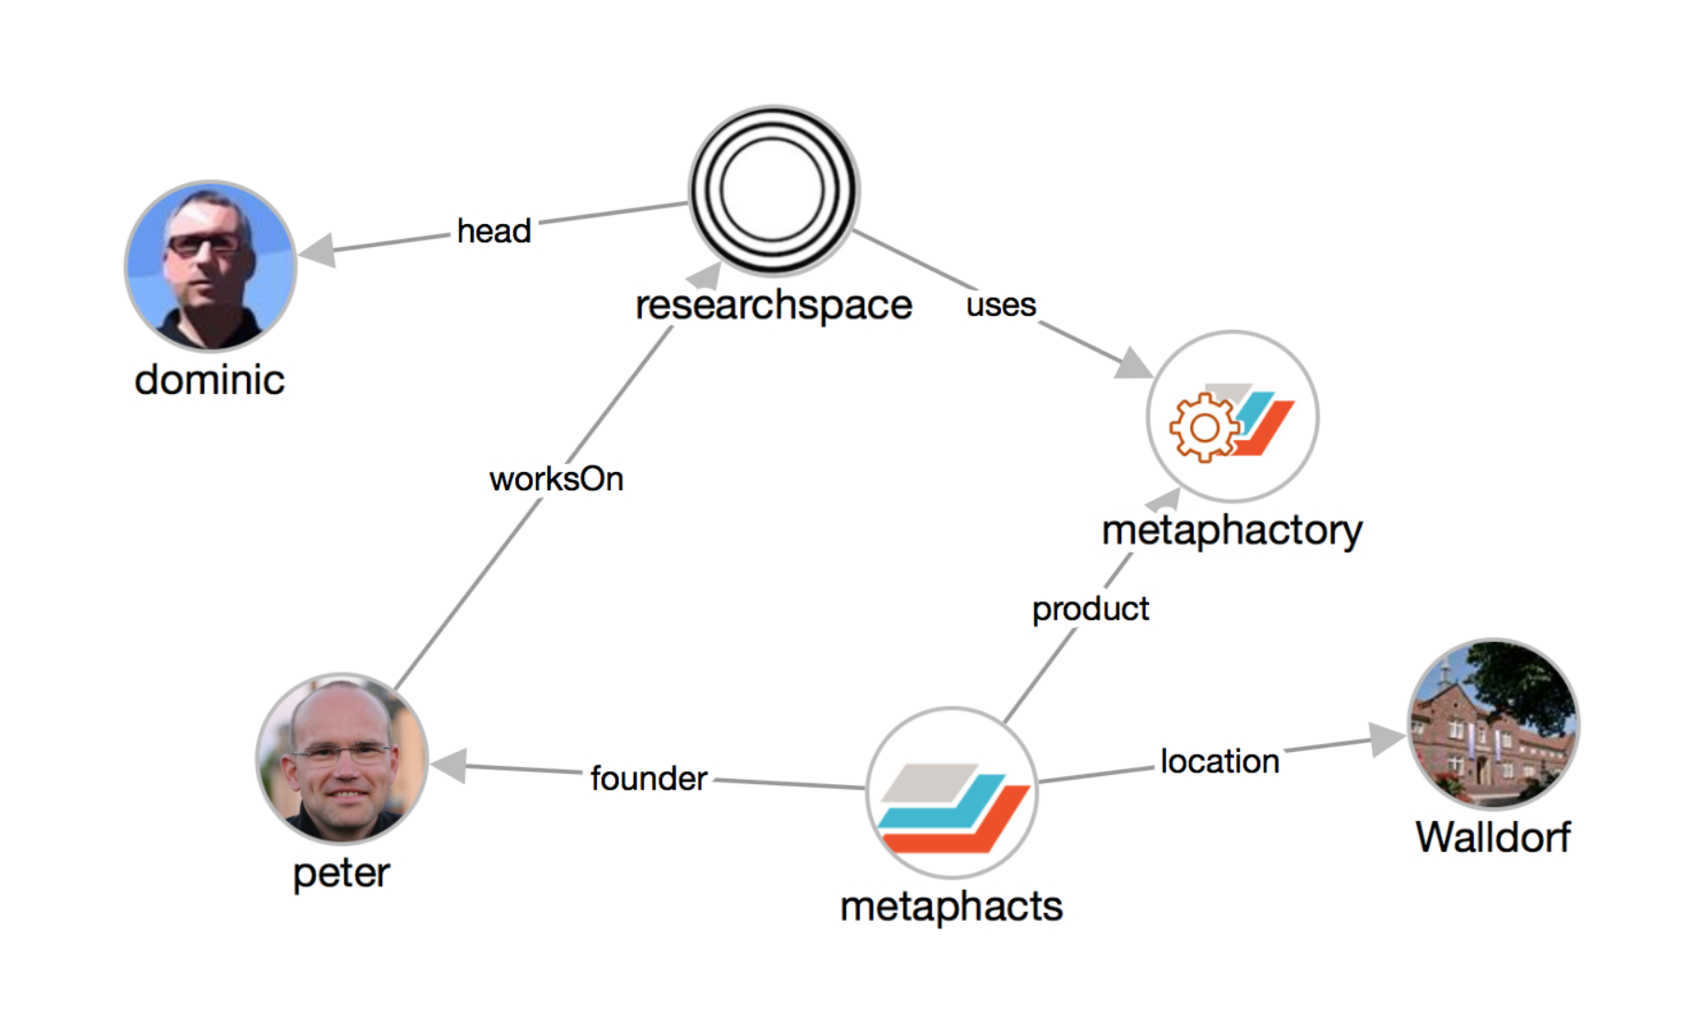
metaphacts at a Glance
COMPANY FACTS
Founded in Q4 2014
Headquartered in Walldorf, Germany
Currently ~10 people
Platform for knowledge graph interaction & application development

Slide 5



metaphactory Features
KNOWLEDGE GRAPH BACKEND
Scalable data processing
Easy-to-use interface
High-performance querying and analytics
Built-in inferencing and custom services
Standard connectors for a variety of data formats
Single server, embedded mode, high availability, and scale out
KNOWLEDGE GRAPH CREATION
Semi-automatic creation of knowledge graphs
Curation and interlinking of data from heterogeneous sources
Collaborative management and authoring
Custom query and templates catalogs
Data annotation
Capturing of provenance information
KNOWLEDGE GRAPH APPLICATIONS
Rapid development of end-user oriented applications
Web components for end-user friendly presentation and interaction
Interactive visualization
Rich semantic search with visual query construction and faceting
Customizable semantic clipboard

Slide 6



metaphactory as an Open Platform
BUILT IN OPEN SOURCE
Dual licensing (LGPL & commercial license)
Open Platform API and SDK
Integration of external tools and application via APIs
Easy development of own web components and services
Full HTML5 compliance
Re-usable, declaratively configurable Web Components
= Easy modification, customization, and extensibility
BUILT ON OPEN STANDARDS
W3C Web Components
W3C Open Annotation Data Model
W3C Linked Data Platform Containers
Data processing based on W3C standards such as RDF, SPARQL
Expressive ontologies for schema modeling based on OWL 2, SKOS/SKOS-XL
Rules, constraints, and query specification based on SPIN and RDF Data Shapes
= Sustainable Solution

Slide 7
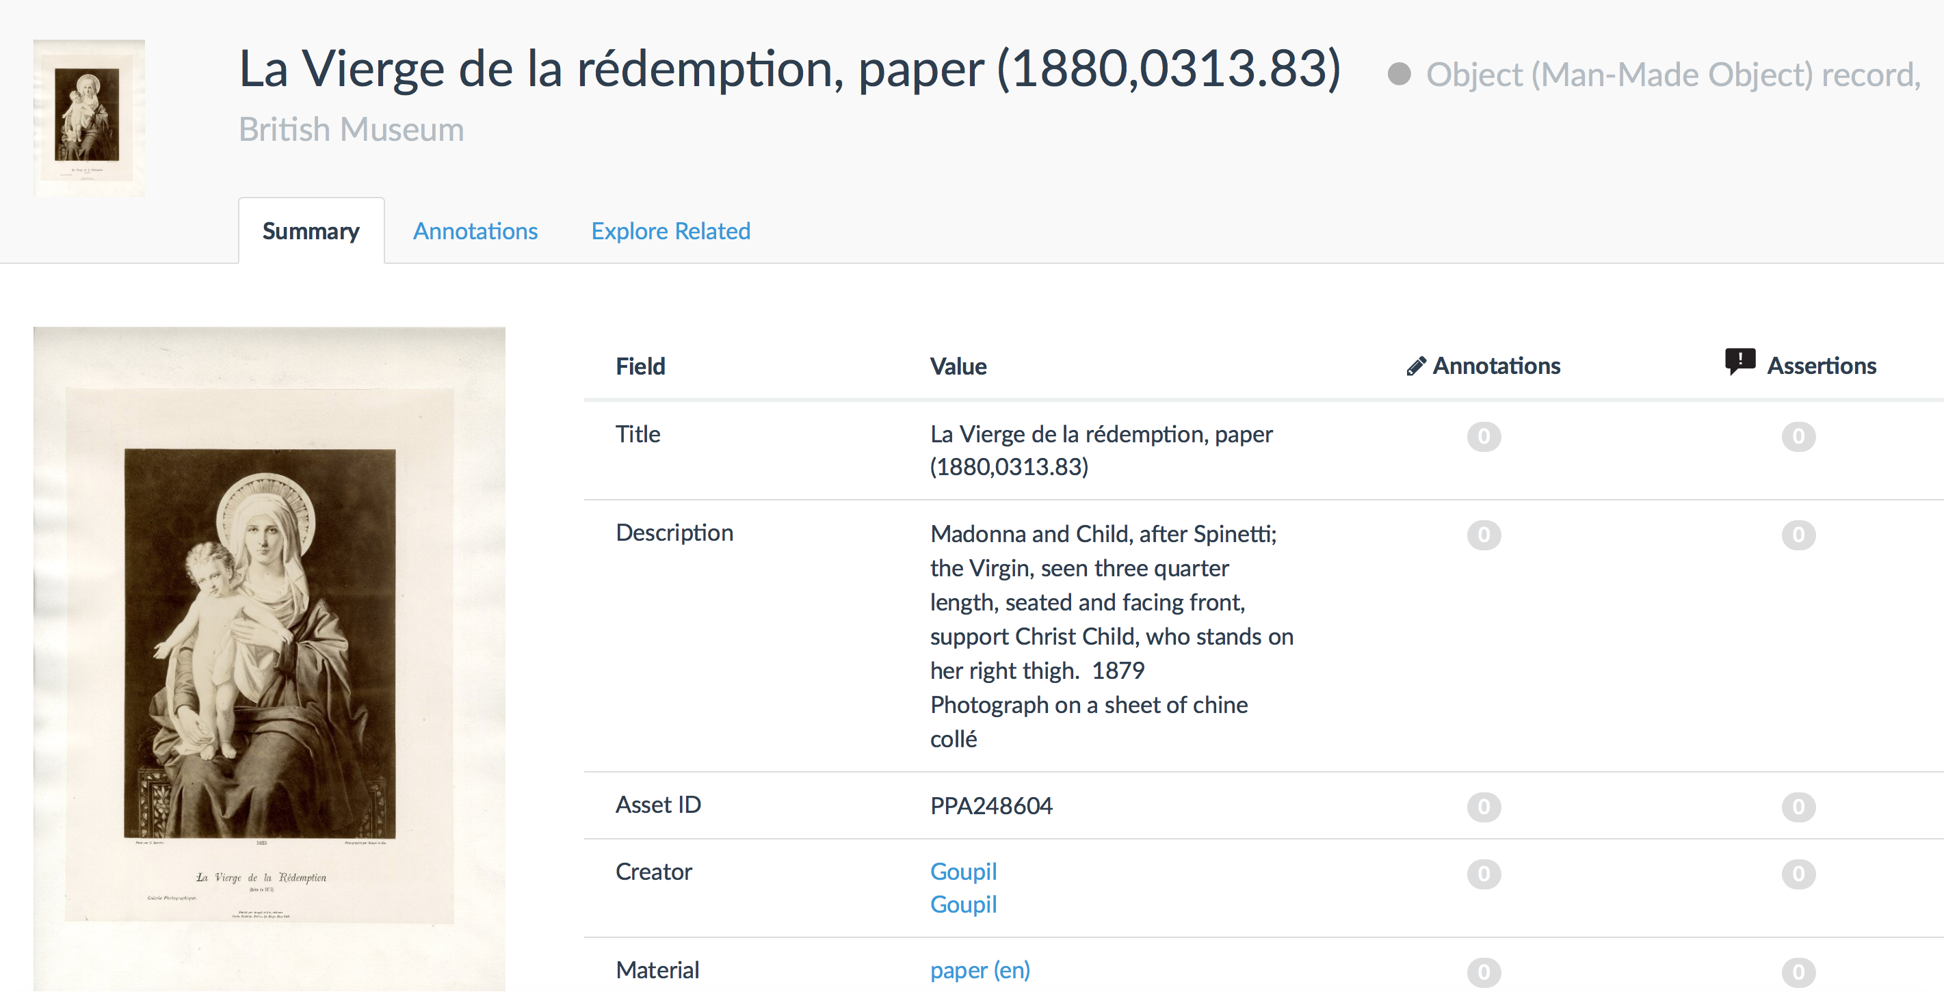
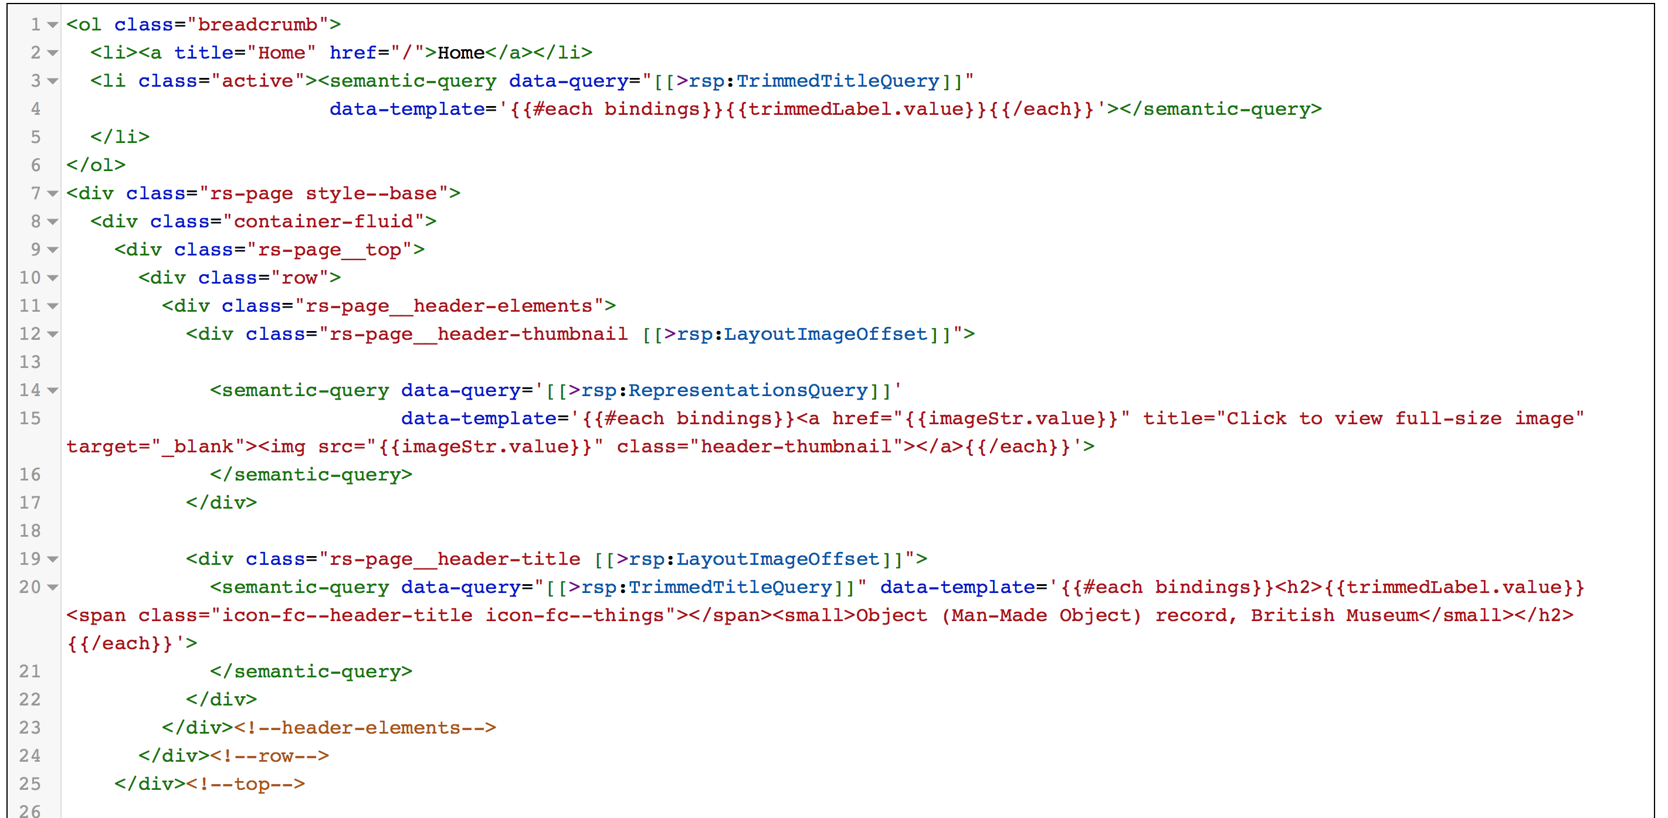
CIDOC-CRM Template

Slide 8
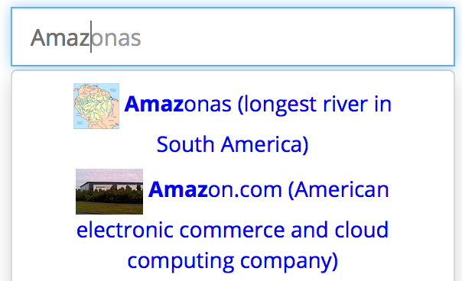
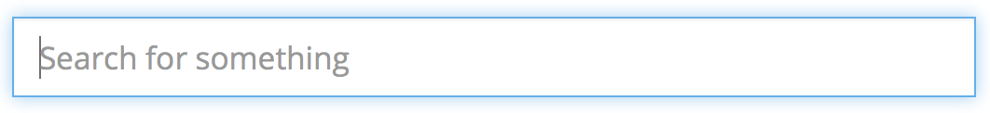
Declarative Components: Simple Semantic Search
Set up in ~2 minutes!
<semantic-simple-search data-config='{
"query":"
SELECT ?result ?label ?desc ?img WHERE {
?result rdfs:label ?label .
?result rdfs:comment ?desc .
?result foaf:thumbnail ?img .
FILTER(CONTAINS(?label, ?token))
}",
"searchTermVariable":"token", // user input
"template":"
<span title="{{result}}">
<img src="{{img}}" height="30"/>
{{label}} ({{desc}})</span>"
}'/>
1. Developer embeds “semantic-simple-search” component into page
Example:
keyword search with semantic autosuggestion, driven by SPARQL
2. Rendered component is displayed to the user
3. Autosuggestions are dynamically computed based on query + user input
Notes:
Zeyton Screenshot

Slide 9

metaphacts Supports the Whole Data Lifecyle
end-to-end
platform
Authoring
Data Extraction & Integration
Visualization
Data Linking & Enrichment
Search
Storage & Repositories
Querying & Inferencing

Slide 10
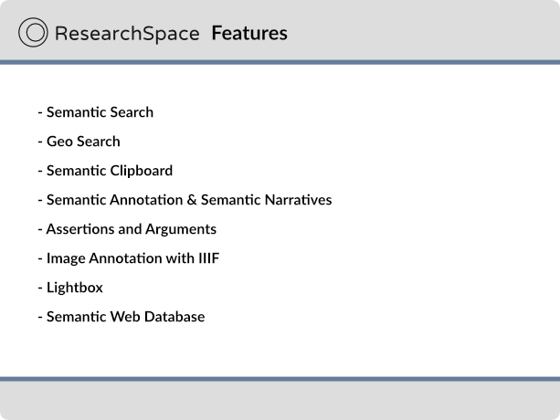

Slide 11
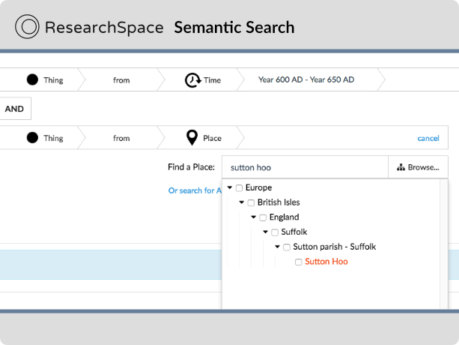

Slide 12
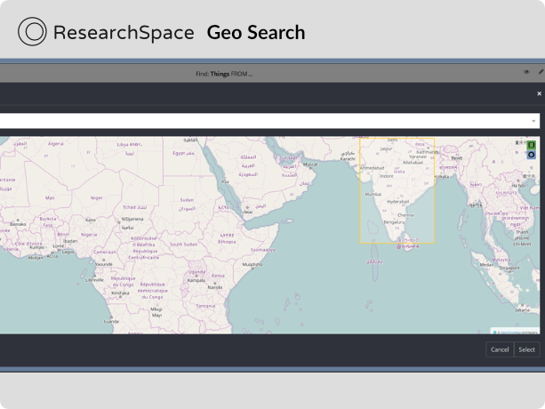

Slide 13
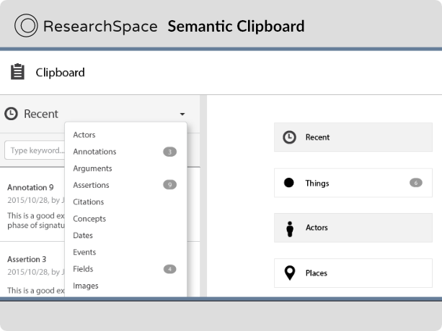

Slide 14
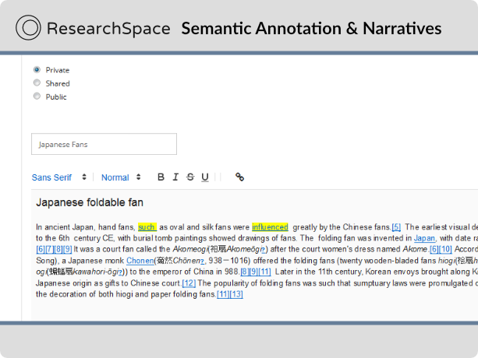

Slide 15
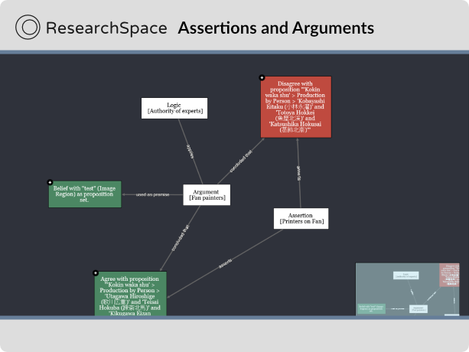

Slide 16
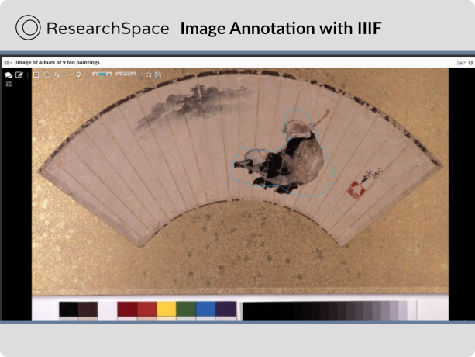

Slide 17
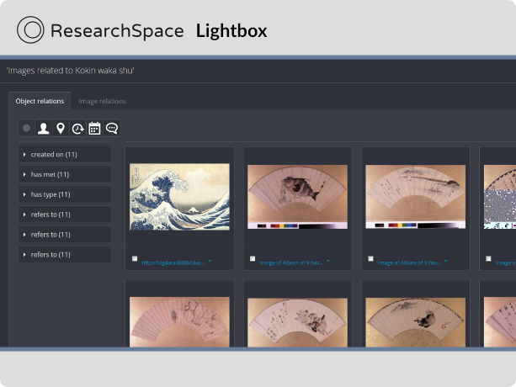

Slide 18
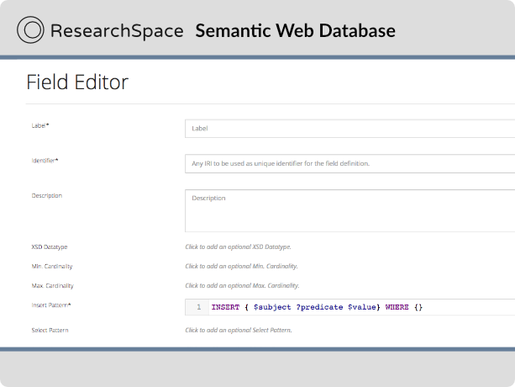

Slide 19
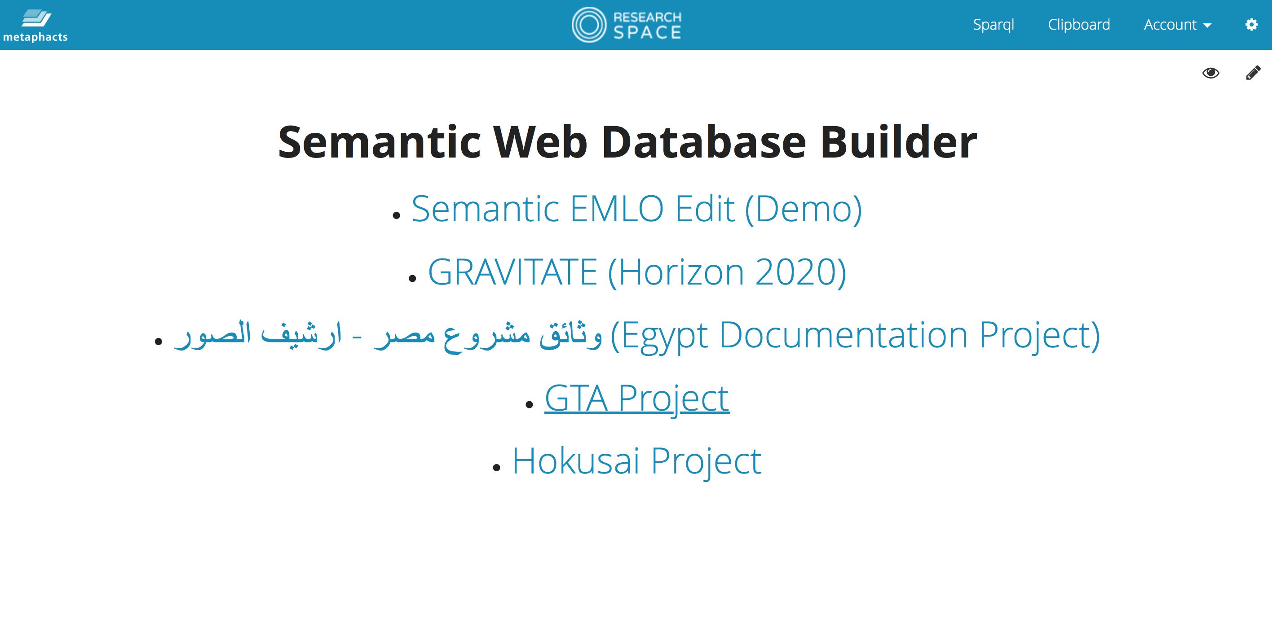
Semantic Database Builder

Slide 20
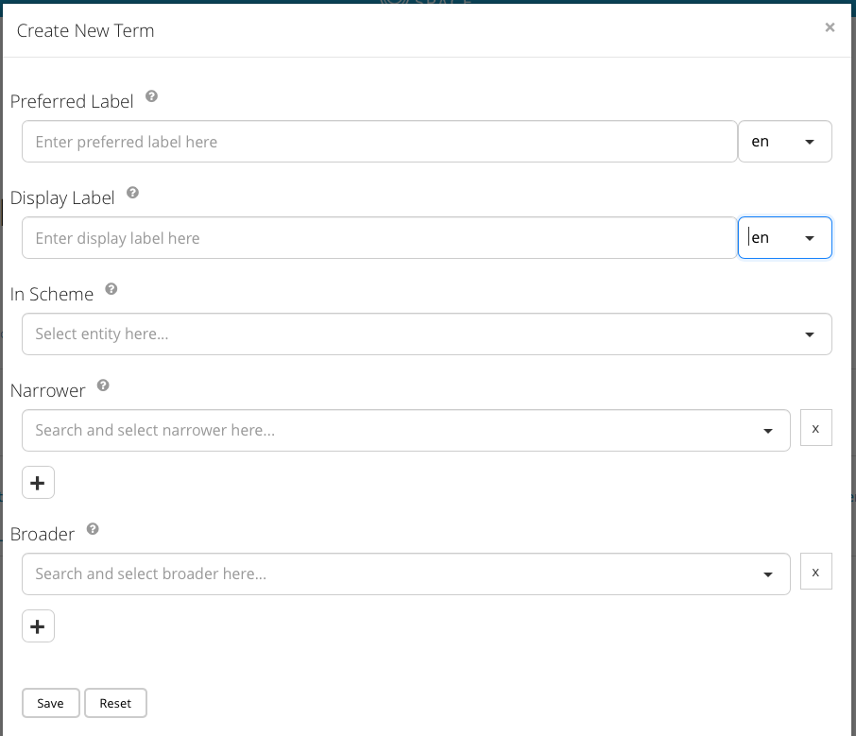
Form-based authoring
User interacts with simple forms for a record
Forms have fields and field values
”Semantic fields” provide mapping from user input to complex graph structures
HTML5 Web Components for user interaction and layout of the form

Slide 21
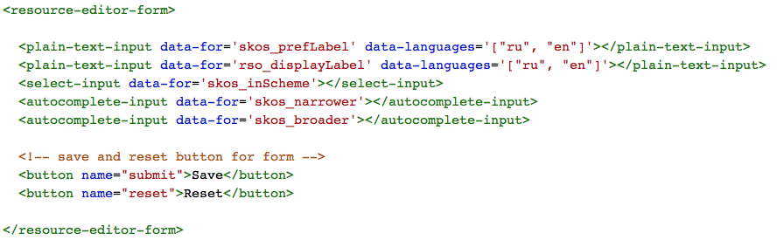
Example Form

Slide 22
Field Definitions & Field Values
A field definition holds all information necessary for the form and the respective form input elements to
read existing field values
add and modify field values
define the XSD datatype for field values
validate field values against the existing knowledge graph at user input time
provide meaning full autosuggestions or a set of pre-defined field values

Slide 23
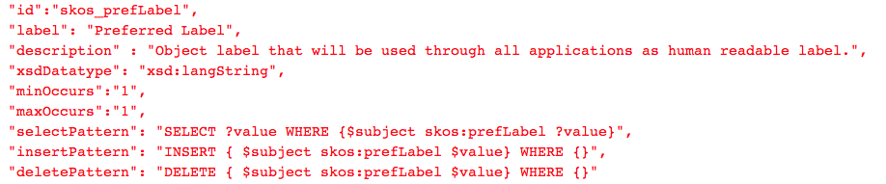
Example: Very simple field definition

Slide 24
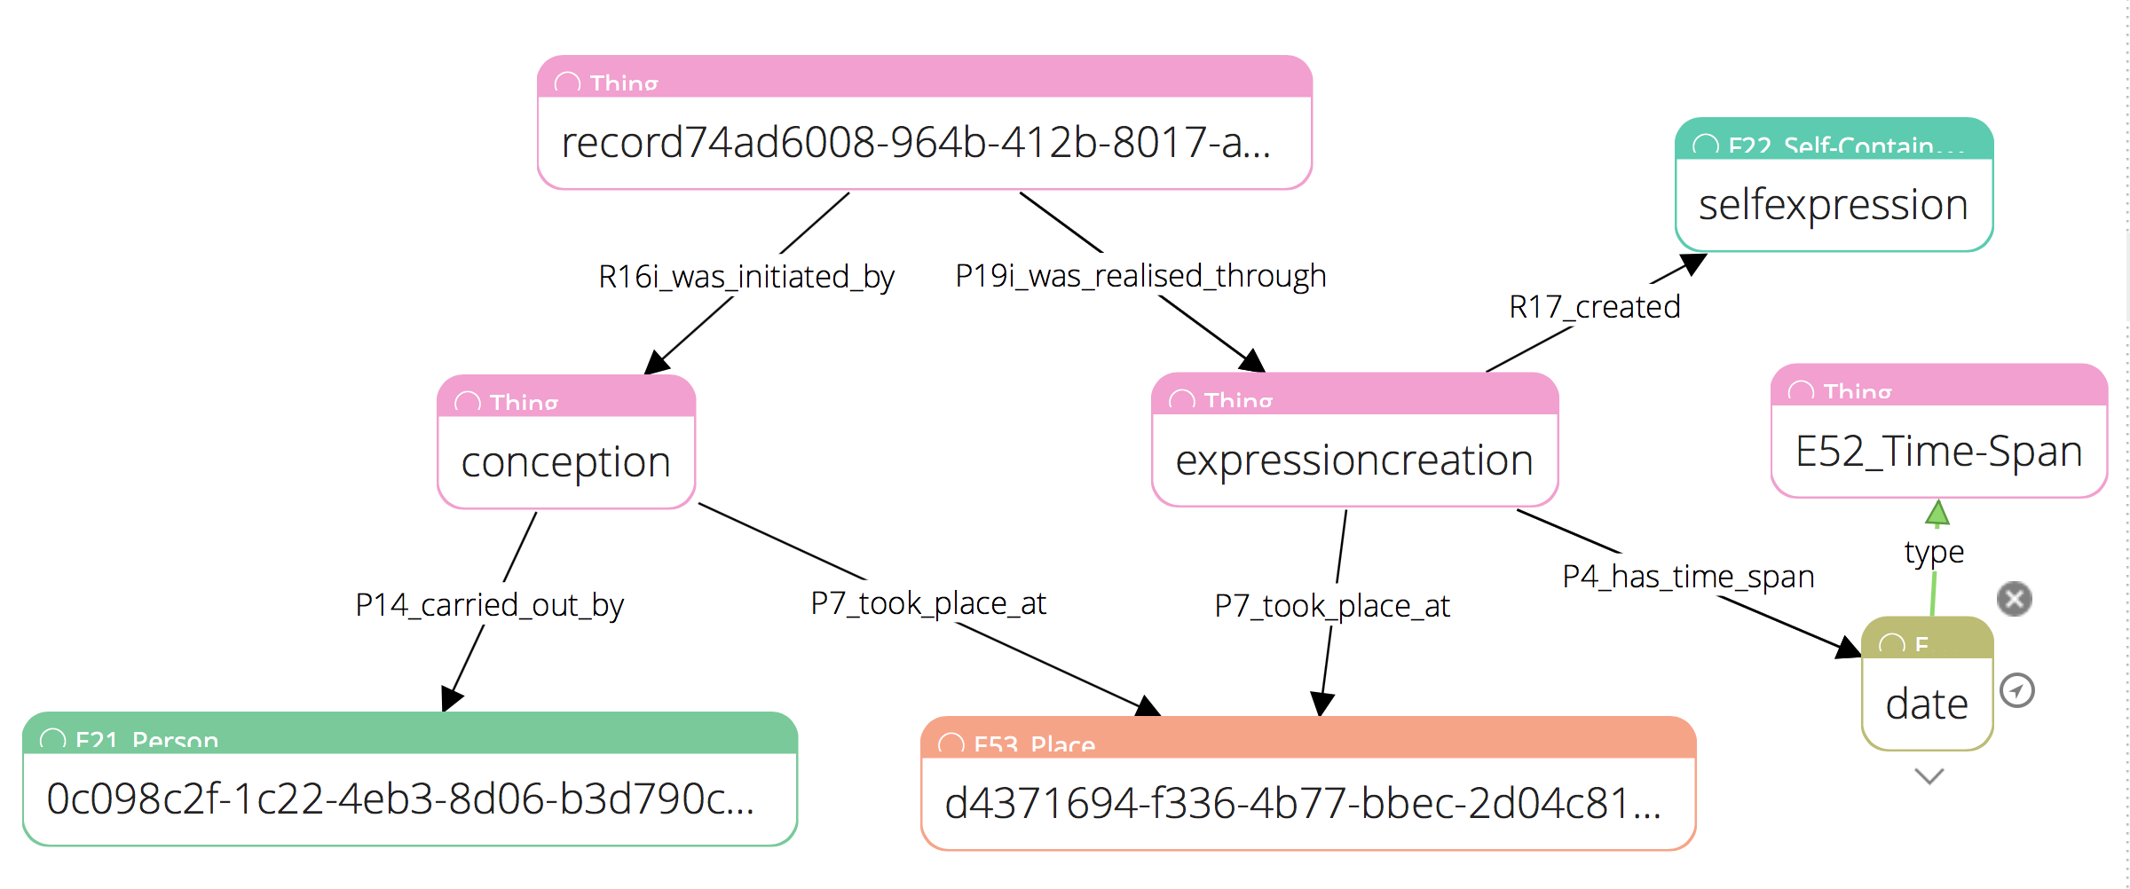
CRM - Graph Structures are Complex

Slide 25
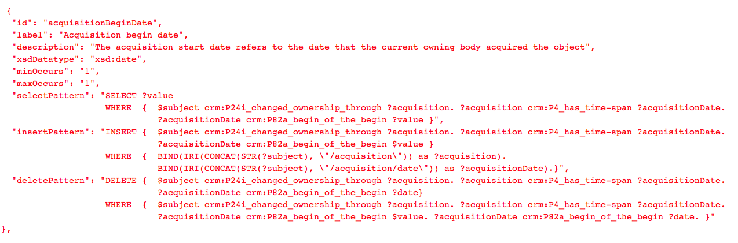
Complex field definition

Slide 26
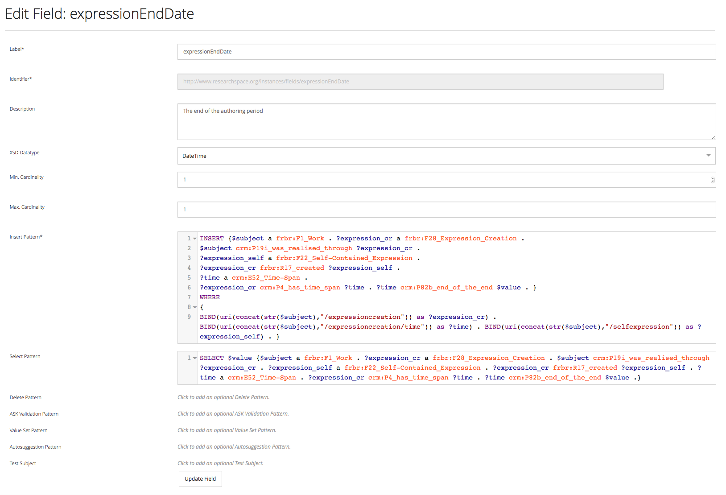
Field Editor

Slide 27
HTML5 Form Markup
Main form input elements:
<semantic-form-text-input for="{fieldId}"> Typically used for Literal values. Accepts an optional attribute "languages", which can be used to let the user select a language tag if xsdDatatype is xsd:langString.
<semantic-form-select-input for="{fieldId}"> Offers a dropdown list to choose entities from, using the "valueSetPattern" from the referenced field definition.
<semantic-form-autocomplete-input for="{fieldId}"> Dynamic autosuggestion while user enters search token, using the "autosuggestionPattern" from the referenced field definition.
<semantic-form-datetime-input for="{fieldId}"> Component to either enter date or dateTime string or to select them visually from a calendar.

Slide 28
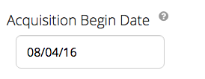
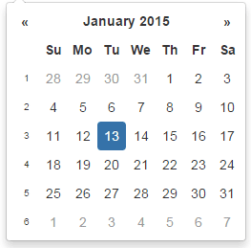
Web Components for Fields

Slide 29
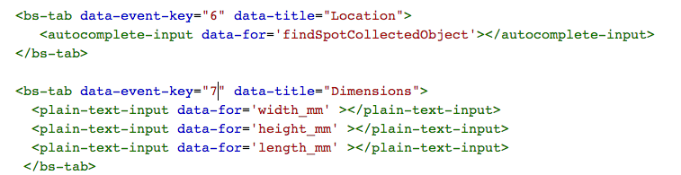
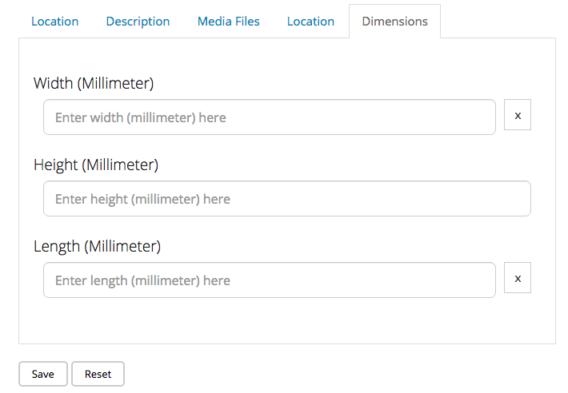
HTML and Bootstrap – Example: Tabs

Slide 30
Other Features
Can be used for instance creation as well as editing
Records can be managed in LDP containers or named graphs
Provenance management (when, who modified)
Full support for XSD datatypes (including input components)
Configurable autosuggestion
Multi-linguality
RDF 1.1 compliance

Slide 31

Get in Touch!
The British Museum
Great Russell Street
London
United Kingdom
p +44 020 7323 8796
m +44 07565 147 422
e ResearchSpace@britishmuseum.org
@ResearchSpace
metaphacts GmbH
Industriestraße 41
69190 Walldorf
Germany
p +49 6227 6989965
m +49 157 50152441
e info@metaphacts.com
@metaphacts

